Slide 1

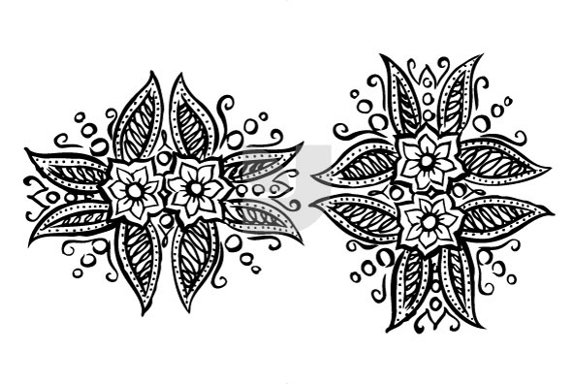
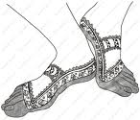
Hindu Art
To know some examples of Hindu art
To understand some uses of Hindu art
To have thought about the difference between this and different religious art

Slide 2
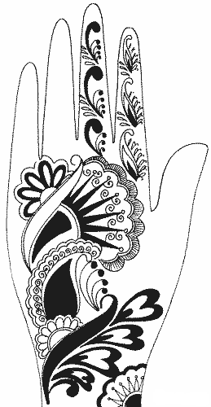

Mendhi
Mendhi is the art of painting henna on hands and feet
Henna is a dye made from plants which is left on over night
When it is washed off it leaves an orange mark that can last for weeks.
        Henna is traditionally used to celebrate weddings and festivals.

