Slide 1
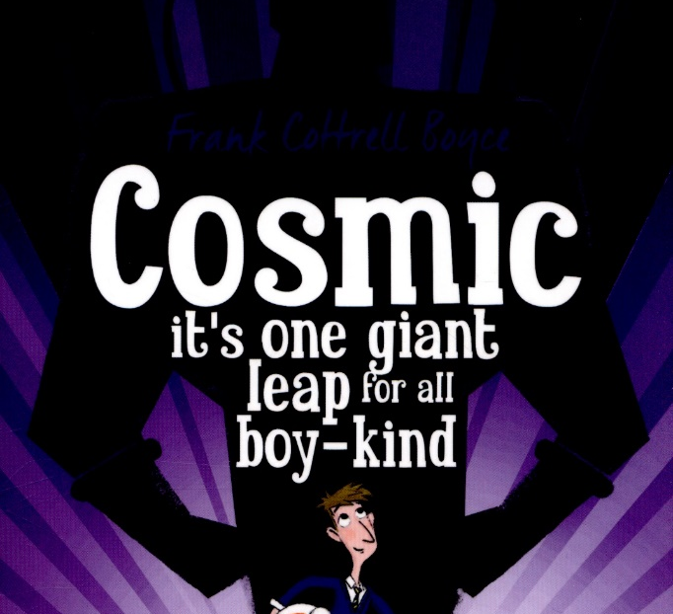
Week 3 Day 4

Slide 2
Starter
Watch the clip and then answer the questions
https://www.youtube.com/watch?v=7DtwCGcIhAw
What does Malfoy call Hermione?
How can you tell that this is a bad thing to say?
What do you think will happen next?

Slide 3
Read Chapter 18 - Astrogossip
On the next slide is today’s first chapter (it’s only one page long)
You need this and a copy of the comprehension questions.
(These are on the document with this PowerPoint.)
Complete the questions to the best of your ability either on the sheet or in your book.
Once you've finished the questions come back and read the next chapter "Gravity is not a trivial monster.'

Slide 4
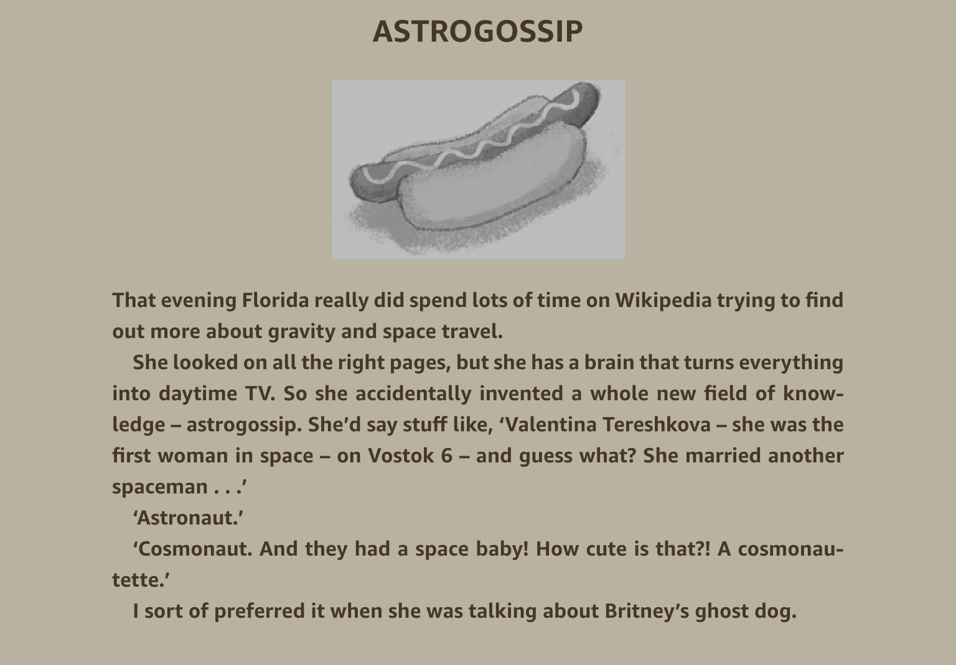

Slide 5
Chapter 19 – Gravity is not trivial monster.

Slide 6
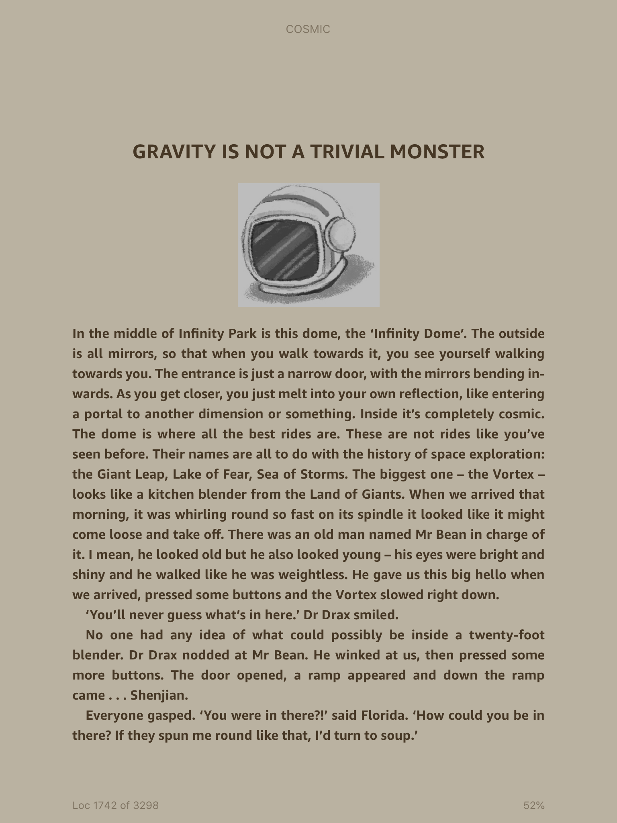

Slide 7
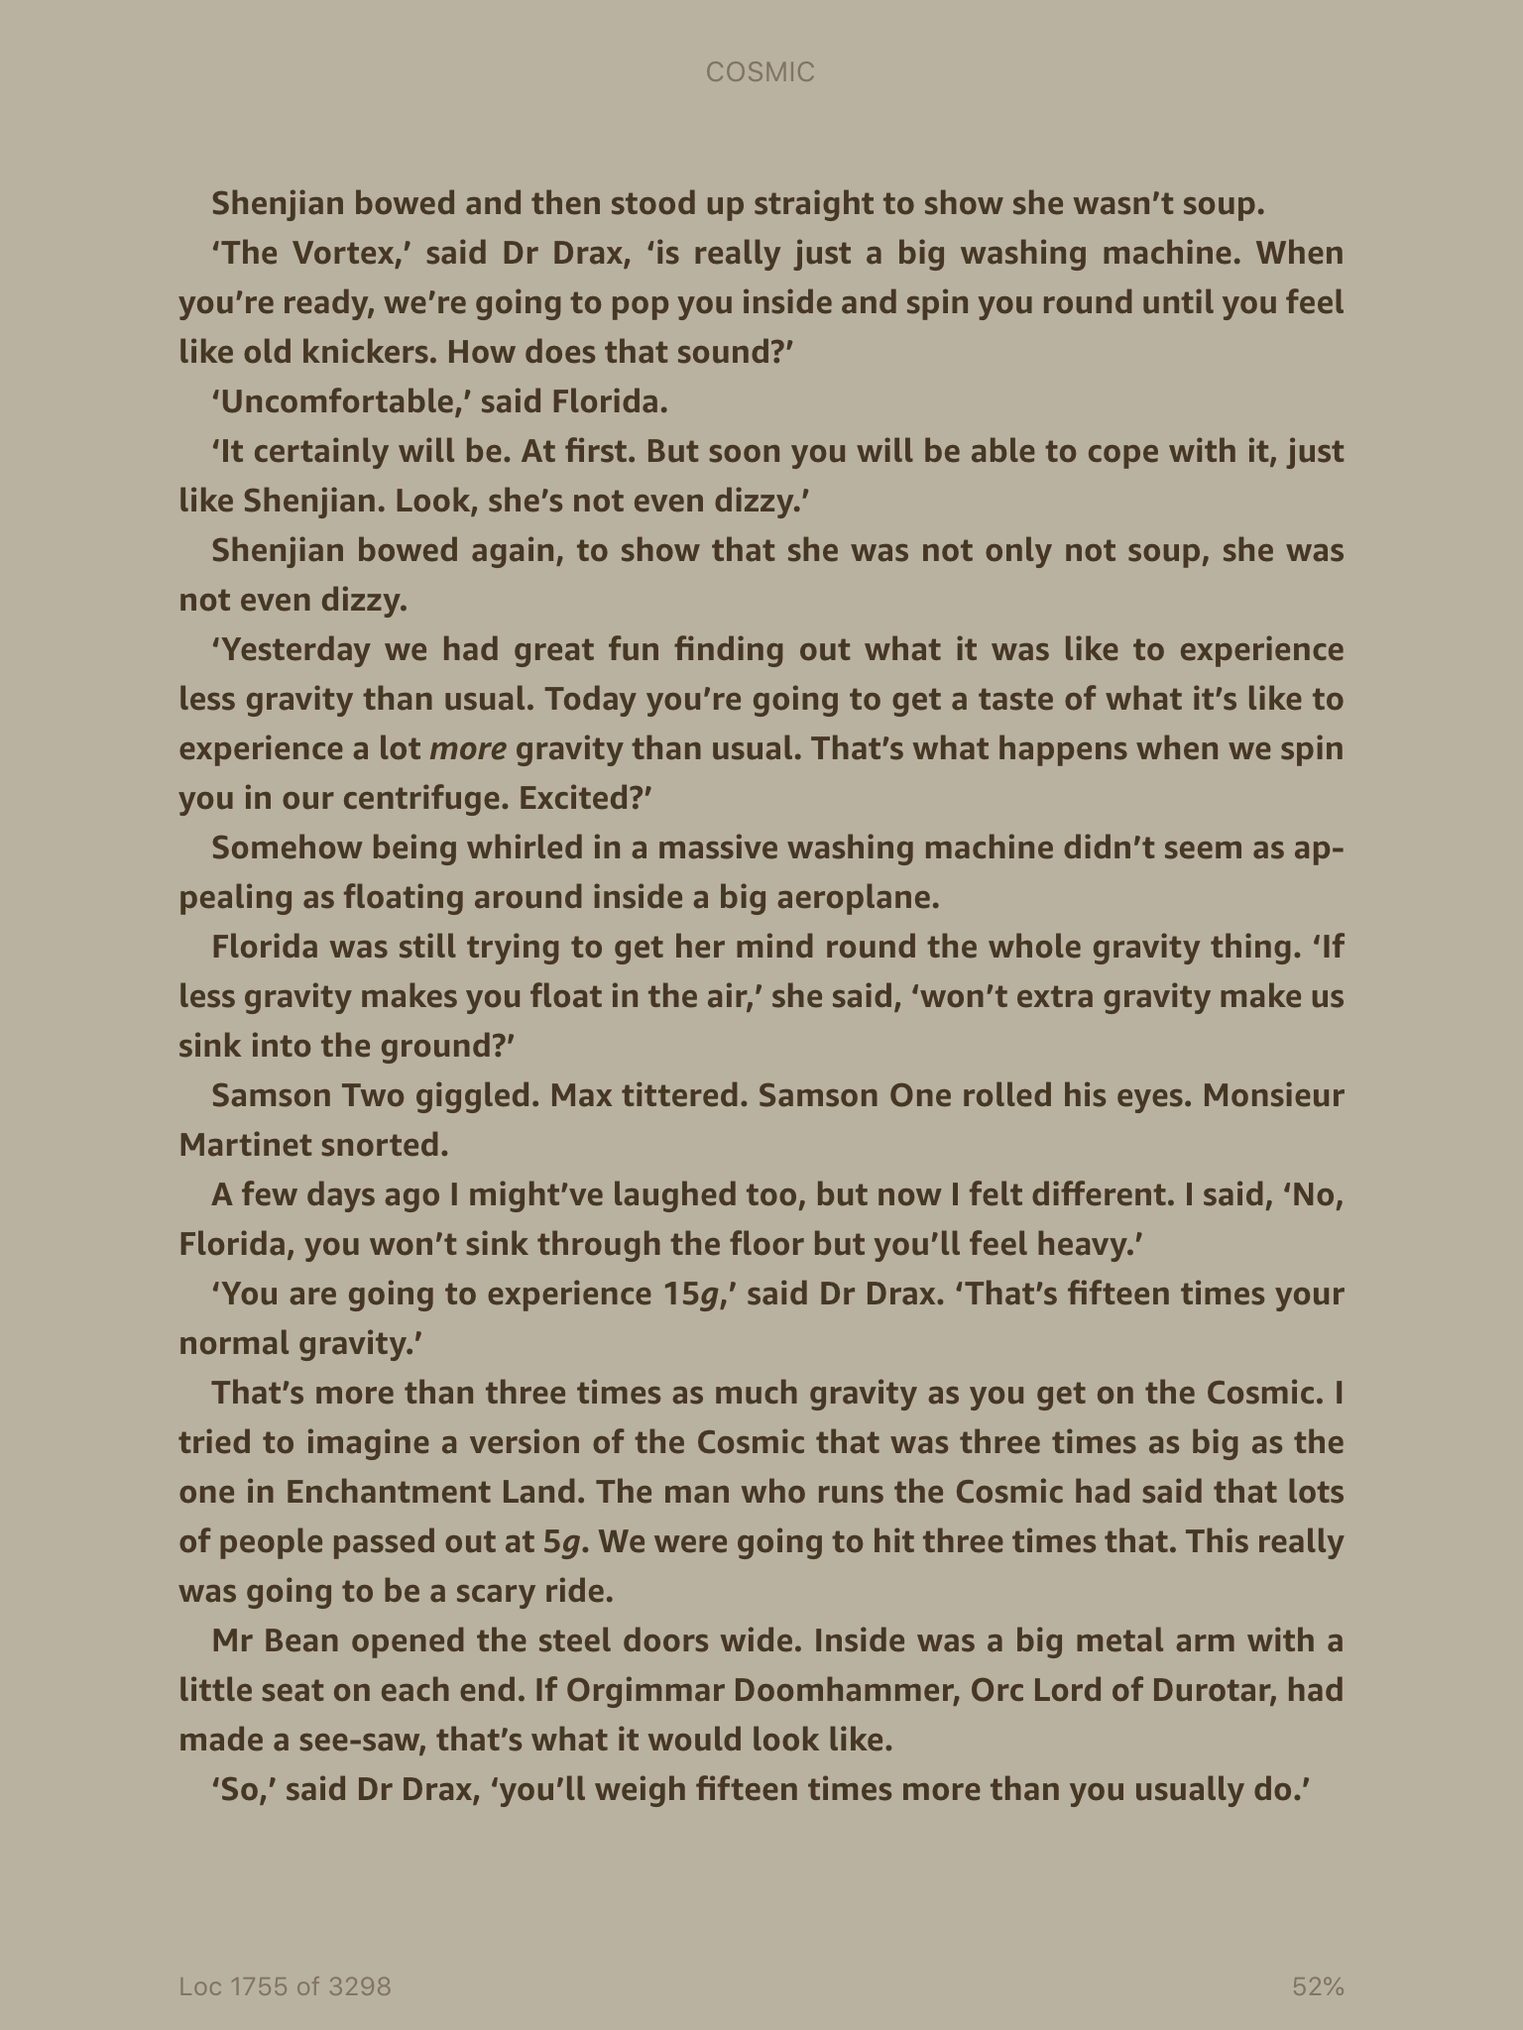

Slide 8
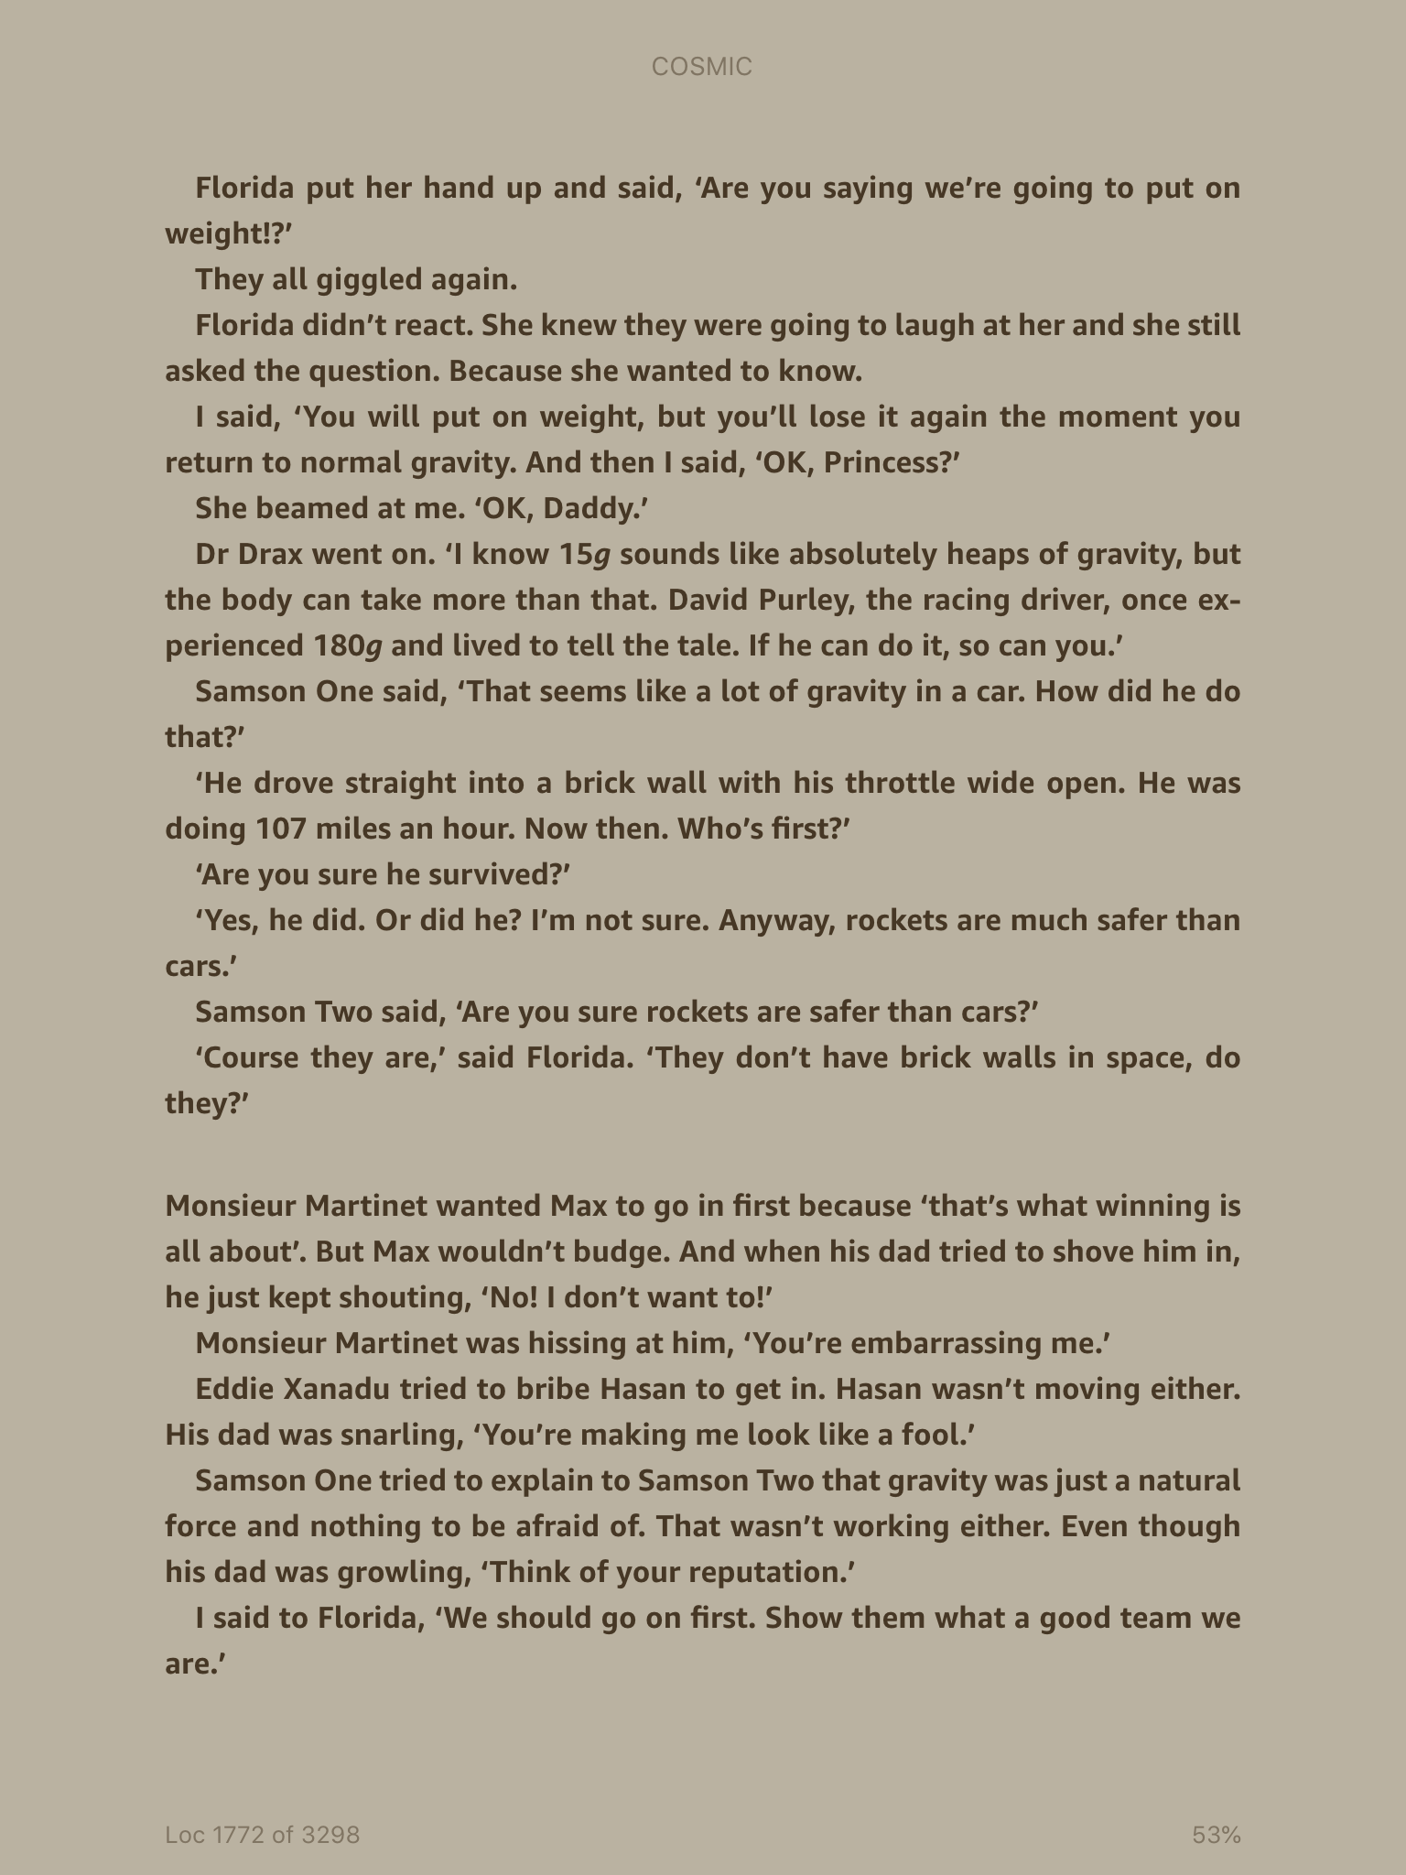

Slide 9
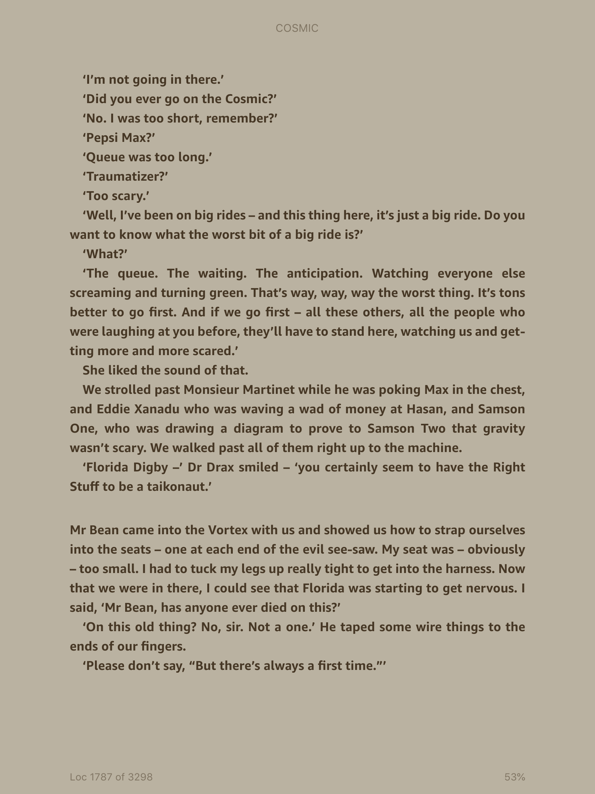

Slide 10
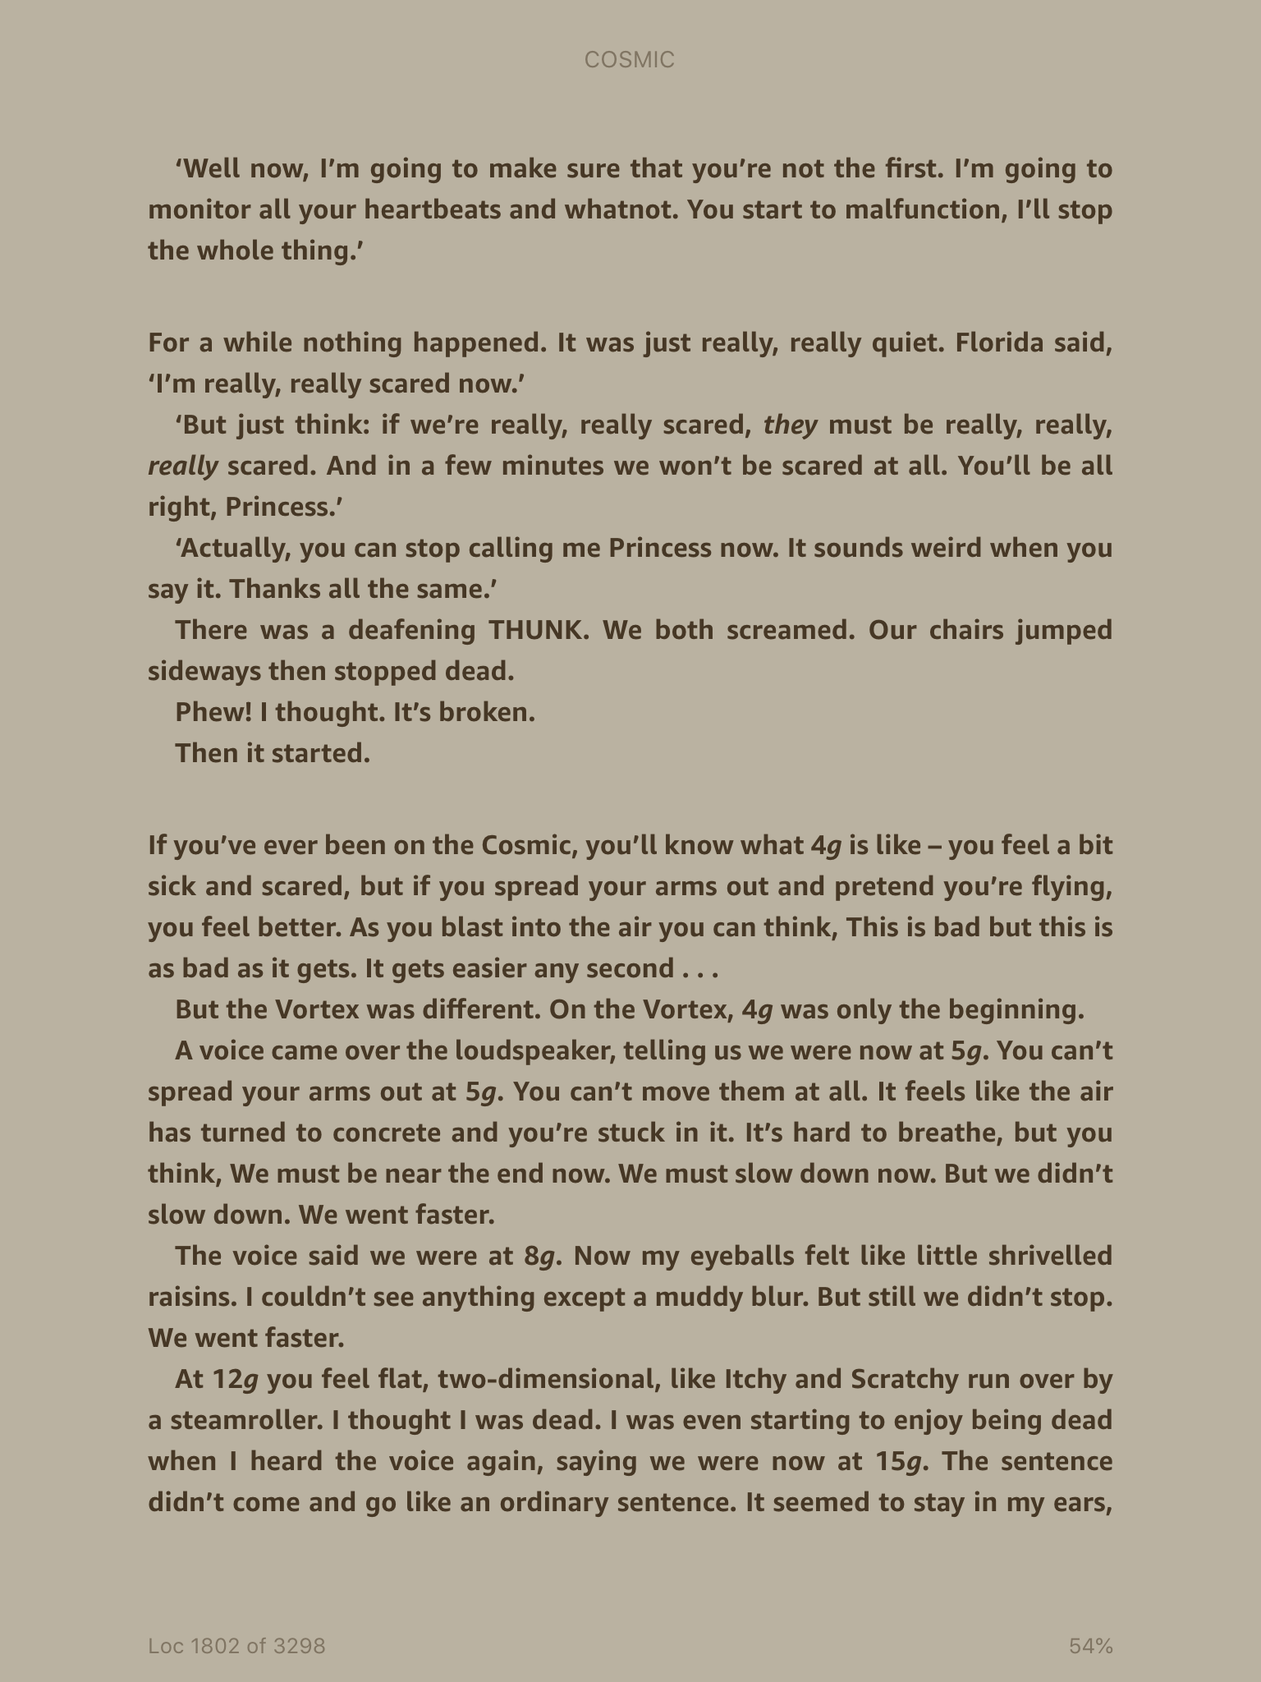

Slide 11
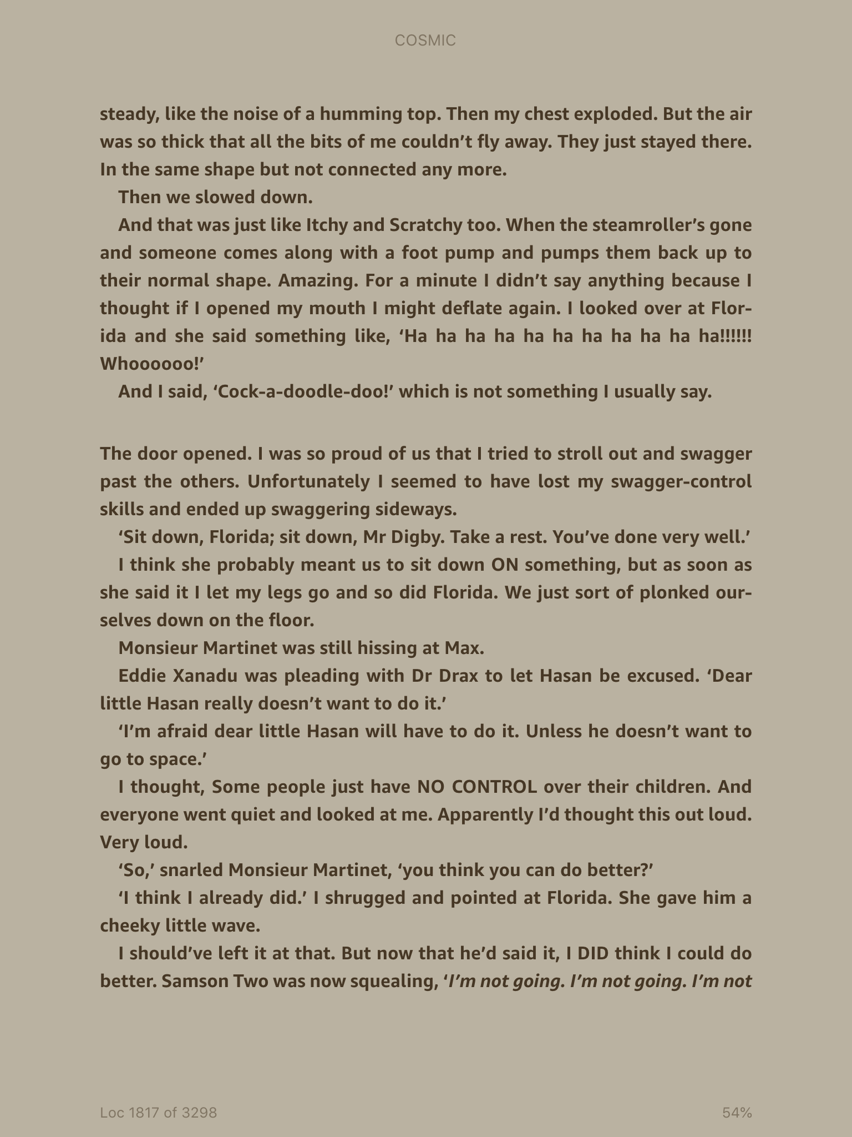

Slide 12
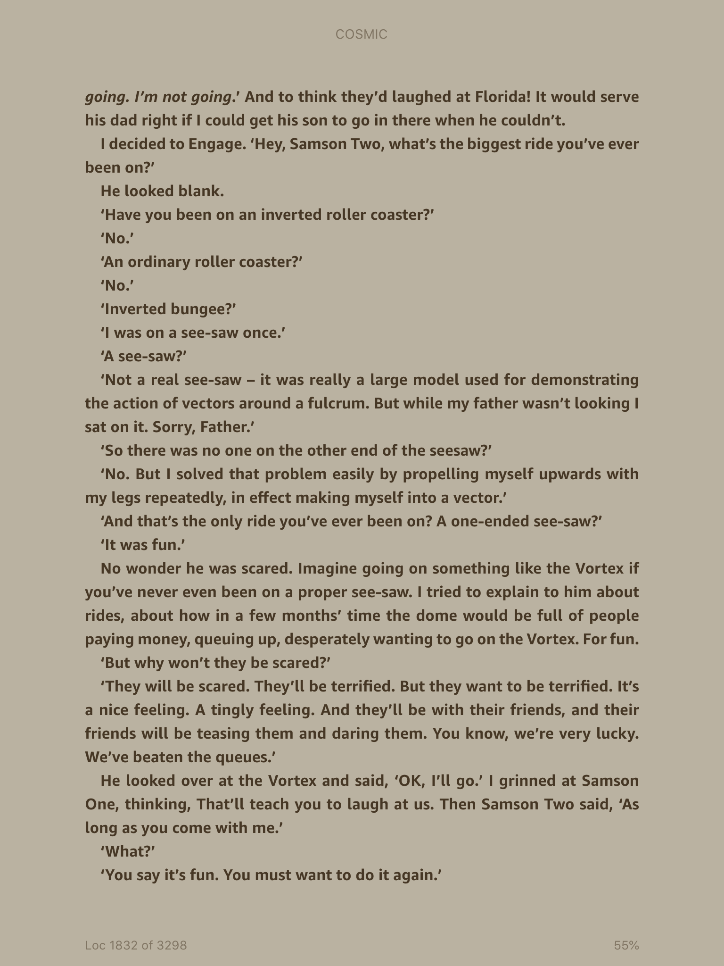

Slide 13
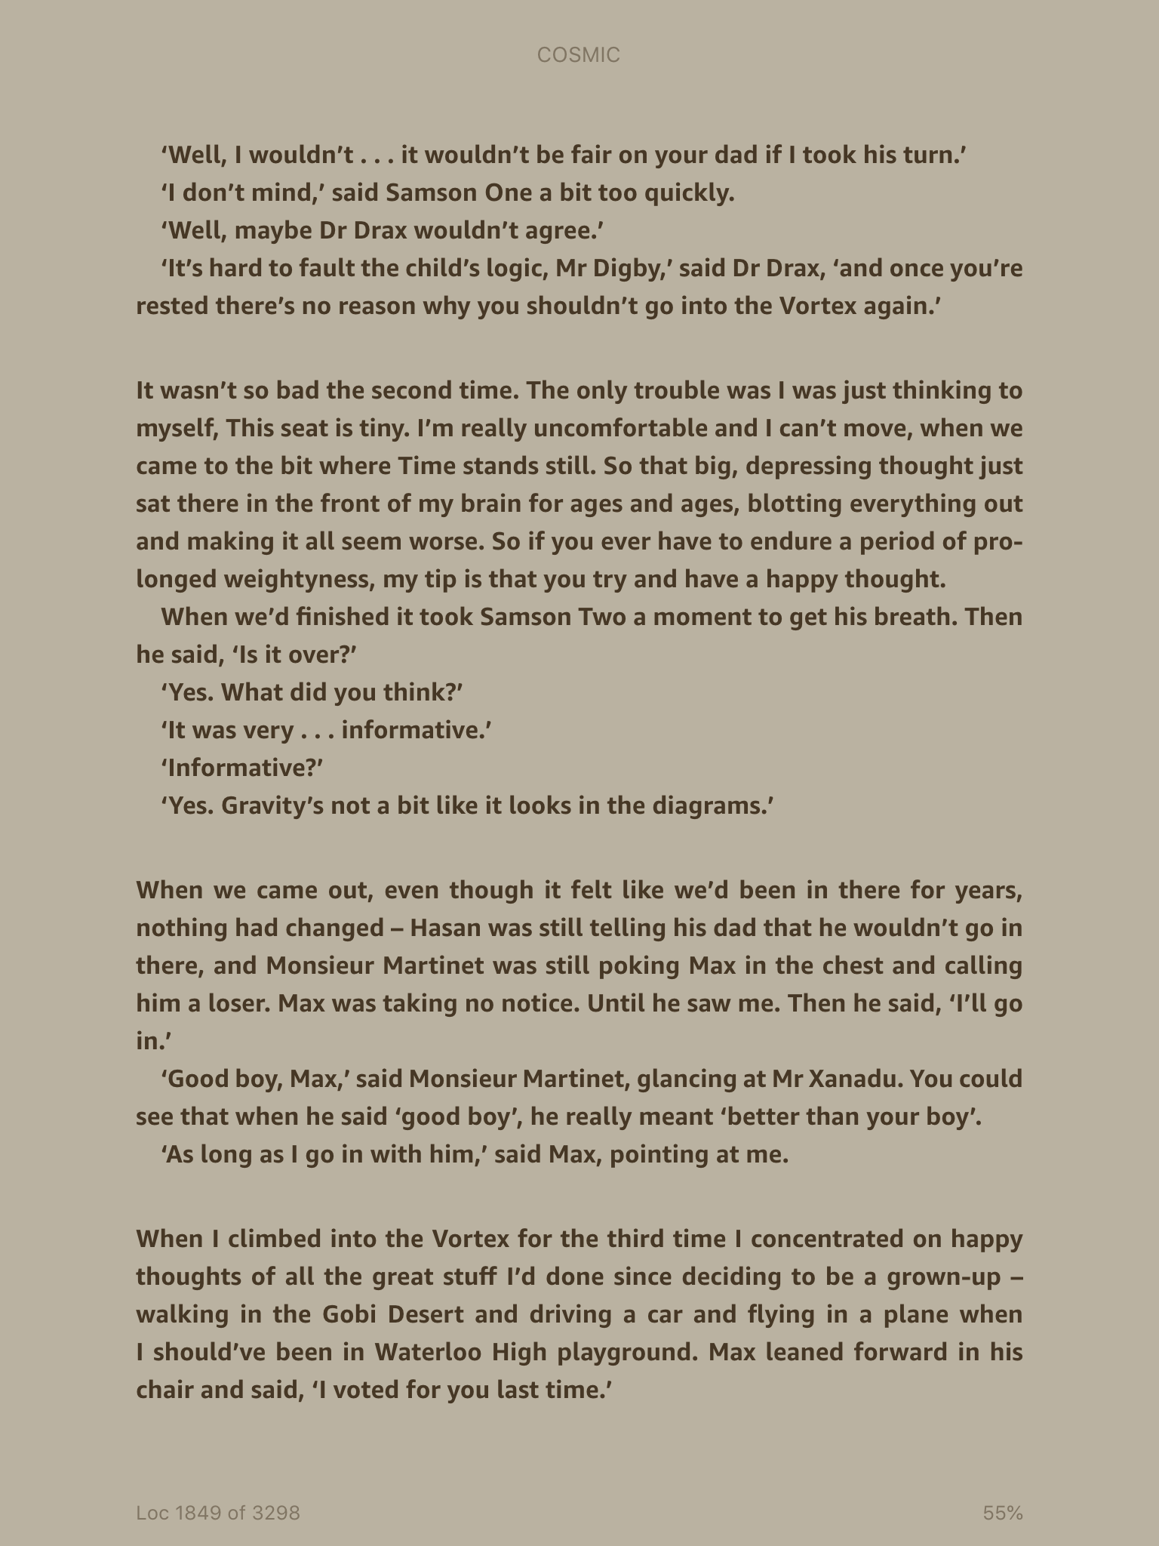

Slide 14
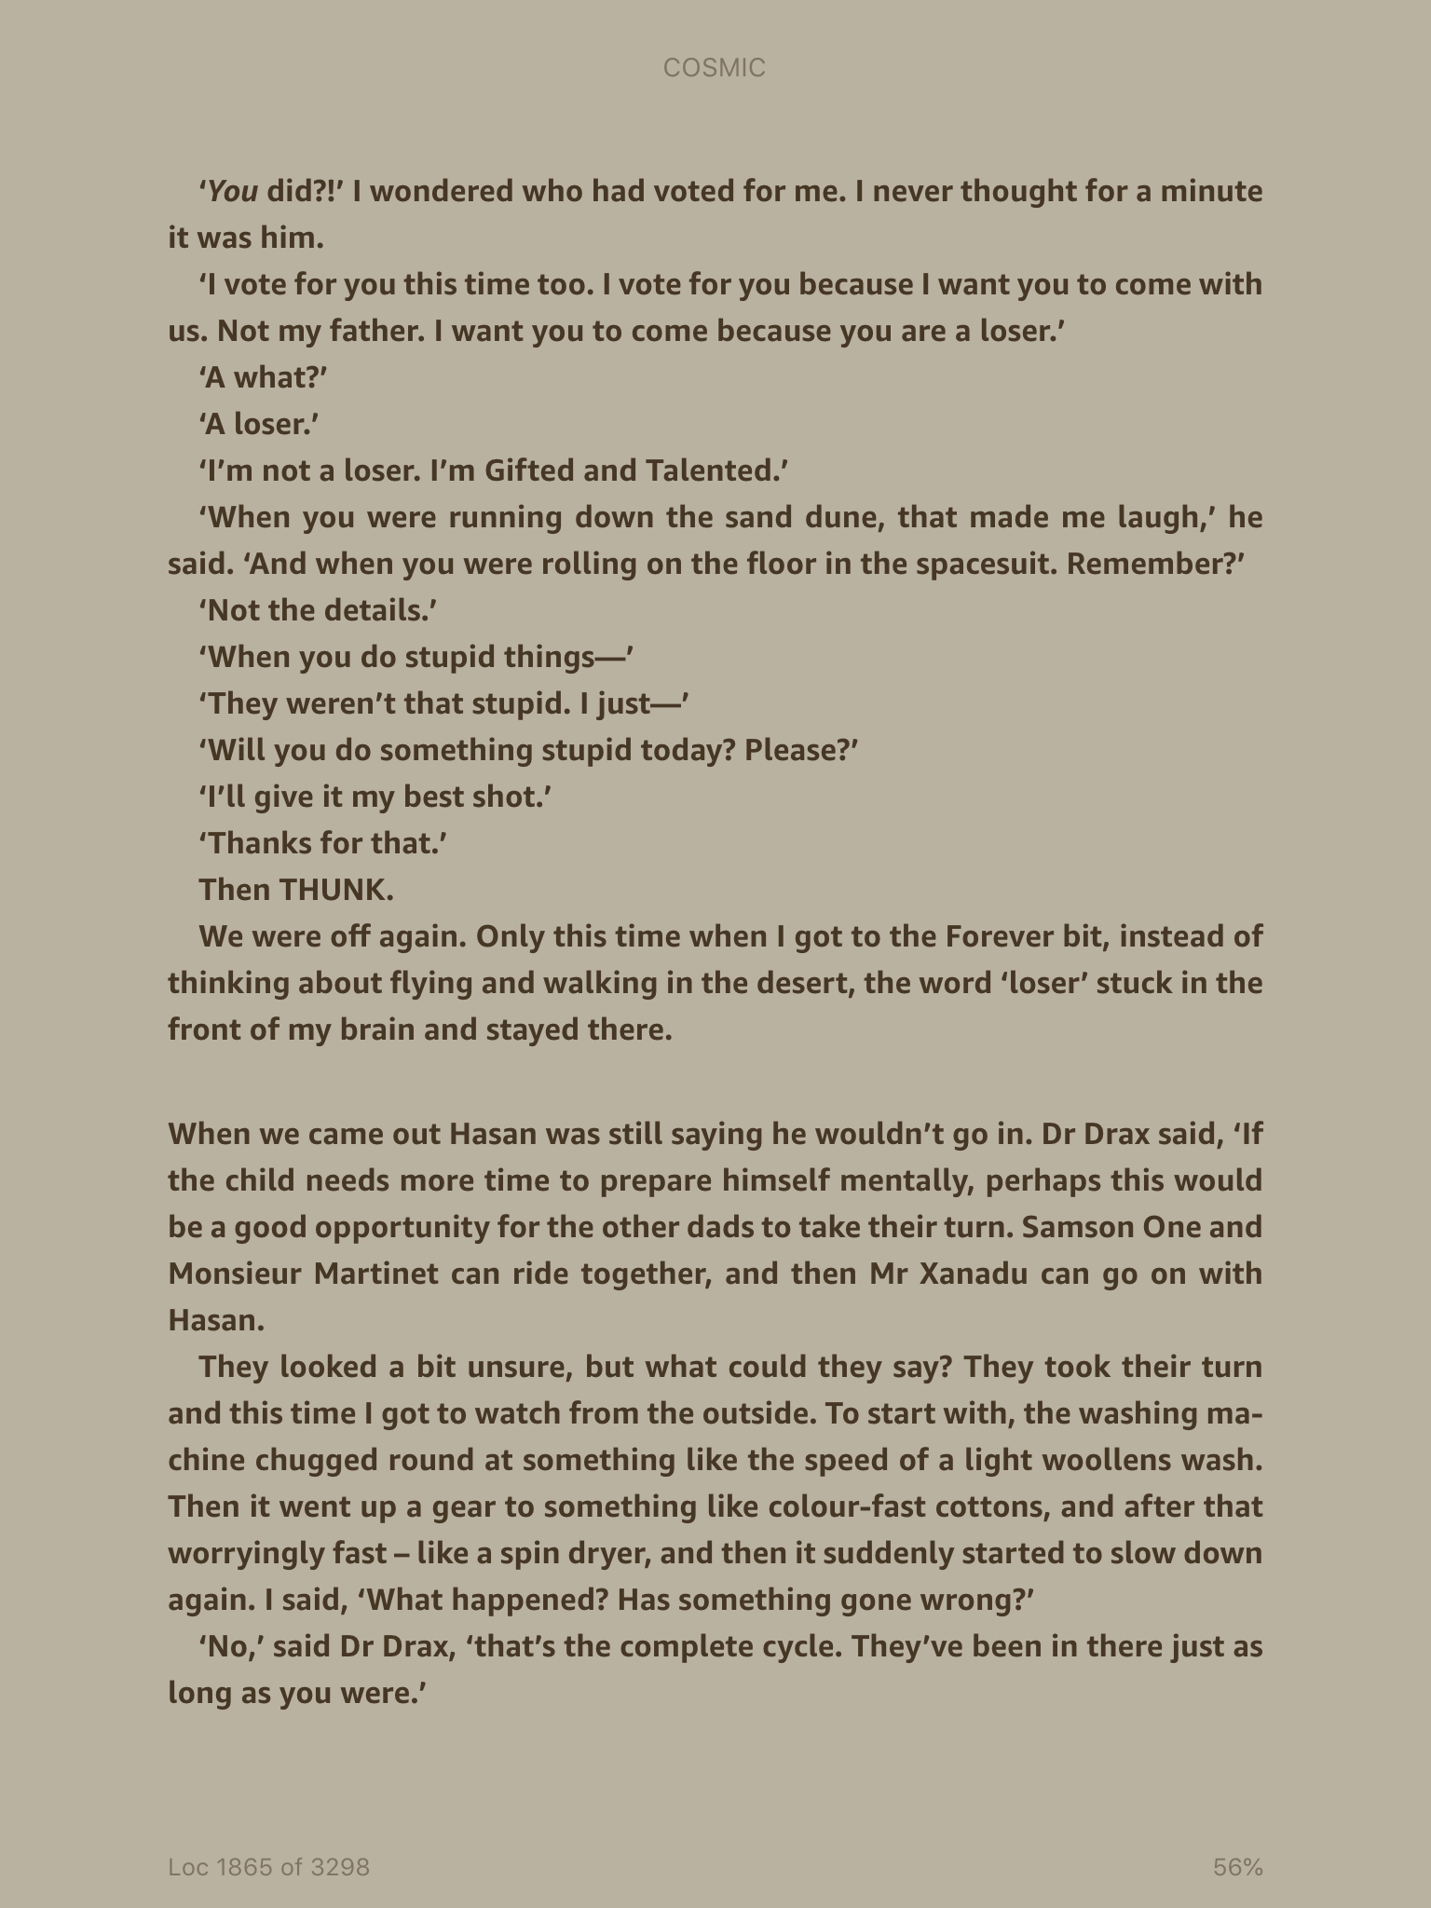

Slide 15
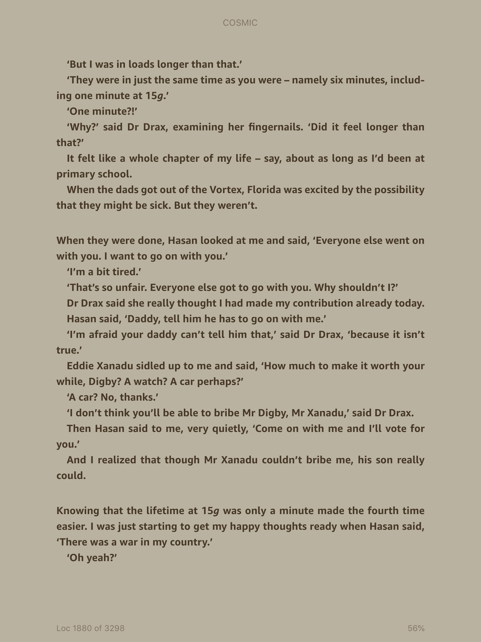

Slide 16


