Slide 1
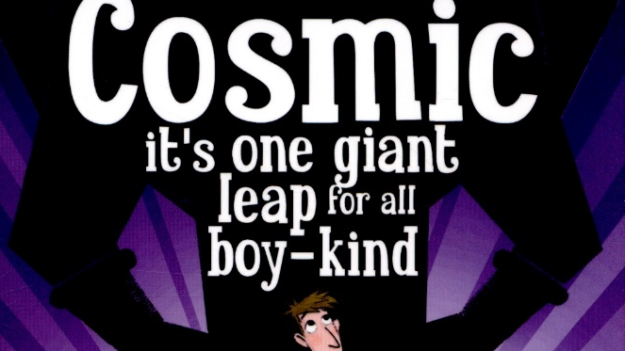
Week 3 Day 5

Slide 2

Read chapter 19 ‘gravity is not a trivial monster’ and chapter 20 ‘last chance to vote.’
You will need to go back to yesterday’s PowerPoint for chapter 19 as you should have already read it. Chapter 20 starts on the next slide.

Slide 3
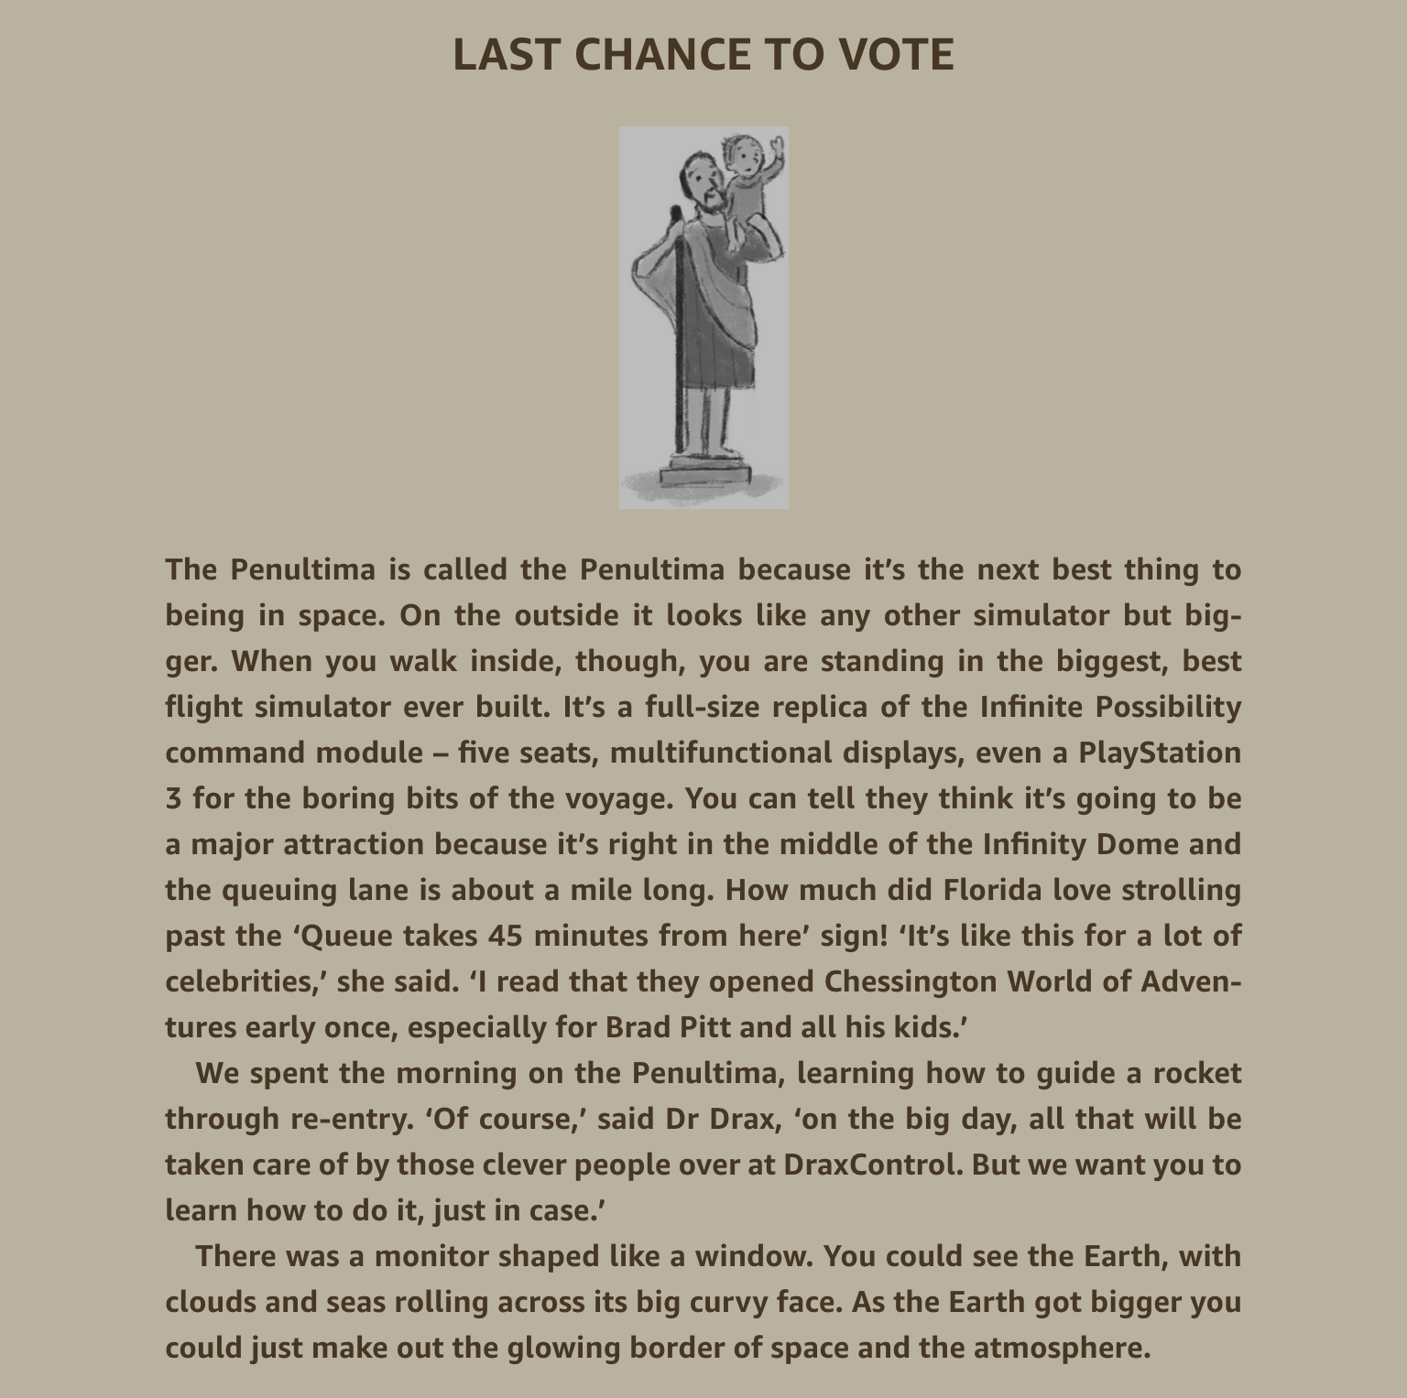

Slide 4
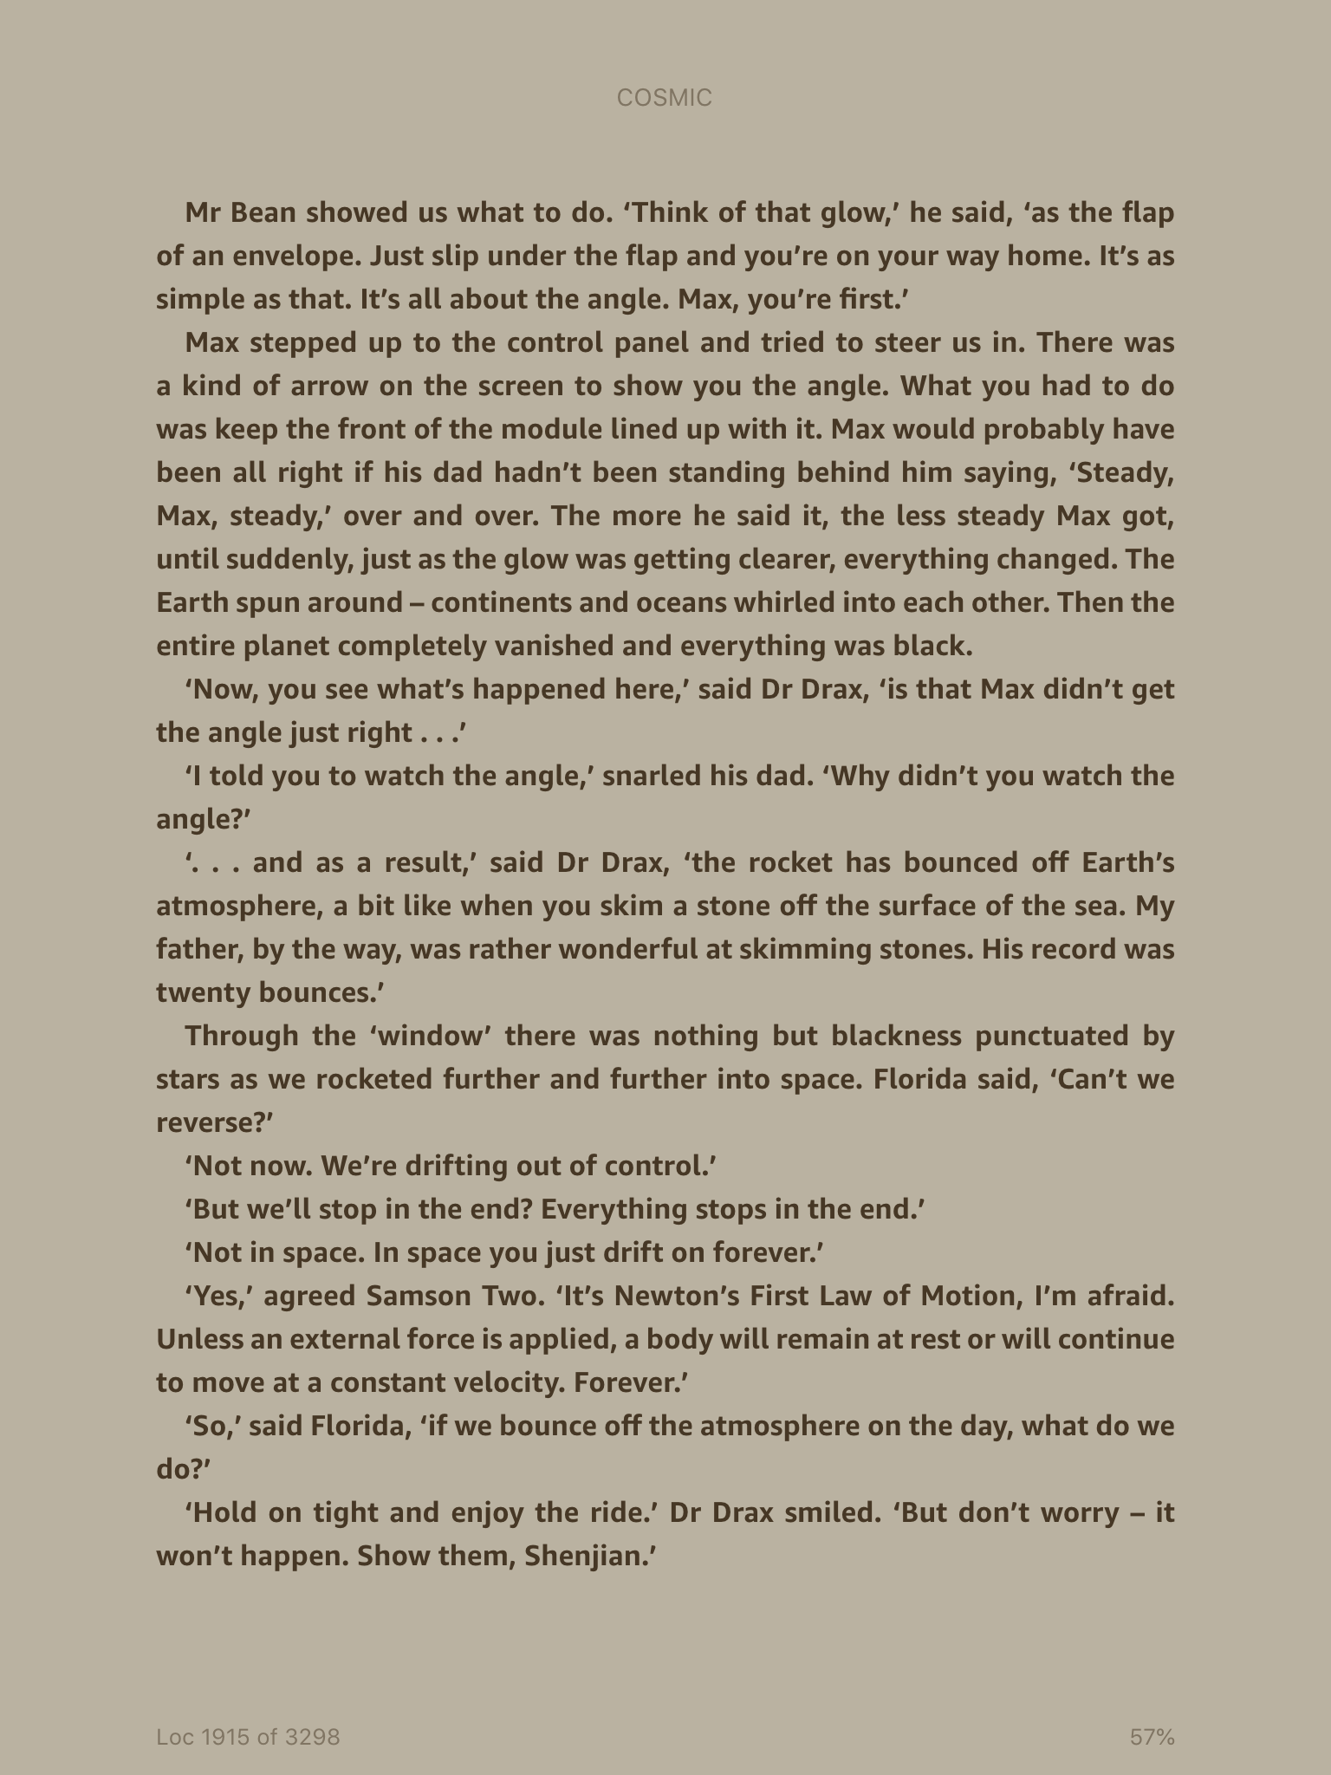

Slide 5
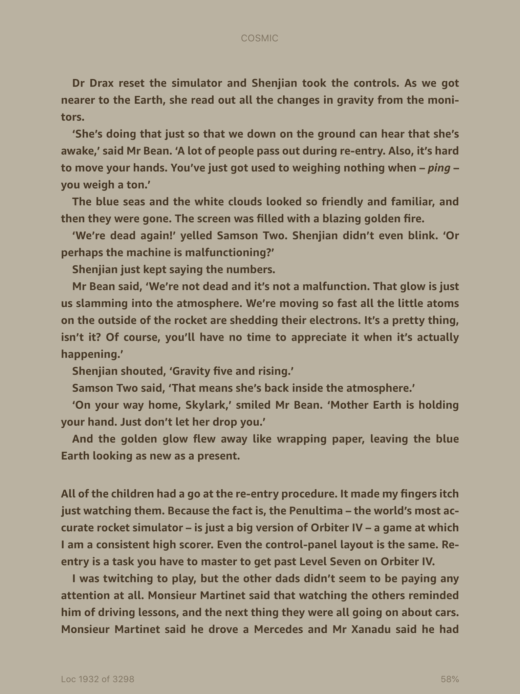

Slide 6
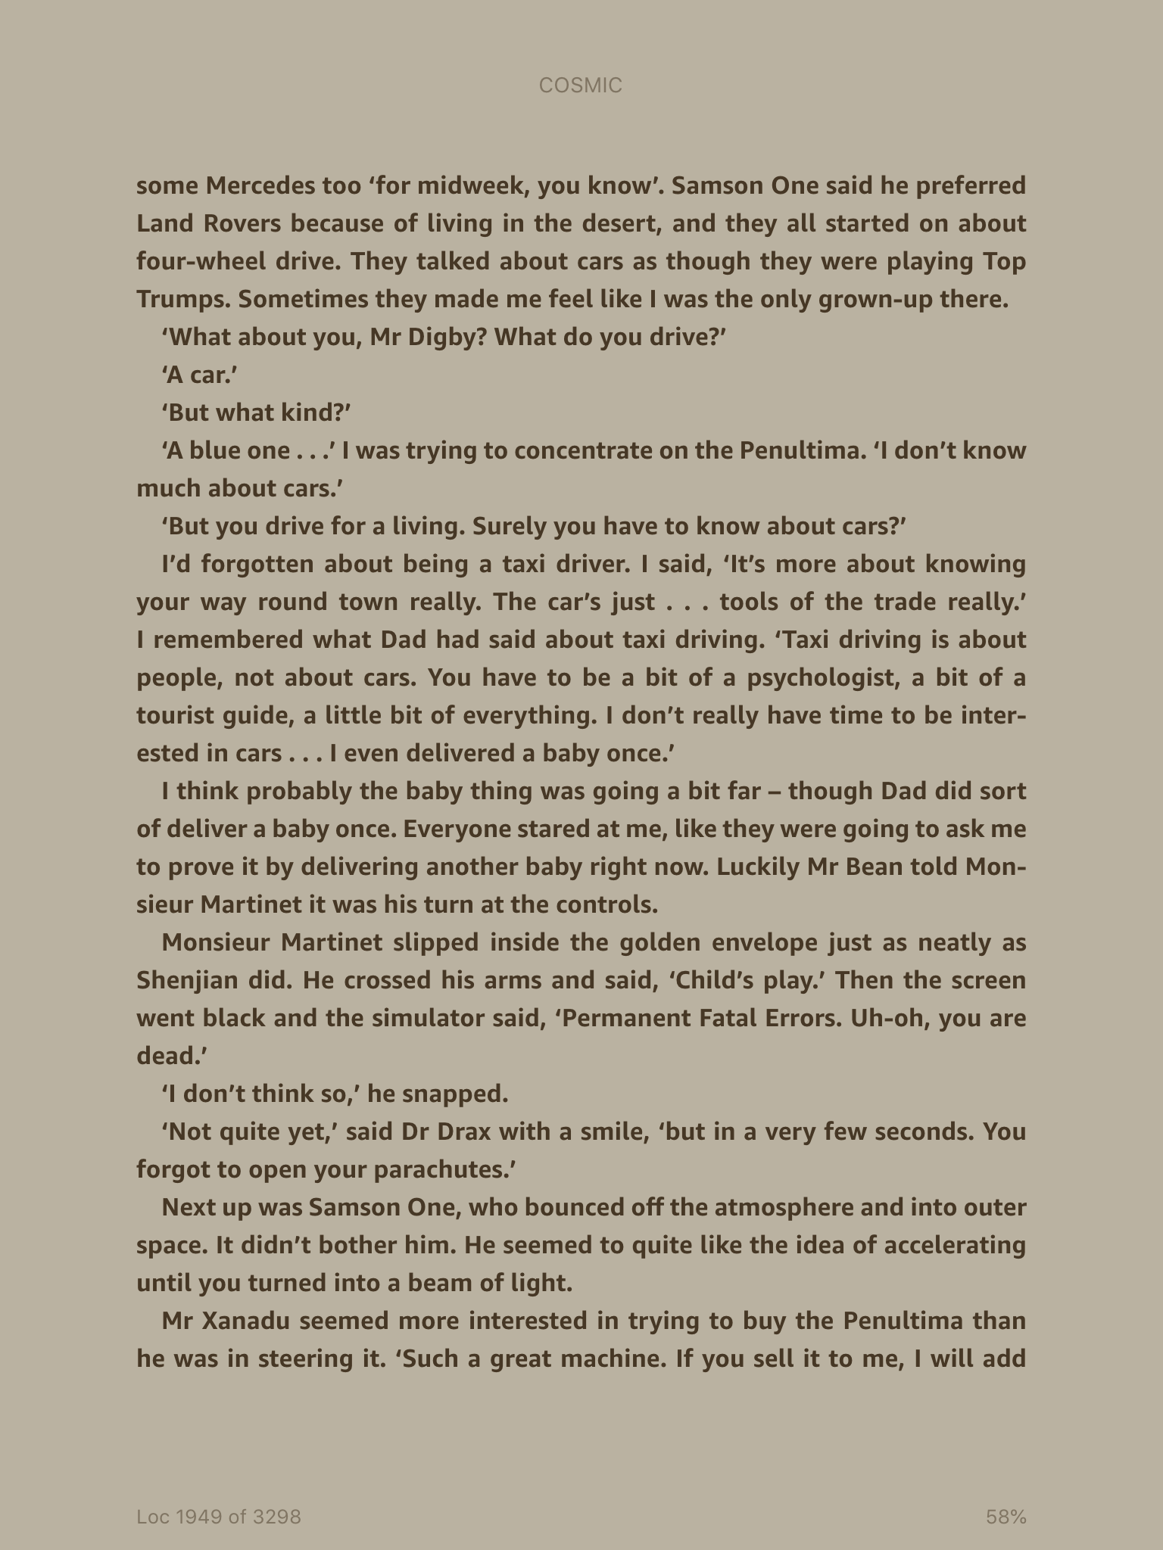

Slide 7
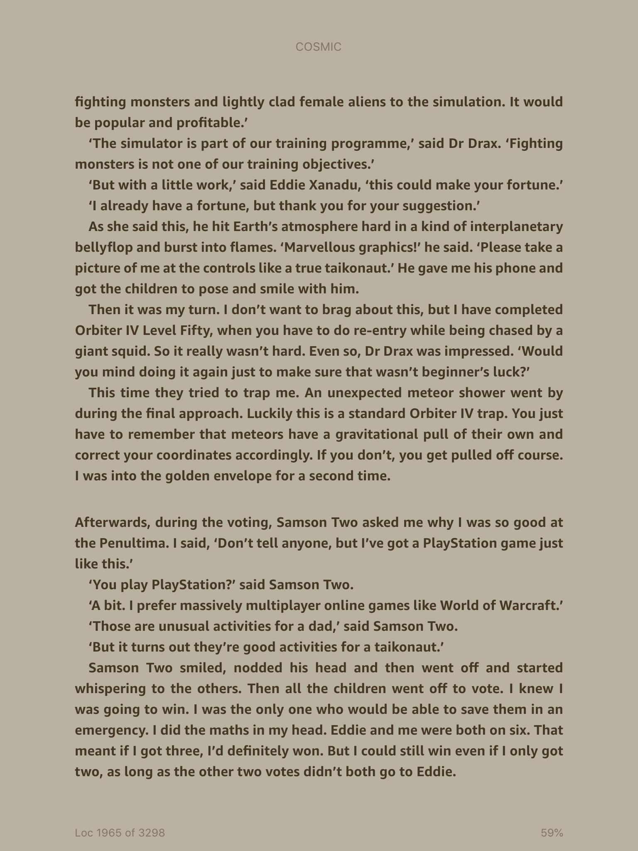

Slide 8
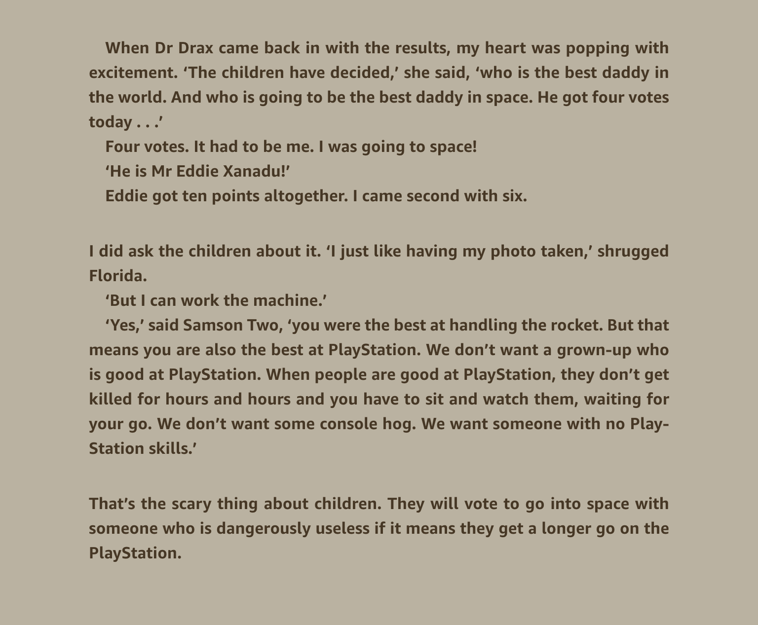

Slide 9
Look at the last paragraph of chapter 20
‘That’s the scary thing about children. They will go into space with someone who is dangerously useless if it means they get a longer go on the play station.’
Who did the children vote for? Why?
What do you notice about the author’s style of writing? Is it similar to any other author you know?
If you were there, who would you have voted for and why?

Slide 10
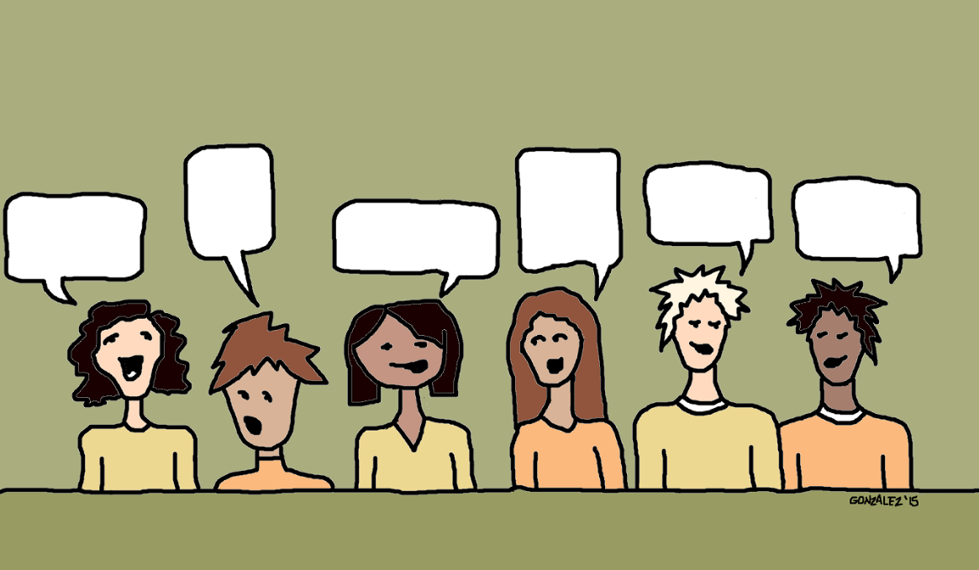
We know Eddie Xanadu was voted for yet we also know at some point Liam ends up in space.
Do you have any ideas of how of how this might happen?
If you were the author how would you adapt the story line so that Liam end up in space ?

Slide 11
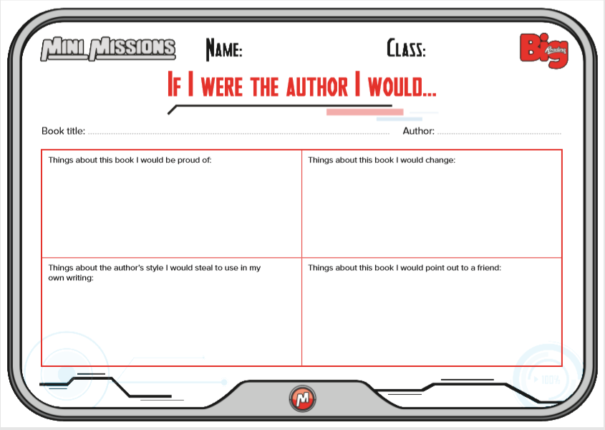
Main Task – Complete the ‘if I were the author, I would task’

