Slide 1
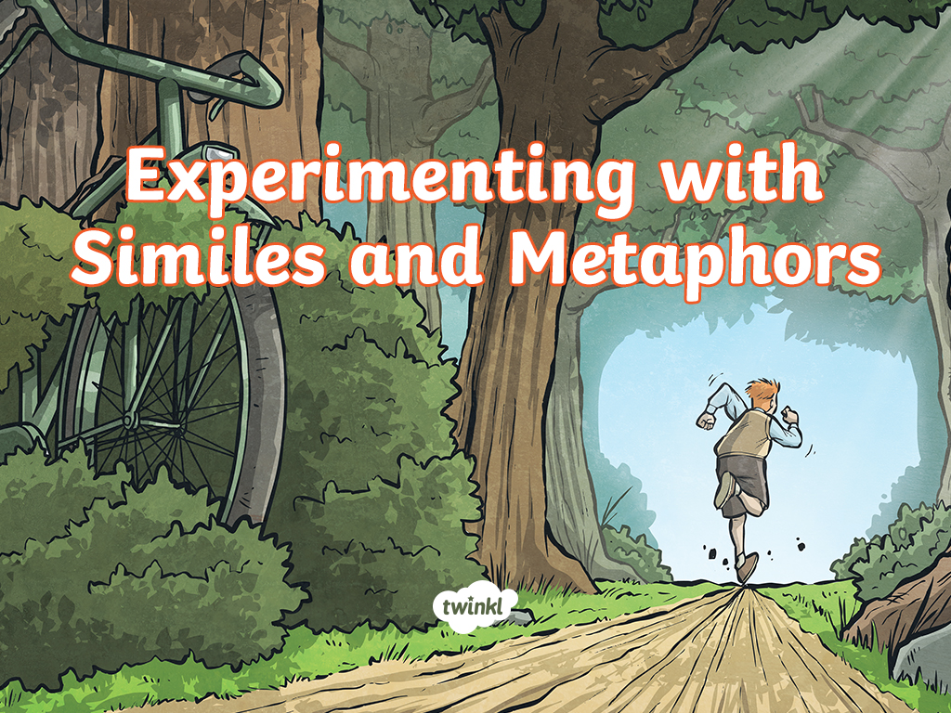

Slide 2
Follow this link and watch the 3 videos on it then complete activity 1 only before moving on to the slides below for more activities.
https://www.bbc.co.uk/bitesize/articles/zhcc92p

Slide 3
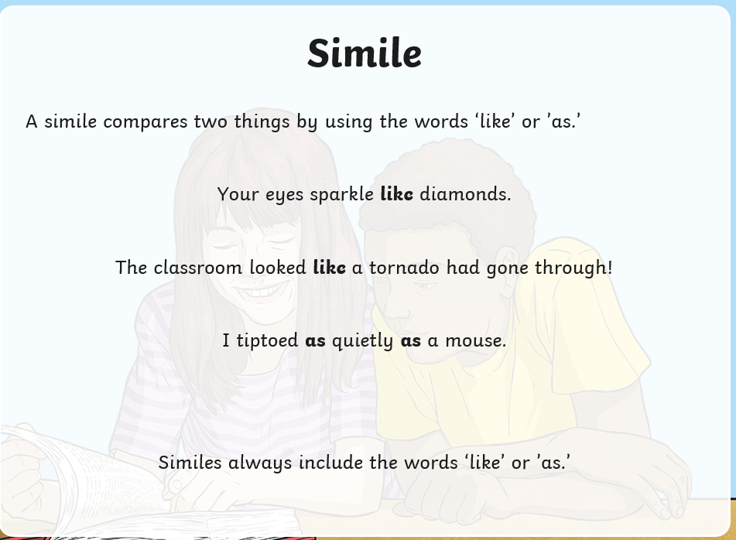
Remember…

Slide 4
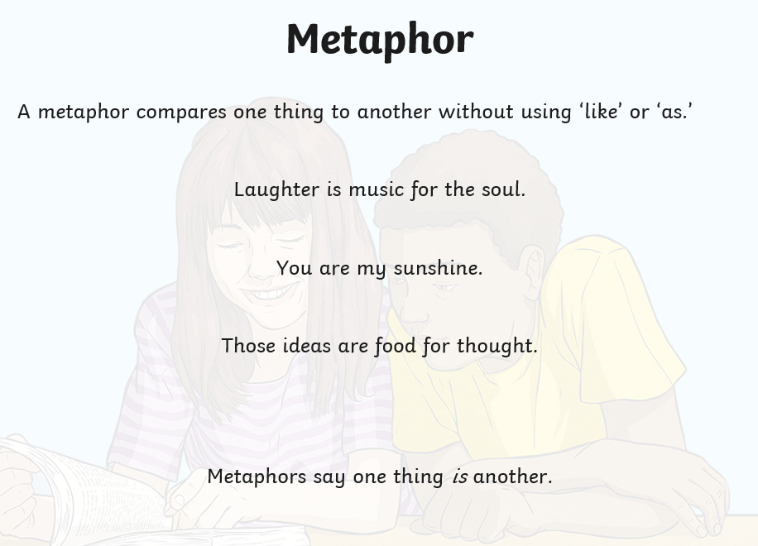

Slide 5
On the slides below, read the simile or metaphor at the top and then experiment with verbally creating some of your own using the phrases that pop up.

Slide 6
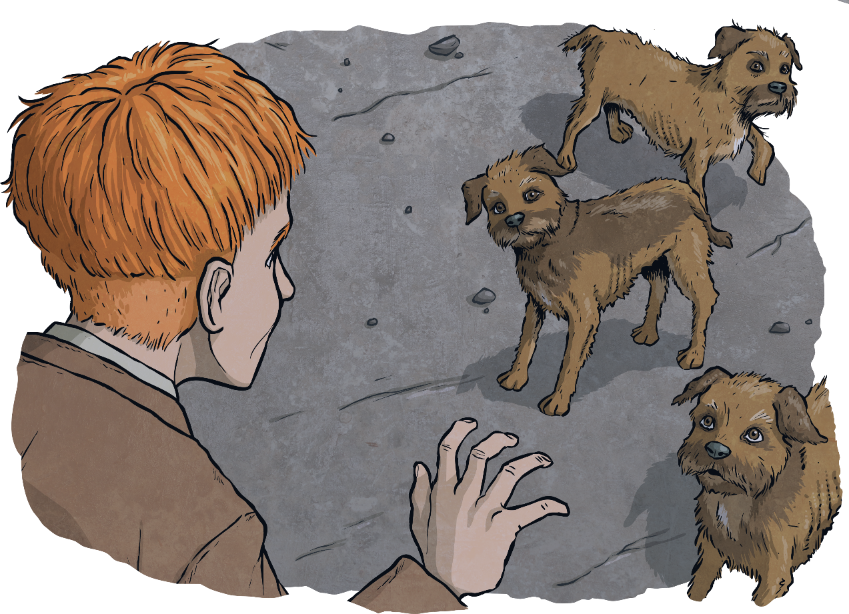
Experimenting with Similes and Metaphors
Their little dark eyes shone like buttons.
as hungry as
scampering around like
matted fur like
as bewildered as
behaved like

Slide 7
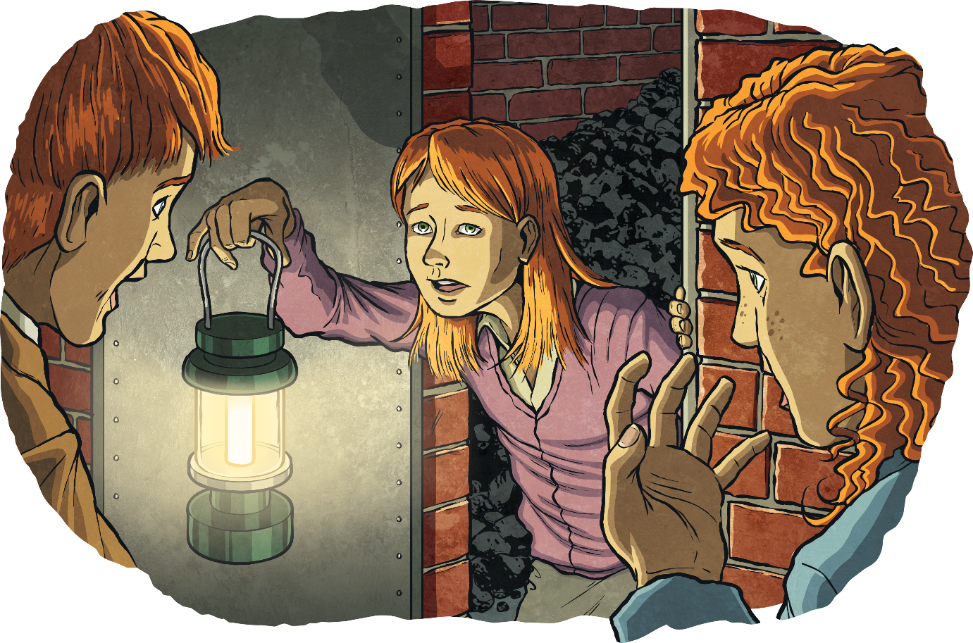
Experimenting with Similes and Metaphors
The orange glow made her red hair shine brighter than a bonfire’s
flame and her green eyes sparkled like emeralds.
as dark as
hair like
sounded like
as shocked as
The light was a

Slide 8
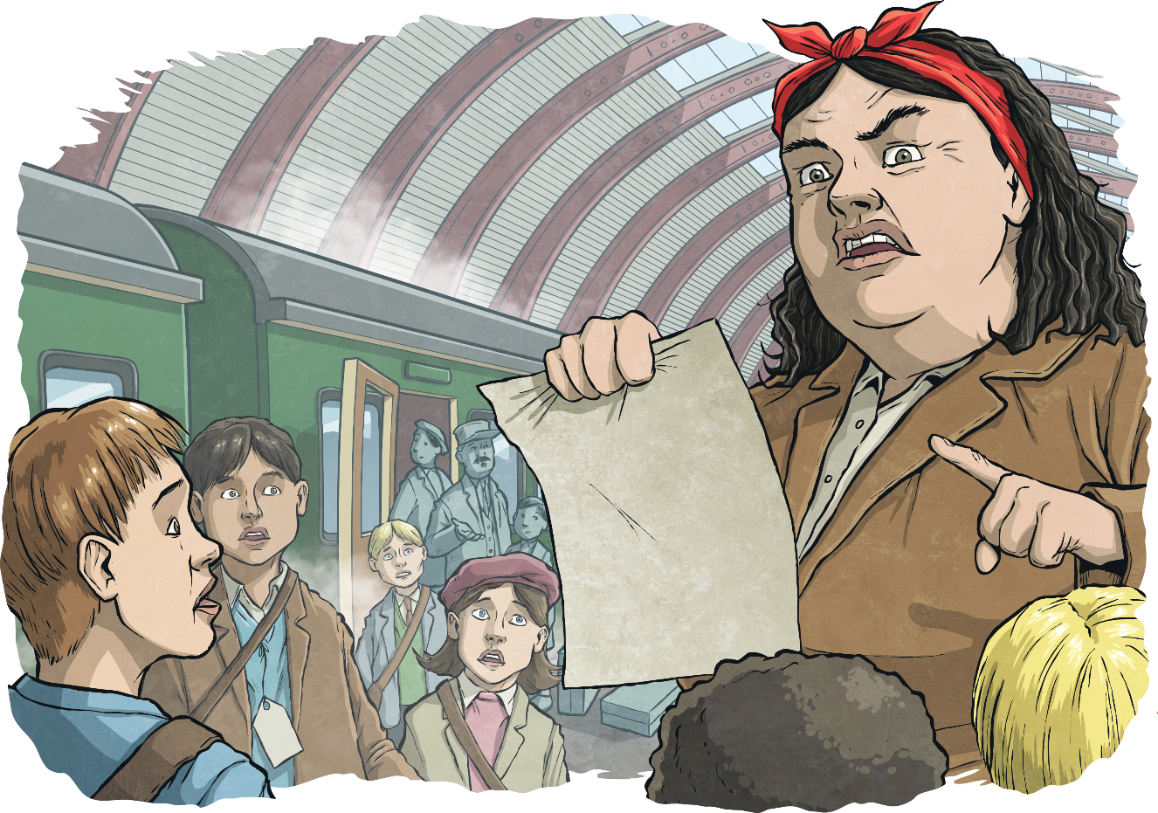
Experimenting with Similes and Metaphors
The thick soles of her boots thumped the platform like blocks
of wood as she prowled before the group.
The station was a
as worried as
a mouth like
a voice which
felt like

Slide 9
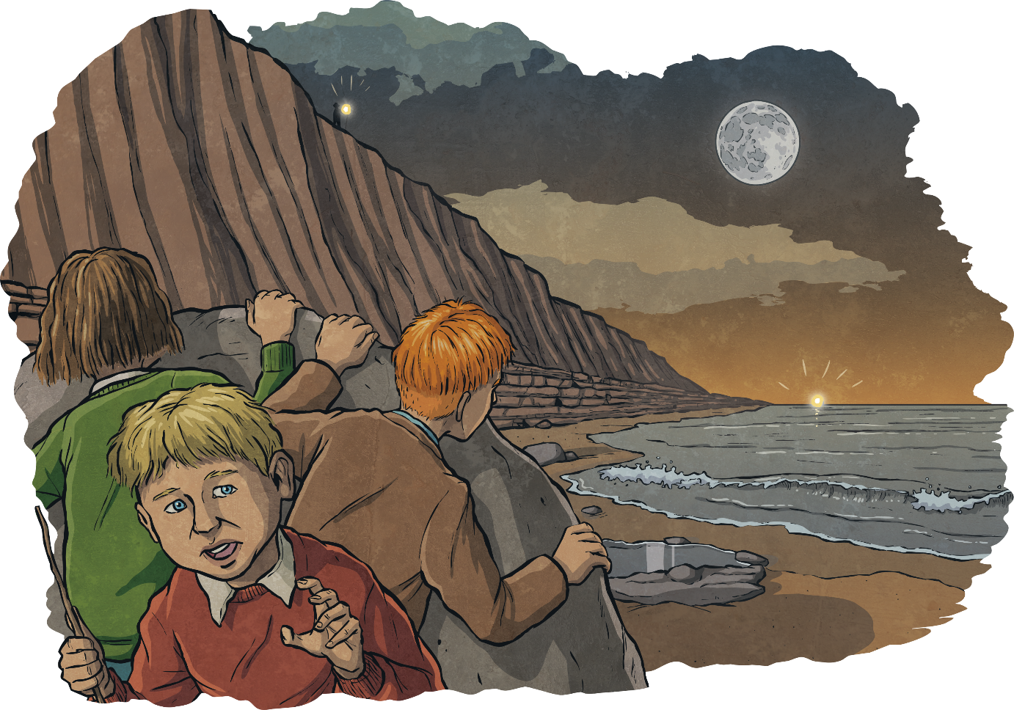
Experimenting with Similes and Metaphors
The sky above the trio’s heads was the colour of rusting iron, as the last lick of the day’s sunlight swept its orange tongue from east to west.
The moon was a
shone like
waves as
as cold as

Slide 10
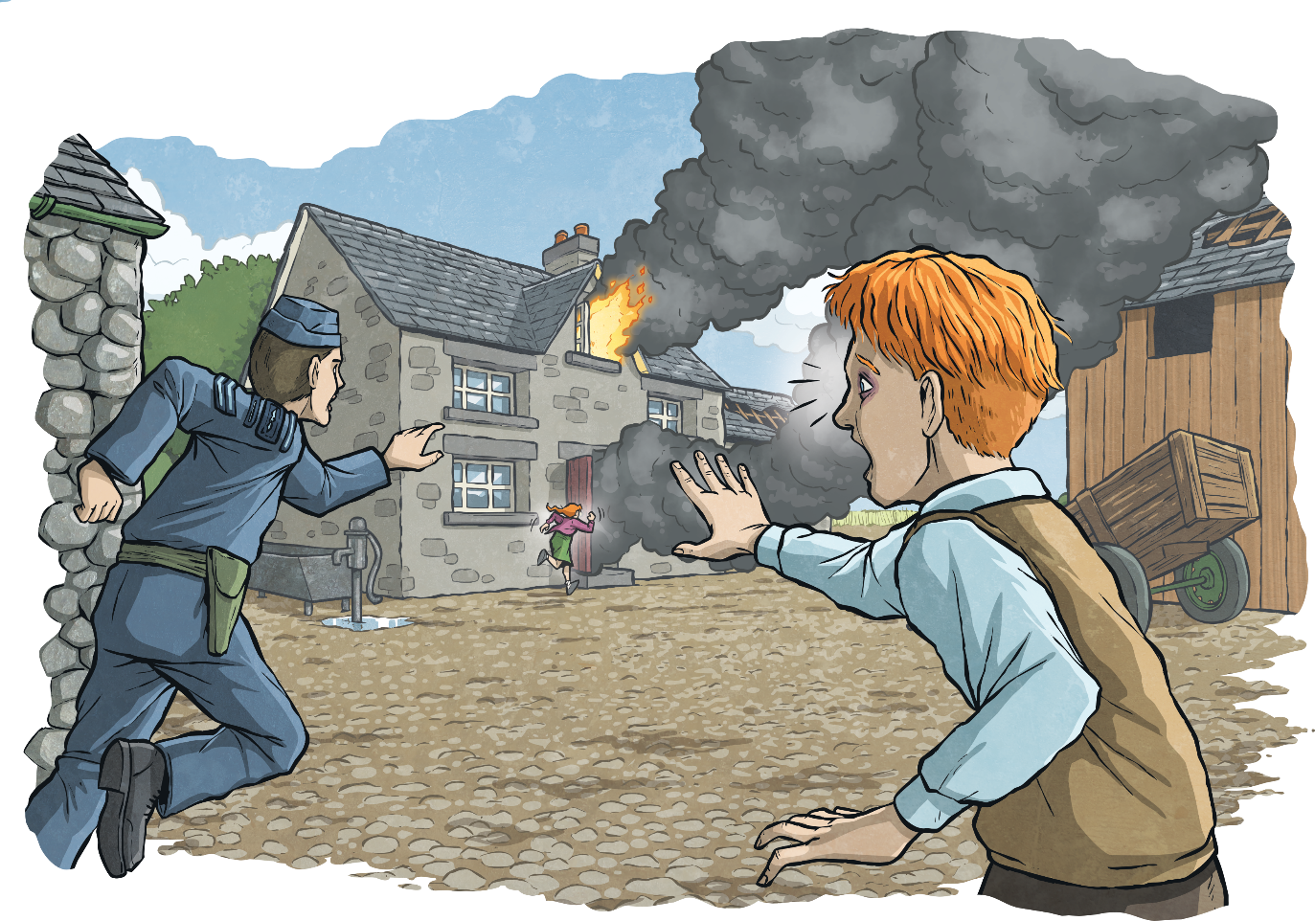
Experimenting with Similes and Metaphors
He threw himself forward, surging through the darkness like
a desperate jungle explorer in search of lost treasure.
The house was a
Sam’s heart…
sprinting like
as though

Slide 11
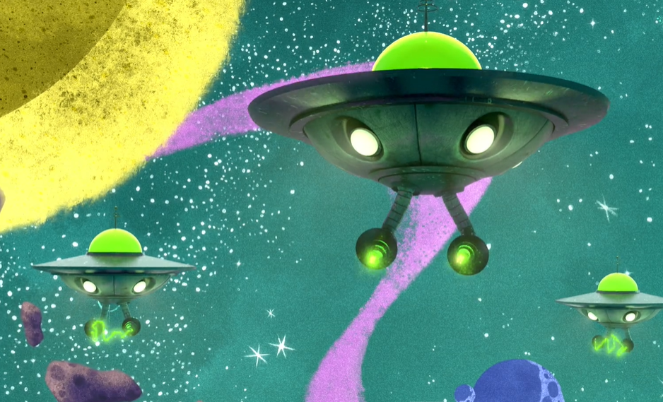
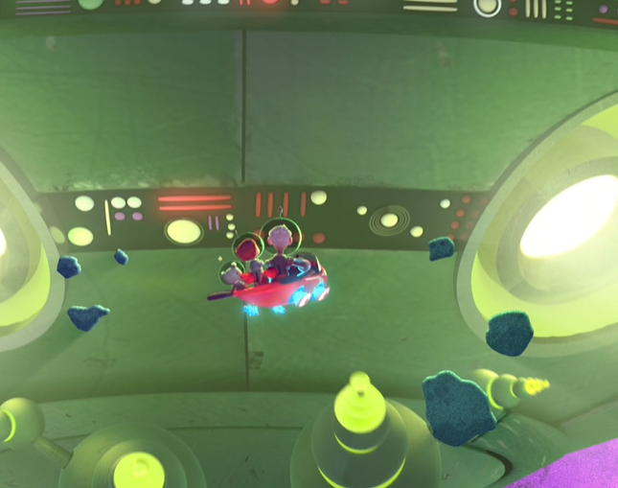
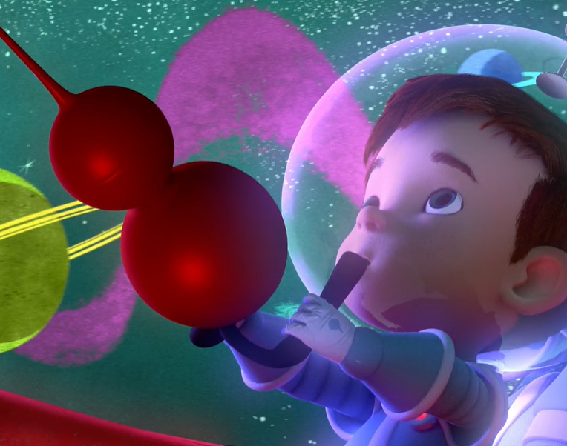
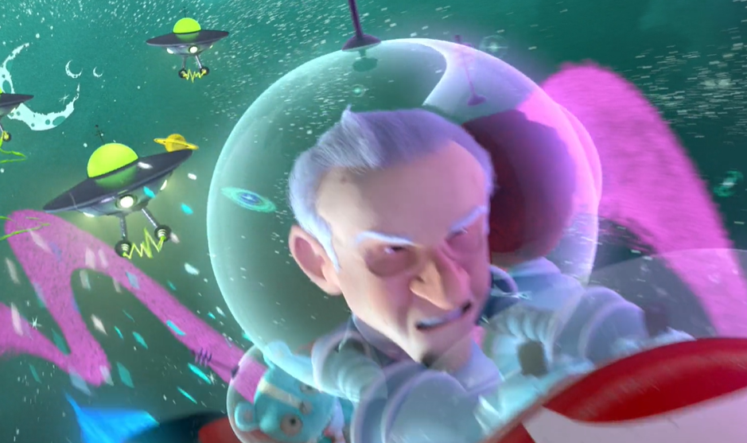
Watch the Taking Flight video clip from 3 minutes 28 seconds – 4 minutes 11 seconds
http://www.literacyshed.com/takingflight.html
In your book, create 5 powerful similes / metaphors about what you can see, hear and smell.

