Slide 1
Chinese Dragons
So why are dragons important in Chinese culture?
They traditionally symbolise power, particularly control over water, rainfall, typhoons, and floods. The dragon is also a symbol of power, strength, and good luck for people who are worthy of it in East Asian culture.

Slide 2
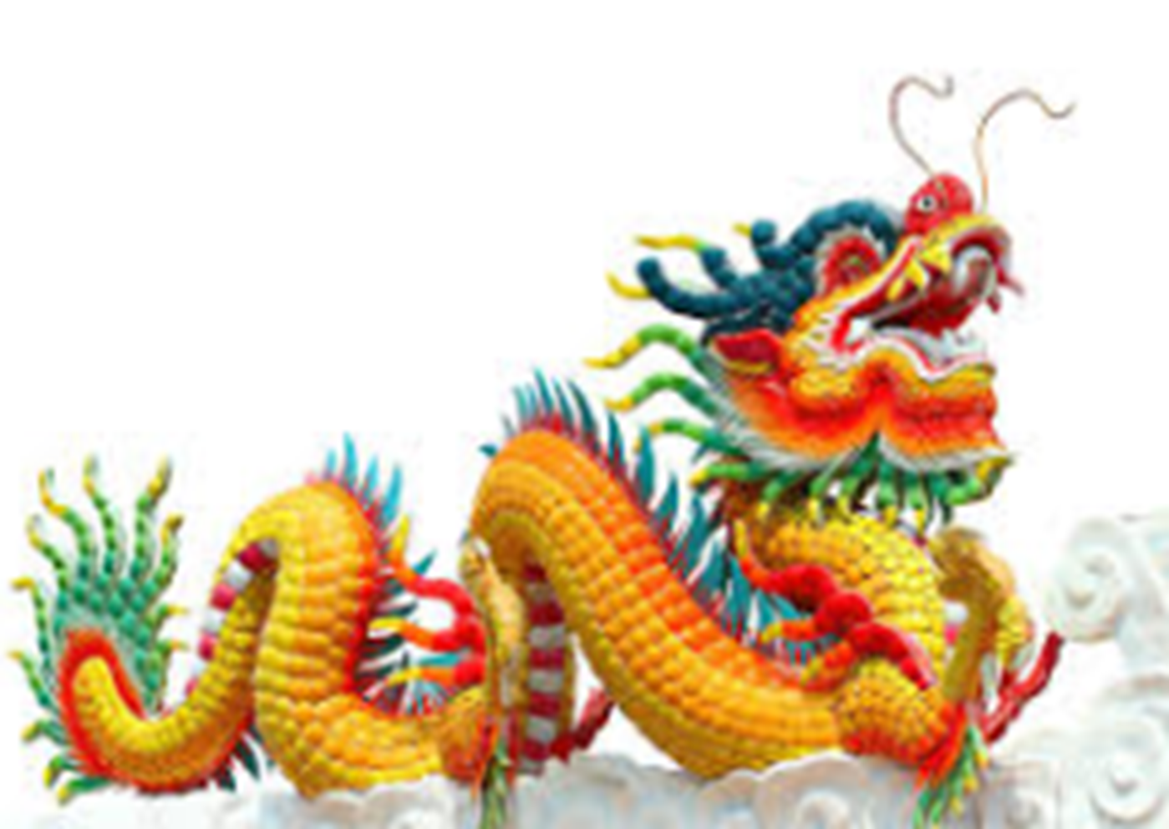
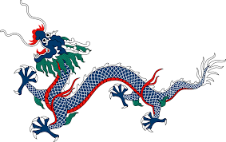
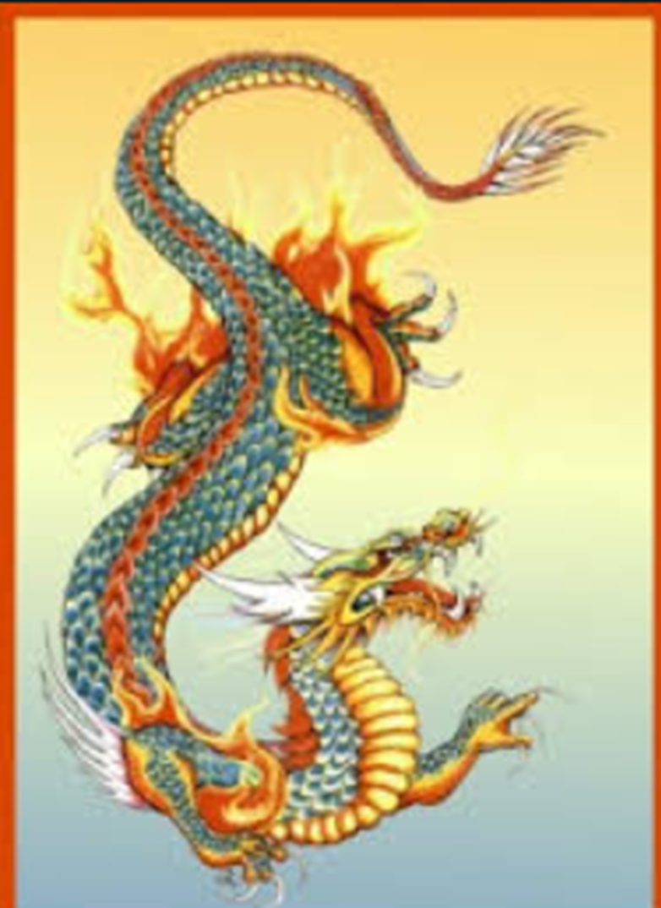
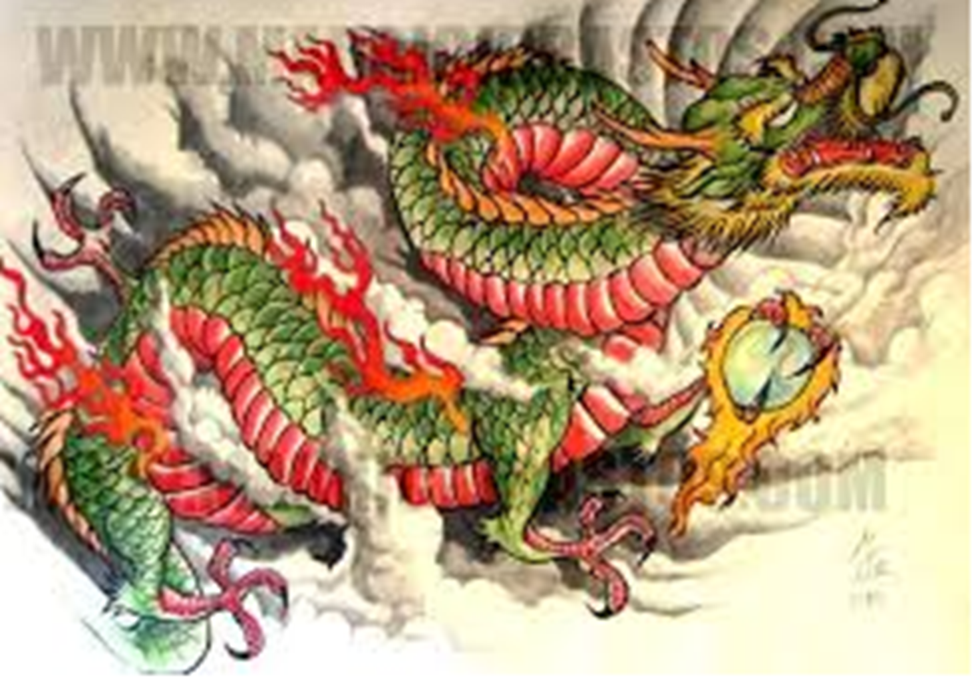
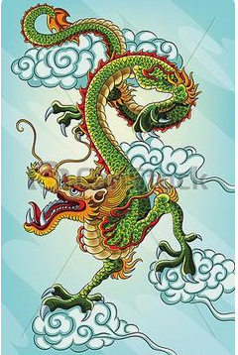
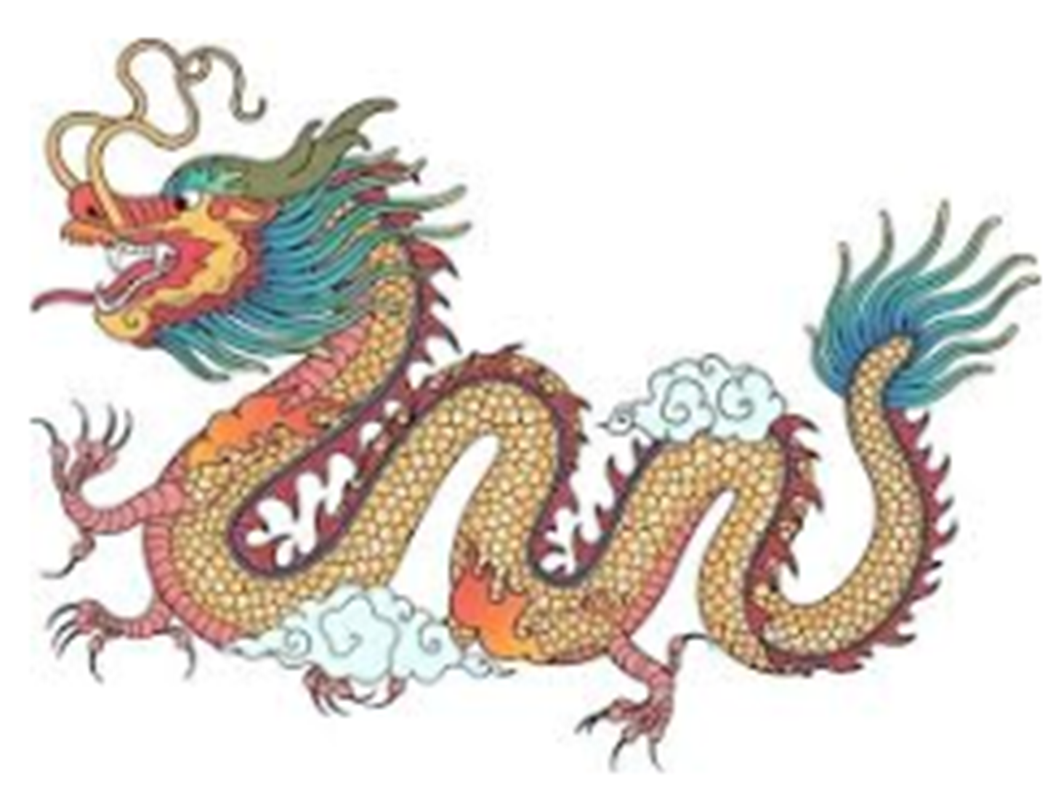
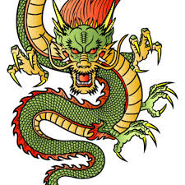
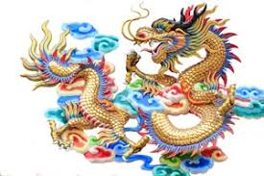

Slide 3
We’re going to have a go at drawing and painting our own Chinese dragons.
You can either watch this video clip and keep pausing as you go (it is a youtube clip so this clip is safe but make sure you don’t click on to anything else):
https://www.google.com/search?q=drawing+a+chinese+dragon&rlz=1C1GCEA_enGB813GB817&oq=drawing+a+chinese+dr&aqs=chrome.0.0j69i57j0l6.3119j0j4&sourceid=chrome&ie=UTF-8#kpvalbx=_Cw7hXruiHsic1fAPiZ2UwAs62
or
you can follow the slides below.

Slide 4
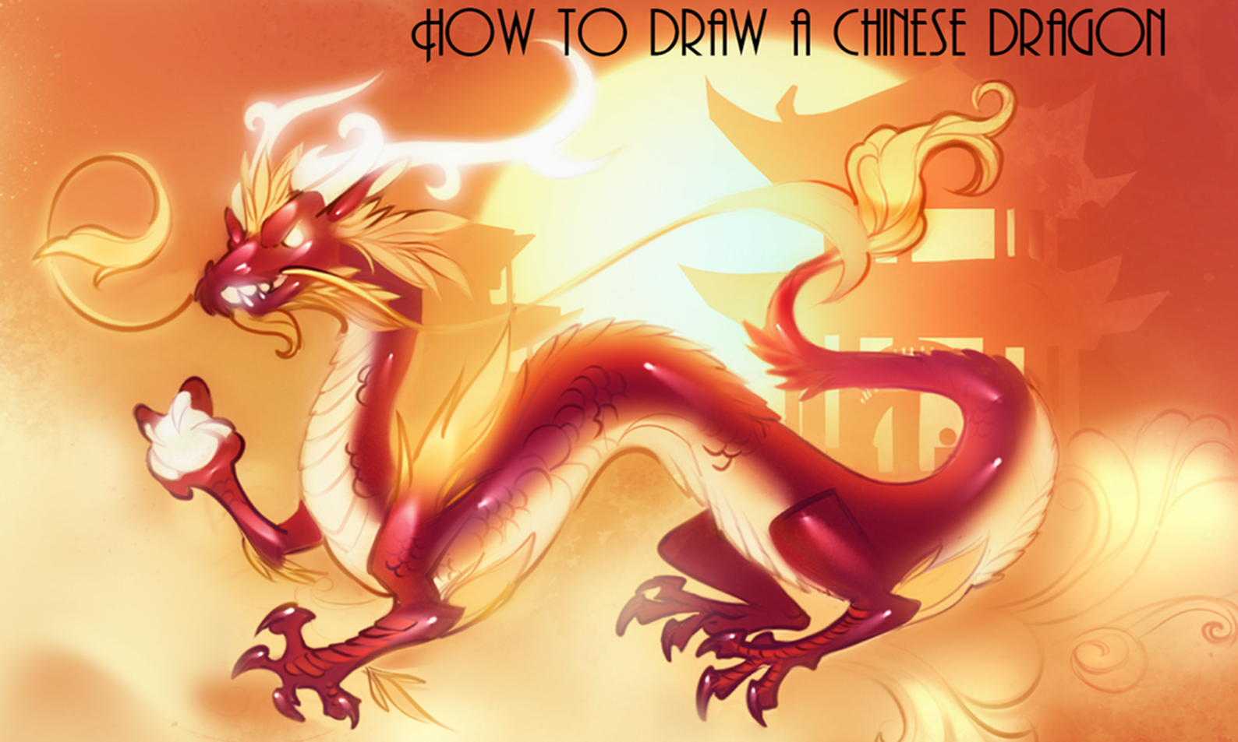

Slide 5


Slide 6
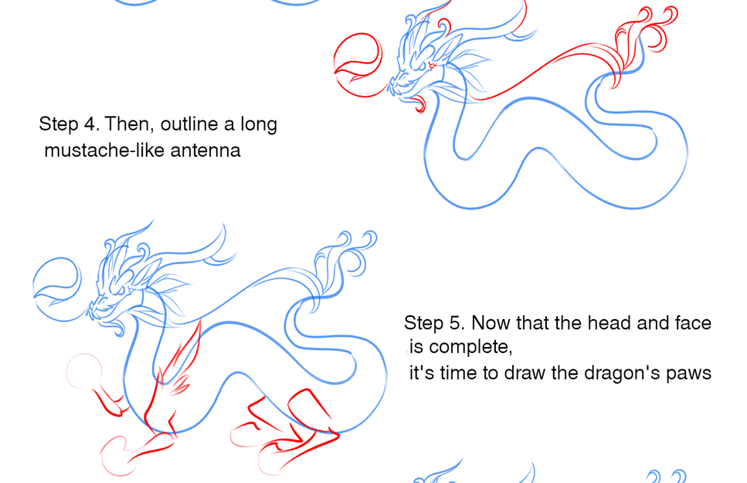

Slide 7
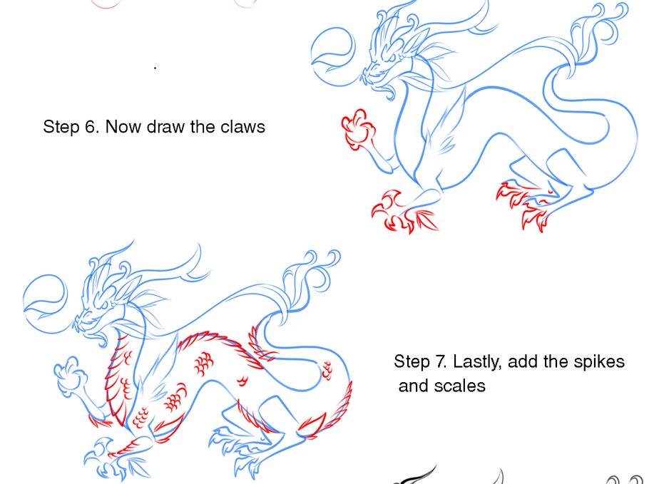

Slide 8
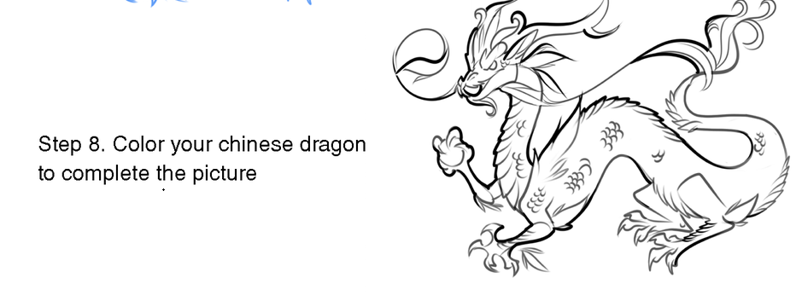

Slide 9
Now choose your colours and get painting (or colouring).

