Slide 1



Slide 2
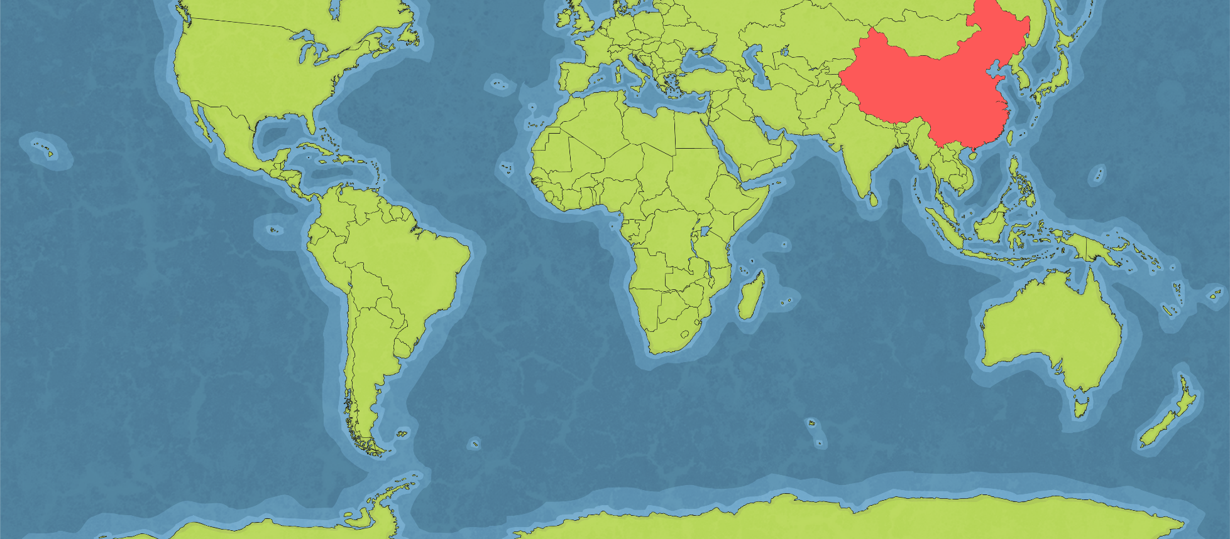

The Shang Dynasty
Watch the video clip again of the Shang Dynasty.
Click here.
We know lots about the Shang dynasty from archaeological remains and written documents. Chinese legend says that the founder of the Shang Dynasty, Cheng Tang, overthrew the Xia dynasty to take power, but there is no definite proof of the Xia dynasty’s existence.

Slide 3
Watch the video clip about how the existence of the Shang Dynasty was discovered.
https://www.bbc.co.uk/bitesize/clips/zqpcycw

Slide 4
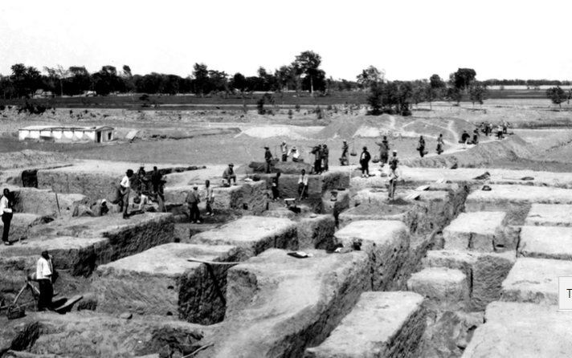
So now we know that writing was found on a ‘dragon bone’ which led to the excavation of a site where archaeologists dug up more evidence. The This is the site that archeologists excavated in Anyang near the Yellow River. They discovered many interesting things including tombs, oracle bones, cities and many items made of bronze and jade.

Slide 5
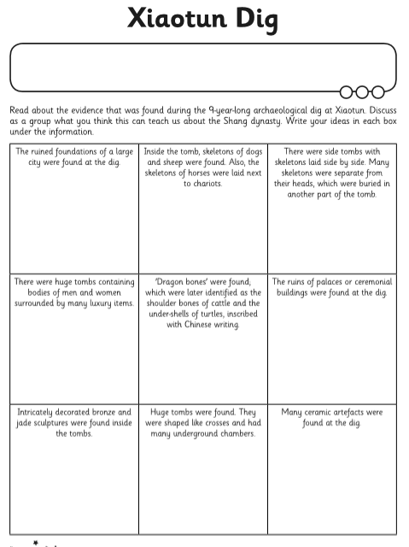
Using the ‘Xiaotun Dig’ PDF sheet, read about the 9 pieces of evidence that were found and write down your ideas about what this piece of evidence tells you about the Shang Dynasty and how they lived.

