Slide 1
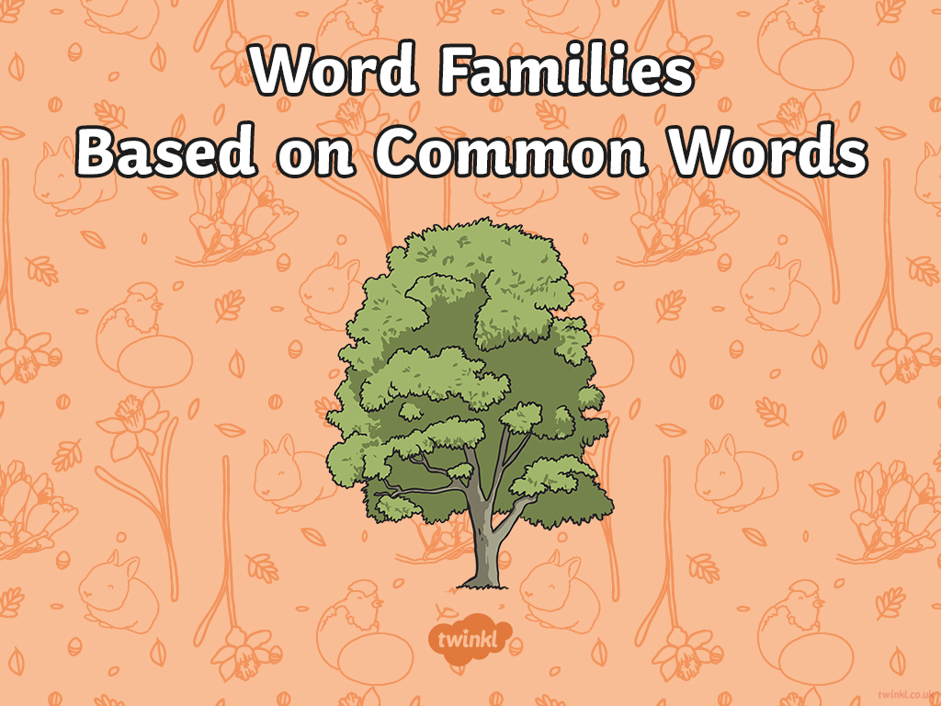

Slide 2

Today, we’re looking at spellings that belong to the same family of words and how words change when we add prefixes and suffixes. Knowing that a word follows a particular pattern can make it simpler to spell.
Many words share the same origin or root word.
The word ‘origin’ means where something came from or where it began.

Slide 3

The particular root word that we are going to look at this week is…
‘sign’
which derives from Latin and is often associated with words that mean to mark or to seal.
Can you think of some words that contain the root ‘sign’?
?
?
sign
?
?
?
?

Slide 4
Working with a partner, can you think of the ‘sign’ words to match these definitions in this quick-fire quiz?
To write your name in a distinctive way to sign off letters or authorise documents.
signature
Click for answer
To allocate a job to someone.
assign
Click for answer
To create a plan or drawing of a building, piece of clothing or object before it is built or made.
design
Click for answer
To appoint a person to a specific job.
designate
Click for answer
Greatly important and worthwhile.
significant
Click for answer

Slide 5
Working with a partner, can you think of the ‘sign’ words to match these definitions in this quick-fire quiz?
Giving up a position or retiring.
resignation
Click for answer
To voluntarily leave a job.
resign
Click for answer
Not all important or worth any thought.
insignificant
Click for answer
A piece of work to complete as part of a job
or course.
assignment
Click for answer
A gesture, action or sound used to
signify something.
signal
Click for answer

Slide 6
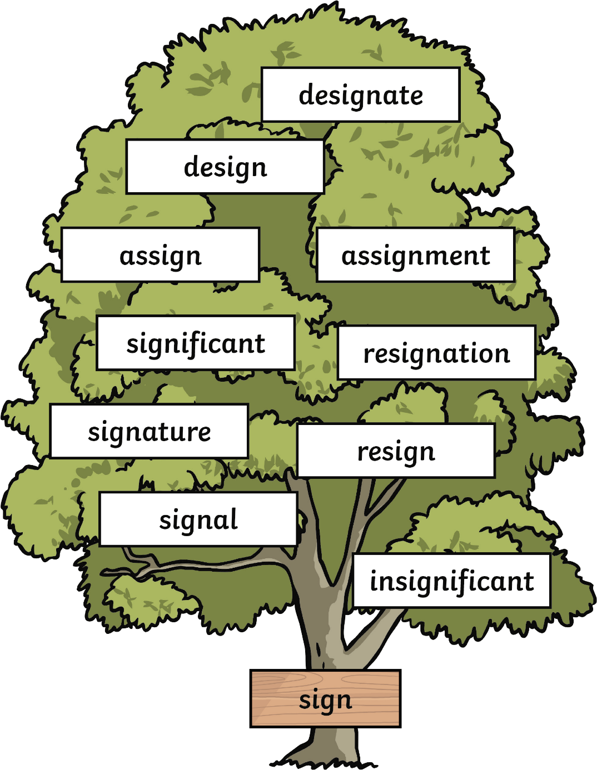
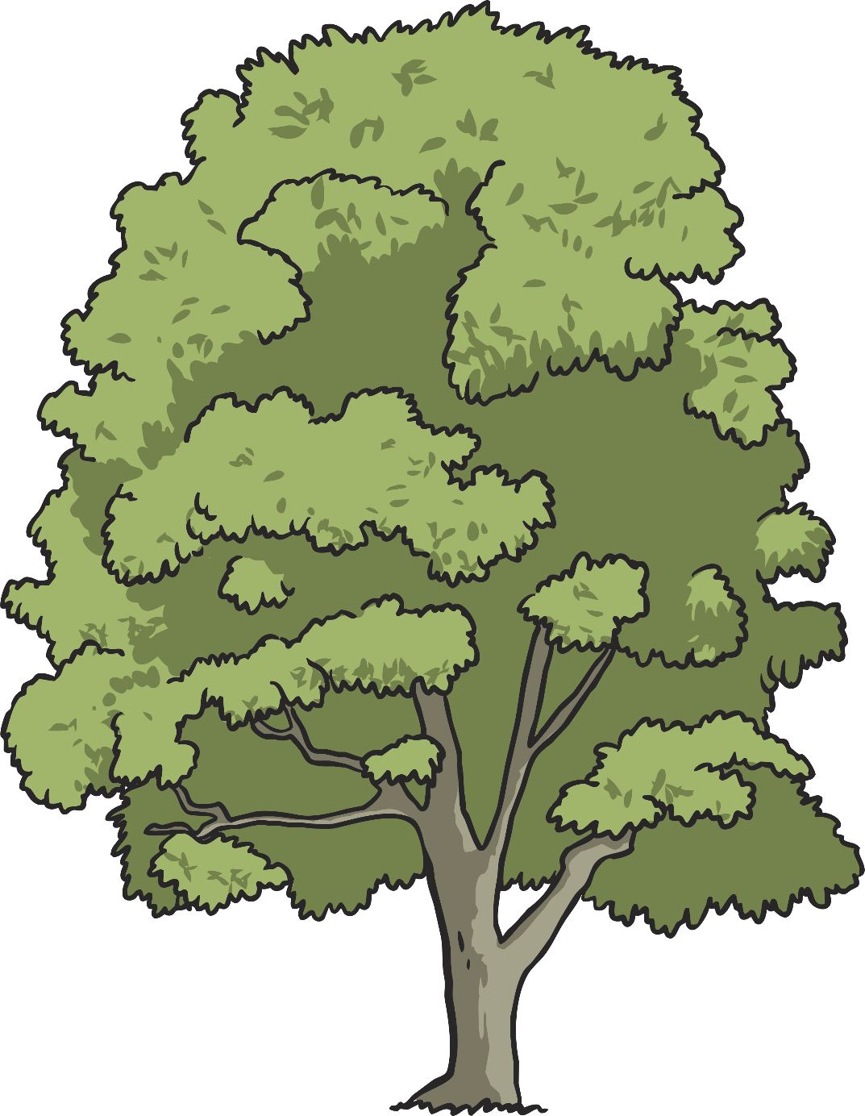
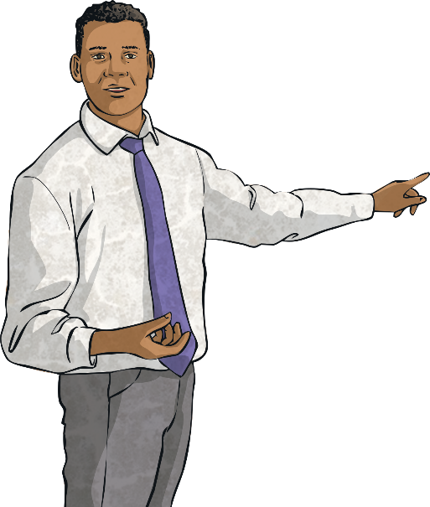
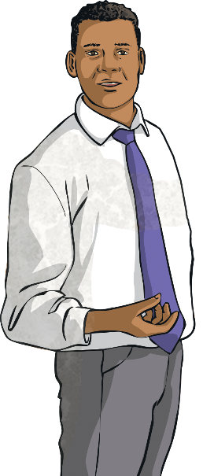
Have another look at your ‘sign’ root word spellings for this week…

Slide 7
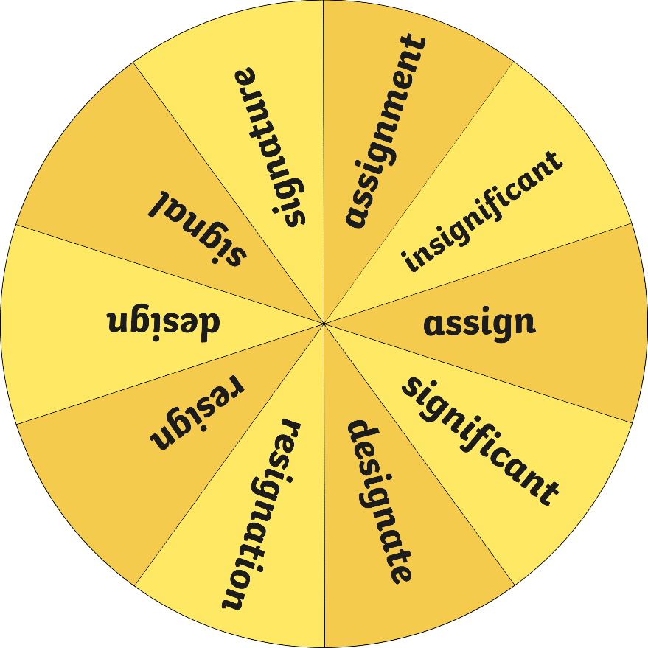
Let’s spin
the spinner!
Now, work with your partner to write a sentence that contains the ‘sign’ word on your whiteboards.
Could your sentence also contain a modal verb or adverb of possibility?
Could your sentence use ‘after’ as a subordinating conjunction?
Could your sentence begin with a fronted adverbial?
Could your sentence be written in the passive voice?
Could your sentence include some direct speech?
Spin

Slide 8

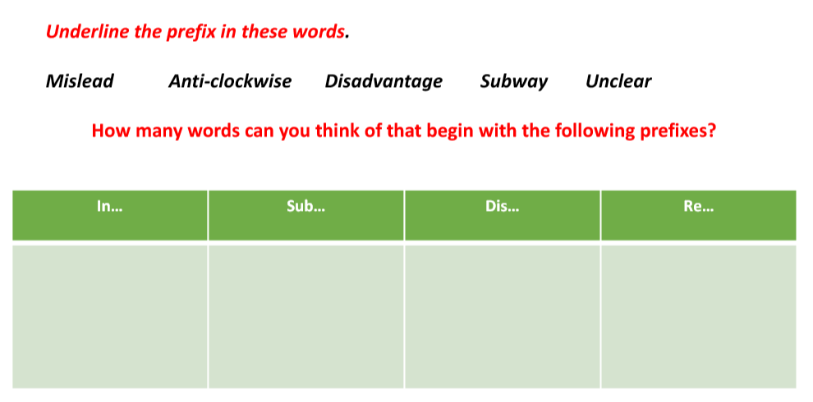
For the words in the slides above, we added prefixes and suffixes to make new words.
Remember, a prefix is added to the beginning of word and a suffix is added to the end.

Slide 9
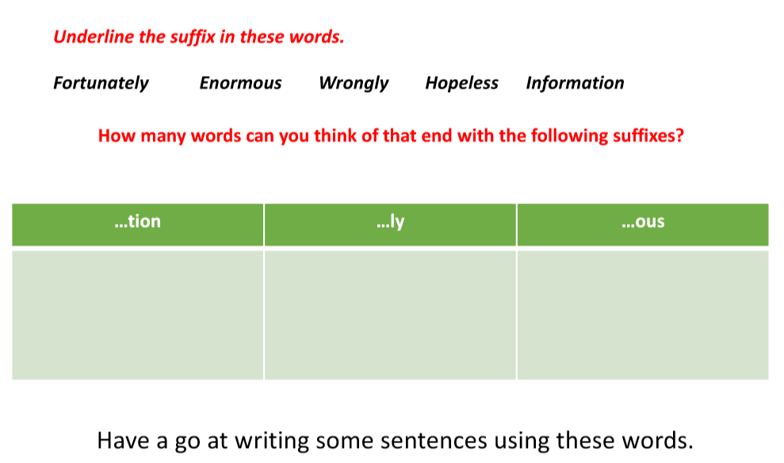

Slide 10
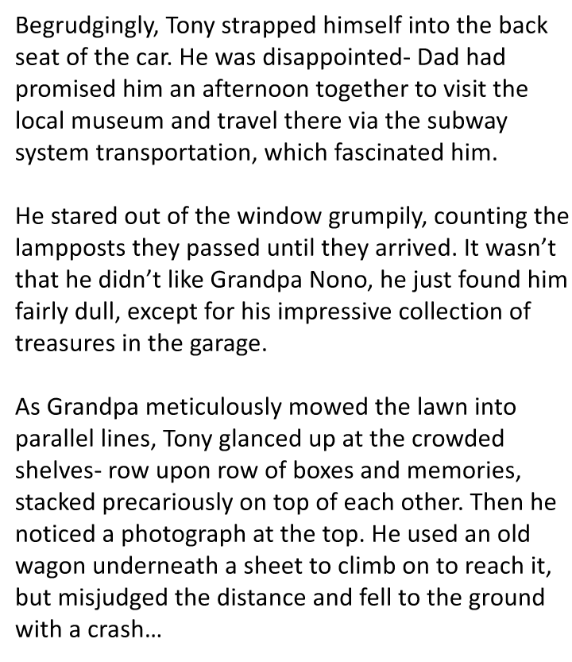
In the text, how many words with prefixes and suffixes can you spot? What is the root of each of these words? E.g. grumpily = grump

Slide 11
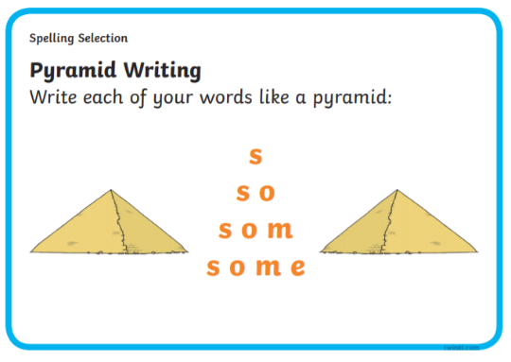
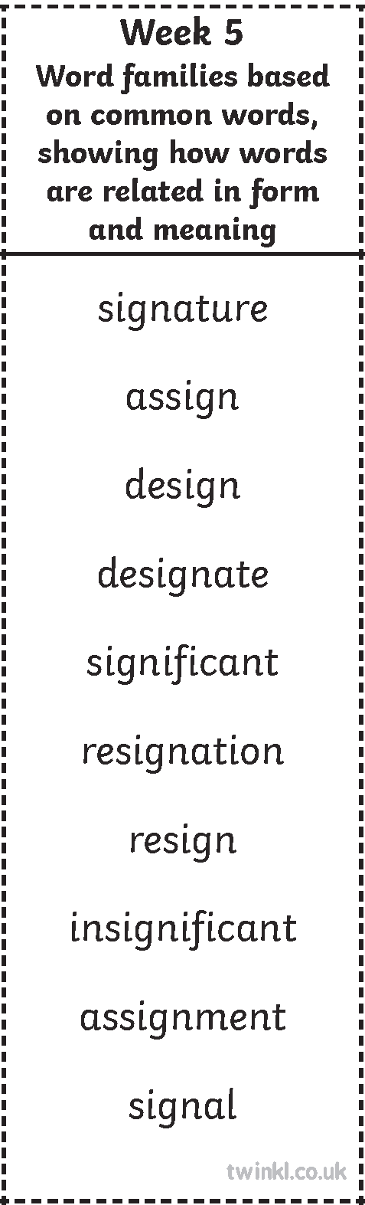
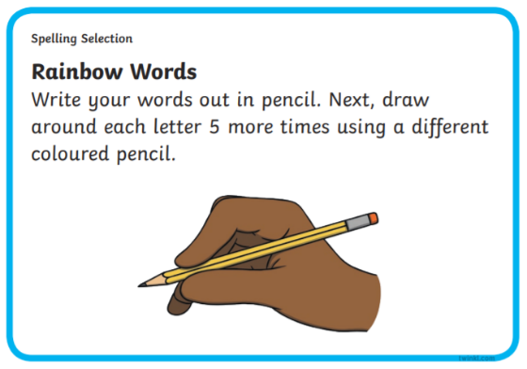
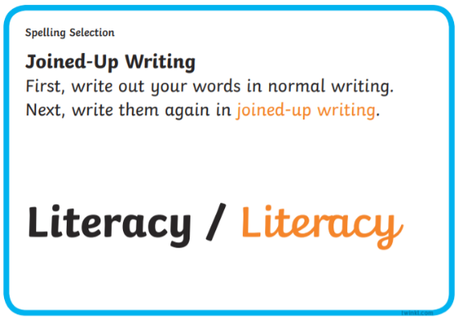
Here are your spelling words for this week.
Choose some of the spelling words opposite and practice spelling them like we do in class. Maybe put on some ‘chill out’ music whilst you do them. Use some of the techniques we use in class too.

