Slide 1
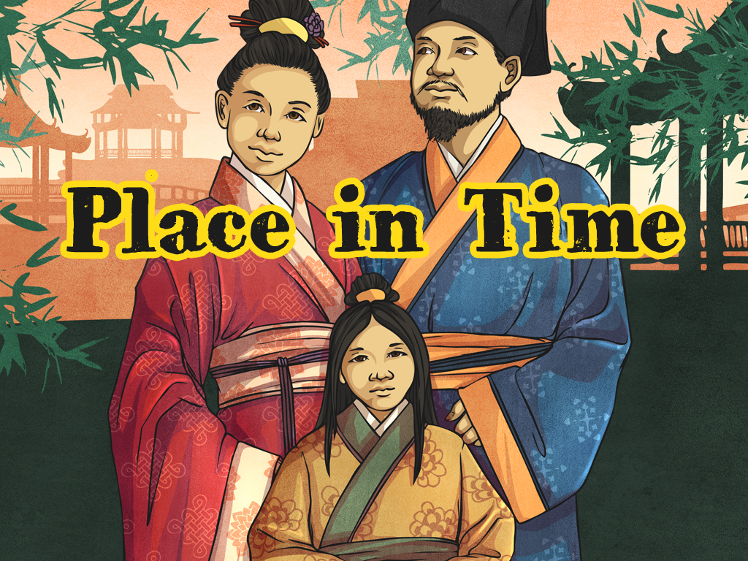


Slide 2

World History Timeline
Here are some of the other great civilisations of the world. What is special about them? Can you complete the comparison chart to show what you know?
Indus Valley
Ancient Greeks
Romans
Ancient Sumer
Anglo-Saxons
Vikings
Shang Dynasty
Ancient Egypt
4000 BC
3000 BC
2000 BC
1000 BC
0
1000 AD
2000 AD

Slide 3
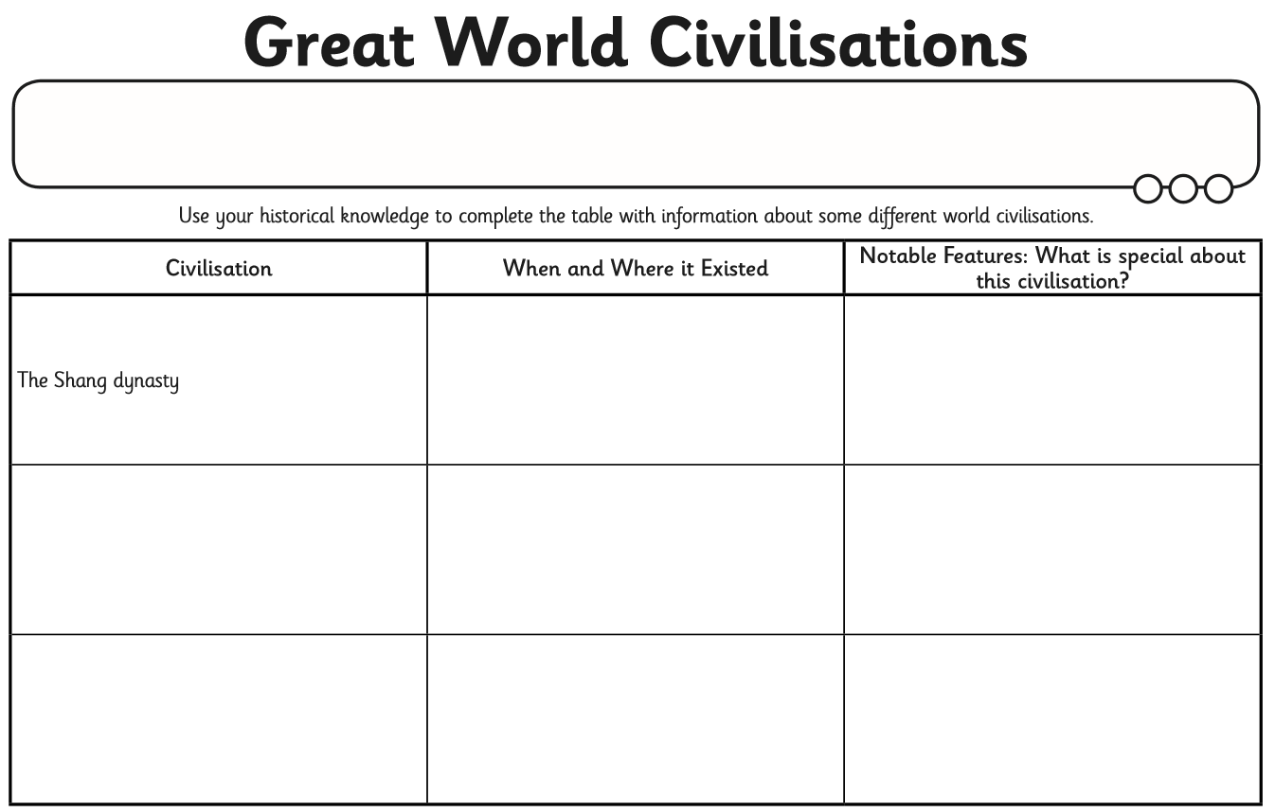
Watch the video clips below. After each one, complete the table with your favourite 3.
Ancient Sumer
Ancient Egypt
Maya civilisation
Baghdad

Slide 4
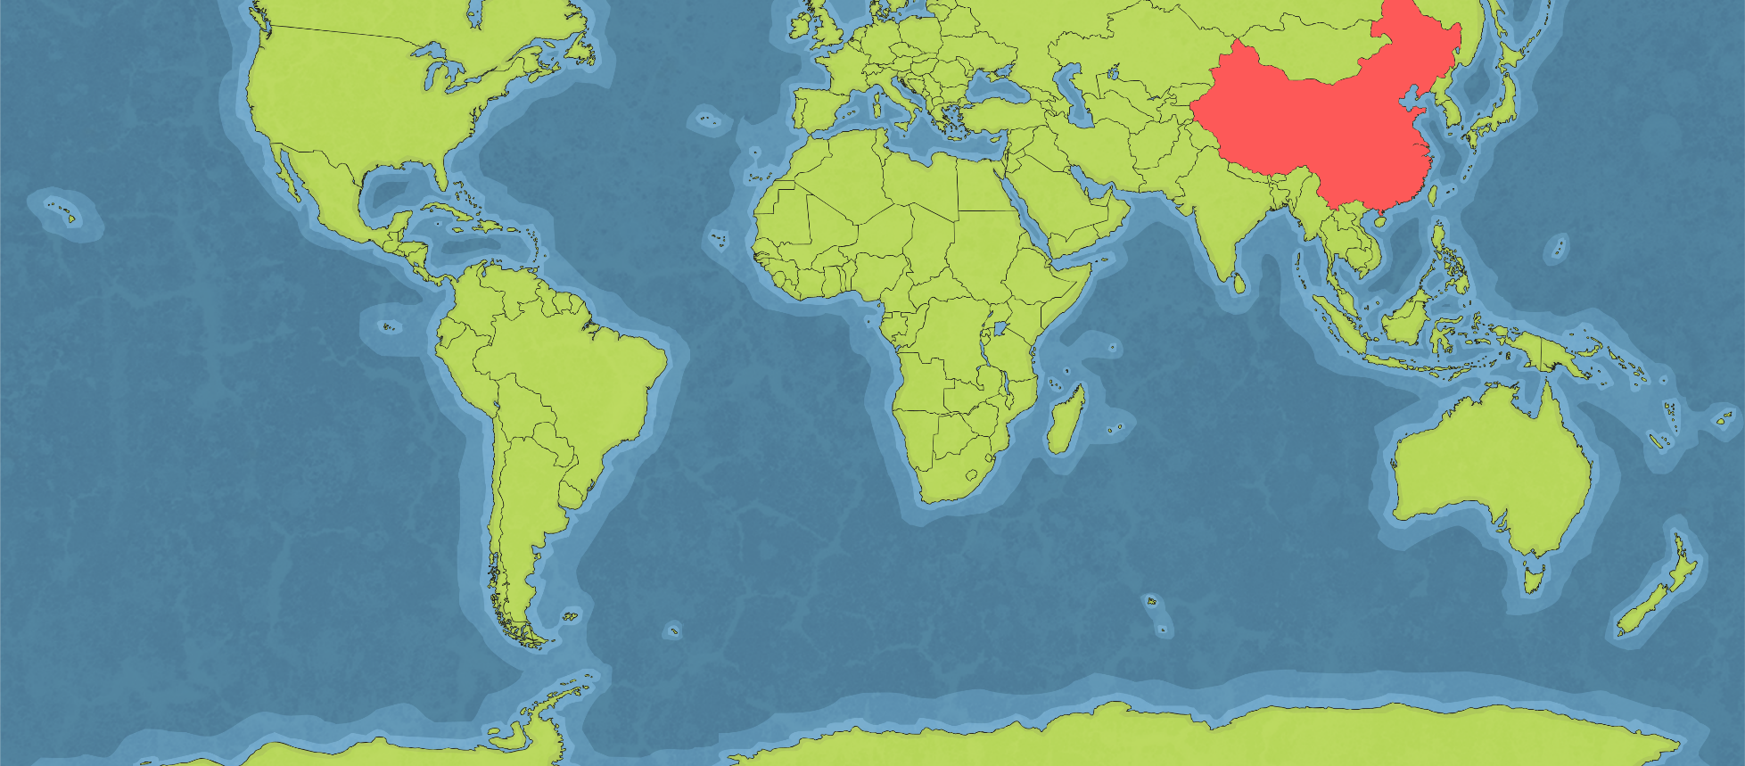

The Shang Dynasty
The Shang dynasty (ruled by the Shang family) was located in ancient China.
The civilisation lasted from around 1600 BC until 1046 BC.
Click here to learn about the Shang Dynasty
We know lots about the Shang dynasty from archaeological remains and written documents. Chinese legend says that the founder of the Shang Dynasty, Cheng Tang, overthrew the Xia dynasty to take power, but there is no definite proof of the Xia dynasty’s existence.

Slide 5

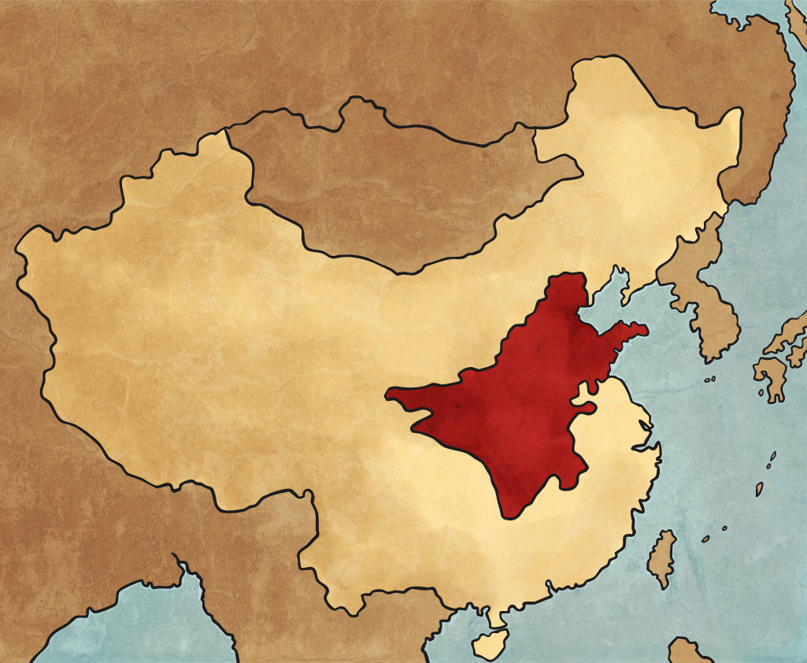
Shang Dynasty Map
Get your ‘map of China’ and mark out where the Shang dynasty (the red area below) was located on your map of China. Use the map here to help you. Then use the map on the next slide to help you find and mark on sheet, the following features:
area of Shang culture
Yellow River
Yangtze River
Himalayas
Beijing
South China Sea
Yellow Sea
The Great Wall (of China)
Names of surrounding countries (India, Mongolia, Pakistan)

Slide 6
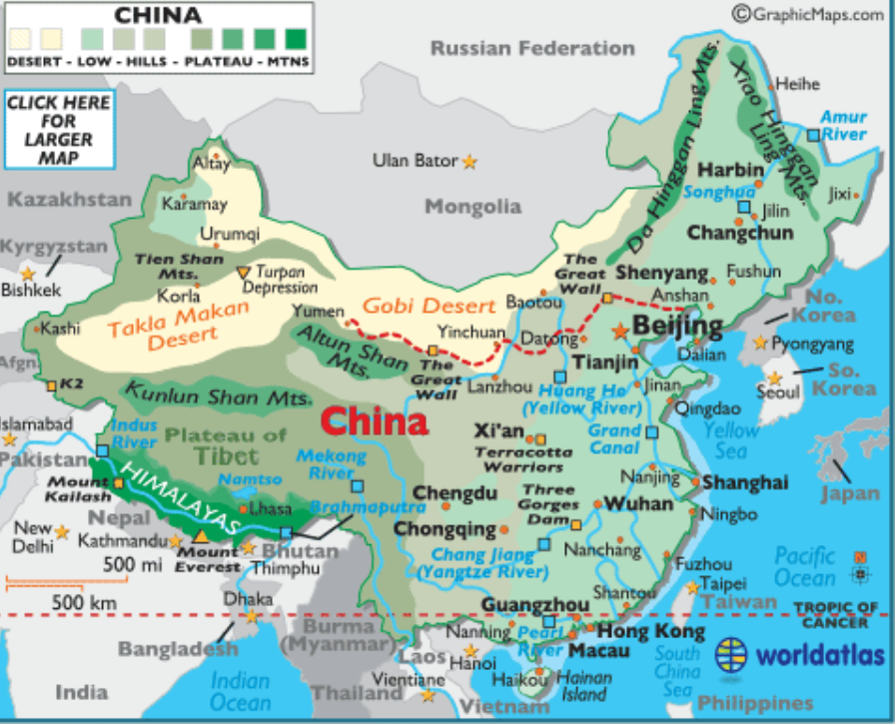

Slide 7
Use the next slide to check you’ve got the features in the correct place.

Slide 8

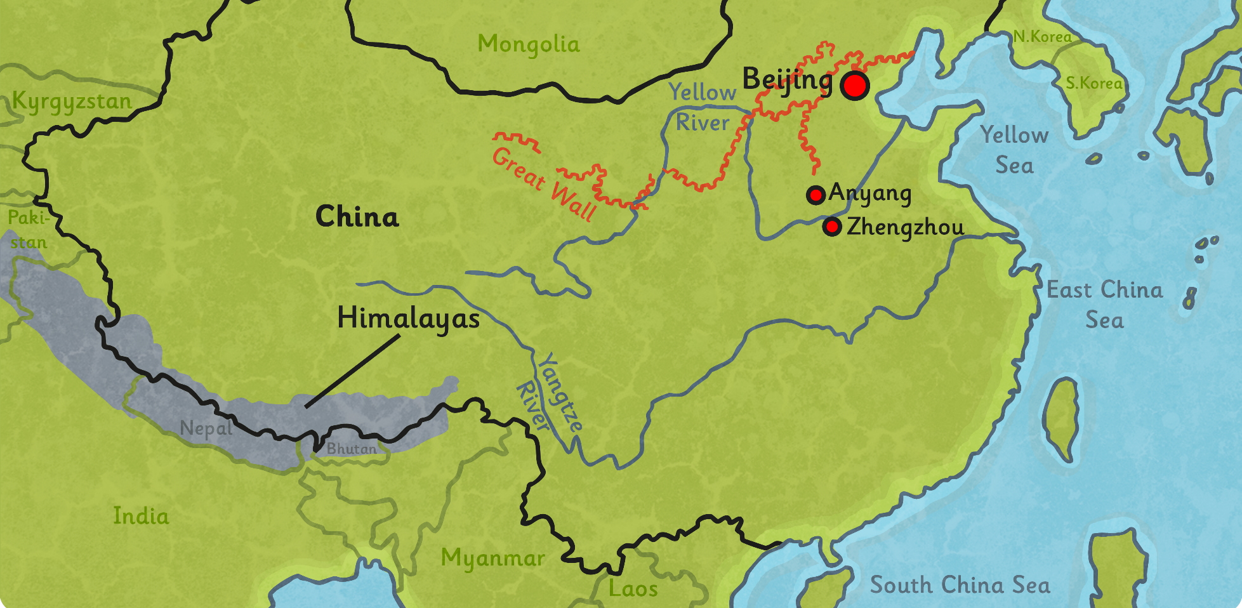
Shang Dynasty Map
Did you find all the features and label them correctly? Let’s check.

