Slide 1
Identifying and Recognising
Kenning Poems

Slide 2
Learning Objective
To recognise the features of kenning poems
Success Criteria
To know that a kenning can consist of either noun-noun phrases or
noun-verb phrases;
To understand that kennings do not name the theme of the poem;
To use the language in the poem to work out the theme;
To understand that kennings are understood best when they are read aloud.

Slide 3

What is a Kenning?
Kennings are like riddles. They describe something without ever saying what it is.
Read these phrases out loud. What could they be describing?
lip-licking
sauce-swirling
chin-dripping
cone-filling
flake-holding
tongue-freezing

Slide 4
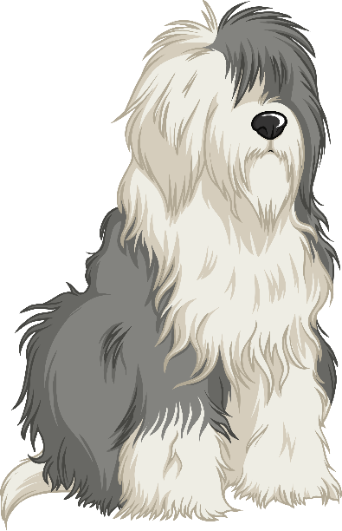
What is a Kenning?
How about these?
tail-wagger
face-licker
ball-catcher
sofa-hugger
door-scratcher
cat-chaser

Slide 5
What is a Kenning?
What did you notice about the poems?
tail-wagger
ball-catcher
door-scratcher
cat-chaser
sofa-hugger
face-licker
lip-licking
chin-dripping
flake-holding
tongue-freezing
cone-filling
sauce-swirling

Slide 6
What is a Kenning?
What did you notice about the phrases in each poems?
Each line of the poem is made of a two-word phrase.
tail-wager
ball-catcher
door-scratcher
cat-chaser
sofa-hugger
face-licker
lip-licking
chin-dripping
flake-holding
tongue-freezing
cone-filling
sauce-swirling
The words are joined by a hyphen.
Here the phrases are made up of a noun + a verb, (by adding -er to the verb)
Here the phrases are made up of a noun + a verb (the verb usually ends in -ing).

Slide 7
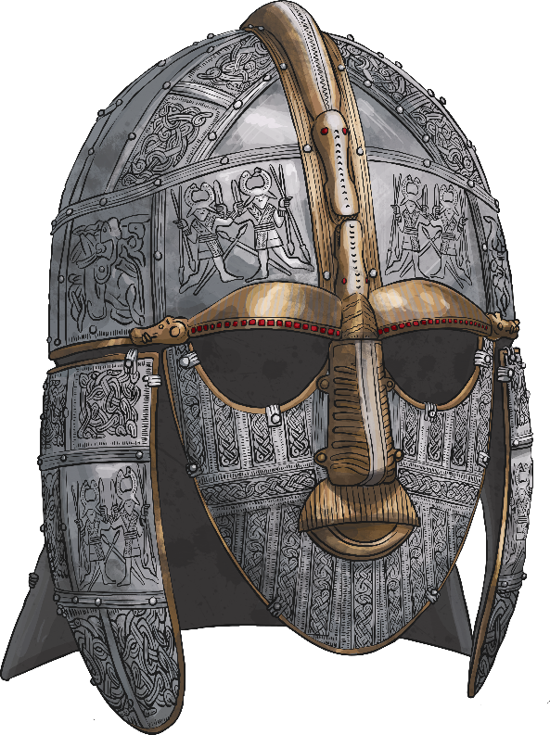
Did You Know?
The two-word format for a kenning relates to the Old Norse tradition of naming things like weapons, e.g. Skull-Splitter or Blood-Taker.
Kennings came into our language via the Anglo-Saxon and Norse cultures. These people came from what is now Scandinavia and northern Germany.
The word ‘kenning’ derives from the Old Norse word ‘kenna eitt við’, which means ‘to express a thing in terms of another’.

Slide 8
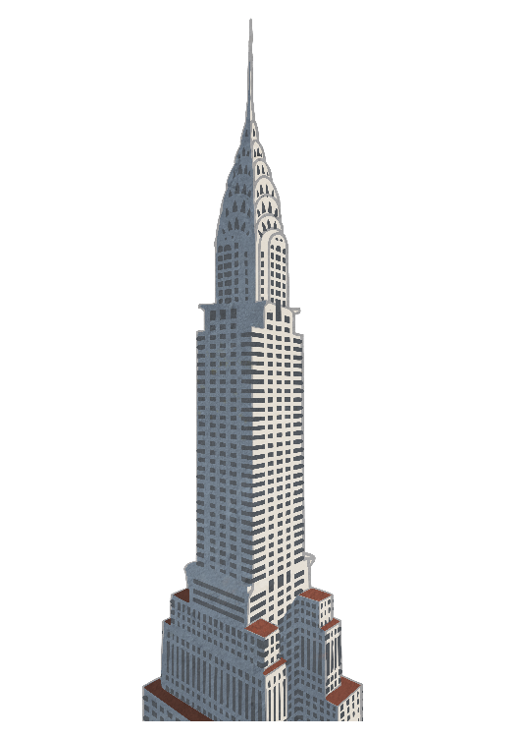
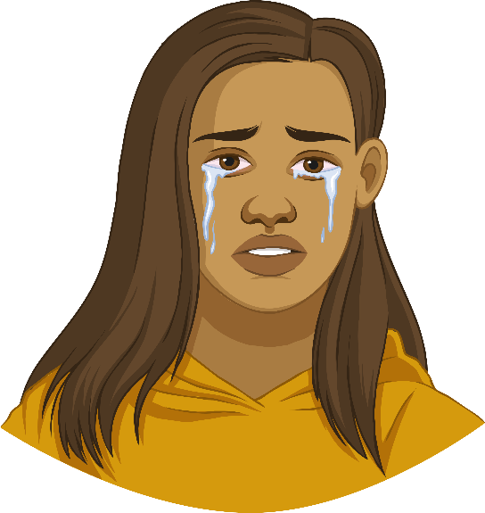
Everyday Language
How do we describe a very tall building?
A really sad film or story is often
called a...
sky-scraper
tear-jerker
Oh look – here’s some alliteration! Other poetic devices can also be found in kennings.

Slide 9
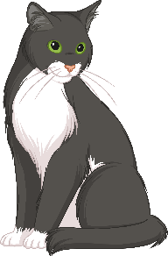
Let’s Have a Go!
How can we write a kenning?
First, we need to choose a theme. (It doesn’t have to be gory, like the Vikings!)
Cat
Then, we brainstorm lots of words or phrases associated with that theme…
mice | drinks | milk | nuzzle
stalk | sleeps a lot | fur | scratch
hunter | hates dogs | rubs ankles | purr

Slide 10
Let’s Have a Go!
To start creating your kenning, try and make a noun + noun phrase or a noun + verb phrase using your words.
nose
mice | drinks | milk | nuzzle
stalk | sleeps a lot | fur | scratch
hunter | hates dogs | rubs ankles | purr
night
lick
ear

Slide 11
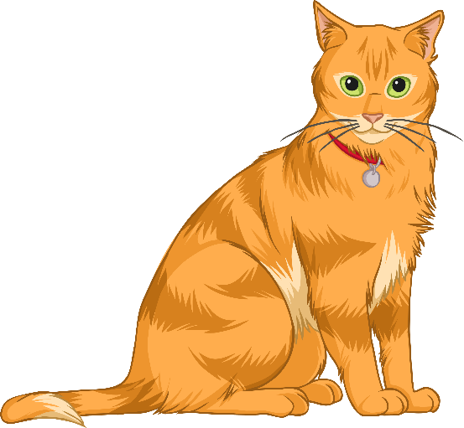
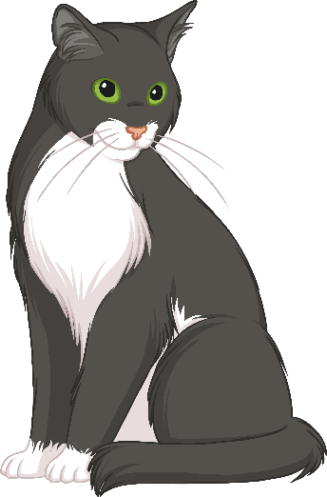
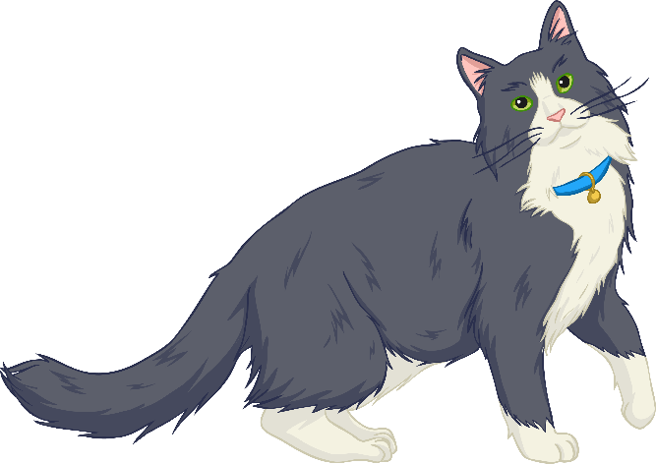
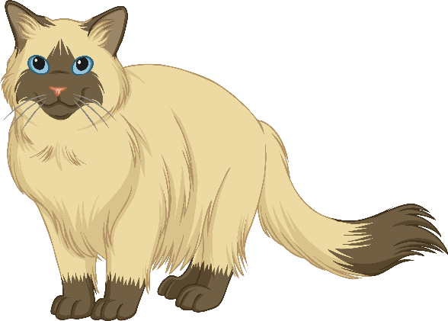
Let’s Have a Go!
Finally, put them together in your two-word phrases. Don’t forget the hyphens!
mouse-hunter
milk-drinker
night-stalker
fur-licker
ankle-rubber
dog-hater
nose-nuzzler
ear-scratcher
loud-purrer

Slide 12
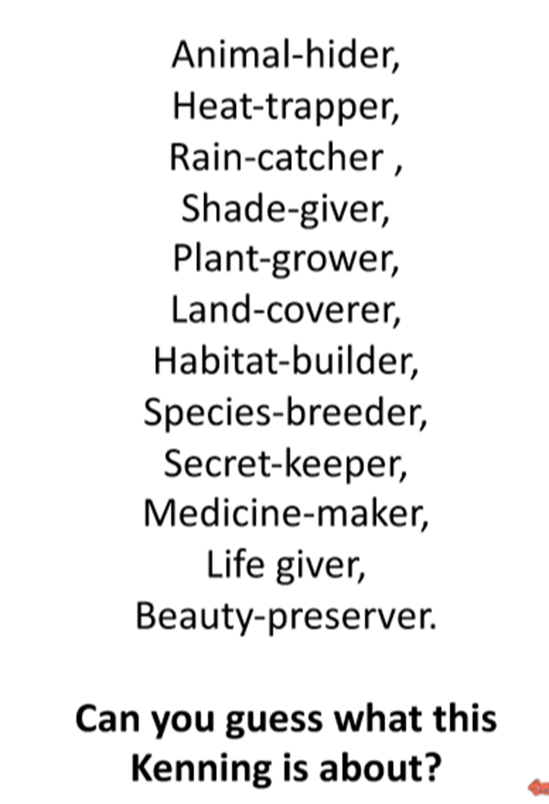
The jungle

Slide 13
Let’s Have a Go!
Now it’s your turn to write a Kenning. It must be about something from our Taking Flight video clip. You might have your own idea.
Grandpa
The boy
Monkey
aeroplane
jungle
Wagon
Space

Slide 14

Plenary
What have we learned about kennings?
Kennings are like riddles – they describe a thing but don’t tell you its name.
They usually have only two words- a noun plus a noun OR a noun plus a verb.
Poetic devices like alliteration can be used.
They’re great when you read them out loud so you can imagine the thing
being describe.

