Slide 1
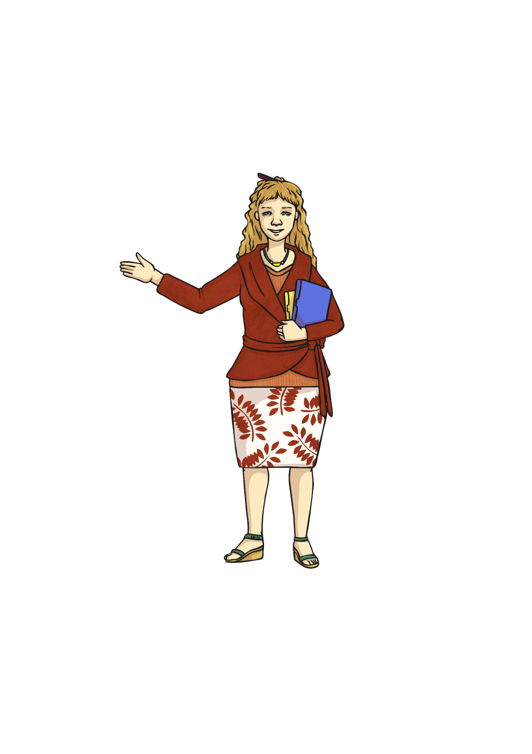
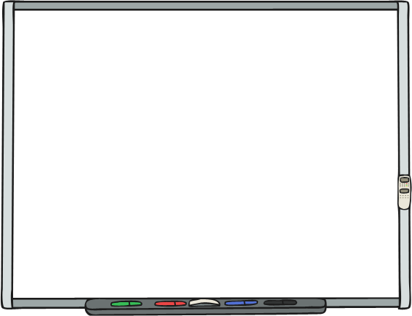
Year 6 Grammar Revision
Prepositions

Slide 2
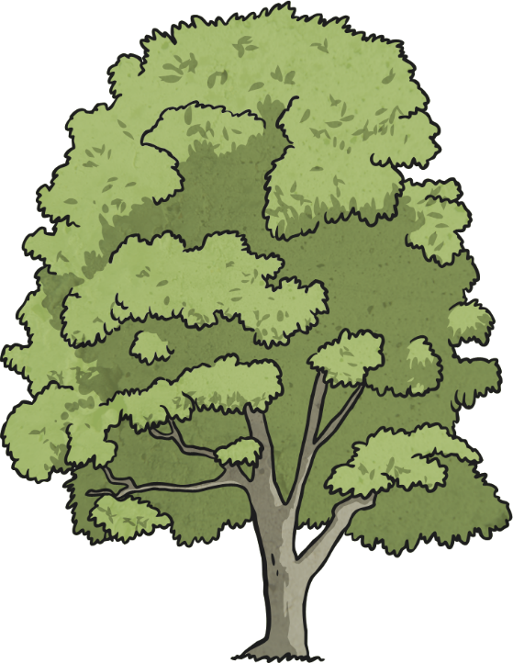
Prepositions of Location: The Rules
Prepositions are used to show the location, time or movement of nouns or pronouns.
Prepositions of location show the place or position of a noun or pronoun e.g.
The tools were inside the garden shed.
The tools were inside the garden shed.
Behind the cloud, the sun peeped.
Behind the cloud, the sun peeped.
Harry sat under the shady tree.
Harry sat under the shady tree.

Slide 3




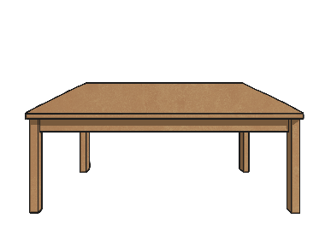

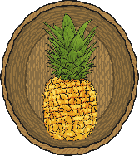


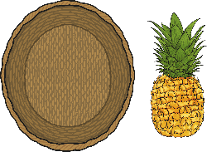
Prepositions of Location: The Rules
There are many prepositions of location. Here are a few of the most commonly used ones:
beside
in front of
near
above
inside
between
behind
far
below
outside

Slide 4
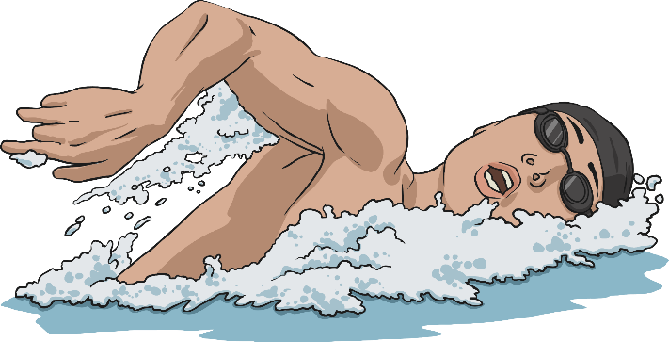
Prepositions of Time: The Rules
Some prepositions show time. The three most commonly used time prepositions are at, on and in.
At the weekend, I am going to the cinema.
At the weekend, I am going to the cinema.
I go to swimming lessons on Thursdays.
I go to swimming lessons on Thursdays.
Leaves turn brown in the Autumn.
Leaves turn brown in the Autumn.

Slide 5
Prepositions of Time: The Rules
There are many more prepositions that show and signal time...
before
since
until
by
before
during
as
past

Slide 6
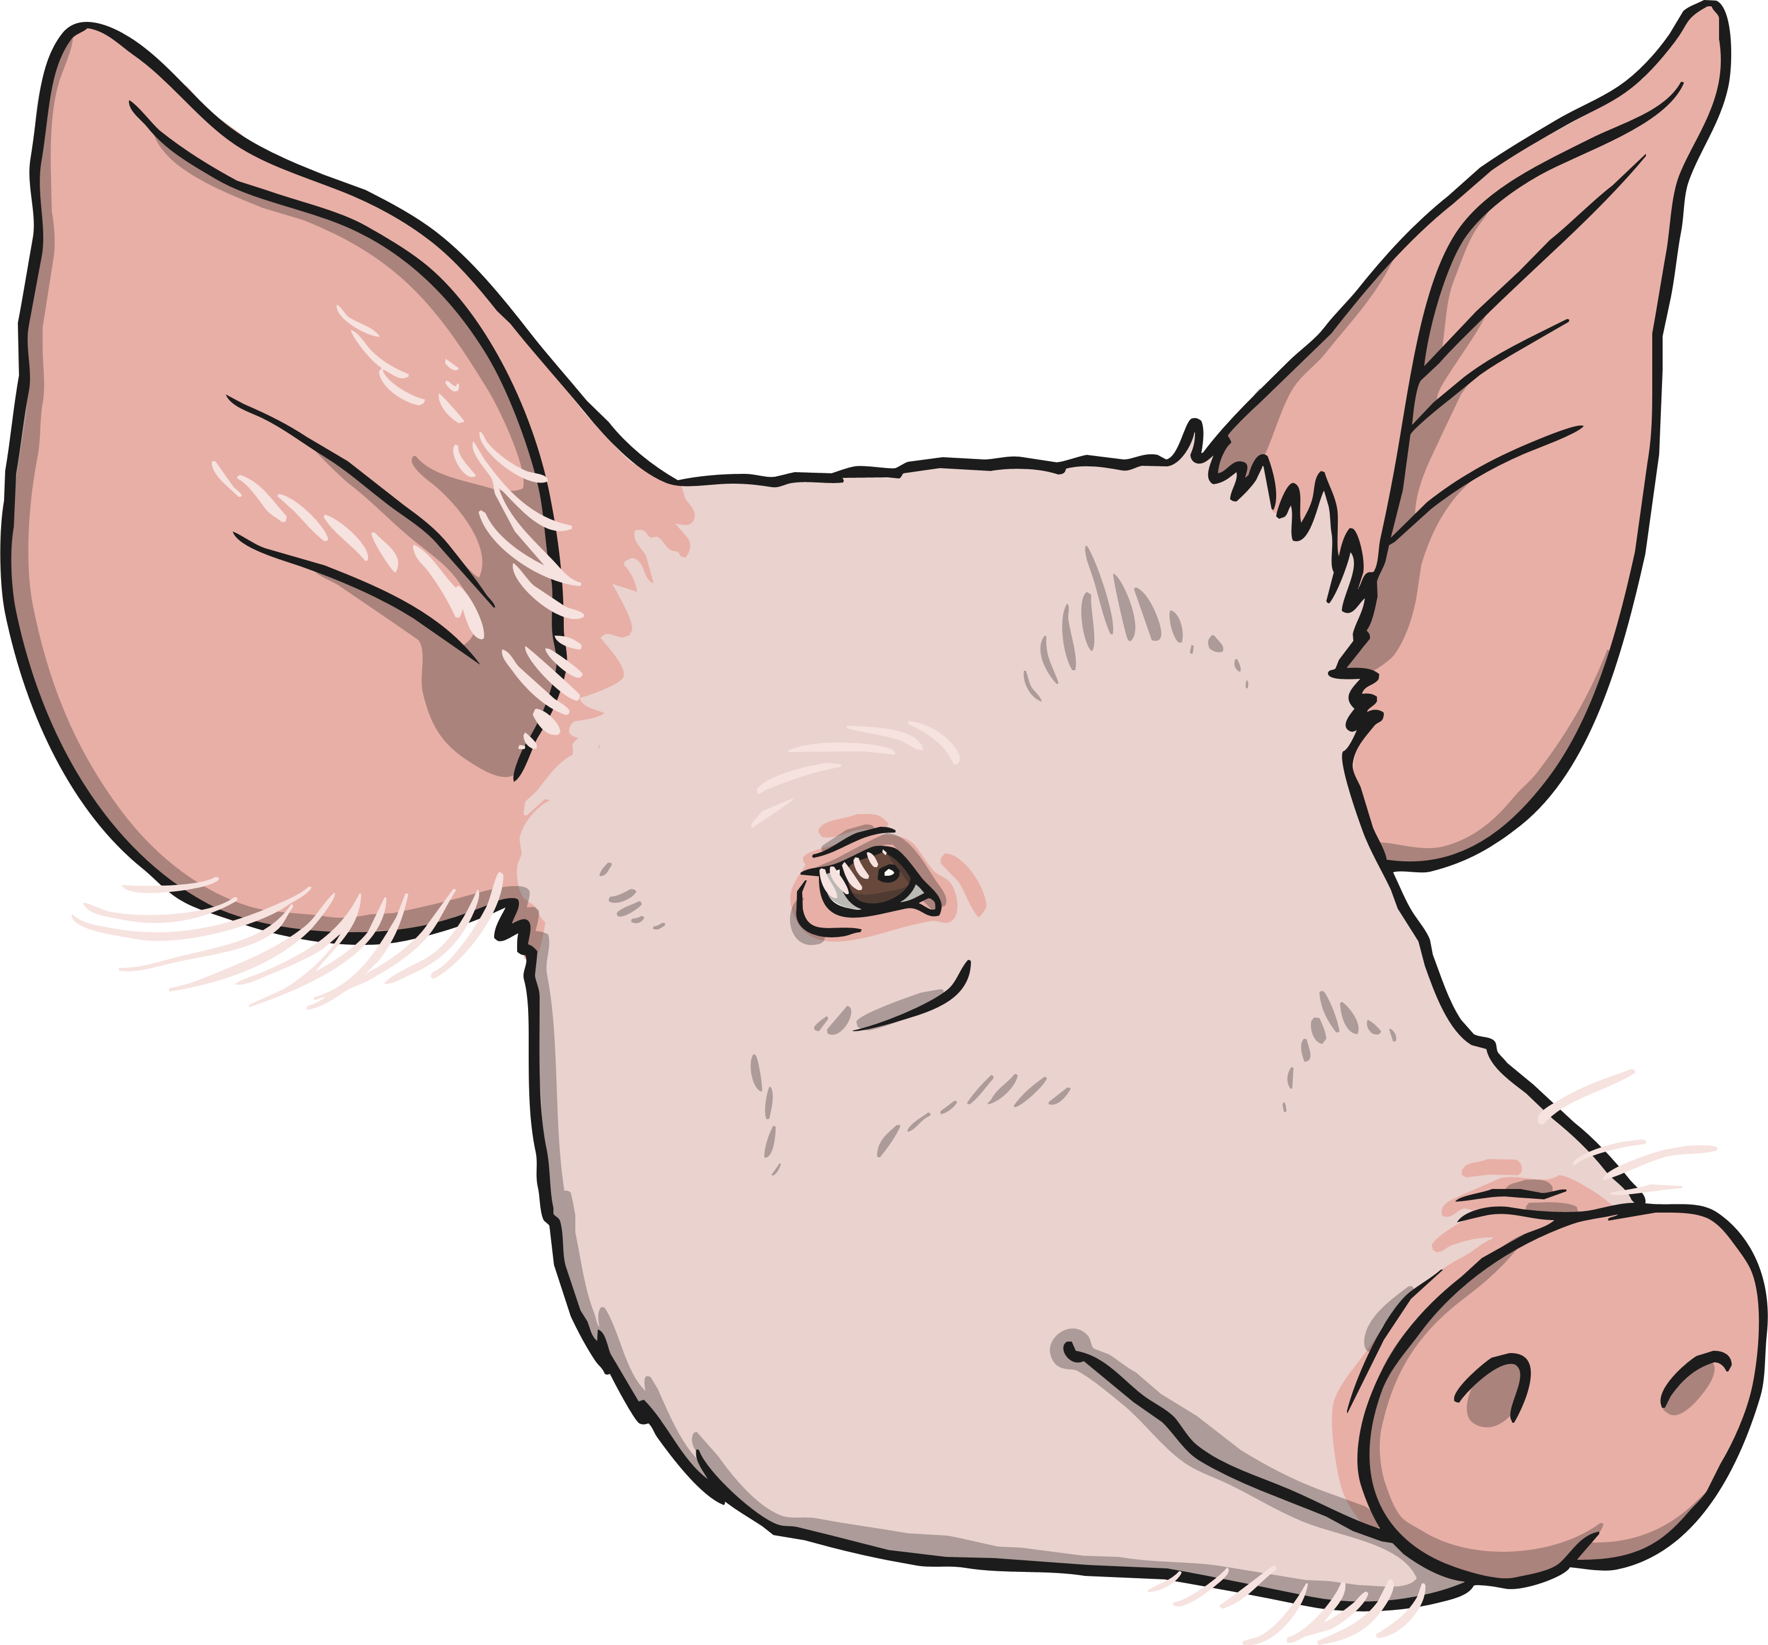
Prepositions of Movement: The Rules
Other prepositions can show movement or direction.
Yasmin zoomed down the slide.
Yasmin zoomed down the slide.
The pig jumped into the pond.
The pig jumped into the pond.
Ben reluctantly got out of bed.
Ben reluctantly got out of bed.

Slide 7
Prepositions of Cause: The Rules
Other prepositions can tell us about how something is caused by something else.
Due to the loud noise, Joy covered her ears.
The match was cancelled because of the weather.
Kyle was admitted to hospital as a result of his blood test results.

Slide 8
Prepositions: The Tricky Bits
Some prepositions can also be subordinating conjunctions.
after
before
until
as
since
Since she won the contest, Vicky had become famous.
In this example ‘since’ is used as a subordinating conjunction to form a subordinate clause.
I haven’t had a shower since Tuesday.
In this example ‘since’ is used as a preposition.
This can be very confusing! If the word is used within a clause that contains a subject and a verb, then it is usually being used as a subordinating conjunction.

Slide 9

Quiz! Part 1
Underline the prepositions in the following sentences.
The children giggled through the puppet show.
Under the bridge, the troll hid and waited.
Linda felt dizzy because of the heat.
The ramblers climbed over the fence.
Gina lives next to the fruit shop.
?

Slide 10

Quiz! Part 2
Tick all the sentences that contain a preposition.
We played football in the garden.
Before lunch, Class 11 had PE.
Frosty the Snowman had a carrot nose.
I’ve been working at the restaurant for a month.

Slide 11
Quiz! Part 3
Put a tick in each row to show whether after is being used as a preposition or a subordinating conjunction.
 | Preposition | Subordinating Conjunction
After Brian left the band, he decided to go solo.
Baby giraffes begin to walk shortly after birth.
I will start at a new school after the holidays.

