Slide 1
Death Valley

Slide 2
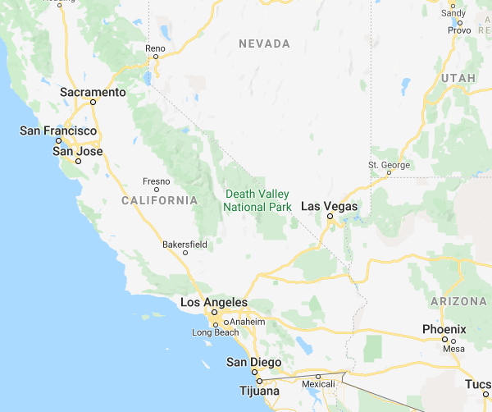
What is Death Valley?
Death Valley is a very lowly populated desert positioned in California, USA. In some places it can be very dangerous. Beware!!!
Here is a map showing where Death Valley is

Slide 3
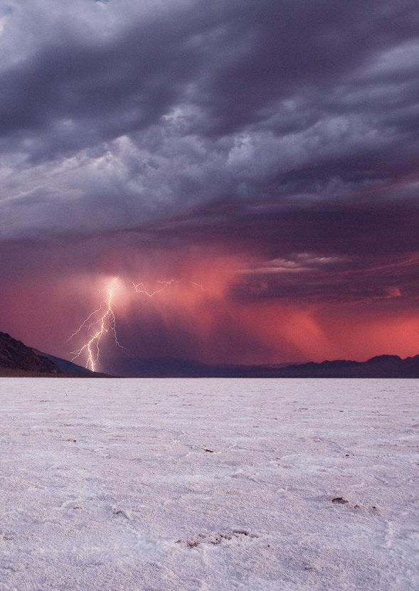
Weather
Weather in Death Valley is from one extreme to the other. blistering heat to ferocious floods and vicious sandstorms, Death Valley has it all! In Death Valley, it hardly rains but when it does, the water comes down in huge quantities for long periods of time. As a result of this, the water flows rapidly through the canyons and valleys building up streams that pick up gravel and stones. When all the rock flows in the river, the surge of water smashes them into the scenery, eroding away the valley and changing it’s shape.

Slide 4
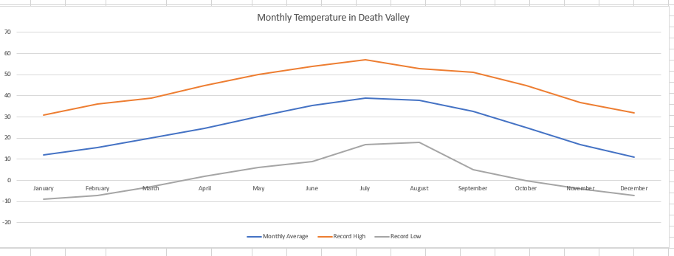
Weather
Temperature
(All Temperatures are in degrees Celsius).

Slide 5
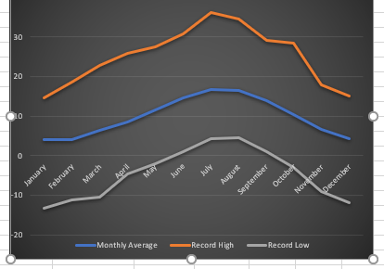
Nottingham
Nottingham is 75km² in area, has a population of 320,000 people and has a highest temperature ever recorded of36.1˚C. These are just some of the endless amount of facts about Nottingham but these few help to compare it to Death Valley
This graph shows the temperature of Nottingham throughout the year.

Slide 6
Death Valley Compared to Nottingham
Death Valley is completely different to Nottingham for many reasons. When you compare the stats you can tell that they are in very different places in the world.
Time zone
Area (km²)
Population
Highest temperature
Lowest Temperature
Continent
Nottingham
GMT
75km²
320,000
36.1˚C
-13.13
Europe
Death Valley
GMT-8
7,800km²
320
57˚C
-9˚C
North America

Slide 7
Quiz Time
For each question, click on the answer that you think is correct. Good luck!!!

Slide 8
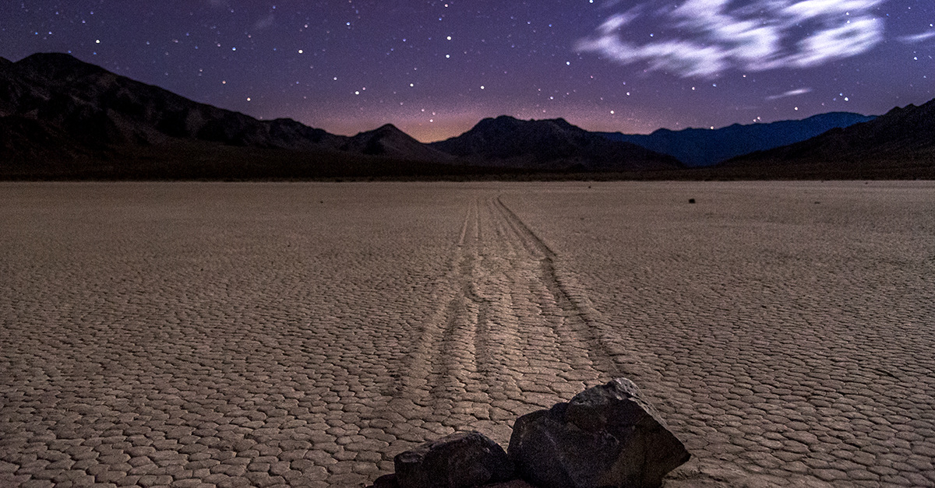
Question 1
Death Valley’s hottest temperature ever recorded is 57˚C.
OR
TRUE
FALSE

Slide 9
Congrats!!!
You got it right! Time for the next question!
Next
Question

Slide 10
OH NO!
Sorry, but that was the wrong answer. It is True. Death Valley’s highest temperature ever recorded is 57˚C!
Next Question

Slide 11
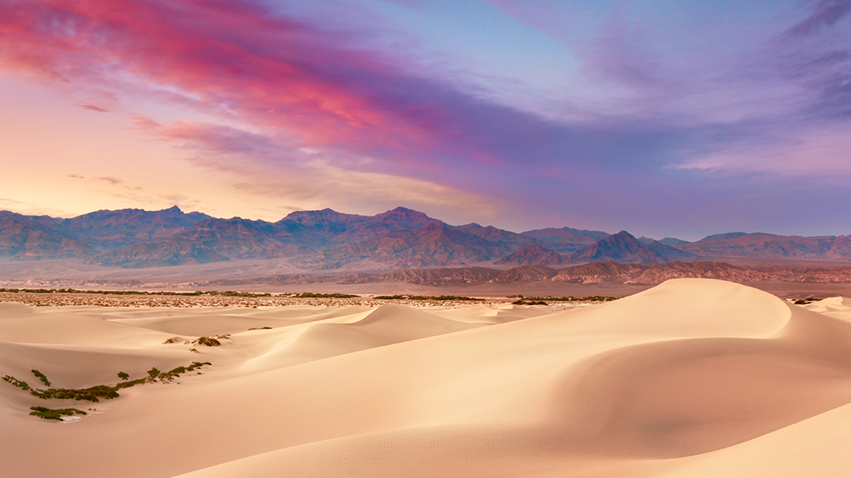
Question 2
What is the population of Death Valley? Is it:
OR
230
320

Slide 12
Congratulations!!!
That’s the right answer! well done!
Next Question

Slide 13
really!!!
OH NO! that was the wrong answer! Have a go at the next one.
Next Question

Slide 14
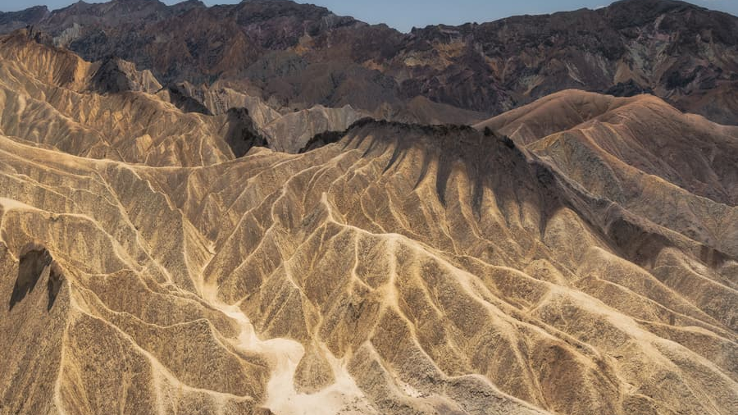
Question 3
What state is Death Valley in? Is it:
OR
California
Nevada

Slide 15
woohoo!!!
You got this one right!!!
Next Question

Slide 16
Woops!!!
Wrong answer! Try the next question.
Next Question

Slide 17
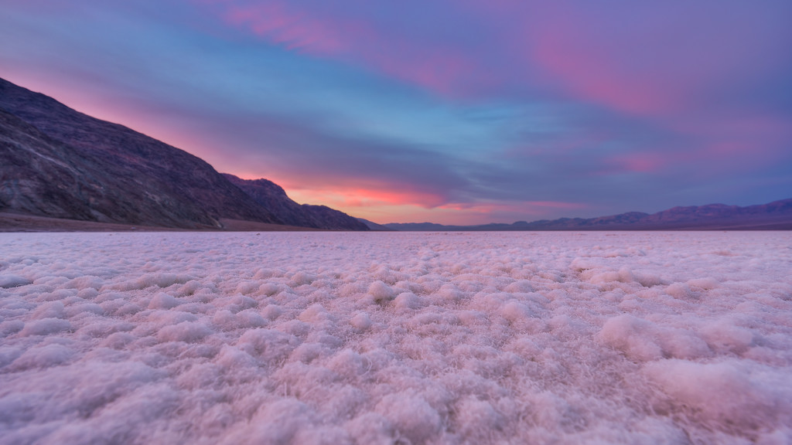
Question 4
Death Valley is 75km²
OR
True
False

Slide 18
YES!!!
Well Done!!! You chose the right one!
Next Question

Slide 19
Nooooooooo!!!
Sorry, you chose the wrong answer!
Next Question

Slide 20
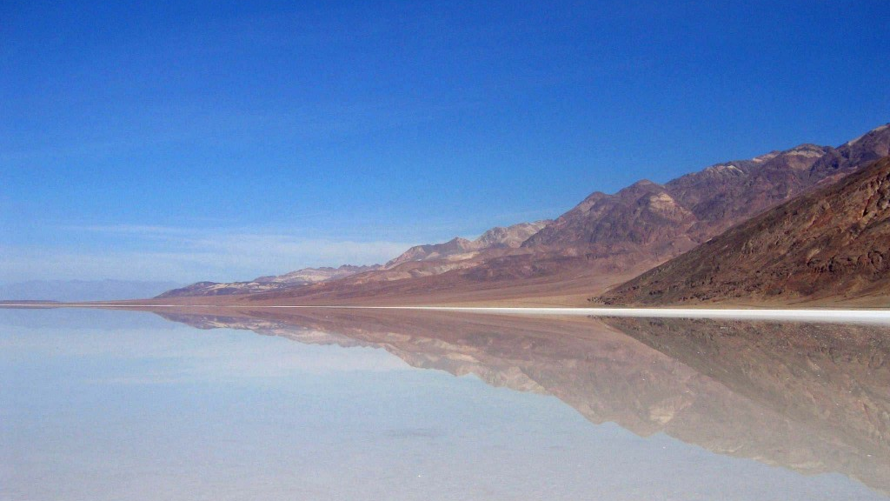
Question 5
What time zone is Death Valley in? Is it:
OR
GMT+8
GMT-8

Slide 21
Congrats!!!
Correct!! You clicked the right one!
Next

Slide 22
Come on!!!
You chose the incorrect one! That’s a shame!
Next

Slide 23
Thankyou!!!
Thankyou for reading my presentation I hope you enjoyed!!!
Theo

