Slide 1
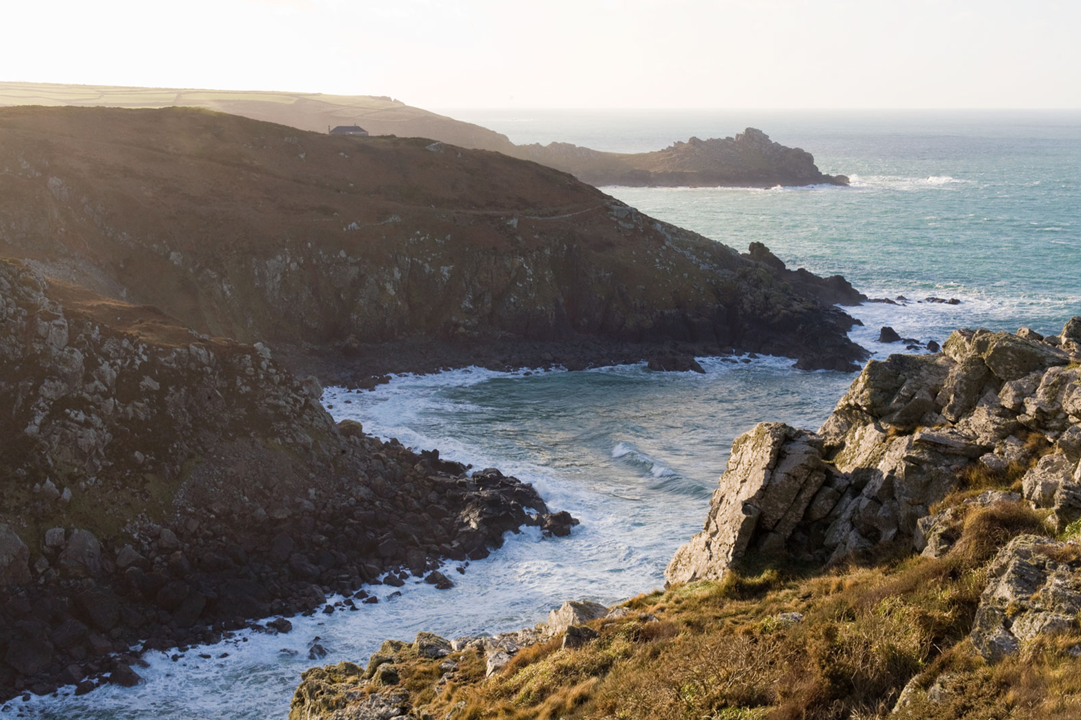
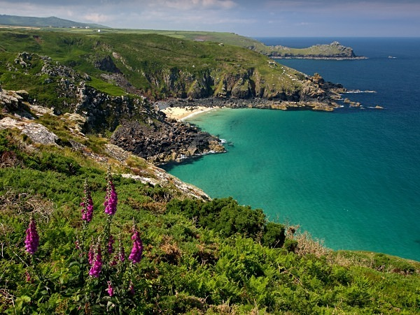
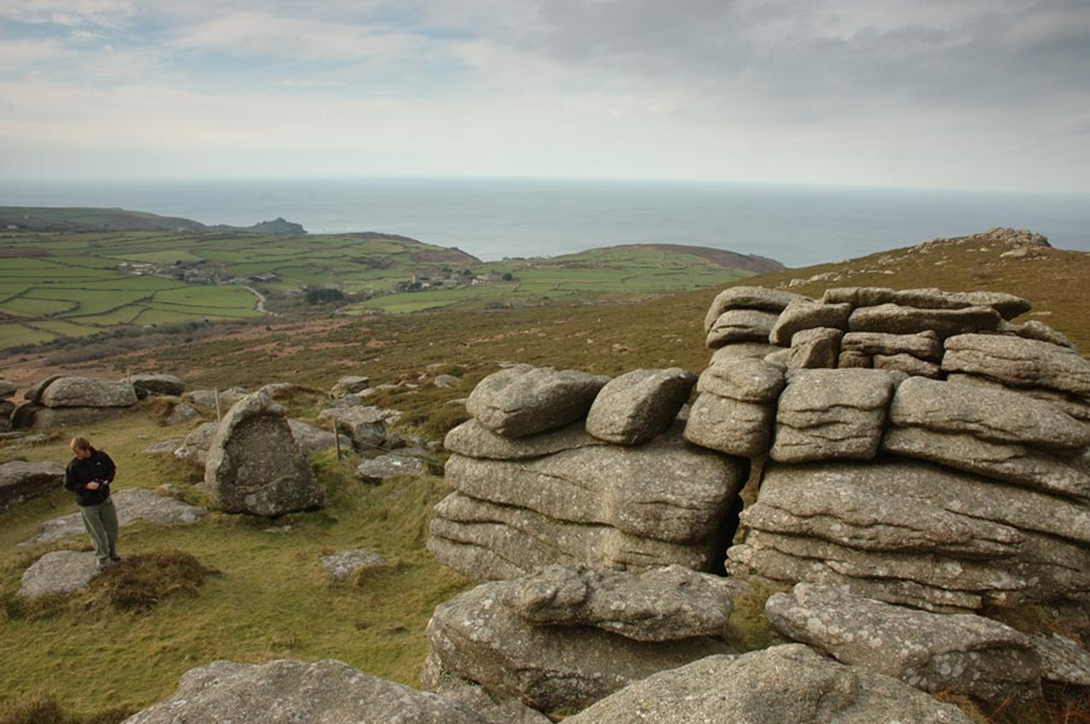
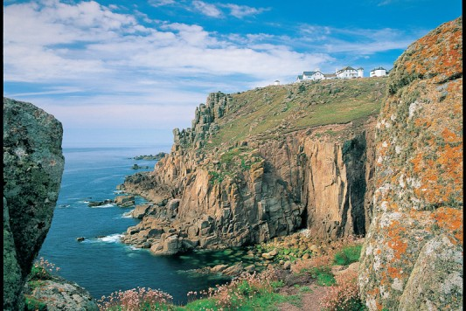
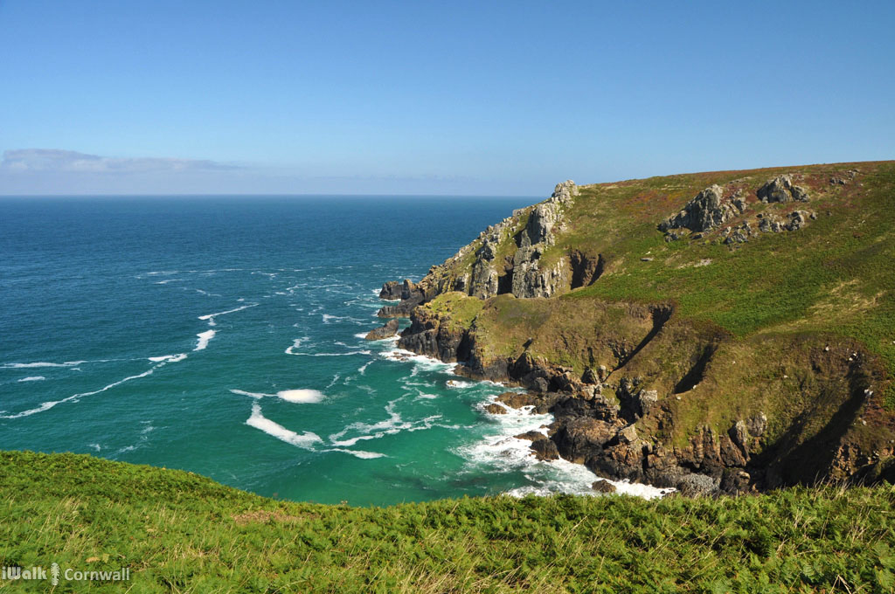
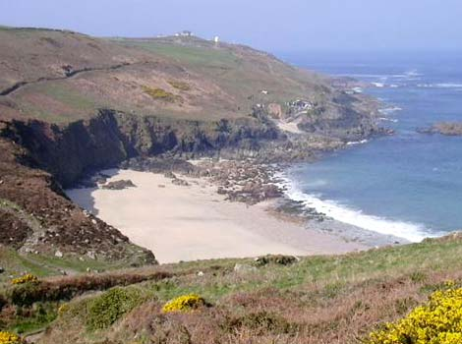
Lesson 6

Slide 2
Looking at evidence from the text.
Today we’re again going to focus on particular parts of the text from what you have read today.
Task One
On the next slide there is a paragraph taken form today’s reading. Try and find the one word that fits.
Task Two
We now have two new characters in our story…but what’s different about them. On slide 4 - 6 you have been given part of today’s text. Find evidence from the text about these men. How has the author made them seem a bit different/unusual?

Slide 3
There was no doubt as to which way she should turn, for one way the tunnel was black, and the other way was lighted with candles that lined the lode wall as far as she could see. She called out, ‘Anyone there? Anyone there?’ She paused to listen for the reply; but all she could hear now was the muffled roar of the sea and the continuous echoing of dripping water.
Find and copy one word that means never-ending.
Find and copy one word that means not loud.
Find and copy one word that means waited.

