Slide 1
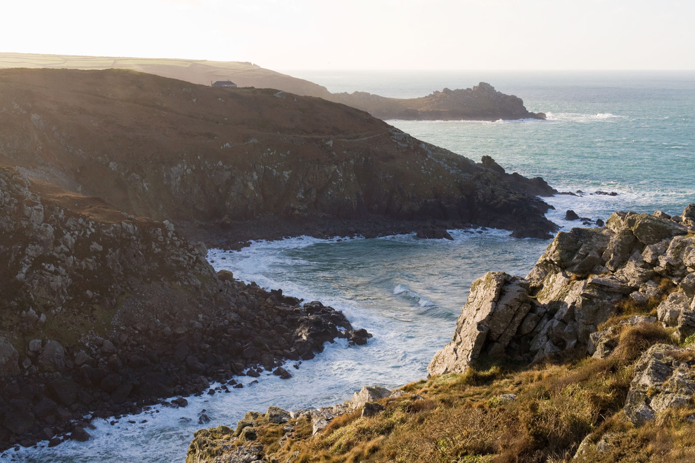
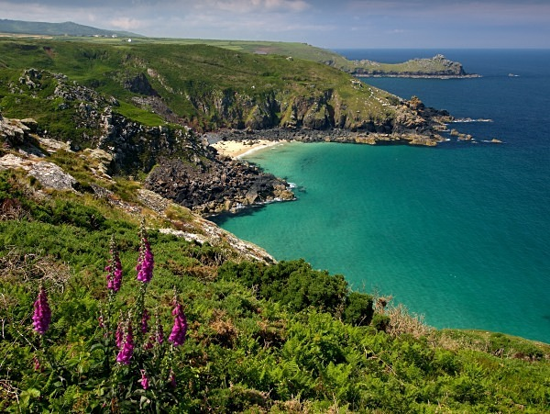
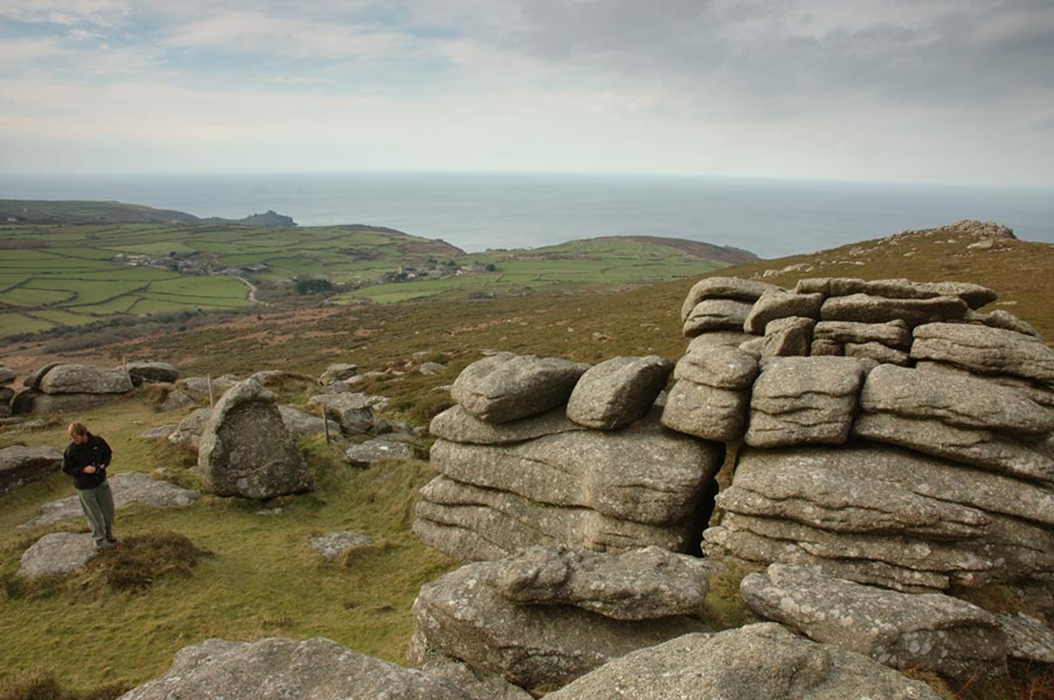
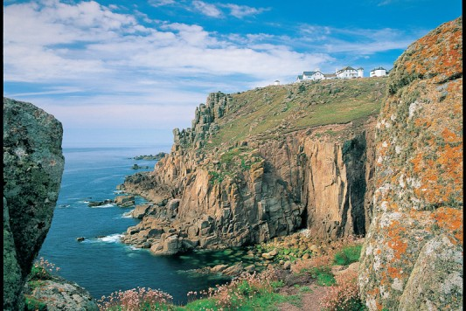
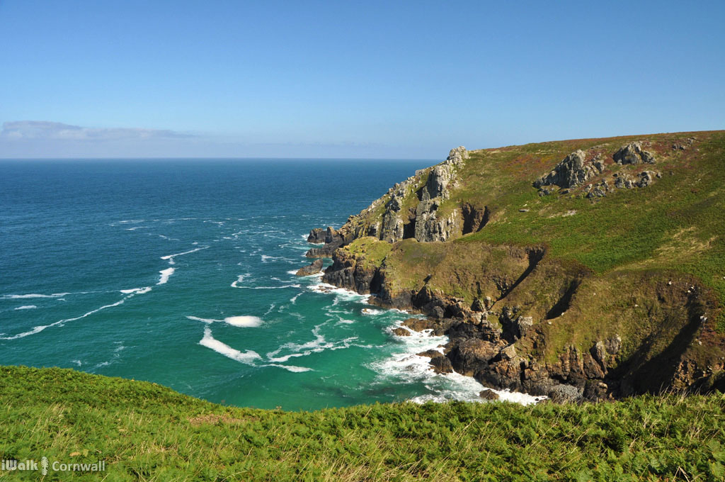
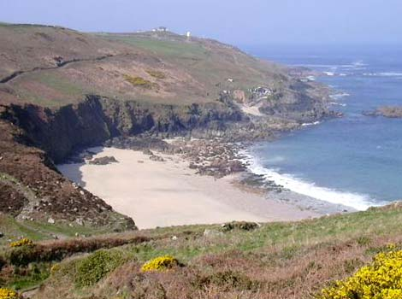
Lesson 7

Slide 2
‘Closed, closed indeed, does it look closed to you? D’you think we’re digging for worms? Over four thousand tons of tin last year and nine thousand of copper ore, and you ask is the mine closed? Over twenty fathoms below the sea this mine goes. We’ll dig right out under the ocean, halfway to ’Merica afore we close down this mine.’
He spoke passionately now, almost angrily, so that Cherry felt she had offended him.
‘Hush, Father,’ said the young man taking off his jacket and wrapping it round Cherry’s shoulders. ‘She doesn’t want to hear all about that. She’s cold and wet.
How are the father and son different from each other? What evidence do you have in this extract?

Slide 3
What is meant by the following phrases:
‘in denial’
‘burying ones head in the sand’
Why are they appropriate to describe the old miner?

Slide 4
What is meant by the following phrases:
‘a realist’
‘down to earth’
Why are they appropriate to describe the young miner?

Slide 5
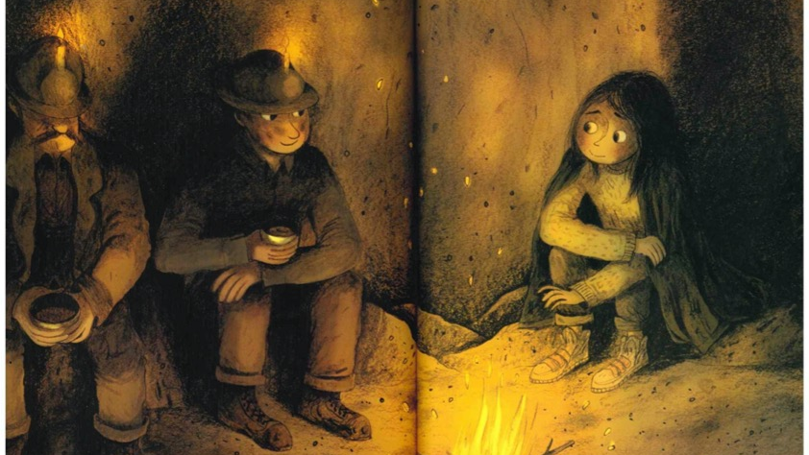
Choose either the old or the young miner.
Write an account of Cherry’s visit from their point of view reflecting their outlook on life.

