Slide 1

Art used in religion
Have a look at the following images of art found to show faith/spirituality.
What do you think?
Do you have a favourite?
What sort of images are pictured?
What are they made from?

Slide 2
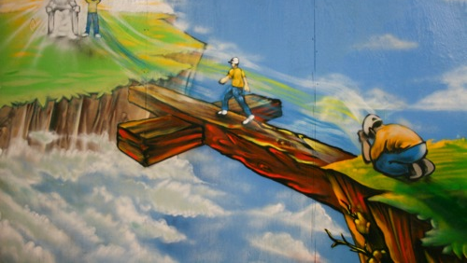

Slide 3
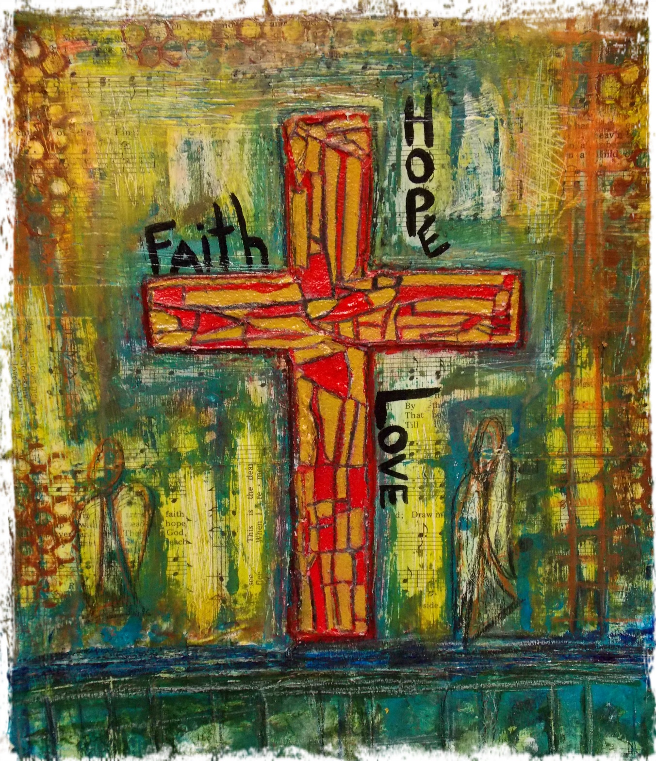

Slide 4
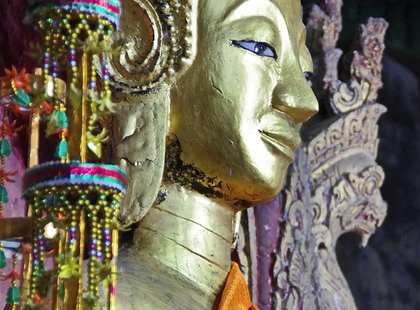

Slide 5
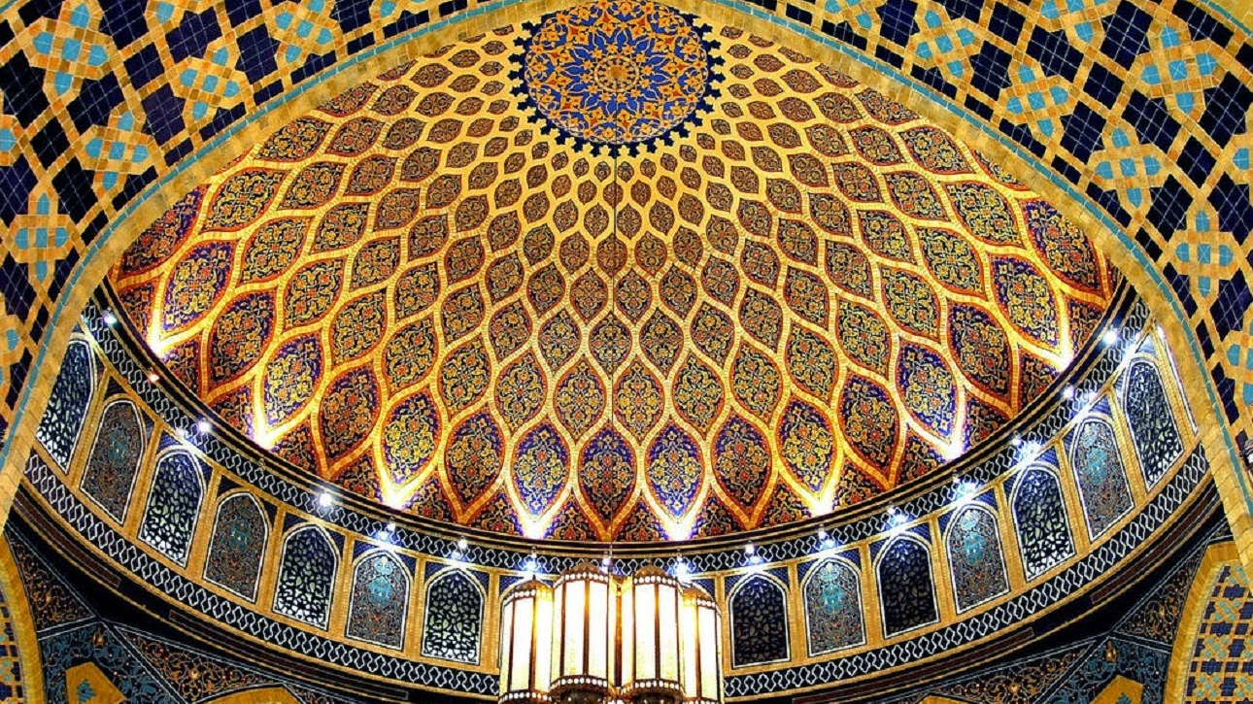

Slide 6
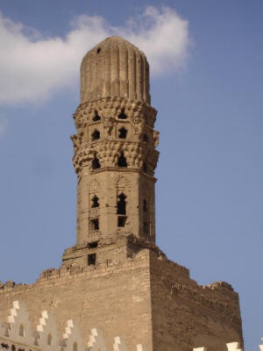

Slide 7
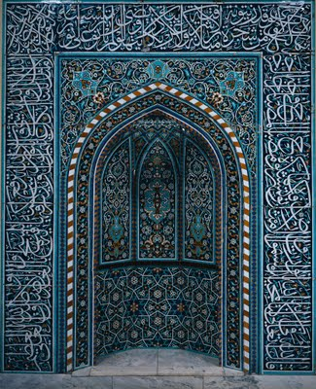

Slide 8
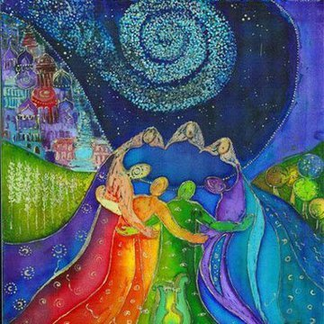

Slide 9
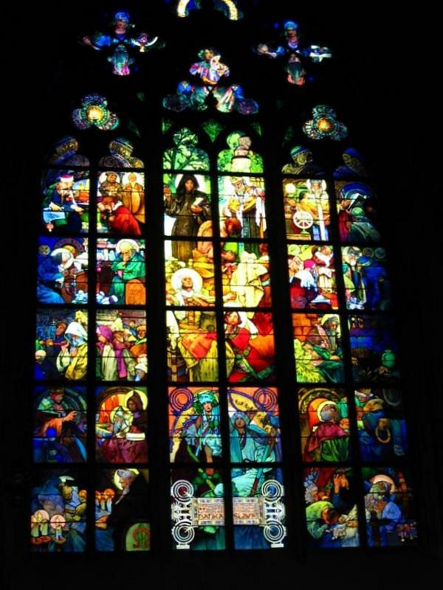

Slide 10
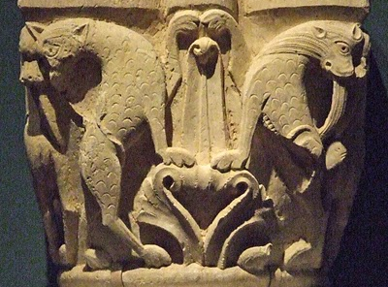

Slide 11
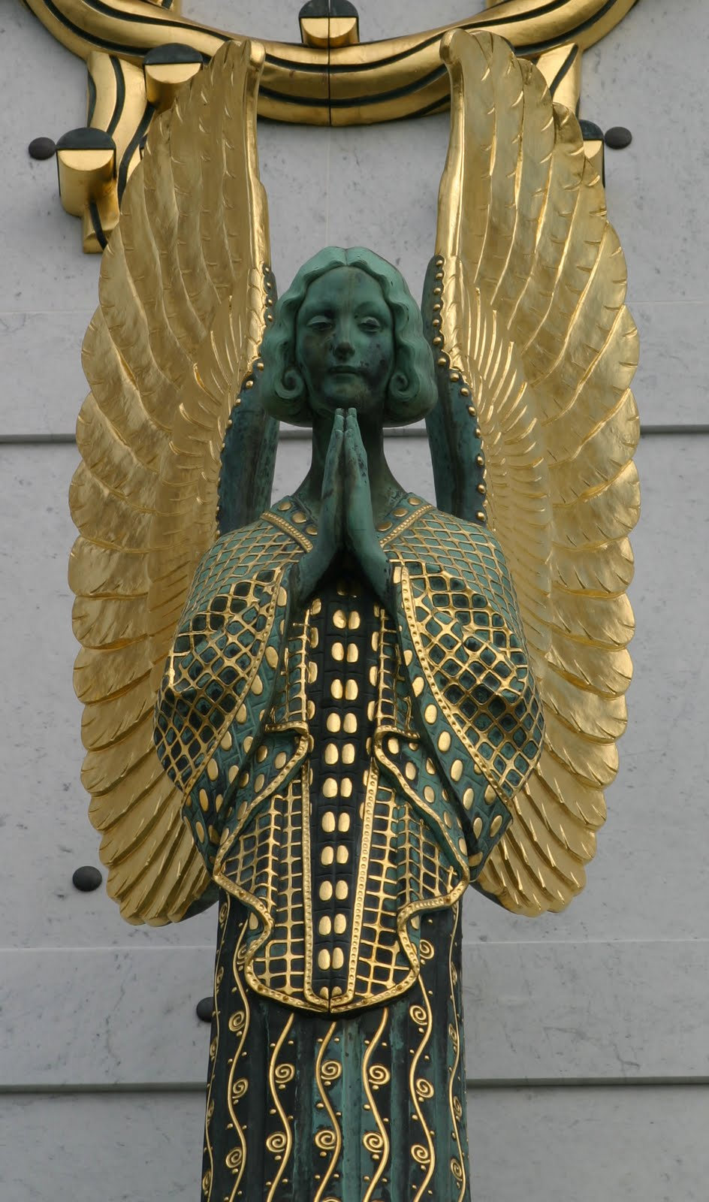

Slide 12
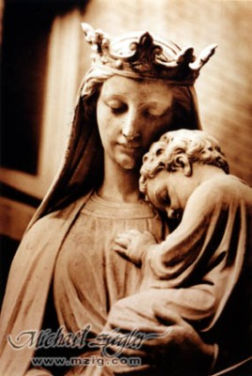

Slide 13
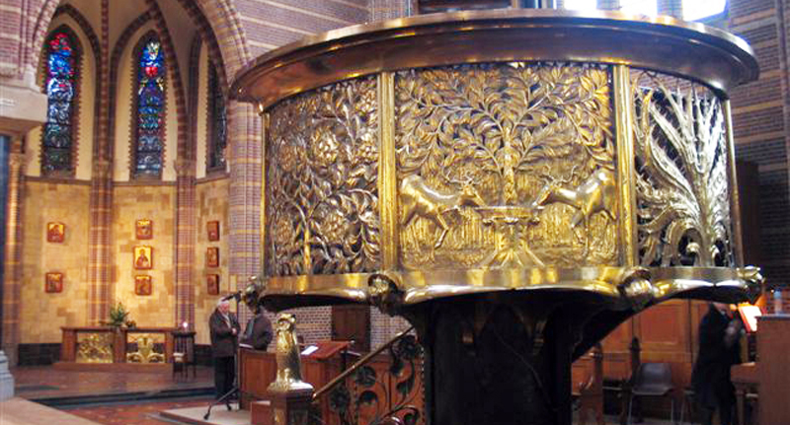

Slide 14
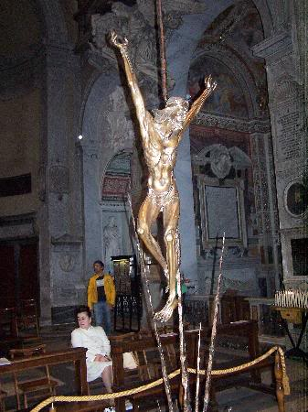

Slide 15
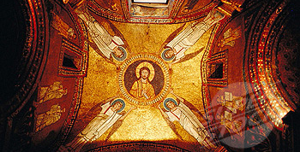

Slide 16
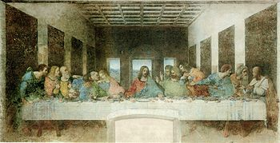

Slide 17
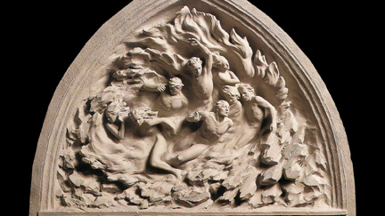

Slide 18
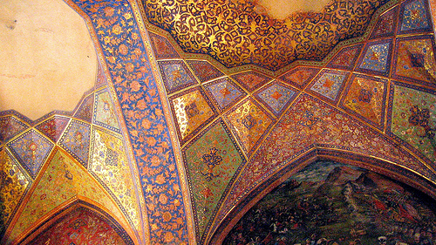

Slide 19
Why do you think people use art to express their faith?
Have go for yourself…What does faith look like to you? Use any medium (material) you wish to create a piece of art that would represent faith to you.

