Slide 1

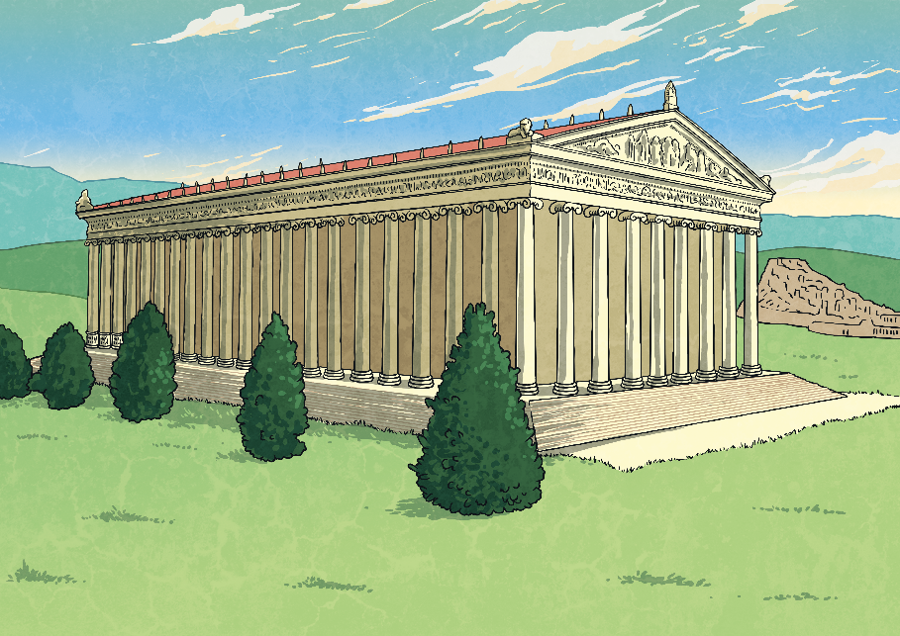
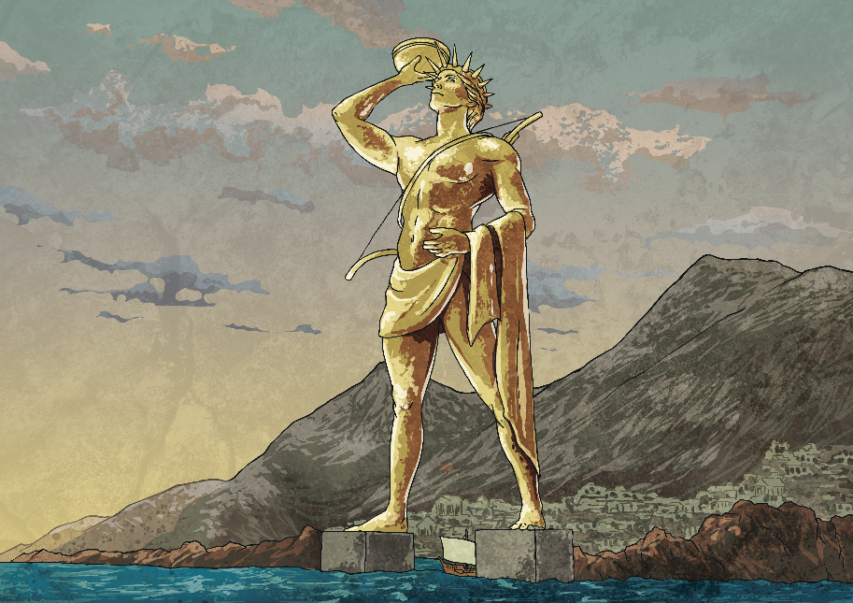

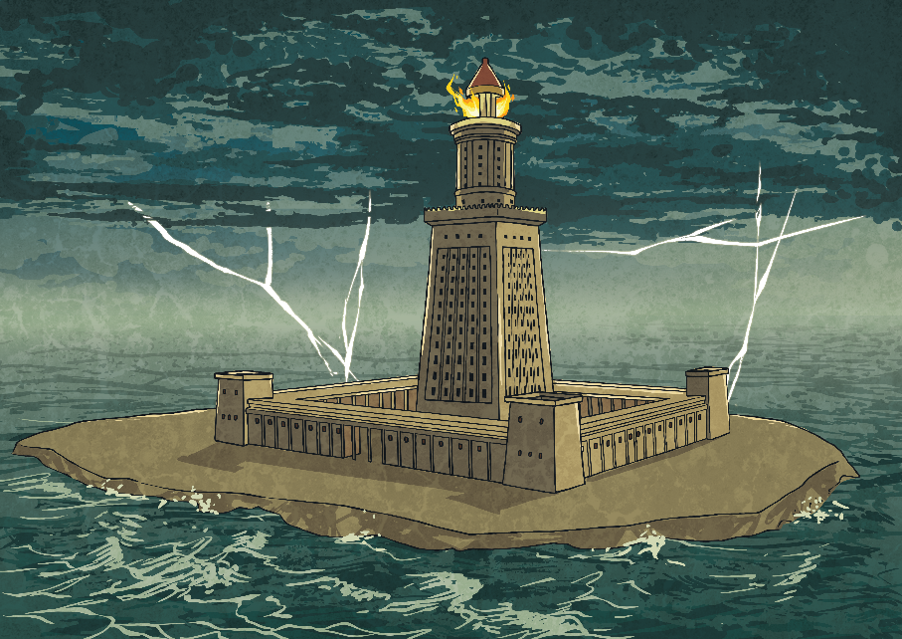
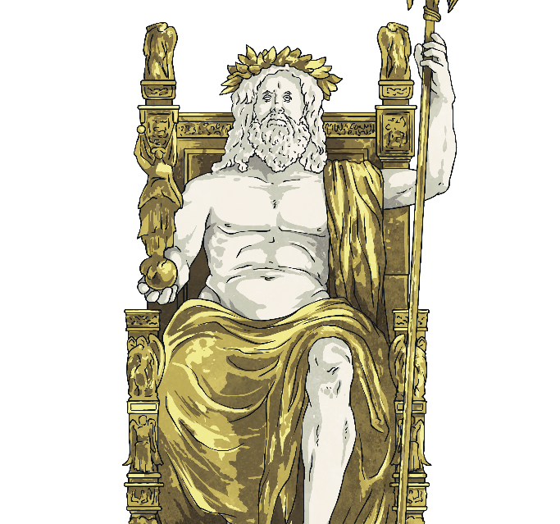
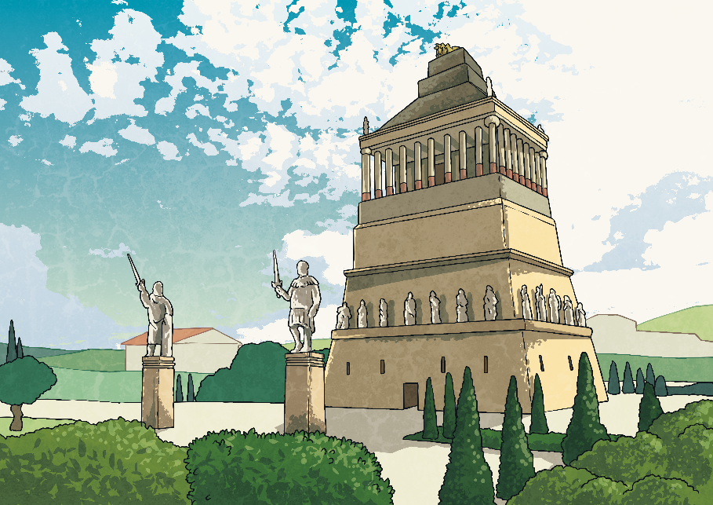
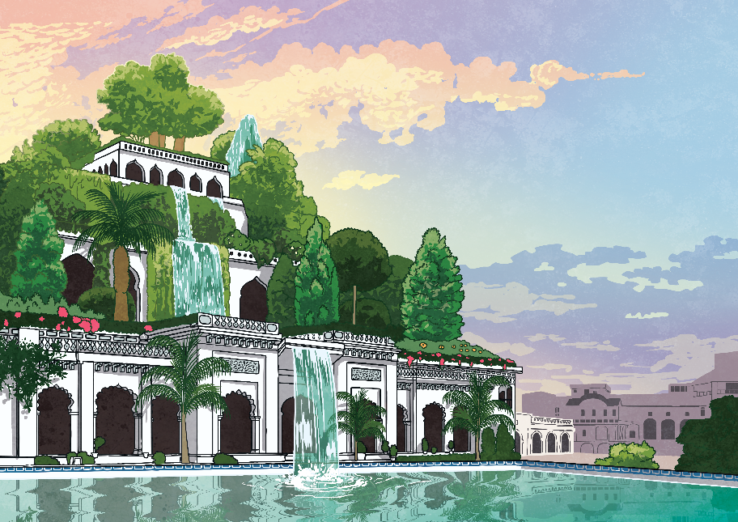
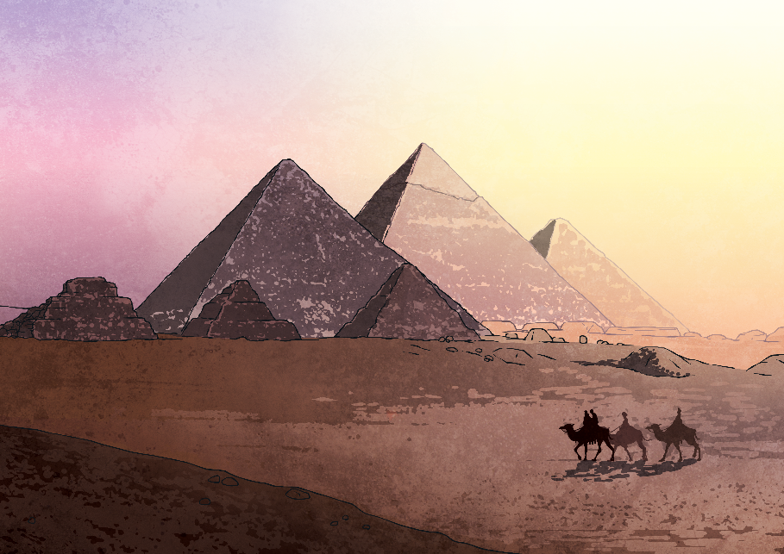

The Seven Wonders of the Ancient World
The Great Pyramid at Giza is the only one of the Seven Wonders that still stands.
Temple of Artemis at Ephesus – Turkey
Lighthouse of Alexandria – Egypt
Colossus of Rhodes – Greece
Mausoleum at Halicarnassus – Turkey
Statue of Zeus at Olympia – Greece
The Hanging Gardens of Babylon – Iraq
The Great Pyramid of Giza – Egypt
(37° 56’ 59’’ N, 27° 21’ 50’’ E)
(31° 12’ 50’’ N, 29° 53’ 08’’ E)
(36° 27’ 04’’ N, 28° 13’ 40’’ E)
(37.4° N, 27.4° E)
(37° 38’ 16’’ N, 21° 37’ 48’’ E)
(32° 54’ N, 44° E)
(29° 58’ 45’’ N, 31° 08’ 04’’ E)

