Slide 1

Geography
The Amazing Americas
Year One
Geography | Year 6 | The Amazing Americas | Wonders | Lesson 6

Slide 3
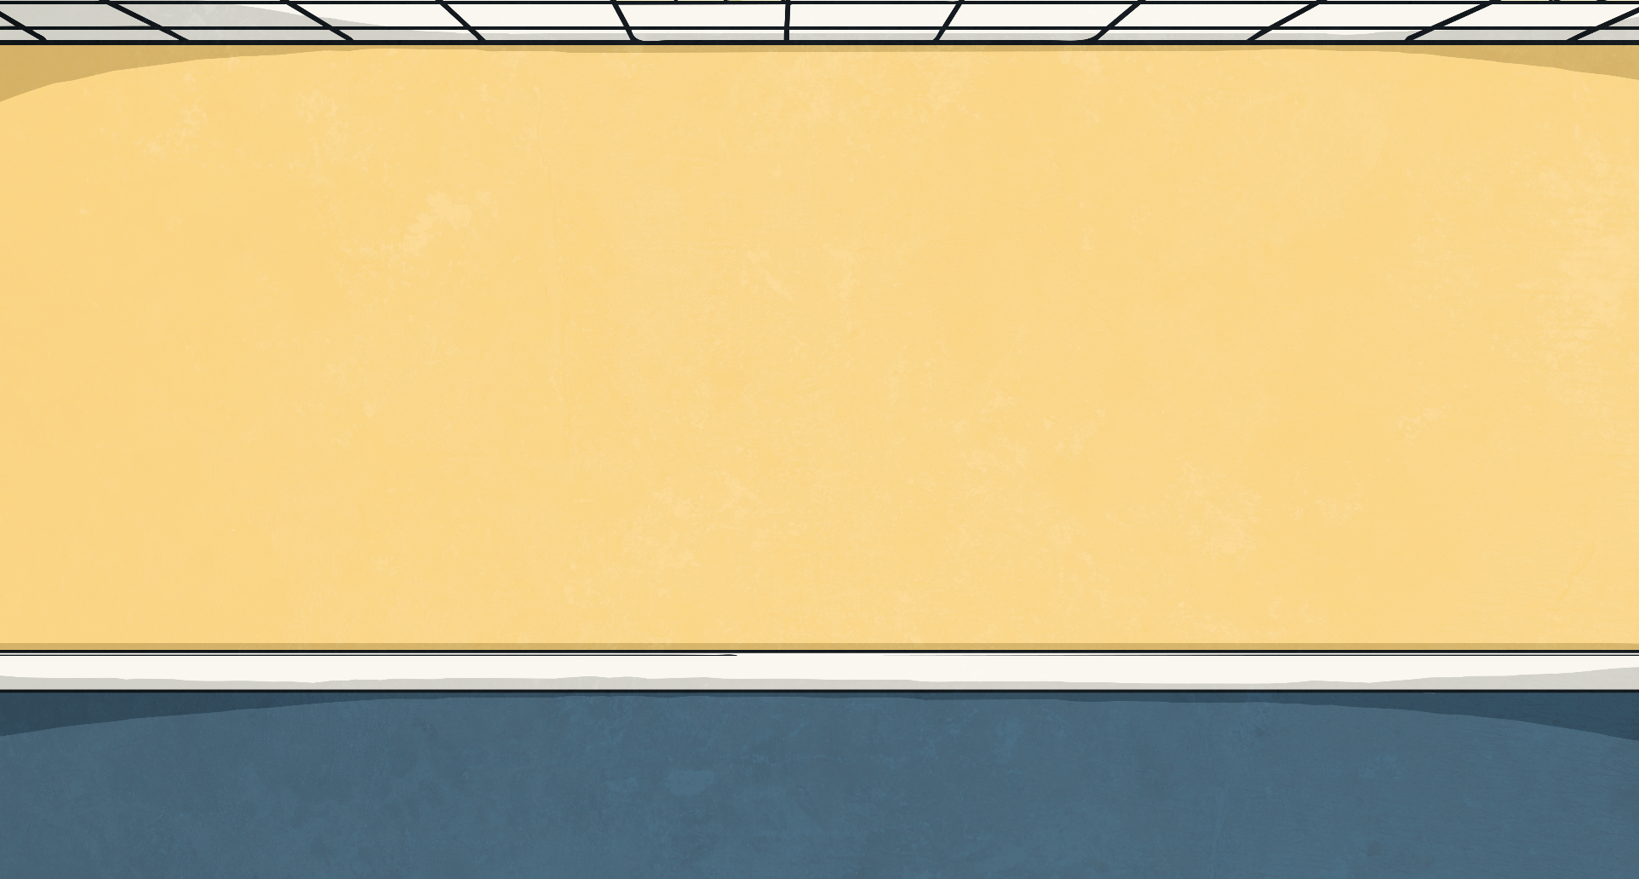

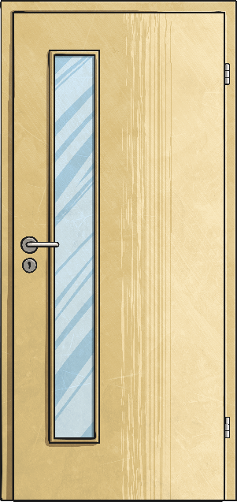
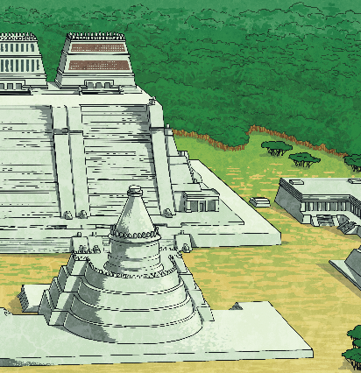
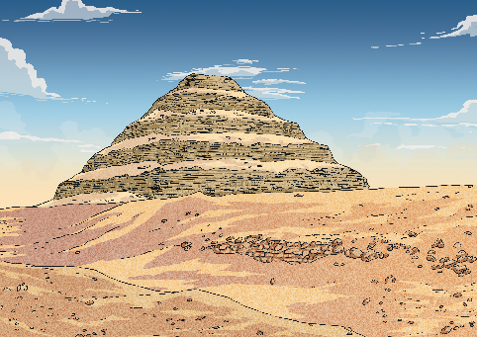
Our Wonderful World
What does it mean if something is a ‘wonder’?
What do you think a ‘wonder of the world’ describes?
Can you name or describe any wonders of the world?
What do you think a
geological wonder is?

Slide 4
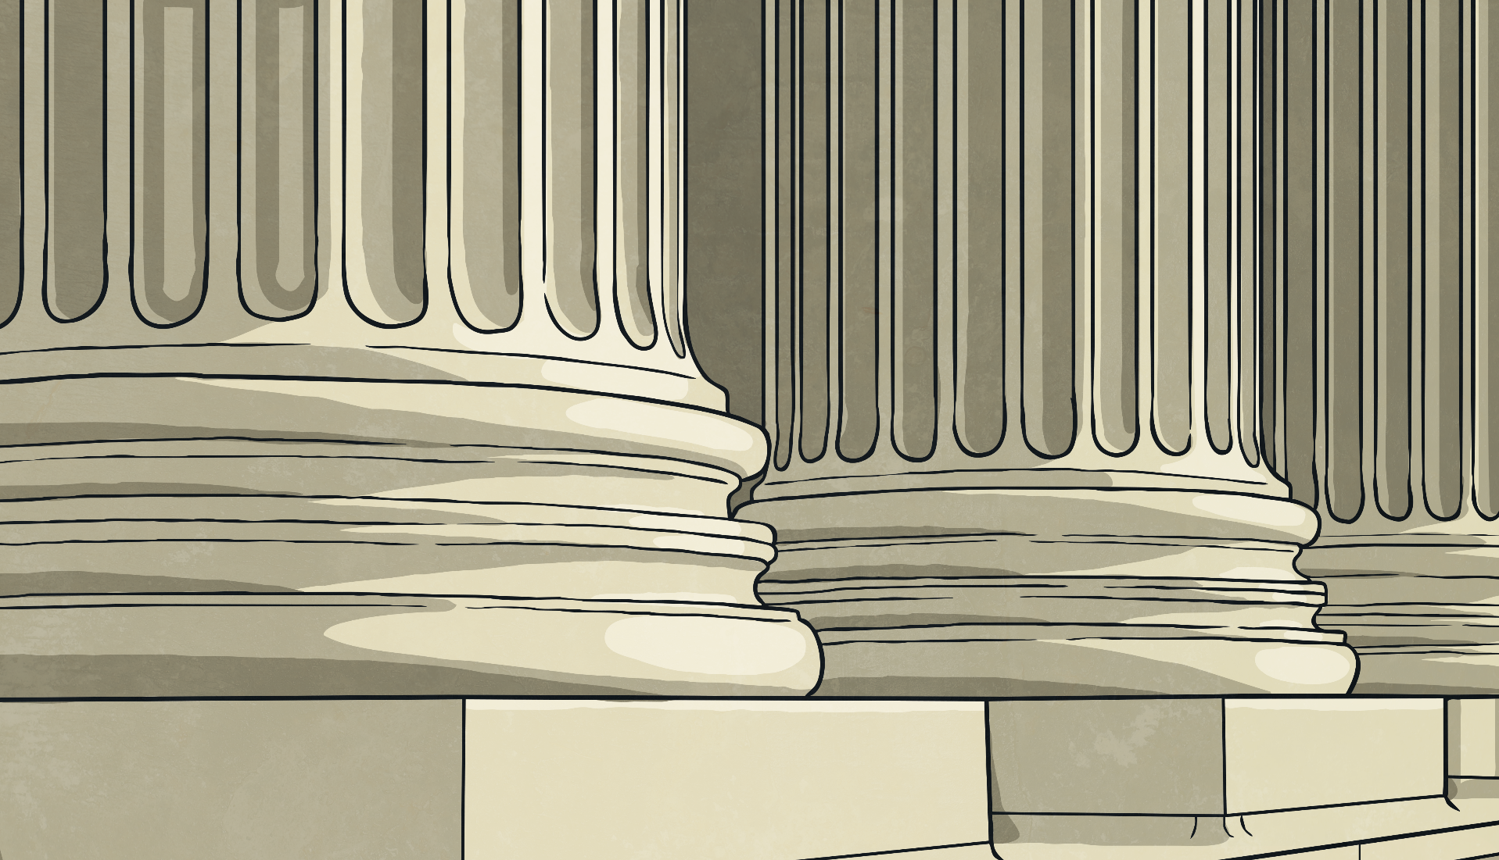
The Seven Wonders of the
Ancient World
It refers to a list of extraordinary monuments noted by Greek travellers around the 4th century BC. At this time the Greeks conquered or dominated much of the known world and the travellers recorded the
remarkable sights they witnessed
during their travels.
The term Seven Wonders of
the World is also referred to as
the Seven Wonders of the
Ancient World.
Do you know any of the Seven Wonders of the Ancient World?
Do you know where they are located?

Slide 5
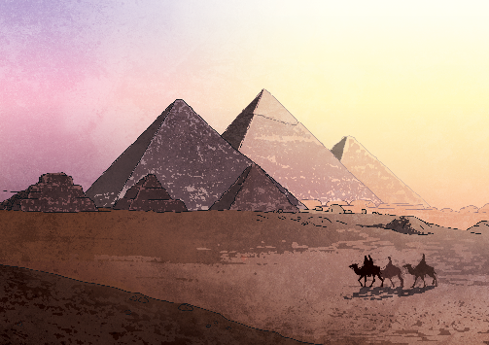
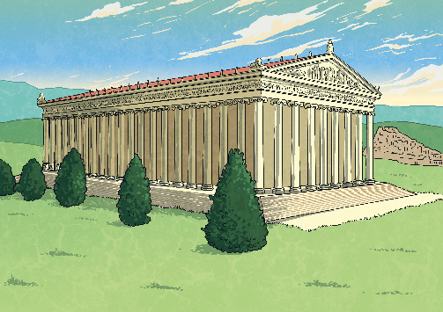
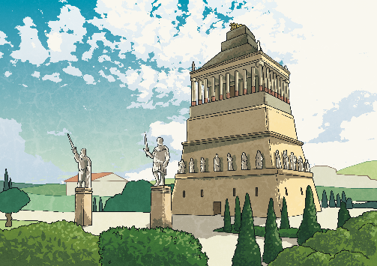

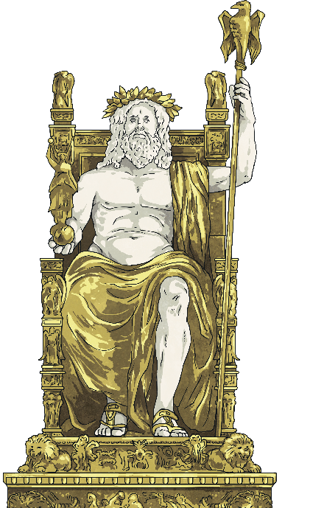
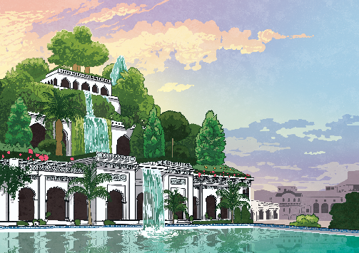
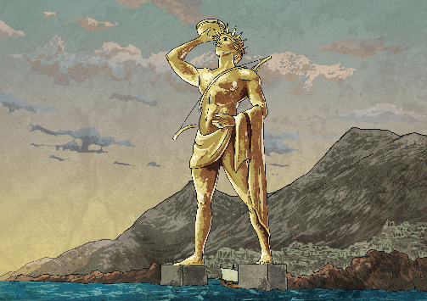
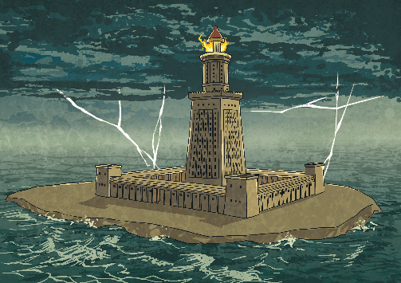
The Seven Wonders of the
Ancient World
All but one of the Seven Wonders of the Ancient World have been destroyed.
Next
Which do you think still stands?

Slide 6
The Seven Wonders of the
Ancient World
All but one of the Seven Wonders of the Ancient World have been destroyed.
Great Pyramid of Giza
Next
Which do you think still stands?

Slide 7
The Seven Wonders of the
Ancient World
All but one of the Seven Wonders of the Ancient World have been destroyed.
Temple of Artemis at Ephesus
Next
Which do you think still stands?

Slide 8
The Seven Wonders of the
Ancient World
All but one of the Seven Wonders of the Ancient World have been destroyed.
Mausoleum of Halicarnassus
Next
Which do you think still stands?

Slide 9
The Seven Wonders of the
Ancient World
All but one of the Seven Wonders of the Ancient World have been destroyed.
Hanging Gardens of Babylon
Next
Which do you think still stands?

Slide 10
The Seven Wonders of the
Ancient World
All but one of the Seven Wonders of the Ancient World have been destroyed.
Colossus of Rhodes
Next
Which do you think still stands?

Slide 11
The Seven Wonders of the
Ancient World
All but one of the Seven Wonders of the Ancient World have been destroyed.
Lighthouse of Alexandria
Next
Which do you think still stands?

Slide 12
The Seven Wonders of the
Ancient World
All but one of the Seven Wonders of the Ancient World have been destroyed.
Statue of Zeus at Olympia
Next
Which do you think still stands?

Slide 13

Your Task
Use an atlas to find the location of the Seven Wonders of the Ancient World. Mark these as accurately as you can on your Wonders of the World Map Activity Sheet.
Once you have done this, have look at the next slideshow to see how you got on.

