Slide 1







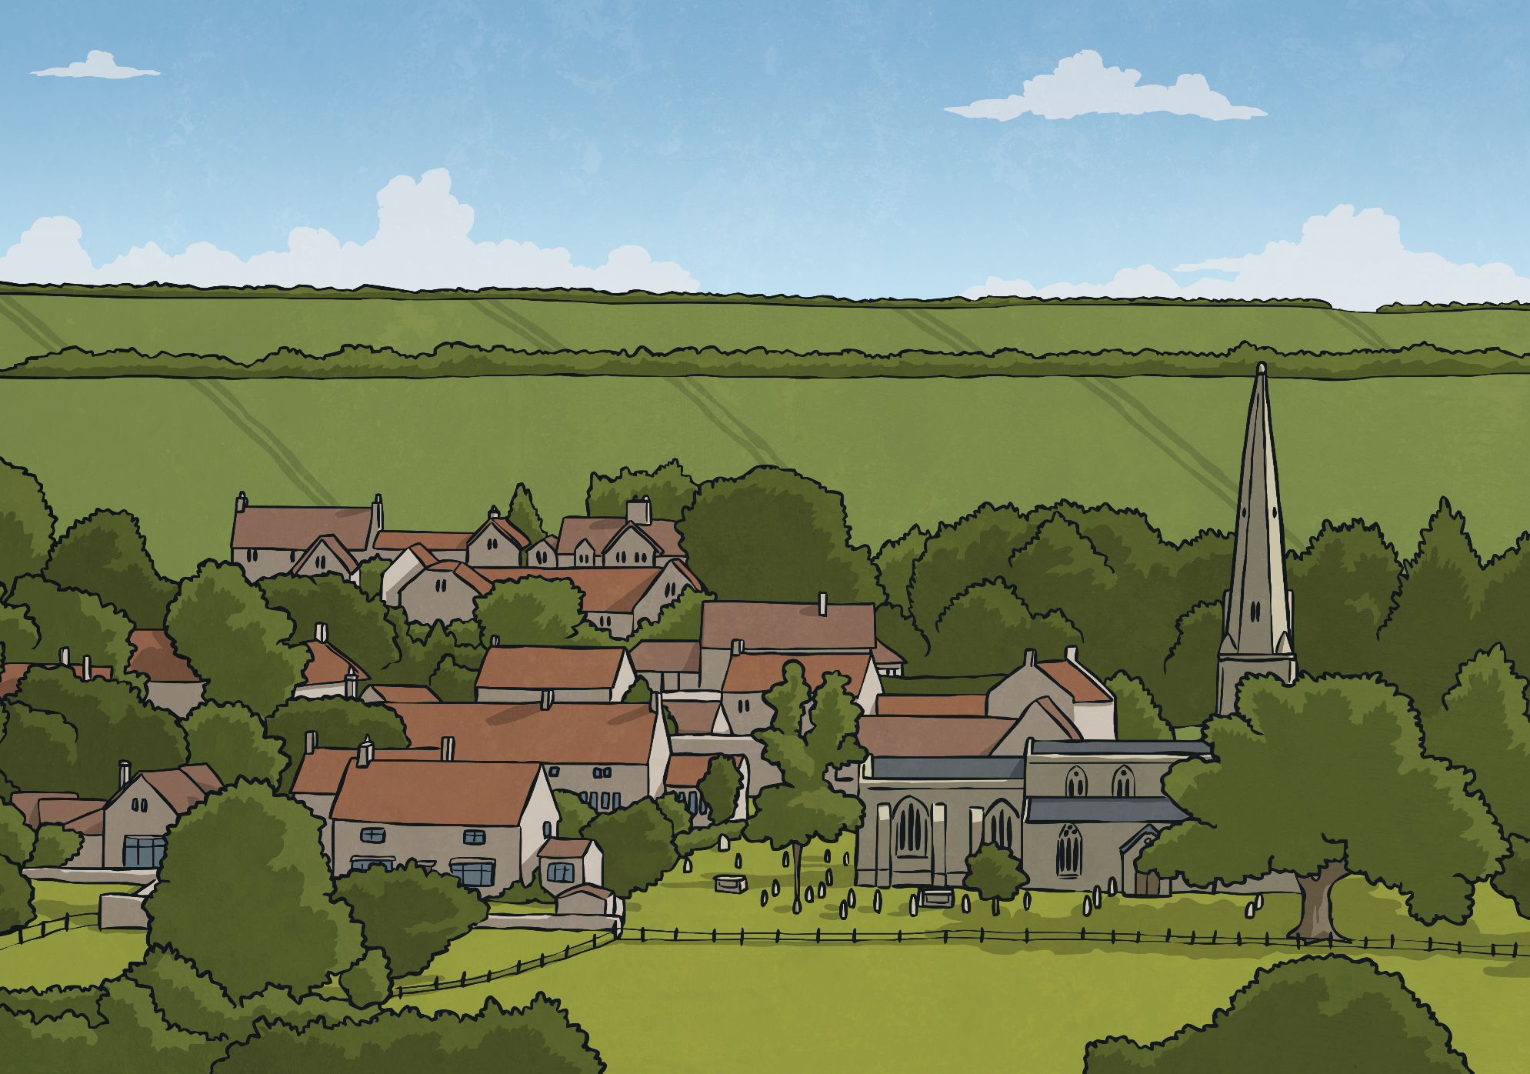

United Twinkldom Population Data
The United Twinkldom is made up of three different countries: Twinkl-land, Twinklonia and Twinklmark.
In the United Twinkldom, a census has been taken every 10 years. A census is a count of all the people in the country on a particular day.
The only time a census was not taken was in 1941.
The table shows the census data for the whole of the United Twinkldom from 1931 to 2011.
Year | Population (in millions, rounded to the nearest million)
1931 | 45
1941 | no data
1951 | 50
1961 | 53
1971 | 56
1981 | 56
1991 | 58
2001 | 59
2011 | 63

Slide 2
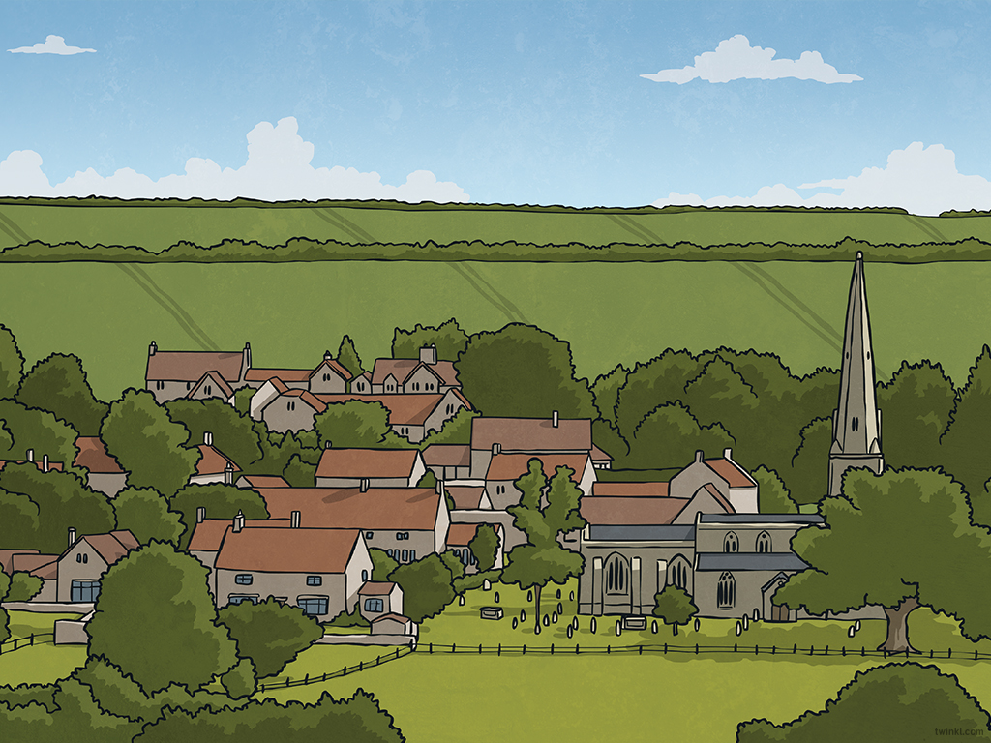

United Twinkldom Population Line Graph
Megan identifies that the table of data shows the change in how many people were living in the United Twinkldom (UT) over 80 years.
She knows that a line graph can be used to show changes to a variable over time, so she decides to draw a line graph.
She knows that a line graph has a horizontal and vertical axis, and that the time data is usually shown along the horizontal axis.
Year | Population (in millions, rounded to the nearest million)
1931 | 45
1941 | no data
1951 | 50
1961 | 53
1971 | 56
1981 | 56
1991 | 58
2001 | 59
2011 | 63
Population (in millions, rounded to the nearest million)
Looking at the table of data, what scale interval would you use on the horizontal axis and vertical axis?
Year

Slide 3
United Twinkldom Population Line Graph
Megan decides on a ten-year interval scale for the horizontal time axis and a two-million interval scale for the vertical distance axis.
As she is creating the scales, Megan makes sure the numbers are positioned on the lines of the axis.
A Line Graph to Show the Population of the United Twinkldom
from 1931 to 2011
She doesn’t label every interval on the axis.
Population (in millions, rounded to the nearest million)
Megan’s line graph also needs a title. What would be a good title for this line graph?
Year

Slide 4
United Twinkldom Population Line Graph
Now, Megan is ready to plot the data about the population onto the line graph.
She knows that this is similar to plotting coordinates.
A Line Graph to Show the Population of the United Twinkldom
from 1931 to 2011
Year | Population (in millions, rounded to the nearest million)
1931 | 45
1941 | no data
1951 | 50
1961 | 53
1971 | 56
1981 | 56
1991 | 58
2001 | 59
2011 | 63
She locates the year values from the data table on the horizontal axis. She finds where these horizontal lines intersect with the population values on the vertical axis and marks each intersection with a small cross.
×
×
×
×
×
×
×
×
Population (in millions, rounded to the nearest million)
Population (in millions, rounded to the nearest million)
Year
Year

Slide 5
United Twinkldom Population Line Graph
Finally, Megan joins the plotted data together with straight lines to create a continuous line which visually represents how the population of the UT changed over the 80 years.
A Line Graph to Show the Population of the United Twinkldom
from 1931 to 2011
×
Year | Population (in millions, rounded to the nearest million)
1931 | 45
1941 | no data
1951 | 50
1961 | 53
1971 | 56
1981 | 56
1991 | 58
2001 | 59
2011 | 63
×
×
×
×
×
×
×
Population (in millions, rounded to the nearest million)
Year

Slide 6
United Twinkldom Population Line Graph
Megan knows there was no data gathered in 1941. She can add a dotted line to join the data for 1931 to 1951. This will show her what the population is likely to have been in 1941.
A Line Graph to Show the Population of the United Twinkldom
from 1931 to 2011
×
Year | Population (in millions, rounded to the nearest million)
1931 | 45
1941 | no data
1951 | 50
1961 | 53
1971 | 56
1981 | 56
1991 | 58
2001 | 59
2011 | 63
×
×
×
×
×
×
×
Population (in millions, rounded to the nearest million)
Year

Slide 7

United Twinkldom Population
Line Graph Questions
Work with your partner to answer Megan’s questions about the population of the UT:
The population increased the most between 2001 and 2011. We can tell because this section of the graph looks like it has the steepest line. When we check using subtraction, these two years have the biggest difference in population – an increase of 4 million people.
A Line Graph to Show the Population of the United Twinkldom
from 1931 to 2011
In which decade did the population of the UT increase the most? How can you tell?
×
×
×
×
×
×
×
×
Population (in millions, rounded to the nearest million)
Year

Slide 8
United Twinkldom Population
Line Graph Questions
Work with your partner to answer Megan’s questions about the population of the UT:
The graph shows that the population stayed the same between 1971 and 1981. However, the population is in millions, rounded to the nearest million, so it could have changed between 55 000 000 and 56 499 999 and it would still be shown as 56 million on the graph. It is unlikely that it stayed exactly the same.
A Line Graph to Show the Population of the United Twinkldom
from 1931 to 2011
Between which years does the graph show the population stayed the same? Do you think it did stay exactly the same?
×
×
×
×
×
×
×
×
Population (in millions, rounded to the nearest million)
Year

Slide 9
United Twinkldom Population
Line Graph Questions
Work with your partner to answer Megan’s questions about the population of the UT:
1941 was right in the middle of the Second World War. It could be that so many of the UT’s resources were engaged in this war that they were unable to carry out the census. From the graph, we can estimate that the population in 1941 was approximately 48 million.
A Line Graph to Show the Population of the United Twinkldom
from 1931 to 2011
Can you think of a reason the census may not have been carried out in 1941?
×
×
×
×
×
×
×
×
(Hint: think about an event that lasted from 1939 to 1945.)
Population (in millions, rounded to the nearest million)
What do you estimate the population might have been from the graph?
Year

