Slide 1








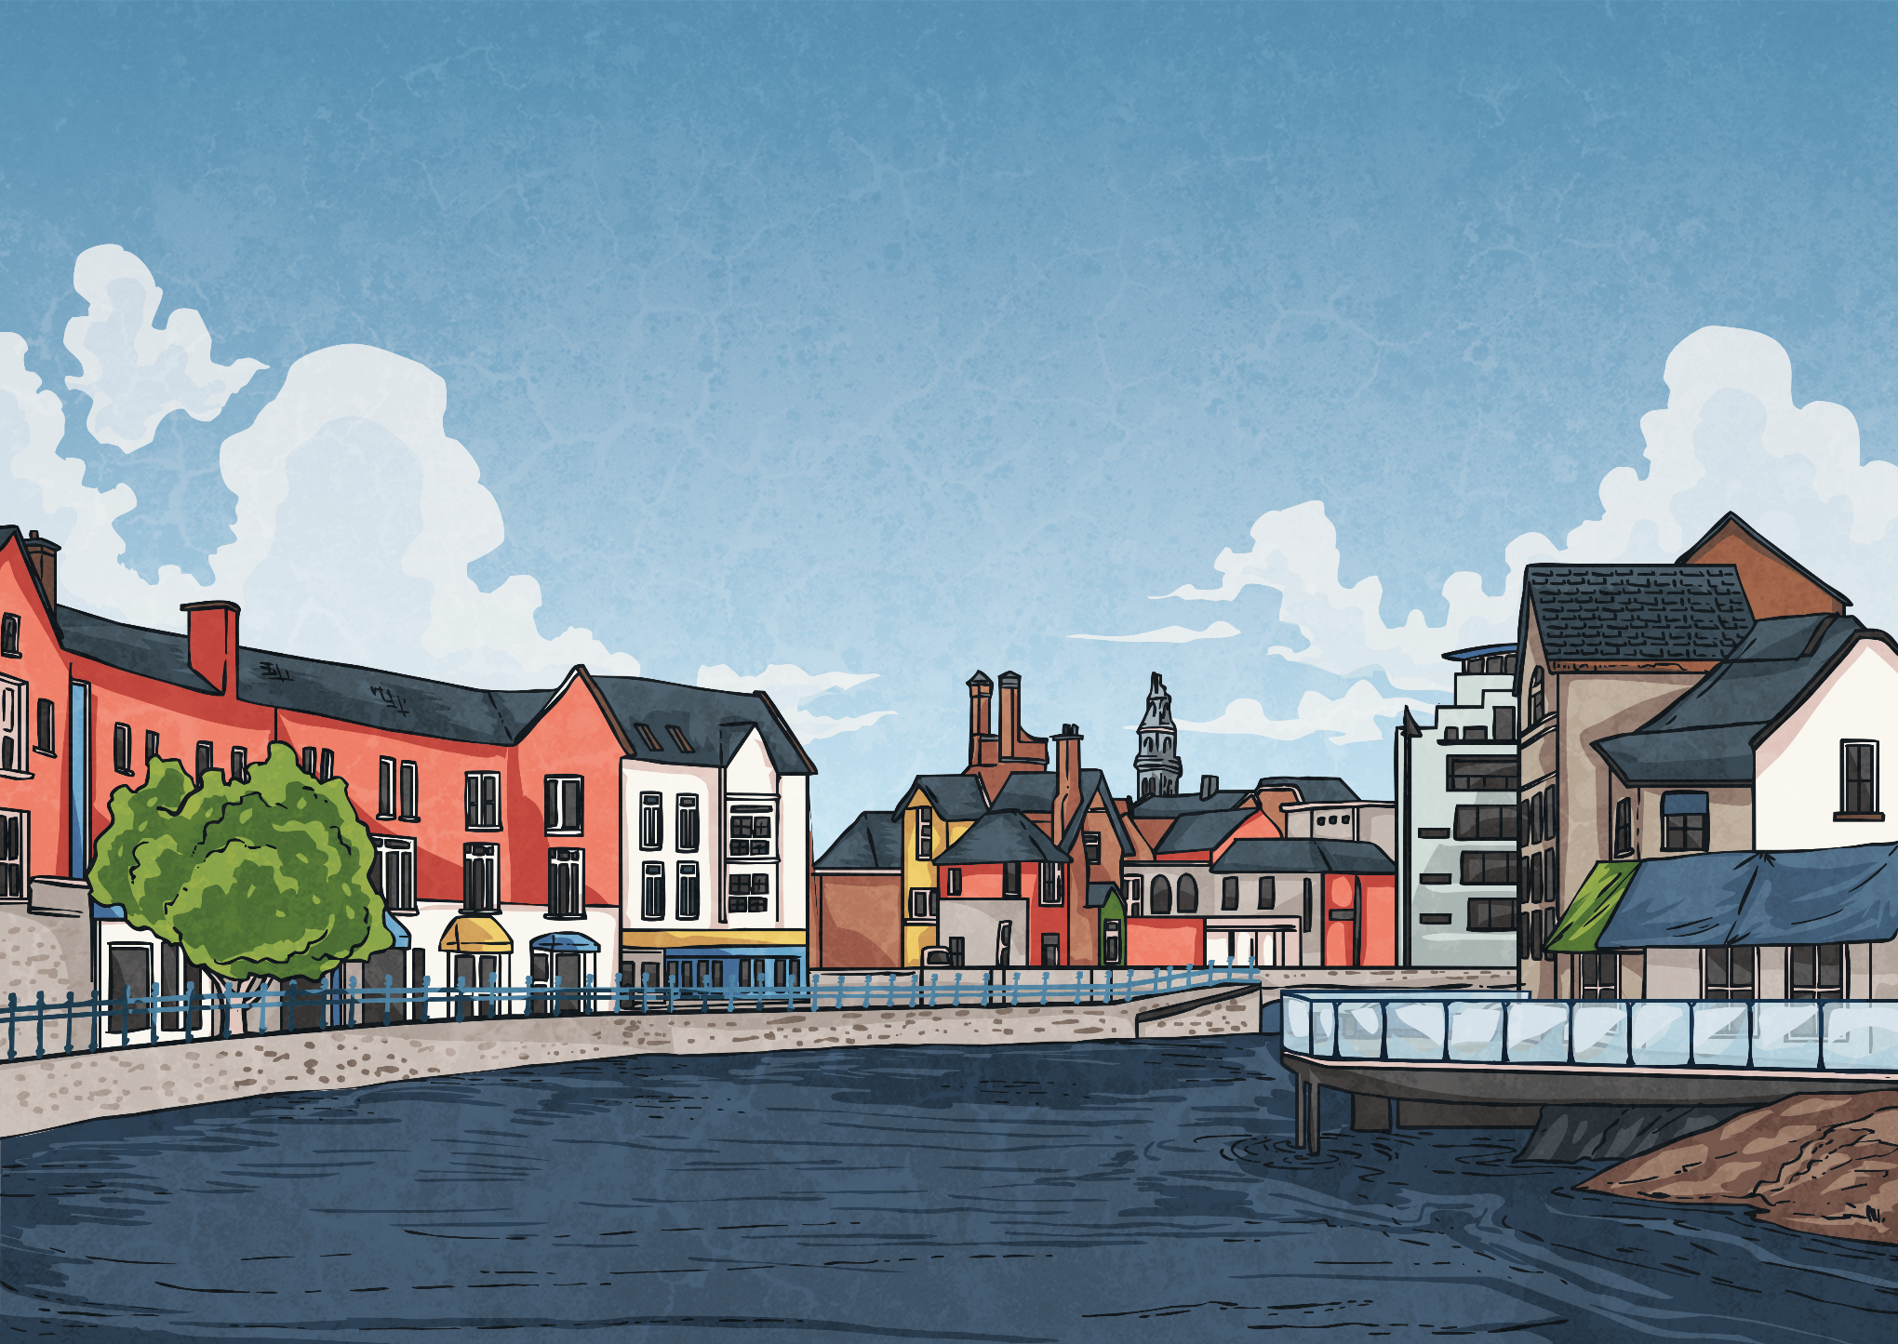
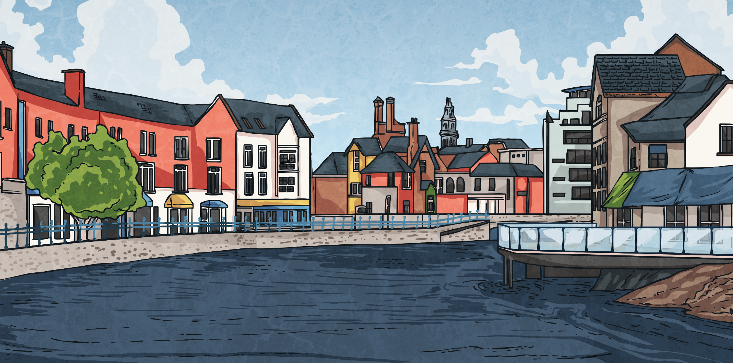
Twinklville and New Twinklton
Twinklville is a small village in the countryside. The nearest town to Twinklville is called New Twinklton.
This line graph shows the population of the two locations over 8 years. The population of a place is the number of people who live there.
A Line Graph to Show the Population of Twinklville and New Twinklton over 8 Years
New Twinklton Twinklville
Population (in millions, rounded to the nearest million)
Years

Slide 2
Twinklville and New Twinklton
What was the approximate difference in population between Twinklville and New Twinklton in 2003?
In 2003, the population of Twinklville was approximately 8000 and the population of New Twinklton was approximately 23 000. The difference is 15 000 people.
A Line Graph to Show the Population of Twinklville and New Twinklton over 8 Years
New Twinklton Twinklville
Population (in millions, rounded to the nearest million)
Years

Slide 3
Twinklville and New Twinklton
In which year did Twinklville’s population reach approximately 10 000?
Twinklville’s population reached approximately
10 000 in 2005.
A Line Graph to Show the Population of Twinklville and New Twinklton over 8 Years
New Twinklton Twinklville
Population (in millions, rounded to the nearest million)
Years

Slide 4
Twinklville and New Twinklton
In which year did the population of Twinklville first rise above approximately 10 000 people?
The population of Twinklville first rose above approximately 10 000 people in 2006.
A Line Graph to Show the Population of Twinklville and New Twinklton over 8 Years
New Twinklton Twinklville
Population (in millions, rounded to the nearest million)
Years

