Slide 1
How many different ways are there for showing emotions?
How can you tell what a person is feeling?
People express their feelings in lots of different ways –
Through writing, drawing, painting, singing, drama, sculpture, poetry etc.
Religious people use these different ways too…

Slide 2
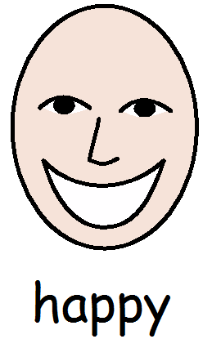

Slide 3
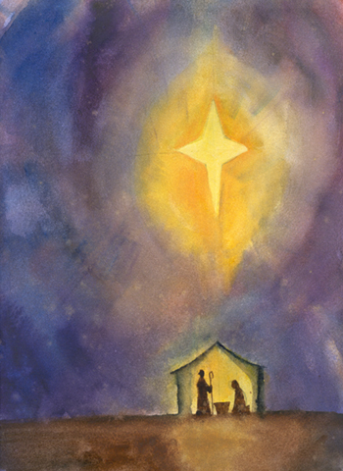

Slide 4
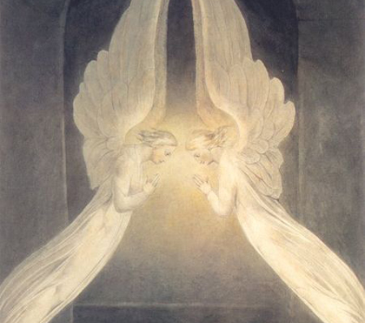

Slide 5
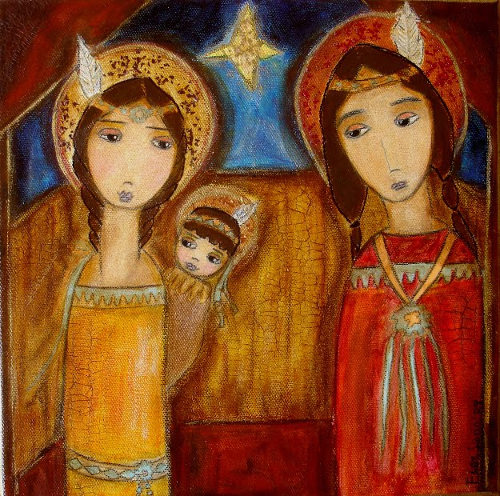

Slide 6
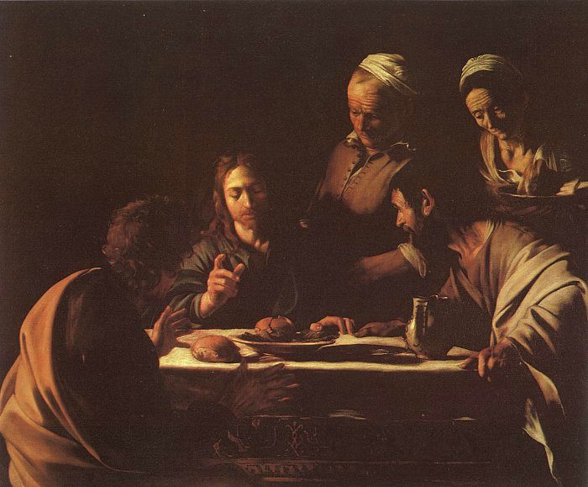

Slide 7
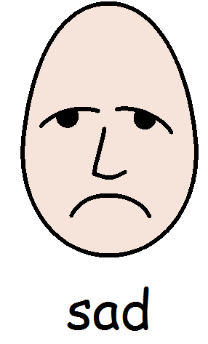

Slide 8
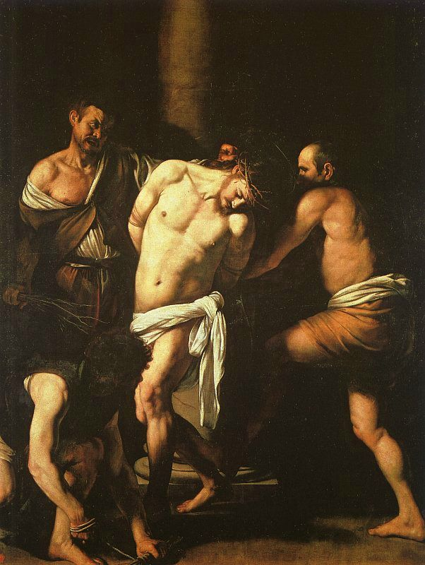

Slide 9
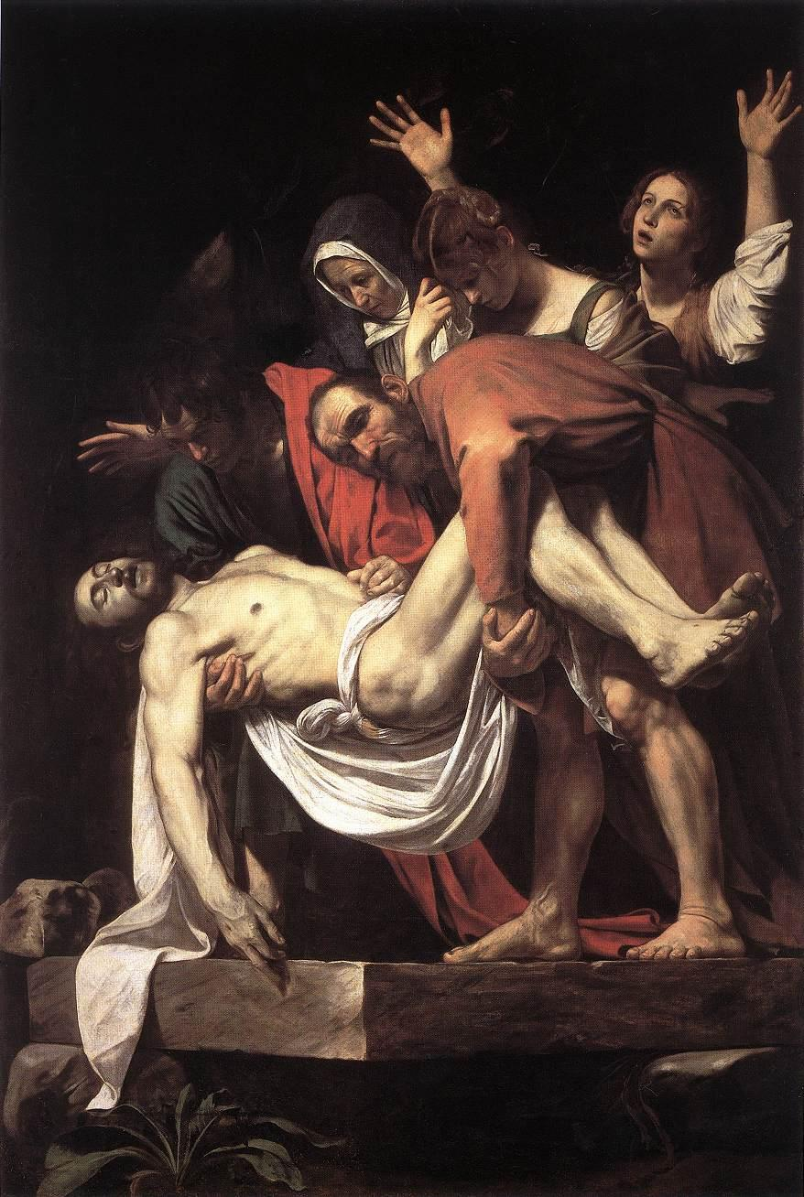

Slide 10
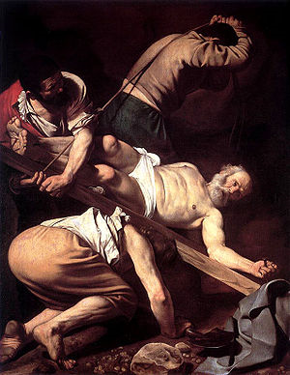

Slide 11
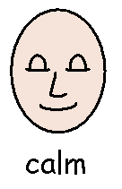

Slide 12
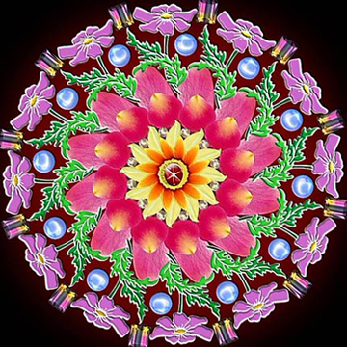

Slide 13
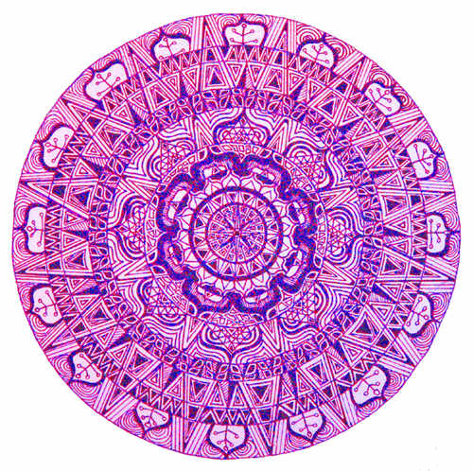

Slide 14


