Slide 1

Computing
Using and Applying Skills – Lesson 1
Year One
Computing | Year 6 | Using and Applying Skills

Slide 2
Aim
I can design a new game, using appropriate software to present information and advertise a product launch.
Success Criteria
I can present research on game types to inform planning.
I can use Scratch or Kodu to create a simple game.
I can design appropriate advertising materials to launch or promote a product.

Slide 3
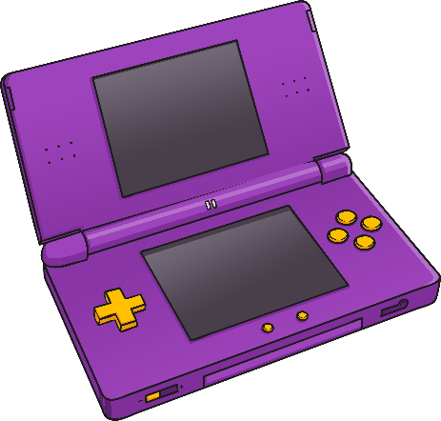
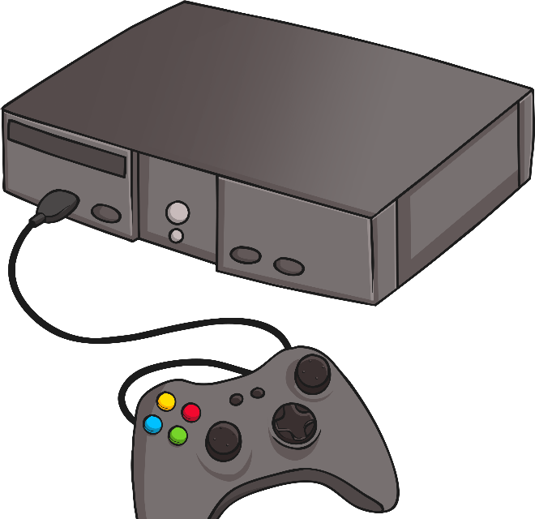
Beginning – Launch a
New Game
The Big Question: Can you design and plan the launch of a new game or app?
You are all familiar with one or more platforms for coding, including Scratch. This can be used to plan and create your own games. You have also used lots of other software that could come in handy.
What type of game could be created? What would people want to play?
What additional ways could you promote or advertise your new game?
You will be working to complete the project over a series of lessons. If you are able to contact other in the class to work with please do – it can be a remote group activity. Tasks can be shared between group members such as market research and results, creating the game & advertising the game. You may even want to create a team from your family or work through this on your own.

Slide 4



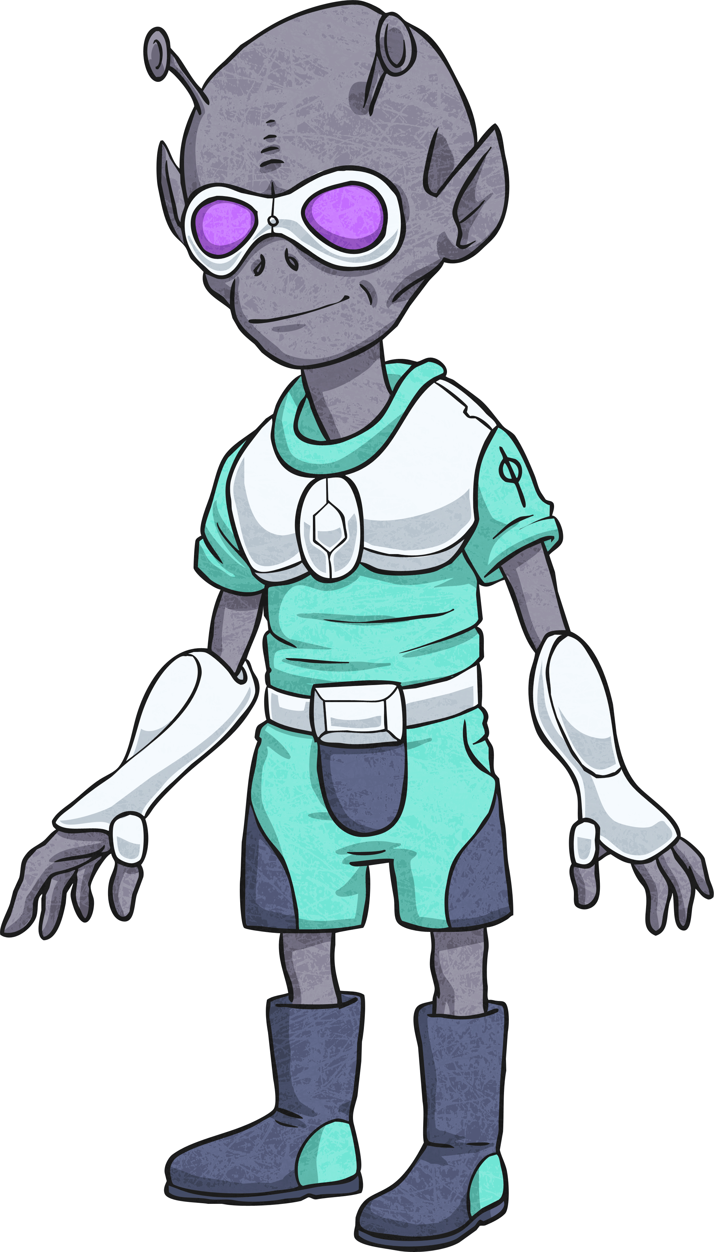


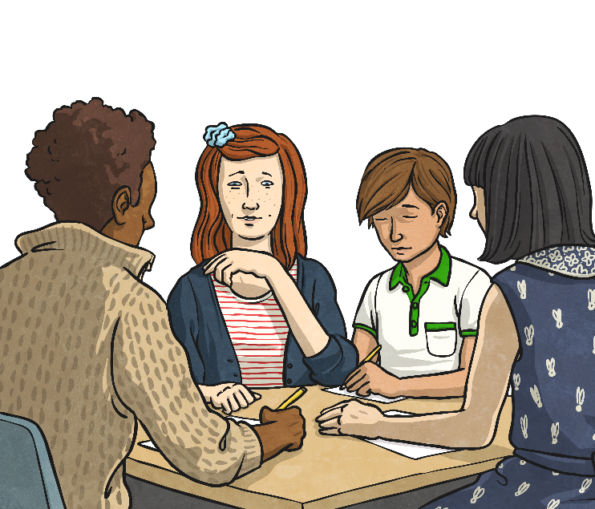
Preparing – Plan and Research
How do real computer game companies decide what type of games people will like?
Research what games are popular; if possible, ask for the views of others, to create an opinion poll.
You could either plan ideas for a new, original game or develop something already created.
How can your game be original and appealing? Look at existing websites for computer games: what information is on them?
Look at adverts for computer games – what is included?
Now complete the research task included for today. You can always do this over the next few days if you need to remotely meet with your team.

