Slide 1
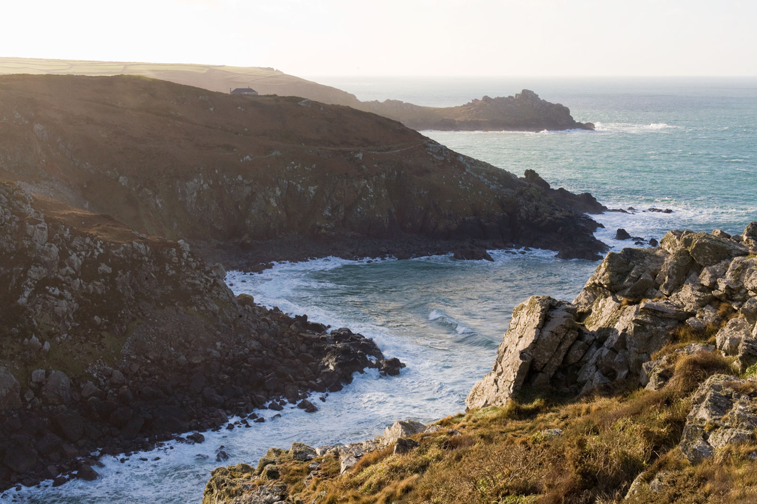
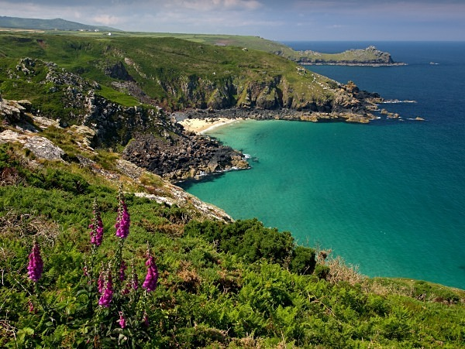
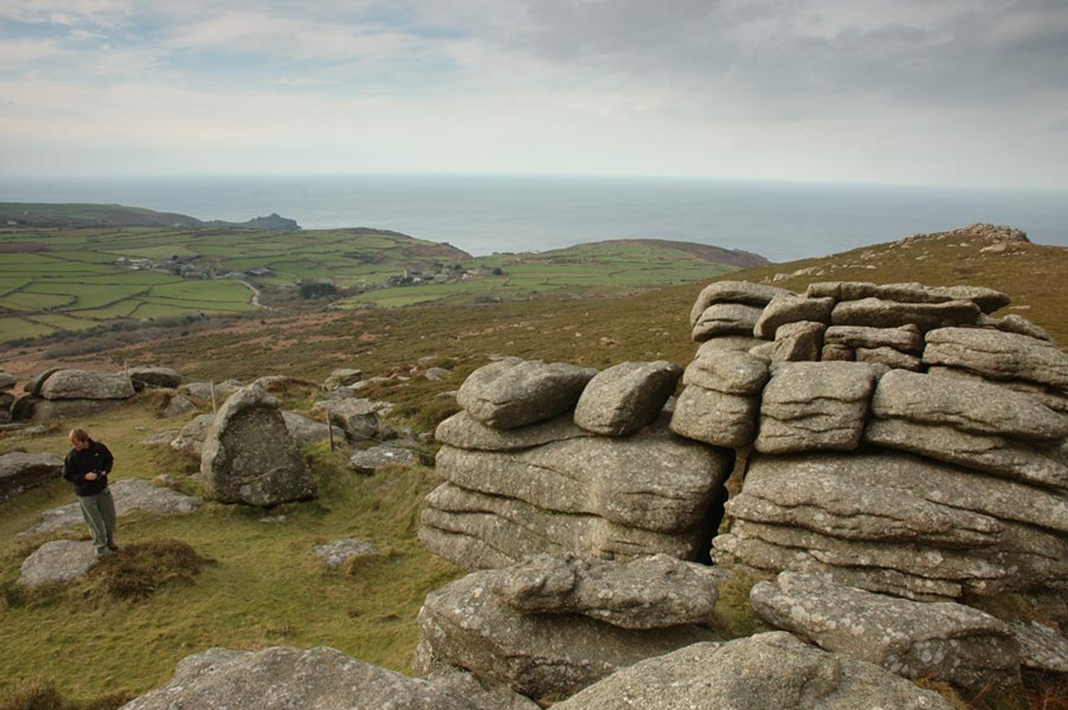
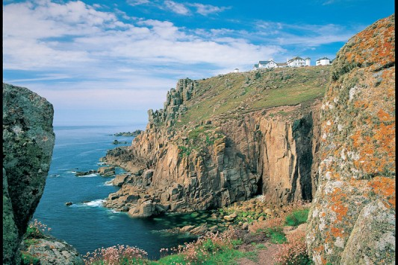
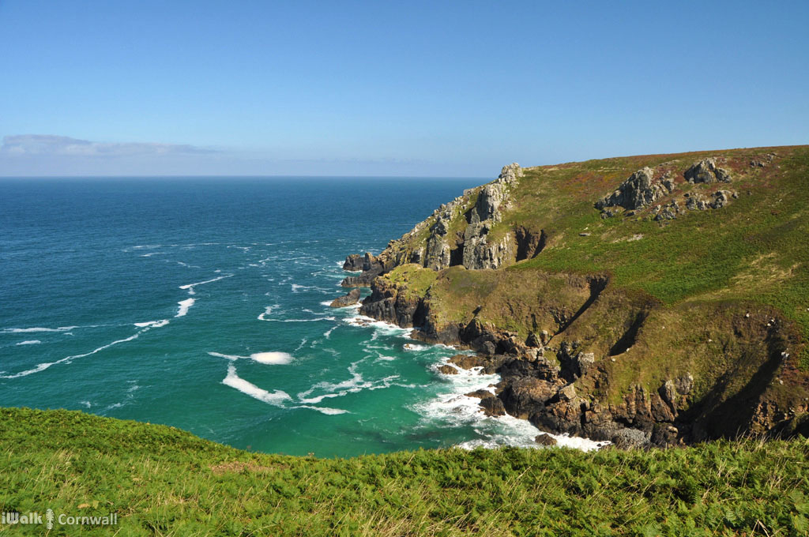
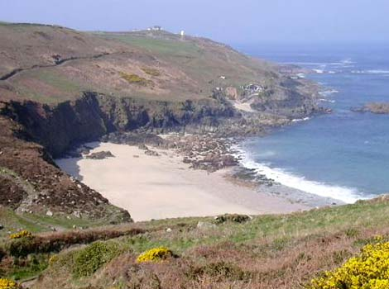
Lesson 4

Slide 2
Verbs, Verbs, Verbs
On Tuesday we had a reminder of what a verb is. (You can always go back and have a look if you didn’t get to do that on Tuesday.)
Today we are going to focus on a specific part of the text and how verbs are used within. Go through the slides on the next few pages, thinking about the questions as you go. Slide 7 has a task for you to complete.

Slide 3
run dashed
took stole
painted vandalised
What is the difference in the pairs of verbs? Why would you choose the second ones rather than the first? What feelings do they create?

Slide 4
Had she not been so immersed in her search, sifting the shells through her fingers, she would have noticed the dark grey bank of cloud rolling in from the Atlantic. She would have noticed the white horses gathering out at sea and the tide moving remorselessly in to cover the rocks between her and Boat Cove. When the clouds cut off the warmth from the sun as evening came on and the sea turned grey, she shivered with cold and put on her sweater and jeans. She did look up then and saw the angry sea, but she saw no threat in that and did not look back over her shoulder to Boat Cove. She was aware that time was running out so she went down on her knees again and dug feverishly in the sand. She had to collect thirty more shells.
What is the effect of these verbs/verb phrases?

Slide 5
Had she not been so immersed in her search, sifting the shells through her fingers, she would have noticed the dark grey bank of cloud rolling in from the Atlantic. She would have noticed the white horses gathering out at sea and the tide moving remorselessly in to cover the rocks between her and Boat Cove. When the clouds cut off the warmth from the sun as evening came on and the sea turned grey, she shivered with cold and put on her sweater and jeans. She did look up then and saw the angry sea, but she saw no threat in that and did not look back over her shoulder to Boat Cove. She was aware that time was running out so she went down on her knees again and dug feverishly in the sand. She had to collect thirty more shells.
What is the effect of these verbs/verb phrases?

Slide 6
Identify the verbs/verb phrases in this paragraph.
For each identified, explain why the author has chosen it. Use a dictionary to help.
It was the baleful sound of the foghorn somewhere out at sea beyond Gunnards Head that at last forced Cherry to take some account of the incoming tide. She looked for the rocks she would have to clamber over to reach Boat Cove again and the winding track that would take her up to the cliff path and safety, but they were gone. Where they should have been, the sea was already driving in against the cliff face. She was cut off. In a confusion of wonder and fear she looked out to sea at the heaving ocean that moved in towards her, seeing it now as a writhing grey monster breathing its fury on the rocks with every pounding wave. Still Cherry did not forget her shells.

Slide 7
Identify the verbs/verb phrases in this paragraph.
For each identified, explain why the author has chosen it. Use a dictionary to help.
It was the baleful sound of the foghorn somewhere out at sea beyond Gunnards Head that at last forced Cherry to take some account of the incoming tide. She looked for the rocks she would have to clamber over to reach Boat Cove again and the winding track that would take her up to the cliff path and safety, but they were gone. Where they should have been, the sea was already driving in against the cliff face. She was cut off. In a confusion of wonder and fear she looked out to sea at the heaving ocean that moved in towards her, seeing it now as a writhing grey monster breathing its fury on the rocks with every pounding wave. Still Cherry did not forget her shells.

