Slide 1


Geography
The Amazing Americas
Year One
Geography | Year 6 | The Amazing Americas | Comparing Places – North America | Lesson 5

Slide 3
Aim
I can identify similarities and differences in the human and physical geography of my local area and a region of North America.
Success Criteria
I can explain the difference between human geography and
physical geography.
I can identify similarities and differences between the human and physical geography of Death Valley, California and where I live.

Slide 4
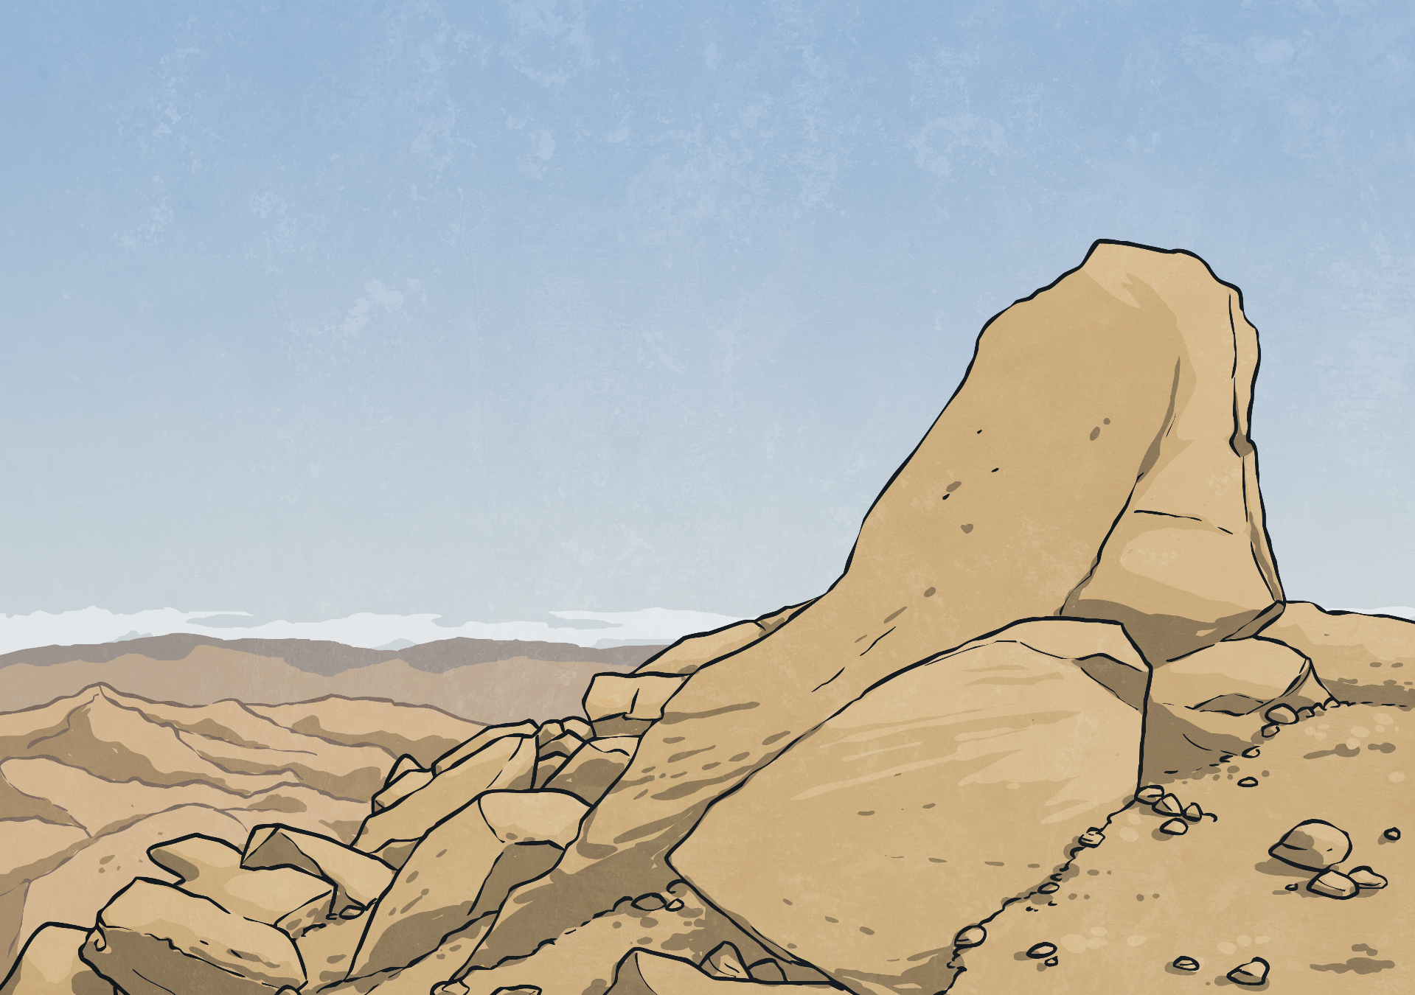
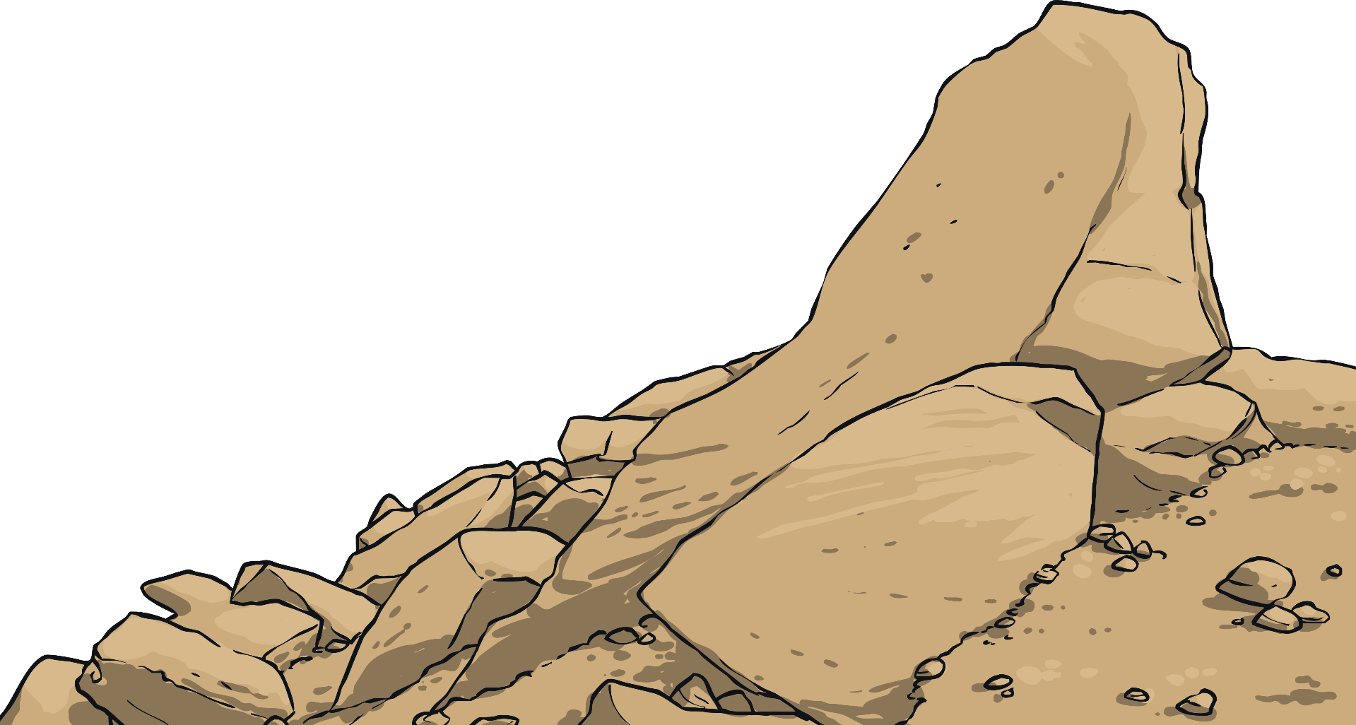
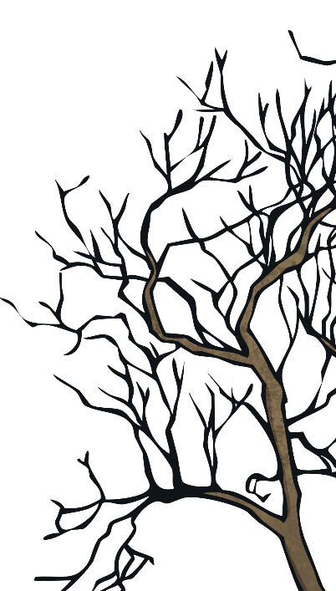
Death Valley, California
Think carefully about the type of information you collect when undertaking your research and how you can compare Death Valley with your local area. How will you find similar information for Death Valley in order to allow you to directly compare the two locations?
Use the information you find to create a second presentation about the human and physical geography of Death Valley.
Death Valley, California, has a dramatic, unforgiving landscape and climate. In the height of the summer, it is one of the hottest and driest places on earth. The people who live in this region have adapted to allow them to live successfully in the desert environment.
Watch these clips and search in information books and/or on the internet to learn more about this unique region of North America.

