Slide 1
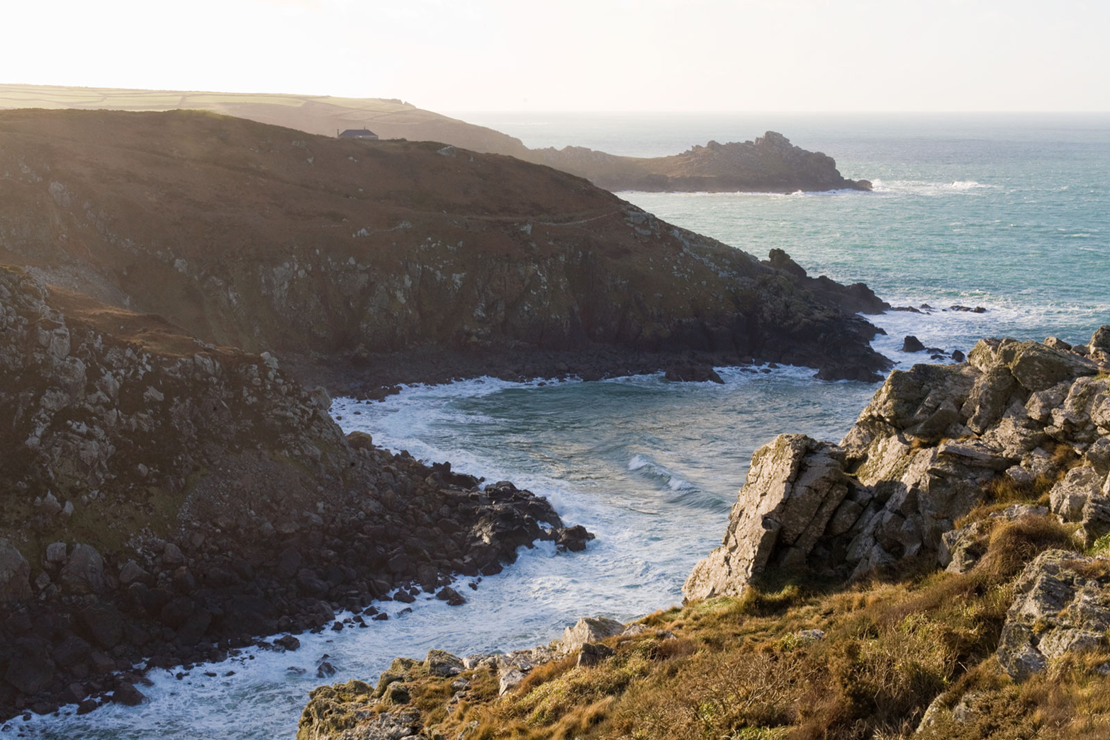
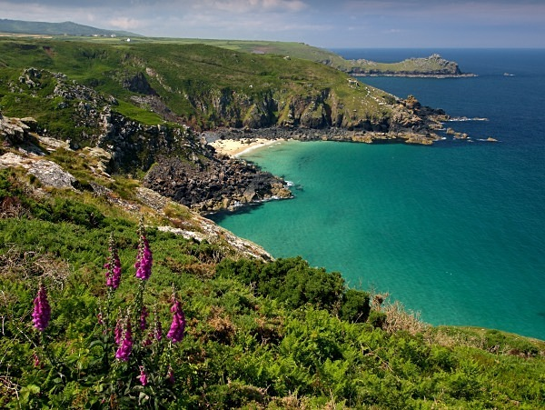
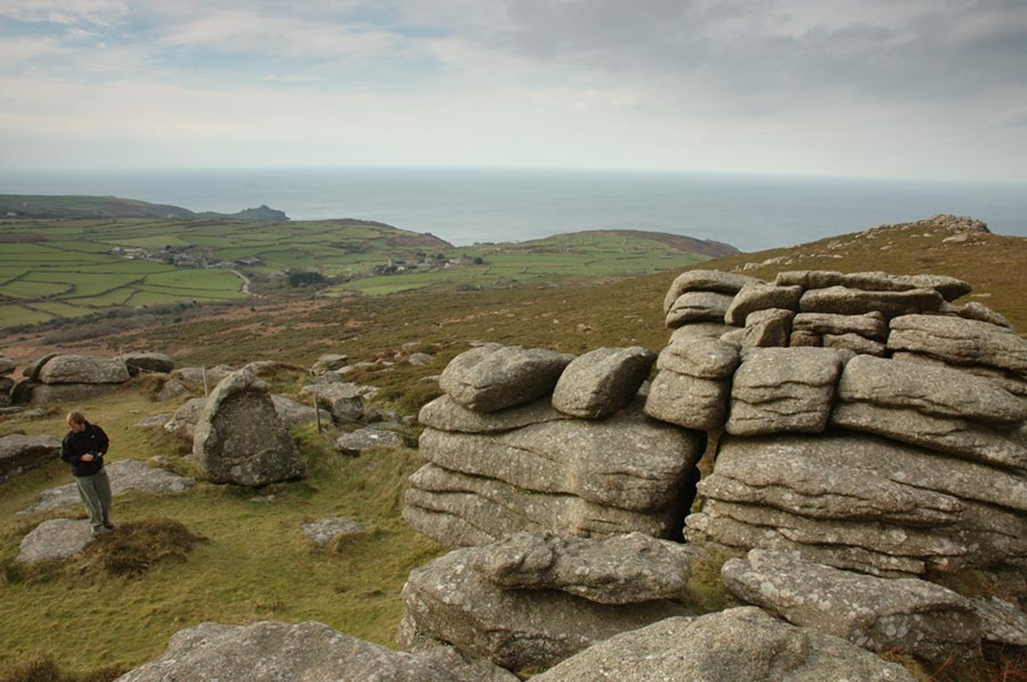
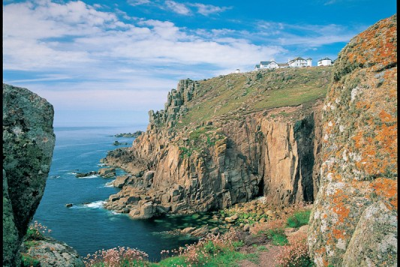
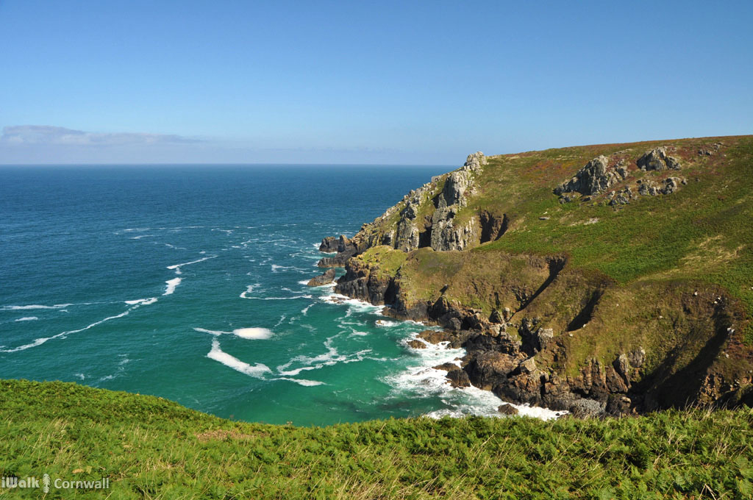
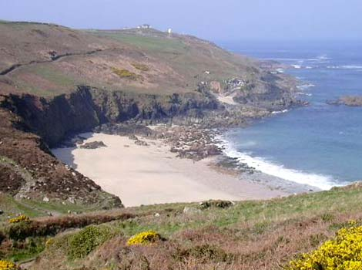
Lesson 5

Slide 2
Identifying different writing techniques.
We often ask you to use lots of different techniques in your writing to help make it more interesting to read. On the next few slides there are some extracts from the Giant’s Necklace but what kind of writing technique is being used? See if you can work each one out. We’ll post the answers on Monday.

Slide 3
Noun phrase
Simile
Metaphor
Alliteration
Personification
What am I?
‘flickering yellow light’

Slide 4
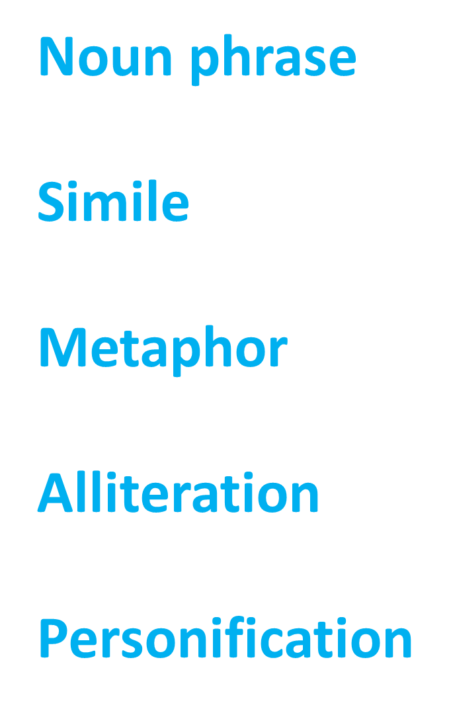
What am I?
‘like a candle shaken by the wind’

Slide 5
What am I?
‘furious sea frothing’

Slide 6
What am I?
‘a ledge of rock’

Slide 7
Look at the paragraph beginning ‘Cherry lay on her side..’
How is Cherry’s situation made to seem dangerous? Explain two features, giving evidence from the text in your answer.
(paragraph included on the next slide.)

Slide 8
Cherry lay on her side where the tide had lifted her and coughed until her lungs were clear. She woke as the sea came in once again and frothed around her legs. She rolled over on her back, feeling the salt spray on her face, and saw that it was night. The sky above her was dashed with stars and the moon rode through the clouds.

