Slide 1


Year 6 – Summer Block 3 – Statistics
Step 4: Circles
© Classroom Secrets Limited 2018

Slide 2
Introduction
Challenge
How long does it take you to complete these calculations?
Double
24
47
86
19.4
62.5
94.37
Half
68
842
94
76
85
38.66
© Classroom Secrets Limited 2018

Slide 3
Introduction
Challenge
How long does it take you to complete these calculations?
Double
24 | 48
47 | 94
86 | 172
19.4 | 38.8
62.5 | 125
94.37 | 188.74
Half
68 | 34
842 | 421
94 | 47
76 | 38
85 | 42.5
38.66 | 19.33
© Classroom Secrets Limited 2018

Slide 4
Varied Fluency 1
Tick the circle which has a radius of 76mm.
A
B
76mm
76mm
© Classroom Secrets Limited 2018

Slide 5
Varied Fluency 1
Tick the circle which has a radius of 76mm.
A
B
76mm
✓
76mm
© Classroom Secrets Limited 2018

Slide 6
Varied Fluency 2
Use the measurements below to label the radius and diameter.
27.5m | 55m
© Classroom Secrets Limited 2018

Slide 7
Varied Fluency 2
Use the measurements below to label the radius and diameter.
27.5m | 55m
55m
27.5m
© Classroom Secrets Limited 2018

Slide 8
Varied Fluency 3
Match each diameter to its radius.
59m | 47.5m
95m | 63.5m
83m | 29.5m
127m | 41.5m
© Classroom Secrets Limited 2018

Slide 9
Varied Fluency 3
Match each diameter to its radius.
59m | 47.5m
95m | 63.5m
83m | 29.5m
127m | 41.5m
© Classroom Secrets Limited 2018

Slide 10
Varied Fluency 4
Use your ruler to draw and measure the radius and diameter.
© Classroom Secrets Limited 2018

Slide 11
Varied Fluency 4
Use your ruler to draw and measure the radius and diameter.
Please note this image will appear larger when
displayed on a whiteboard. You may wish to print
copies for your children to view at the correct size.
4.5cm
9cm
© Classroom Secrets Limited 2018

Slide 12
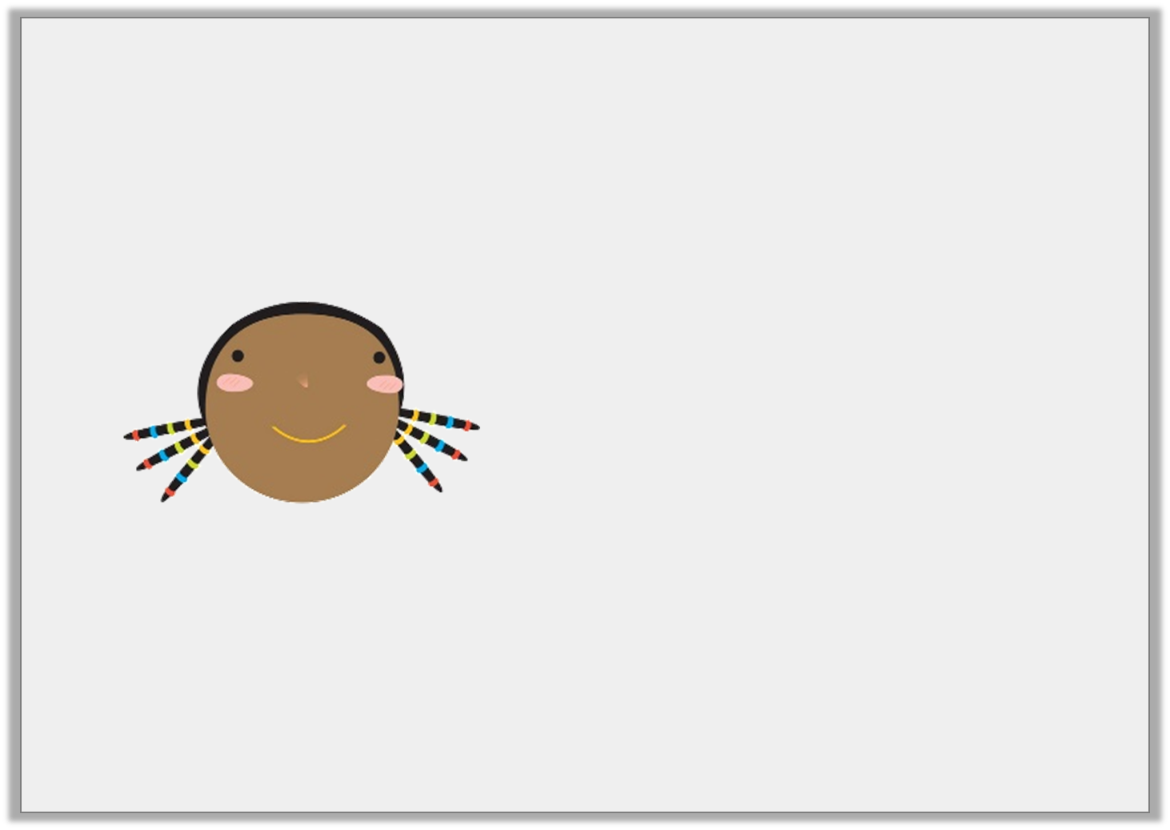
Reasoning 1
Jemima says,
Is she correct?
Explain your answer.
If the radius of a circle is 95.5mm then the diameter
must be 190mm.
© Classroom Secrets Limited 2018

Slide 13
Reasoning 1
Jemima says,
Is she correct?
Explain your answer.
Jemima is not correct because…
If the radius of a circle is 95.5mm then the diameter
must be 190mm.
© Classroom Secrets Limited 2018

Slide 14
Reasoning 1
Jemima says,
Is she correct?
Explain your answer.
Jemima is not correct because the diameter is always double the length of the radius, so it would be 191mm.
If the radius of a circle is 95.5mm then the diameter
must be 190mm.
© Classroom Secrets Limited 2018

Slide 15

Reasoning 2
Find the radius of the plate.
Explain how you know.
147mm
© Classroom Secrets Limited 2018

Slide 16
Reasoning 2
Find the radius of the plate.
Explain how you know.
The radius of the plate is 73.5mm because…
147mm
© Classroom Secrets Limited 2018

Slide 17
Reasoning 2
Find the radius of the plate.
Explain how you know.
The radius of the plate is 73.5mm because it is half of the diameter which is 147mm.
147mm
© Classroom Secrets Limited 2018

Slide 18
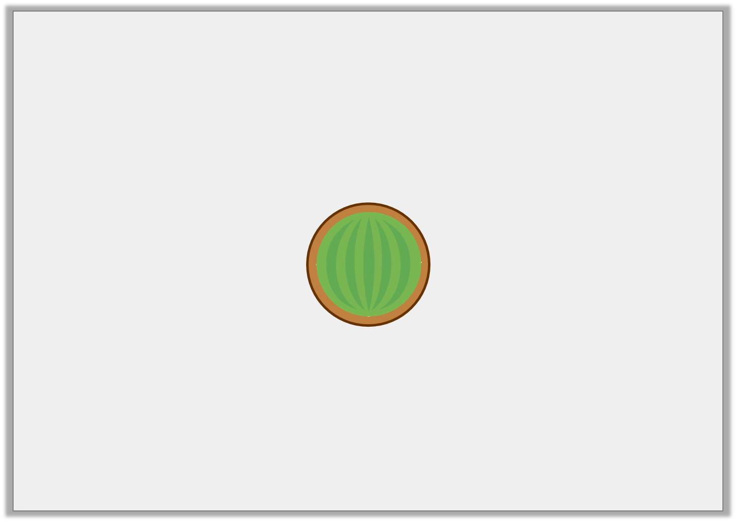
Problem Solving 1
Melons are stored in round tubs.
The tubs must be bigger than the melons.
Calculate the missing sizes.
1
5
Melon Radius | Tub Diameter
45mm
 | 80mm
© Classroom Secrets Limited 2018

Slide 19
Problem Solving 1
Melons are stored in round tubs.
The tubs must be bigger than the melons.
Calculate the missing sizes.
1
5
Melon Radius | Tub Diameter
45mm | 108mm
32mm | 80mm
© Classroom Secrets Limited 2018

