Slide 1







How do I understand
information
about money
from around
the world?
Presentation

Slide 2
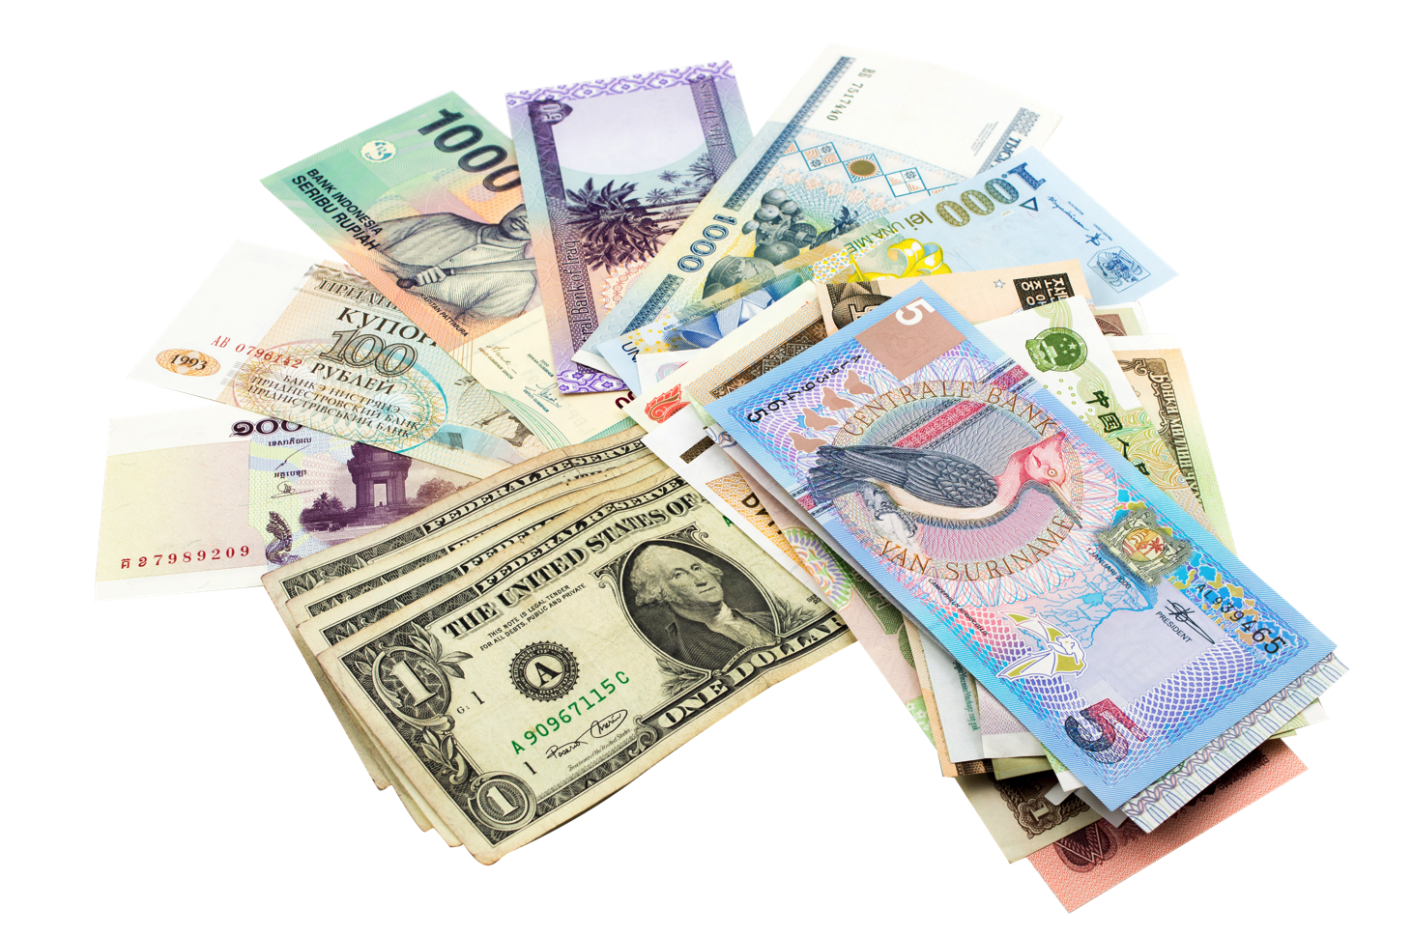
How is money different
in other
countries?
In the UK we use
British pounds, but other countries have different types of currency (money).

Slide 3
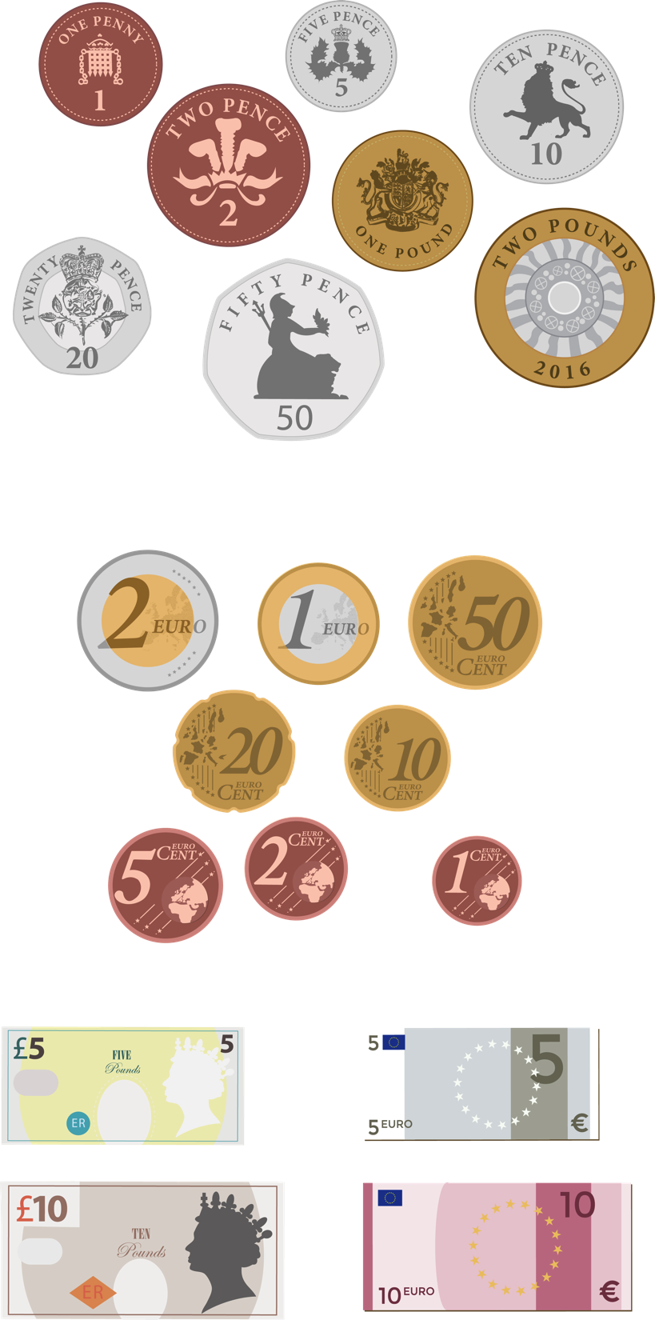
The euro
Many countries in Europe use the same currency – the euro. If you have euros, you can spend them in Ireland, France, Germany, Spain, Italy, and many other European countries.
But this doesn’t mean that things cost the same amount in each of the countries.
The same product would cost more in some countries and less in others.
How do I understand information about money from around the world? | 3

Slide 4
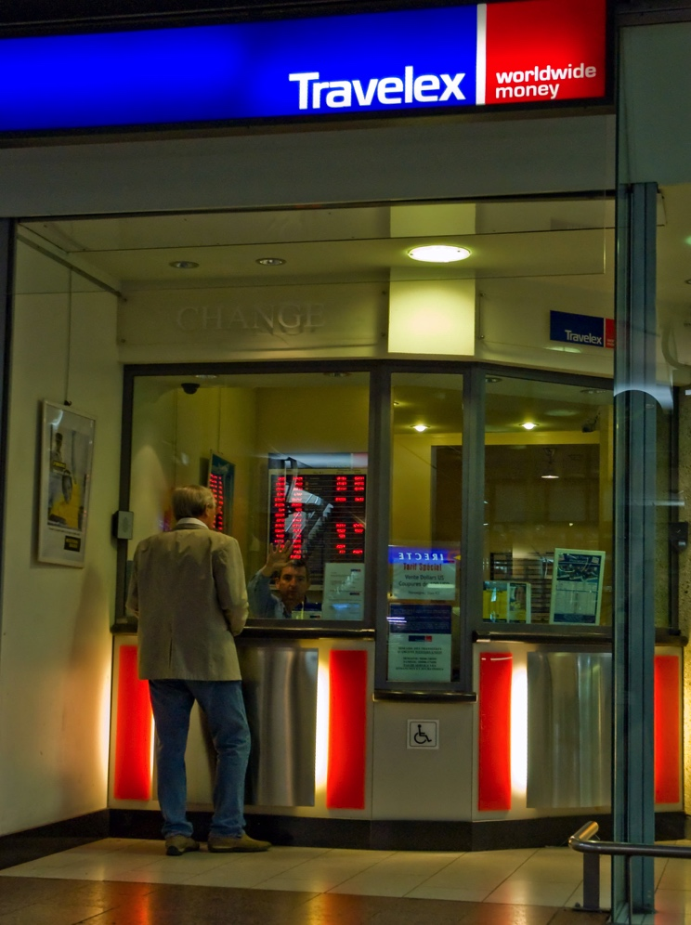
Exchanging British pounds for foreign currency
If you travel to another country, you need to exchange your money for the currency of the country you’re going to.
There are lots of places that exchange money, such as banks, post offices and travel agents.
You give them a certain amount in British pounds and they give you an amount in the currency you need.

Slide 5
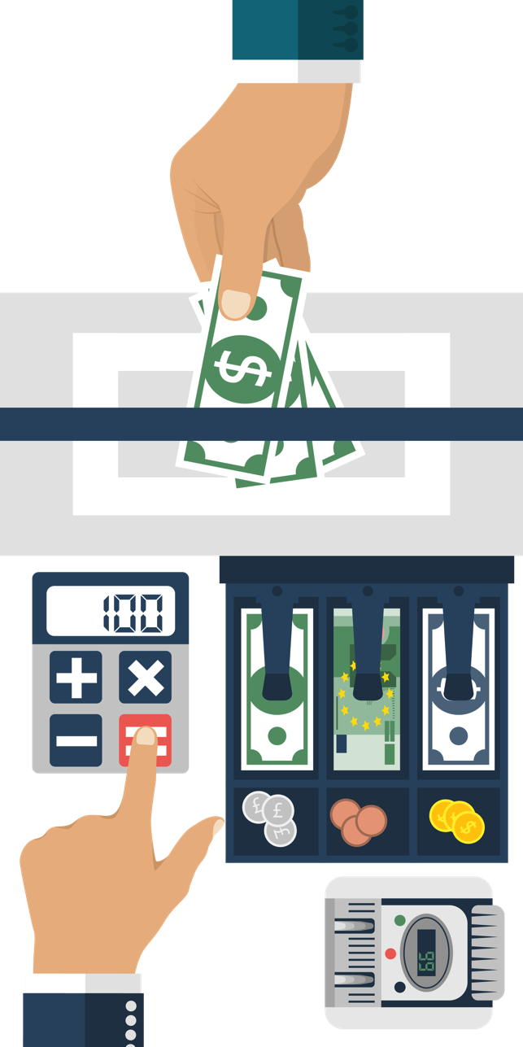
Exchange rates
The exchange rate tells us how much of a foreign currency you can buy for one British pound.
For example, if the exchange rate to convert British pounds to Australian dollars was:
1 British pound = 2 Australian dollars
for 10 British pounds, you’d get back 20 Australian dollars.
Exchange rates can change daily (and sometimes even more frequently).

Slide 6
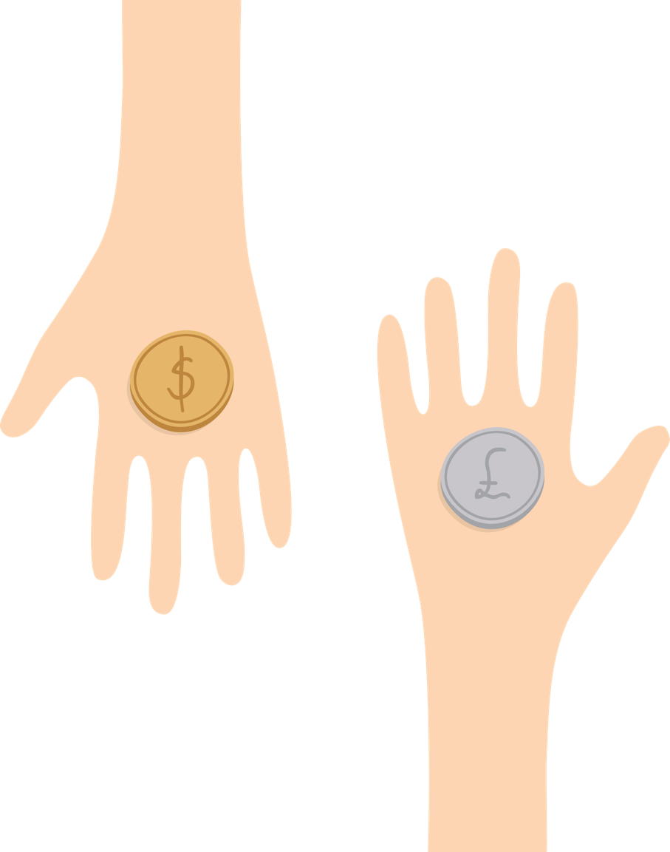
Changing exchange rates
The value of different currencies is always changing. Currencies can get ‘weaker’ or ‘stronger’, compared with other currencies.
For example, 1 British pound was worth nearly
2 US dollars in 2008.
But in 2016, 1 British pound was only worth around
1 US dollar. The value of the pound had weakened.
That means that buying a pair of $100 trainers in America might have cost £50 in 2008…
…but nearly £100 in 2016!

Slide 7
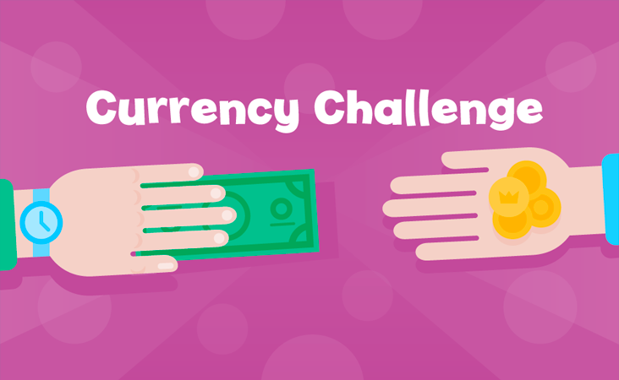
‘Currency challenge’ interactive activity

Slide 8
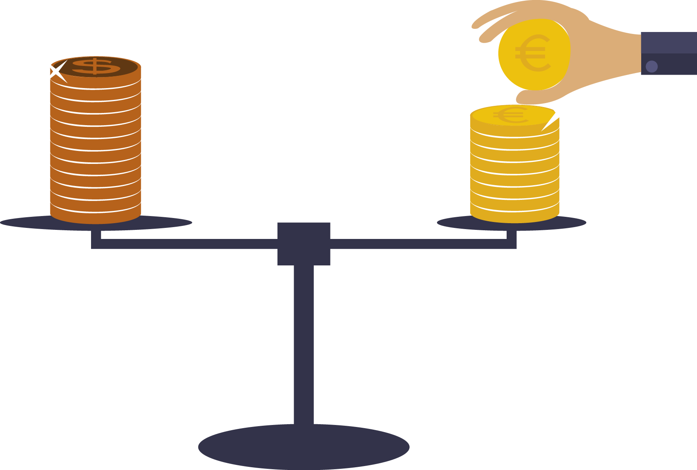
Money around the world activity
You’re going to visit a number of different countries to find out how much a product costs in each. Convert the amounts into British pounds to find out which country is selling the product the cheapest.
Remember, to change a foreign currency back to British pounds:
foreign currency ÷ exchange rate
= amount in British pounds
Example: If 1 British pound = 90 Indian rupees
180 Indian rupees ÷ 90 = 2 British pounds

Slide 9

Why is it important to know about other currencies?
Here’s one reason…
Imagine you’re travelling to South Korea. You’ve changed your British pounds into South Korea’s currency – the ‘won’.
You see a chocolate bar, but it costs
690 South Korean won!
Is that really expensive?
What would you need to know?

Slide 10

Why is it important to know
about other currencies?
The exchange rate is:
1 British pound =
1,380 South Korean won
Remember that the chocolate bar cost 690 won.
How much does it cost
in British pounds?

