Slide 1
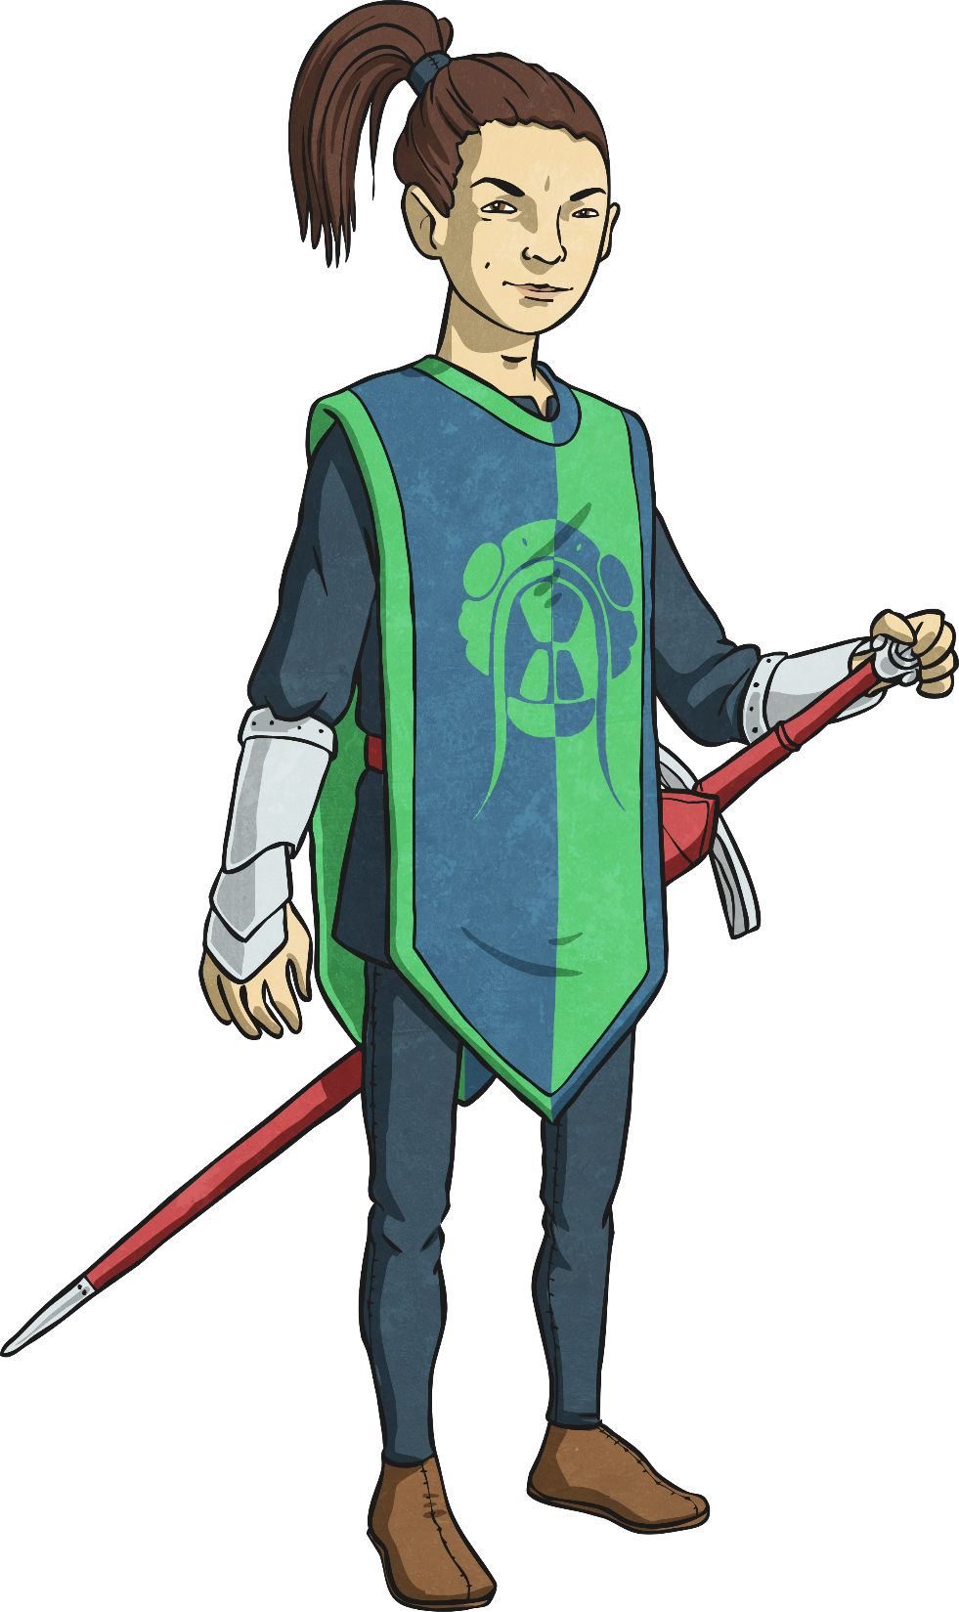
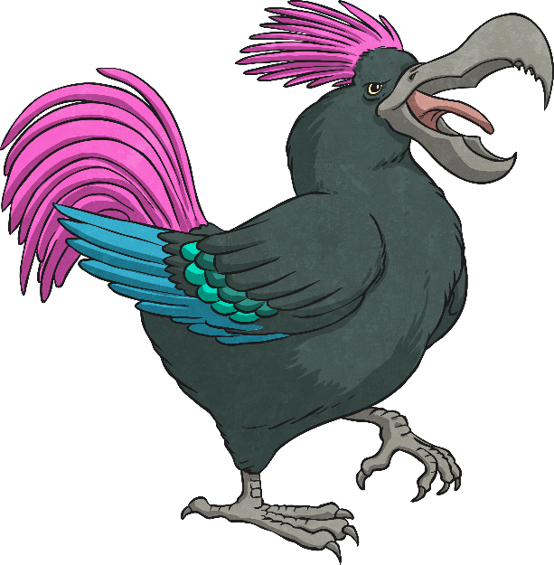

Imitation Poem

Slide 2
Watch a different performance of the Jabberwocky by clicking below. Can you join in with any of it?
https://www.bbc.co.uk/programmes/p011n4hk

Slide 3

Imitation Poem
In this lesson, you are going to imitate a poem.
Top Tips
Do follow the poem closely. Follow the formal features of the poem: word placement on the page, shape, syllables, narrative structure and punctuation.
Don’t follow the original poem’s subject matter – the subject matter should be far away from the original poem’s so that your poem doesn’t sound just like the original.

Slide 4

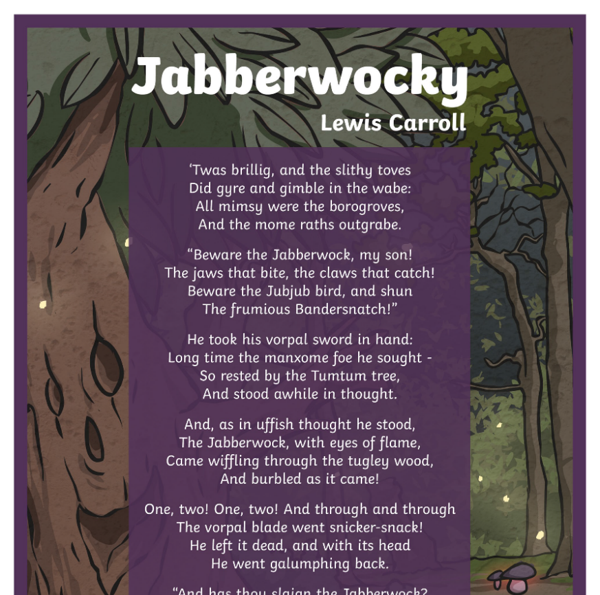

Imitation Poem
You will decide upon your own setting. Choose one from below or another of your choice.
Where is the setting of the poem?
Who is the personal enemy (manxome foe)?

Slide 5

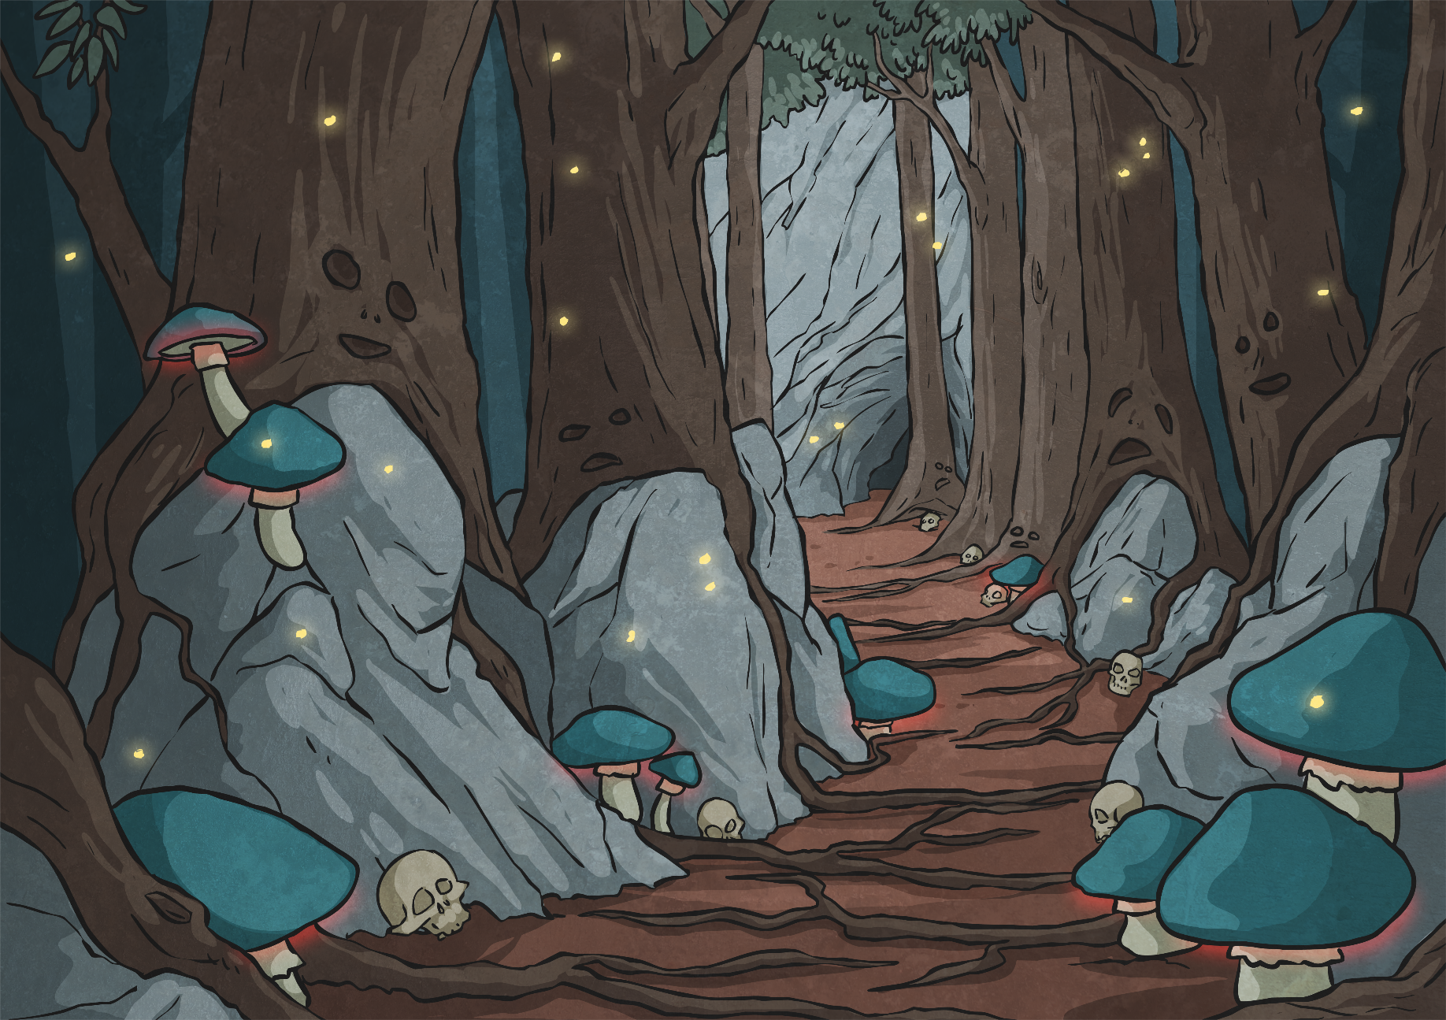
Imitation Poem
Kiddersnacky
‘Twas bleakly, and the frighthy ghousts
Did gaunt and himble in the hoube;
All spoofsy were the chilogans,
And the visc vamps roamabe.
Who is the personal enemy going to be? (like the manxome foe?)

Slide 6

Formal Features
Here comes the tricky part!
Jabberwocky has a regular rhyme scheme. It is written in quatrains (four-line stanzas). Let’s look at the first lines with the accents all marked out:
‘Twas Brill-ig, and the sli-thy toves
Did gyre and gim-ble in the wabe’
Do you notice that there are four stressed syllables in each line, and that they alternate neatly with unstressed syllables, with the unstressed syllable coming first? That's called iambic tetrameter. The iambic bit refers to the unstressed-STRESSED, unstressed-STRESSED rhythm of it, and the tetrameter bit is just to let you know that there are four iambs (or four unstressed-STRESSED groupings) in each line.
We call this type of poem Ballad Stanza.
What's a ballad? The short answer is that it's a song. Ballad stanza is traditionally found in folk songs and is used as a way for people to communicate legends and tales to each other orally. Its rhythm and rhyme make it easy to remember for this reason. Even though it has some strange language, Jabberwocky is no exception. Because it has the memorable rhythm and rhyme, Jabberwocky remains one of the most frequently memorised poems in the English language.

Slide 7
Formal Features
It would be a bit tricky to copy the stressed and unstressed syllables exactly, but we can try to copy the number of syllables in each line.
Count the syllables in the first line of the Jabberwocky, then count the syllables in the first line of Kiddersnacky.
Do they match? Repeat for the other lines.
How does this improve the imitation poem?
Jabberwocky
‘Twas brillig, and the slithy toves
Did gyre and gimble in the wabe:
All mimsy were the borogroves,
And the mome raths outgrabe.
Kiddersnacky
‘Twas bleakly, and the frighthy ghousts
Did gaunt and himble in the hoube;
All spoofsy were the chilogans,
And the visc vamps roamabe.

Slide 8
Formal Features
Can you spot any other formal features that have been imitated from the Jabberwocky?
The placing of the punctuation.
The placing of the nonsense/portmanteau words.
Jabberwocky
‘Twas brillig, and the slithy toves
Did gyre and gimble in the wabe:
All mimsy were the borogroves,
And the mome raths outgrabe.
Kiddersnacky
‘Twas bleakly, and the frighthy ghousts
Did gaunt and himble in the hoube;
All spoofsy were the chilogans,
And the visc vamps roamabe.

Slide 9
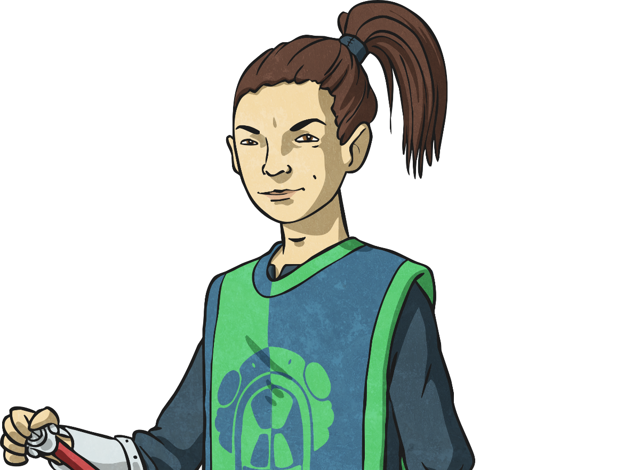
Formal Features
You are now going to work to create your own imitation poem. Remember:
Choose your setting and your personal enemy.
Imitate the placing of the punctuation.
Imitate the placing of the portmanteau/nonsense words.
Try to imitate the number of syllables in each line.

Slide 10
Use the planning sheet to help you keep to the same rhythm, rhyme and syllables in the poem. We’ll be spending the next couple of days writing our poems so you don’t have to do it all in one day.

