Slide 1
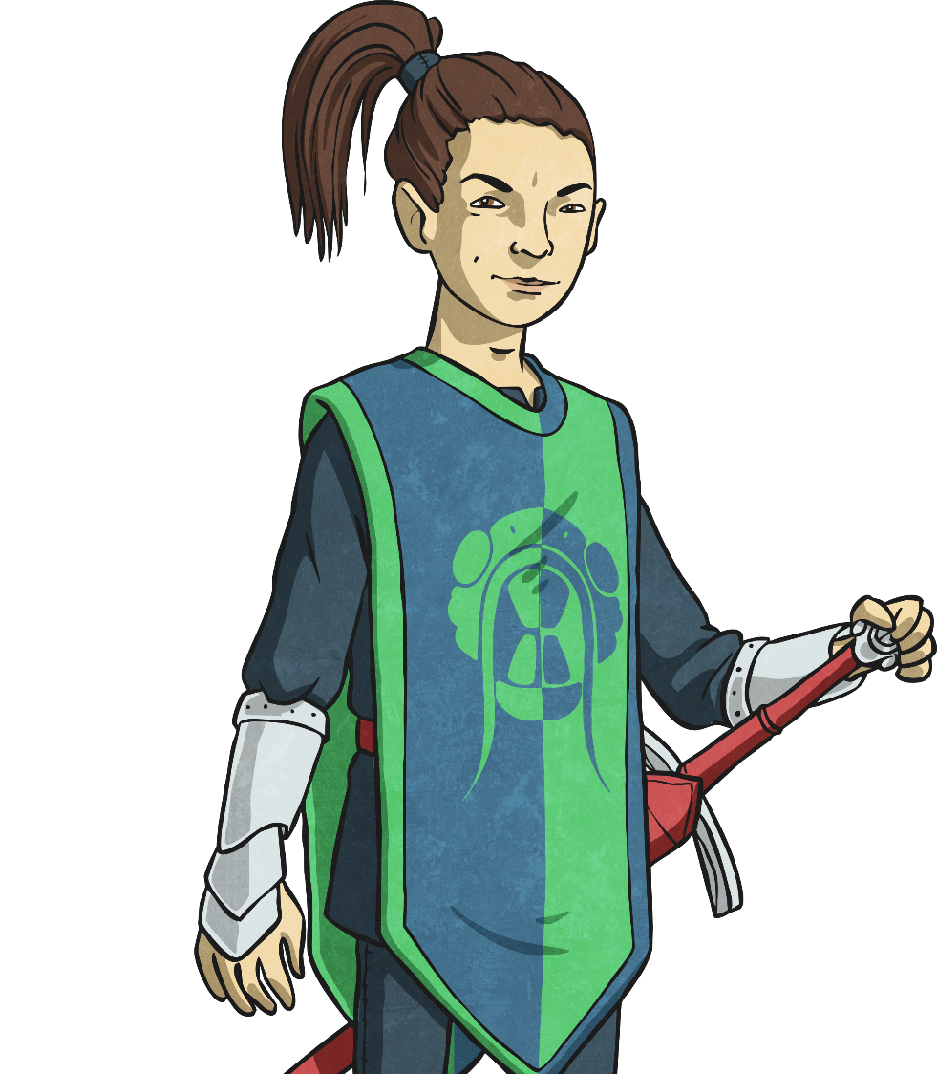
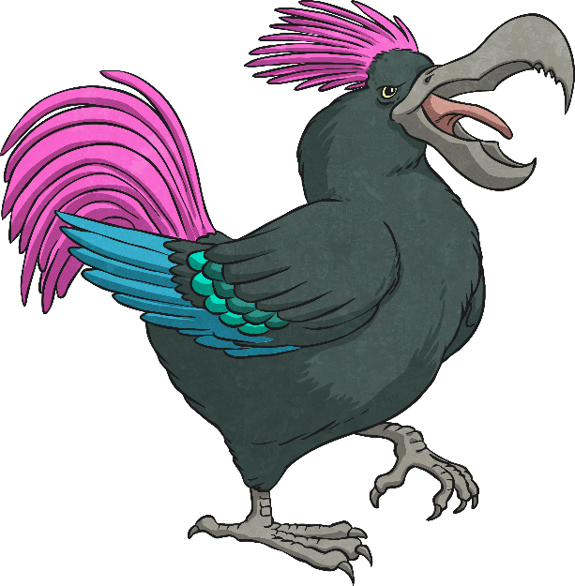

The Jabberwocky

Slide 2
Watch another different performance of the Jabberwocky by clicking below. Can you join in with any of it?
https://www.bbc.co.uk/bitesize/clips/z378q6f
If you want to read along, you could print out the Jabberwocky poem on the webpage or look at slide 4.

Slide 3

Think about these questions
Spend some time reading through the poem on the next slide or print off a copy if you’d like to.
What does ‘brillig’ mean to you? Is it a time of day e.g. dusk
What did you think ‘toves’ are?
Does ‘slithy’ mean something between ‘slimy’ and ‘writhing’?
Do you think ‘gyring’ and ‘gimbling’ are verbs? If so, what would you be doing if you were ‘gyring’ and ‘gimbling?’
What might vorpal mean?
Ensure you have a good understanding of the poem before you move on to the activity.

Slide 4
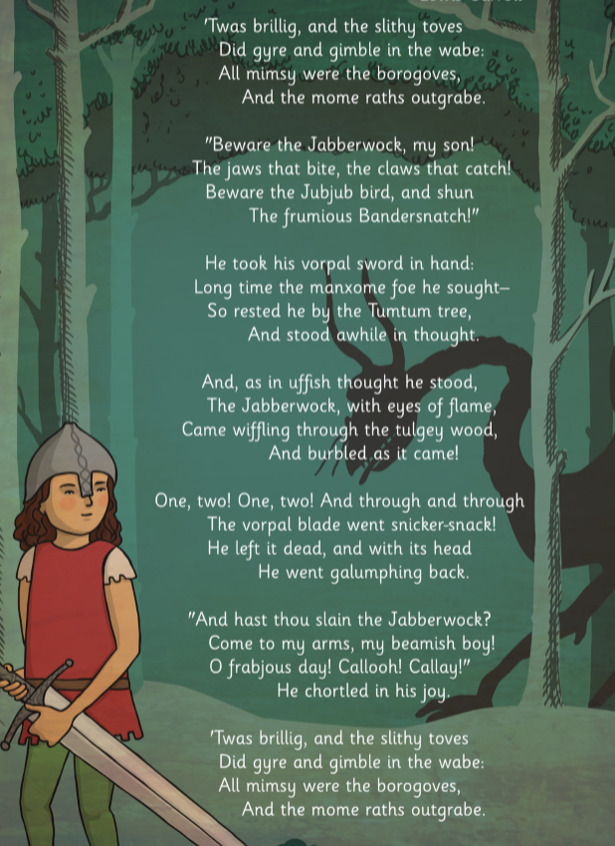

Slide 5
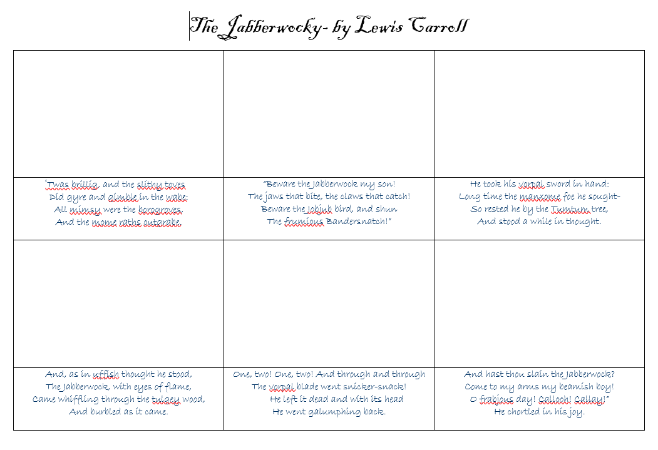
Use the Jabberwocky storyboard sheet on the webpage to illustrate what is happening in each verse of the poem. Try to include everything that it mentions in the verse so that you can talk through your ideas when you share it with us. This activity may take you a few days. (if you can’t print, ask to pick up a copy or use plain paper).

