Slide 1

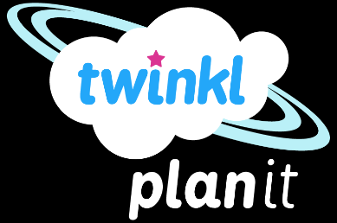
English
Jabberwocky
Year One
English | Jabberwocky | Narrative Poetry | Poetic Conventions | Lesson 1 of 4

Slide 2

Poetic Conventions

Slide 3
The Jabberwocky is a famous poem written by Lewis Caroll. It was written as part of Alice in Wonderland book.
Read through the poem on the next slide then watch it performed by Michael Rose, Can you make any sense of it?
https://www.youtube.com/watch?v=iBFSiGDZC-Y
What did you like/ dislike? What puzzles you? Can you make sense of any part of the poem? Try performing the poem yourself- can you learn part of it by heart?

Slide 4
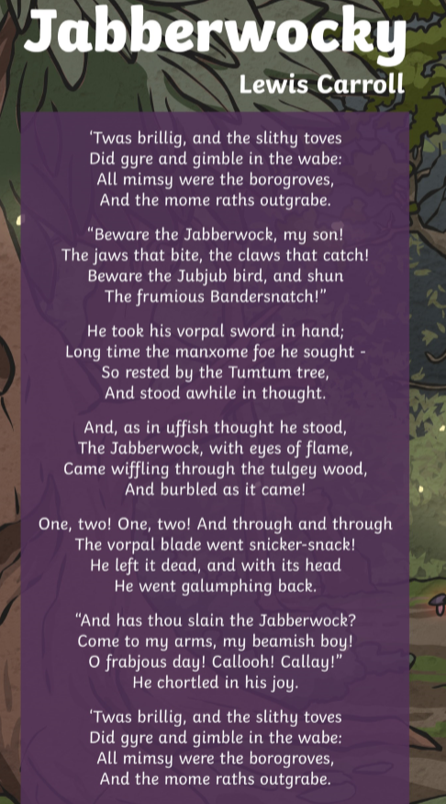
There is some tricky language in here. What do you think these words mean? Use a dictionary if you need to.
*slain,
*awhile,
*foe,
*shun,
*sought

Slide 5
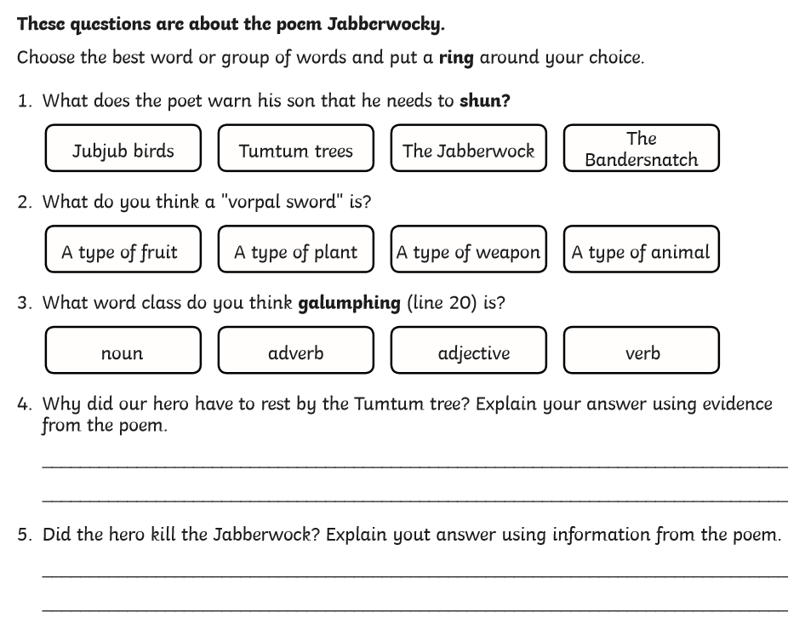
Think about these questions. No need to write.

Slide 6



Poetic Conventions
Writers use lots of poetic conventions to create different effects within their poems- remind yourselves of the different conventions that you’ll have been taught throughout KS2. Can you think of an example of each type?
Alliteration
Repeating the same sound or letter at the beginning of each or most of the words in a sentence.
Which other poetic conventions might a poet use to help them create their poems?

Slide 7
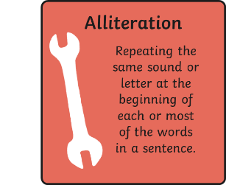
Poetic Conventions
Which poetic conventions might a poet put into his poetry toolbox?
Rhythm
Using words in a fun pattern that makes the poem easy to remember.

Slide 8
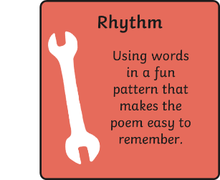
Poetic Conventions
Which poetic conventions might a poet put into his poetry toolbox?
Metaphor
Telling the reader that something is something else.

Slide 9
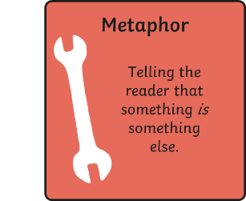
Poetic Conventions
Which poetic conventions might a poet put into his poetry toolbox?
Imagery
Using words to help the reader form a picture in their mind.

Slide 10
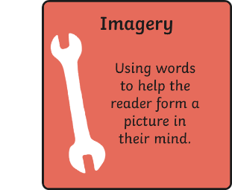
Poetic Conventions
Which poetic conventions might a poet put into his poetry toolbox?
Personification
Giving human qualities to something that isn’t human.

Slide 11
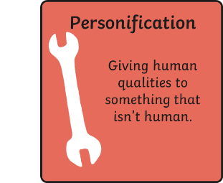
Poetic Conventions
Which poetic conventions might a poet put into his poetry toolbox?
Onomatopoeia
A word that imitates the natural sound of the thing it is describing.

Slide 12
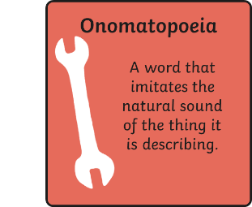
Poetic Conventions
Which poetic conventions might a poet put into his poetry toolbox?
Rhyme
Using words that have endings that sound the same.

Slide 13
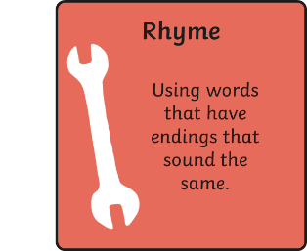
Poetic Conventions
Which poetic conventions might a poet put into his poetry toolbox?
Similes
Comparing two things using the words ‘like’ or ‘as’.

Slide 14
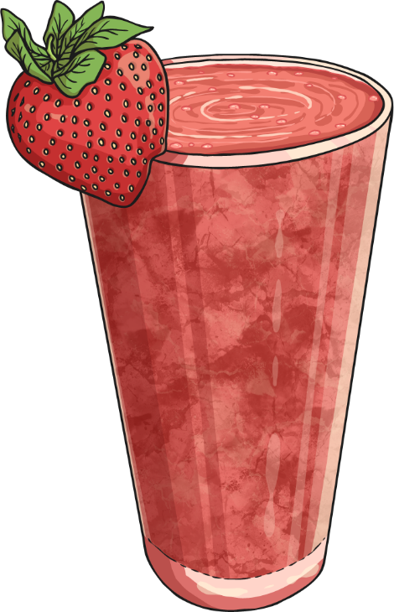
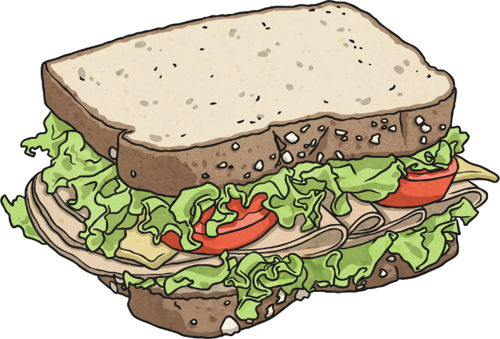
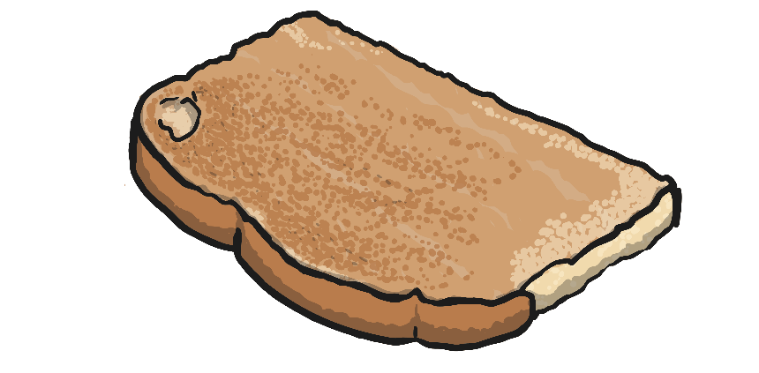
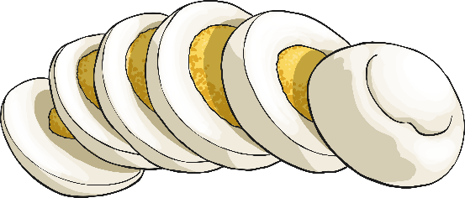
Poetic Conventions
The final poetic convention we are going to add to our toolbox is one which is used a lot in the poem Jabberwocky – portmanteau.
Portmanteau
Definition:
The convention of joining together two or more words in order to create an entirely new word.
Example:
Smoke + fog = smog. Smog has the properties of both fog and smoke.
Lion + tiger = liger. A hybrid of the two feline species, possessing both characteristics of a lion and a tiger.
Breakfast + lunch = brunch. A late morning meal eaten instead of breakfast and lunch.

Slide 15

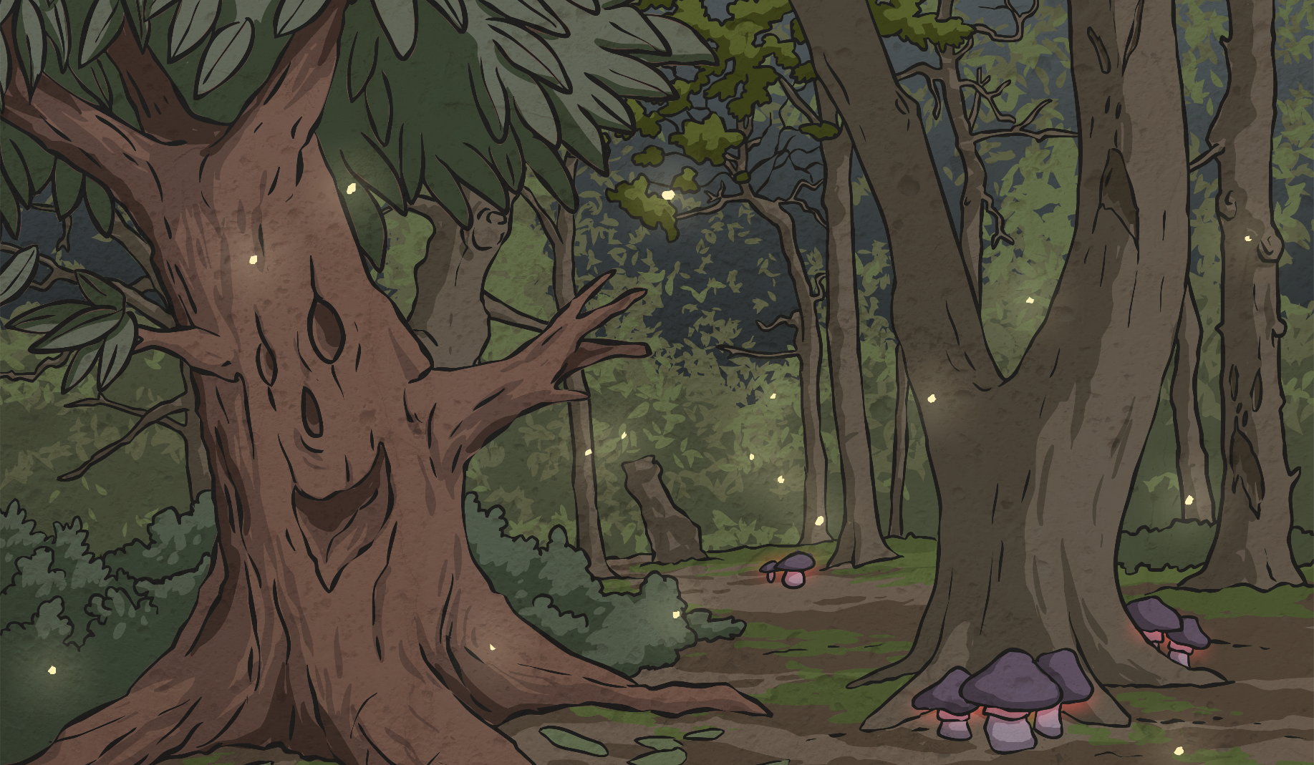
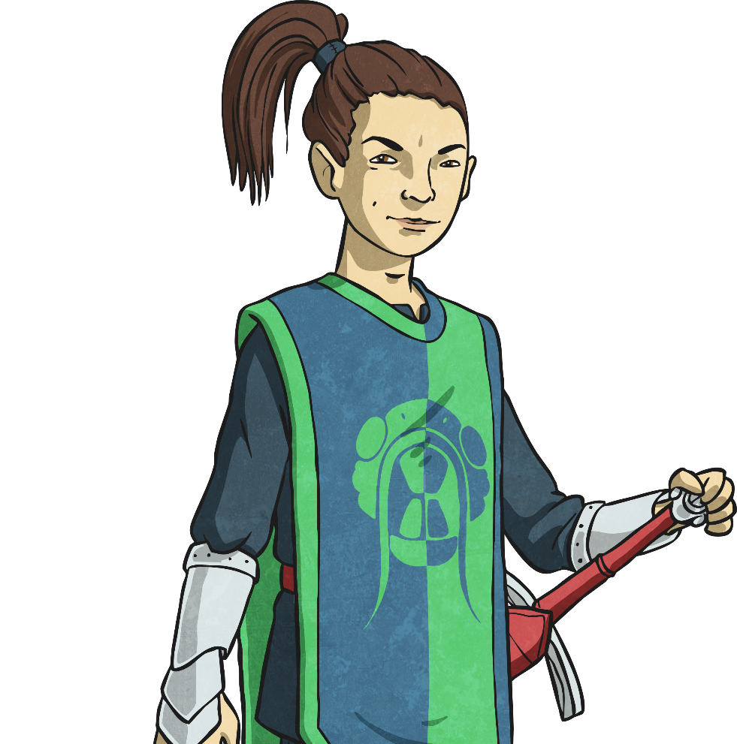
Portmanteau
Which words do you think use portmanteau?
‘Twas brillig, and the slithy toves
Did gyre and gimble in the wabe:
All mimsy were the borogroves,
And the mome raths outgrabe.’

Slide 16
Portmanteau
Complete the chart- which two words do you think the poet has joined together? You can check what we think on the end slide (these are just guesses- we’ll never know for sure)
Word taken from the poem | Word 1 | Word 2
brillig
frabjous
galumph
mimsy
slithy
chortled

Slide 17

Create Your Own
In your book, create your own portmanteau words.
Write down which two words have been used and what the new word means.
Example
Brinkle = brilliant + twinkle.
A term used to describe something amazing.
You could invent words to describe:
Weather
New creatures
Times of day
Verbs (ways of moving or doing)
You could set out your learning similar to the chart on slide 16.

Slide 18
Portmanteau Answers
Which two words do you think the poet has joined together?
Word taken from the poem | Word 1 | Word 2
brillig | brilliant | morning
frabjous | fabulous | joyous
galumph | gallop | triumph
mimsy | miserable | flimsy
slithy | slimy | lithe
chortled | chuckled | snorted

