Slide 1

Light
1. Seeing Light

Slide 2
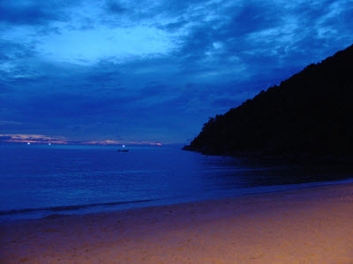
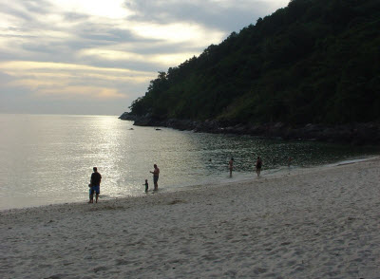


Look at the following photographs which were all taken in the same location.. Can you explain why they are not all the same?

Slide 3
Can you explain why the beach looks different in each photograph?

Slide 4
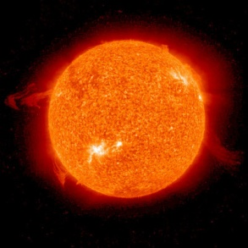
This is the reason why.
It’s the sun. This picture has been taken by a special camera in space.
On days when there are no clouds, it is bright because there is nothing to block the light from the sun.
On cloudy days, even though we can’t see the sun, the light from it still shines through the clouds because it is so bright, and still lets us see.
The sun is the main source of light on earth.

Slide 5
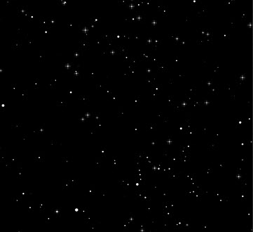
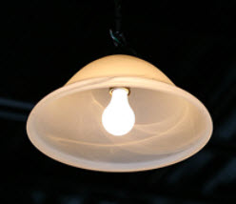
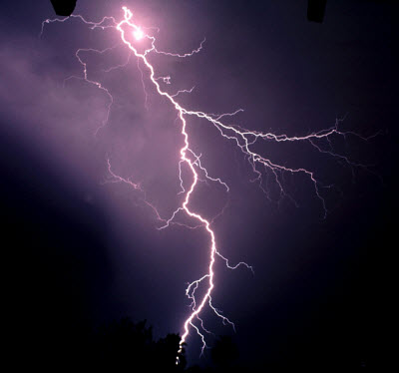
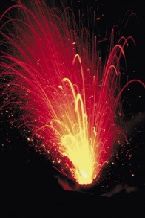
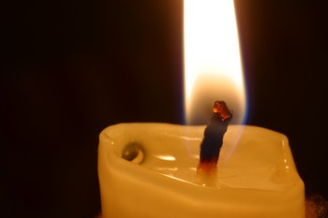
Can you think of any other sources of light?

Slide 6
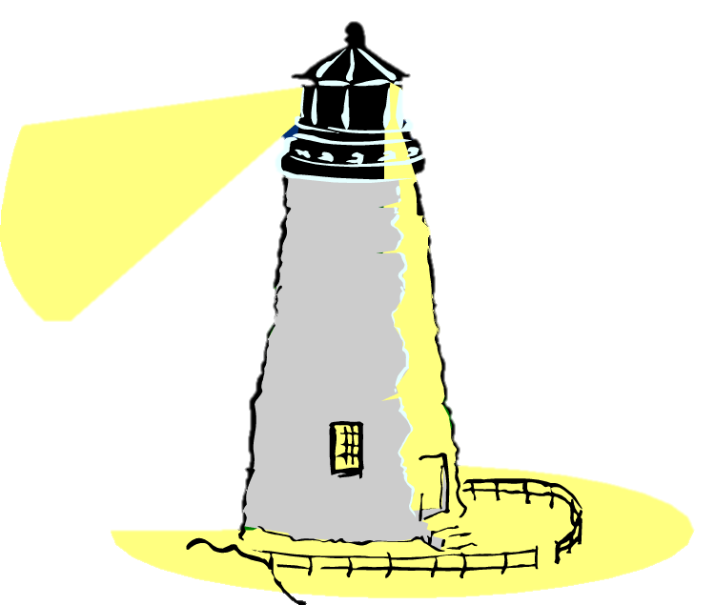
Light originates from sources of light, such as the sun, or this lighthouse.
Light travels away from sources of light in straight lines. It takes time for the light to travel, but it is so fast that it is impossible to notice.
Light travels 300 million metres every second. That’s nearly a billion miles per hour.

Slide 7
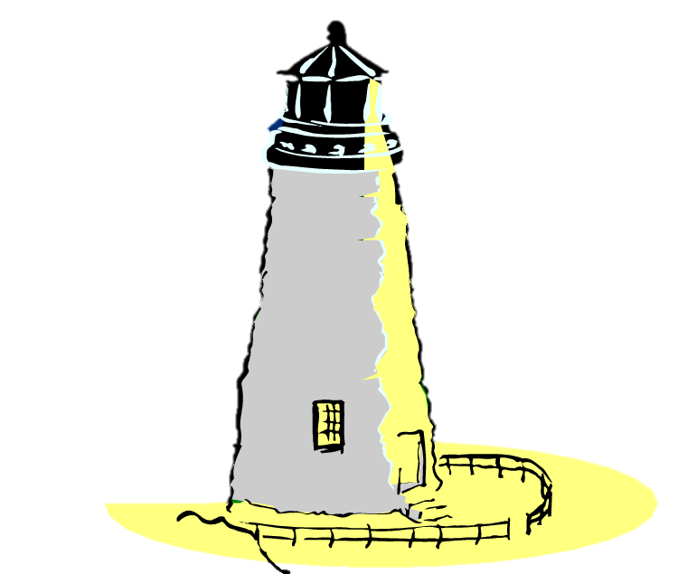
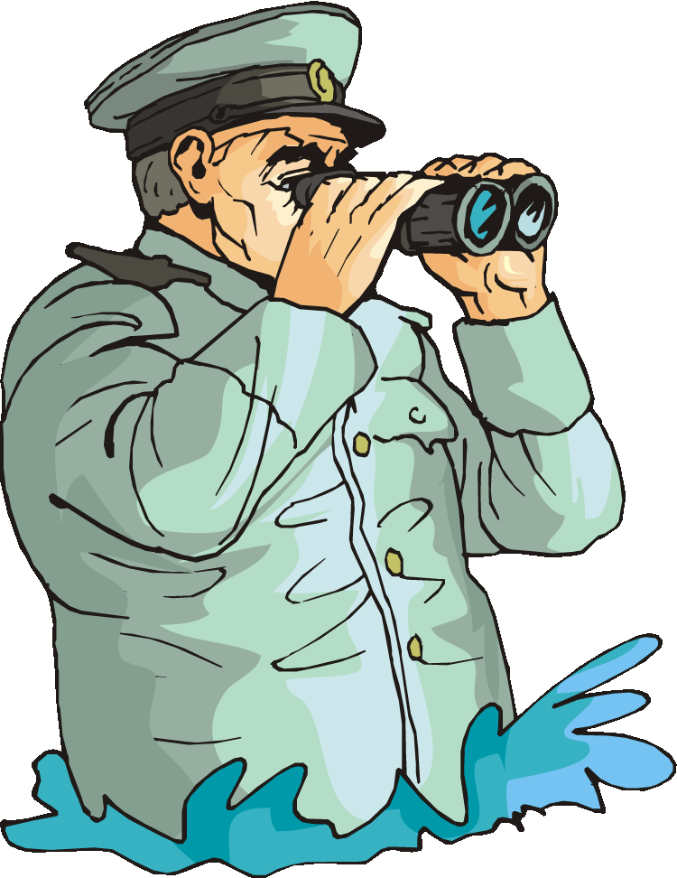
This lighthouse warns sailors of rocks.
The light from the lighthouse travels into the captain’s eyes, and he sees a bright light, which he knows means that there are rocks nearby.

Slide 8
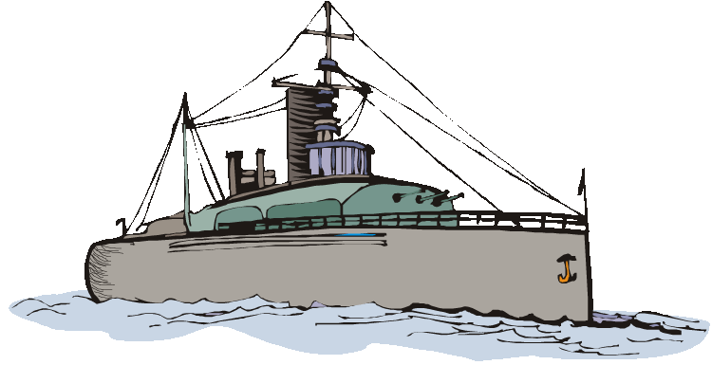
Light can also hit and bounce off objects.
During the day, the light from the Sun hits a ship.
After hitting the ship, the light then travels to the captain, allowing him to see the ship.

Slide 9
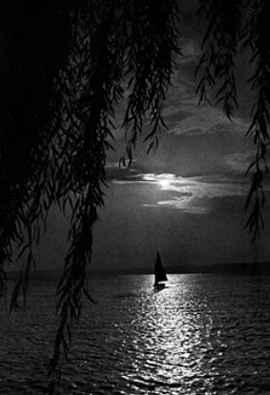
Night
In total darkness our eyes cannot see.
This rarely happens in towns and cities as there is usually always light from streetlights or light reflected from the moon.
When there is very little light our eyes adjust to the dark. Our eyes can only see faded colours, or black and grey tones.

Slide 10

Light will travel in a straight line from its source until it hits something.
Light from the Sun travels 150 billion metres before it hits the Earth. It takes the light 8 minutes to make this journey.
So if you look out the window during the day, you are watching light that has travelled 150,000,000,000 metres, only to stop after reaching your eyeballs.

Slide 11
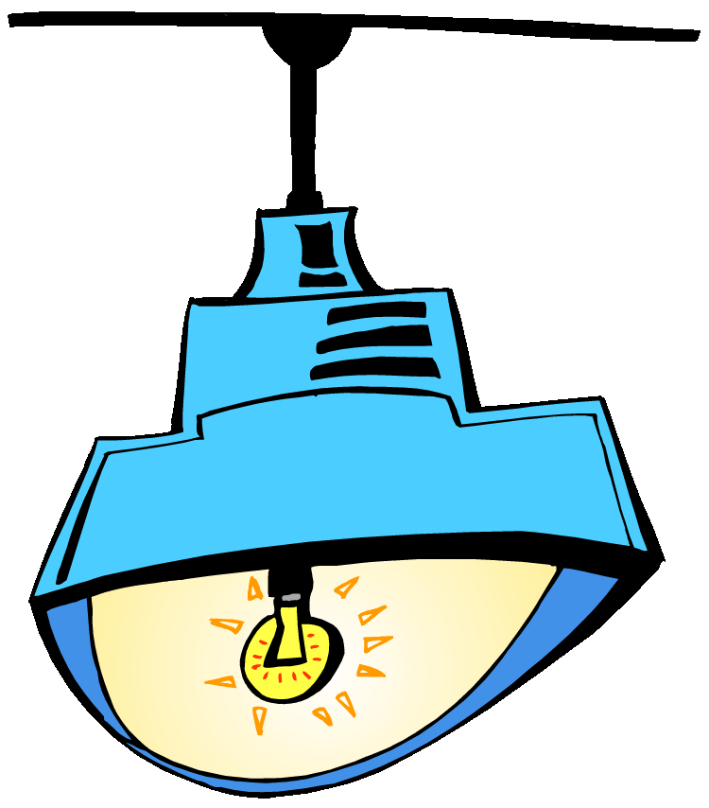
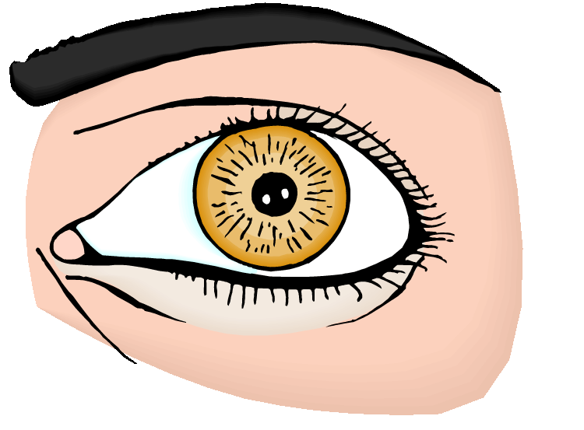
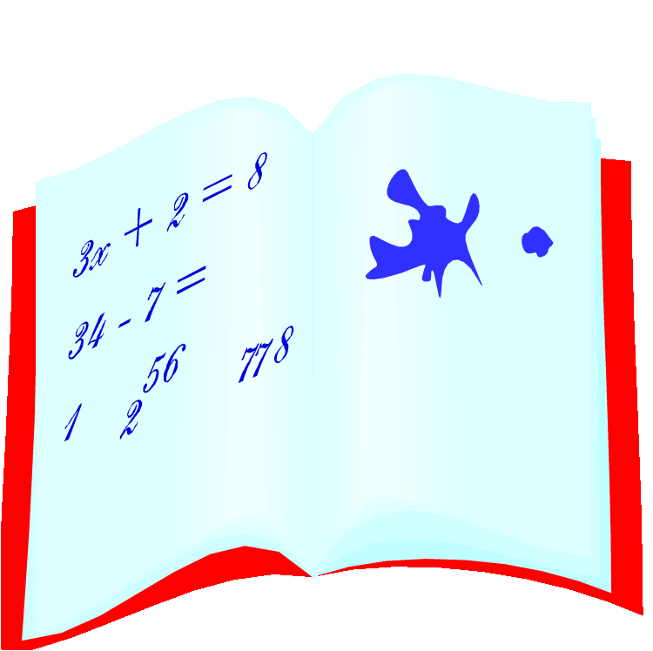
When light enters our eyes, it is focused onto the part of the eye that detects light, the retina.
The retina turns the light into a signal and sends it to your brain, allowing it to see.

Slide 12
There is an area on your retina that does not detect light, called your blind spot.
Close your right eye and look at the circle. If you are at the correct distance, you will not be able to see the square because it is in your blind spot!
Your teacher might want to find the correct distance before you try this.

Slide 13


Warning!
NEVER LOOK DIRECTLY AT THE SUN!
The Sun lights up the entire Earth. It is much too bright for our eyes to handle, and if we look directly at it we can permanently damage our eyes and even become blind.

Slide 14
Seeing Light
Can you answer these questions?
How do we see light?
Where does light come from?
Why can’t you see around a corner?
When you turn your light on, does the light instantly appear?

