Slide 1
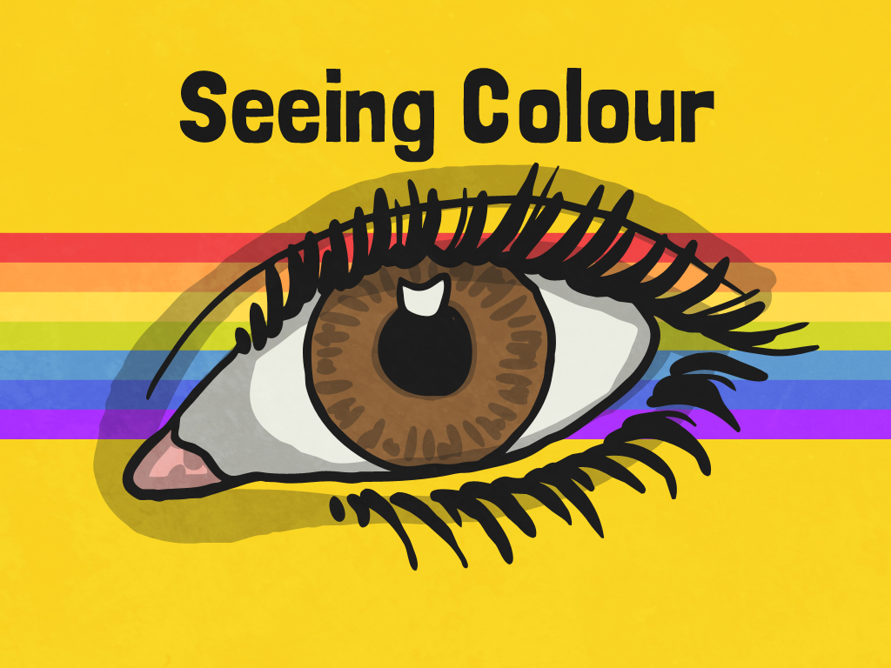


Slide 2


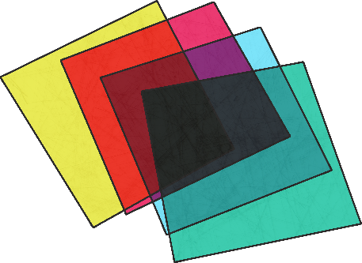


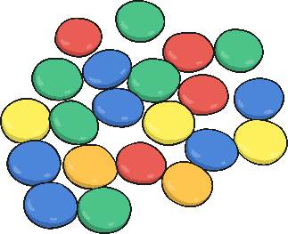

Newton’s Discovery
An optical filter is a device that lets some colours of light through, but not others.
If we had been at school, we’d have used different coloured filters to look at some coloured objects.
What do you think they will look like through the different filters?

Slide 3
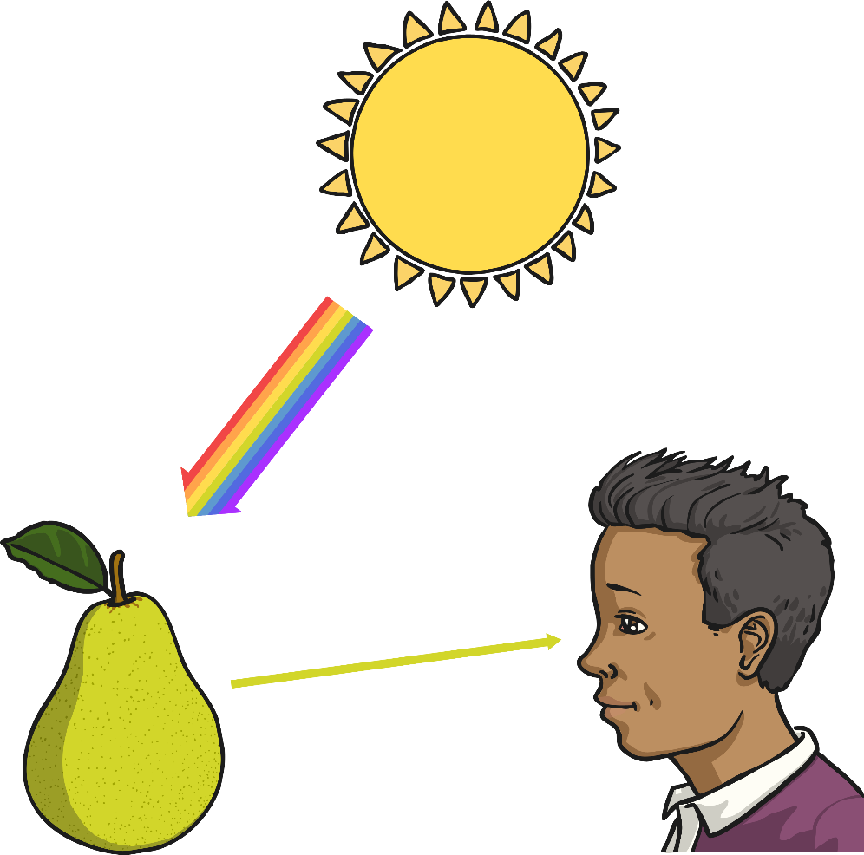
Filtering Facts
As you found out in the last lesson, white light is actually made up of all the colours of the rainbow.
This is called the ‘visible spectrum’.
When a ray of white light shines on an object, the object absorbs some colours and reflects others.
A pear reflects the green light and absorbs the other colours of light.
It is only the green light that bounces back into our eye.
The pear looks green to our eyes!

Slide 4
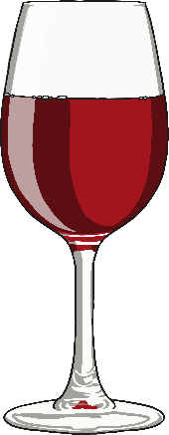
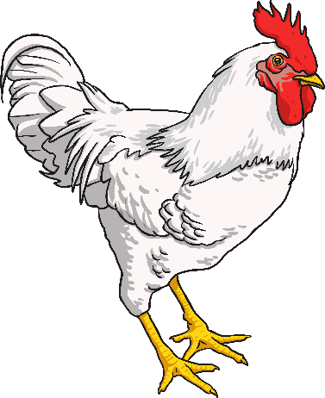
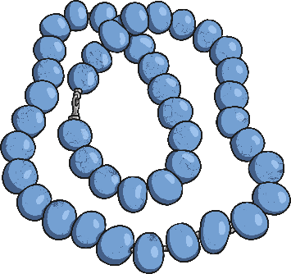

Filtering Facts
Blue objects absorb all colours of light but blue, which they reflect.
Red objects absorb all colours of light but red, which they reflect.
White objects reflect all the colours of light.
Black objects absorb all the colours of light.

Slide 5
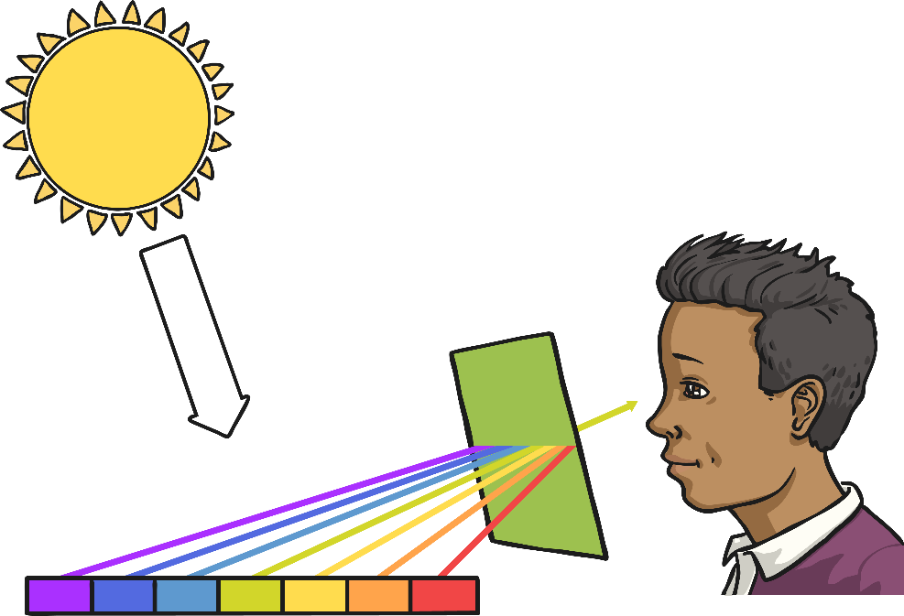
Filtering Facts
A filter only allows certain colours of light through. For example, a green filter allows green light through, but absorbs the other colours.
So if you look at a green pear through a green filter, it will still look green, because the green light will get through the filter to your eyes.
But if you look at it through a red filter, it will look black, because there is no red light reflecting off the pear, and the green light that is reflecting off it will be absorbed by the filter.

Slide 6
Watch this clip to see what happens when we mix filters.
Colour mixing

