Slide 1
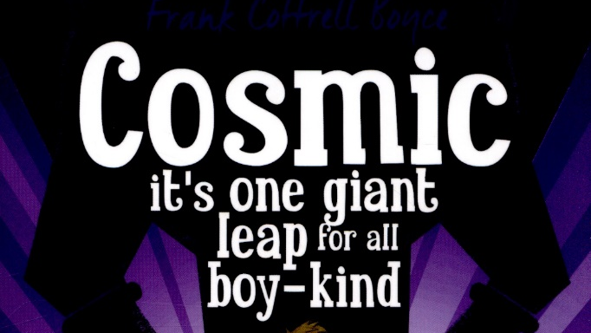
Week 1 Day 3

Slide 2

Read Chapter 4 ‘I nearly shaved myself to death’
As you read, jot down interesting information about Liam in your books.

Slide 3
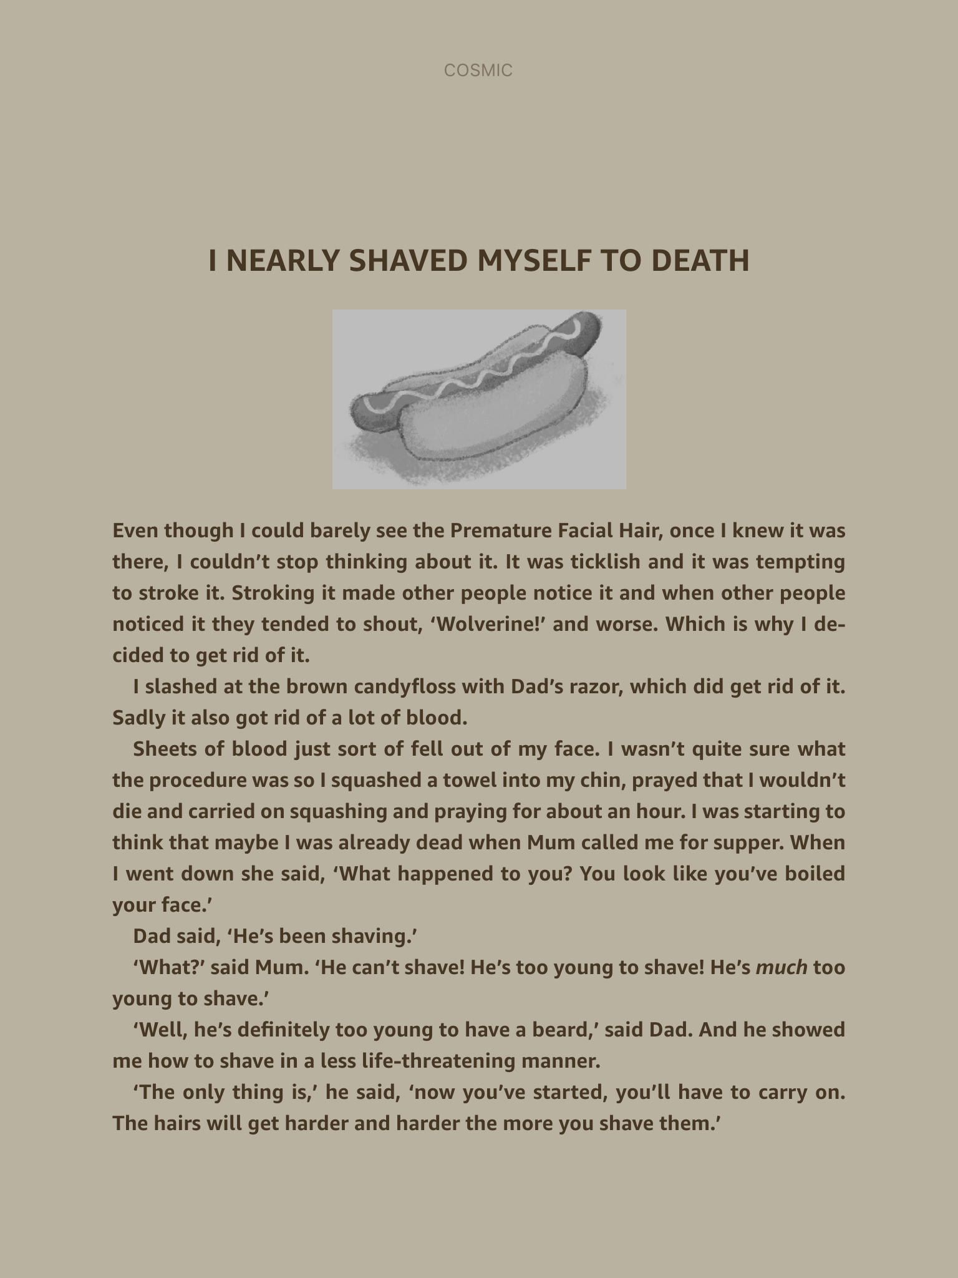

Slide 4
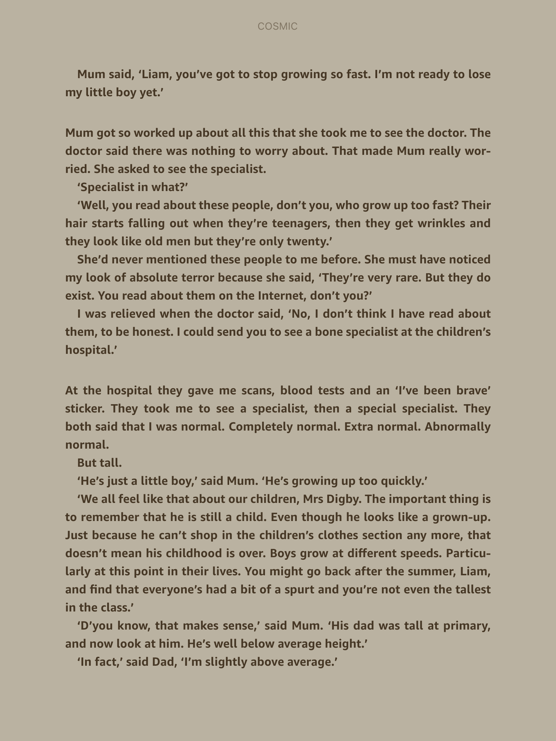

Slide 5
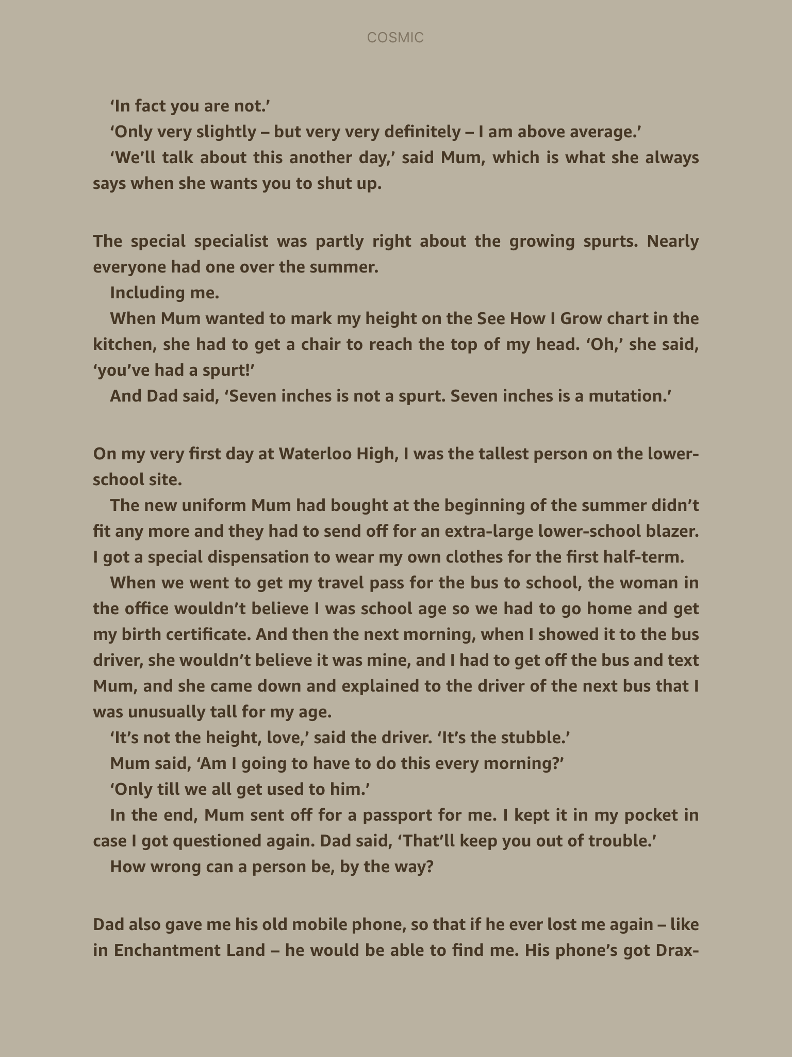

Slide 6
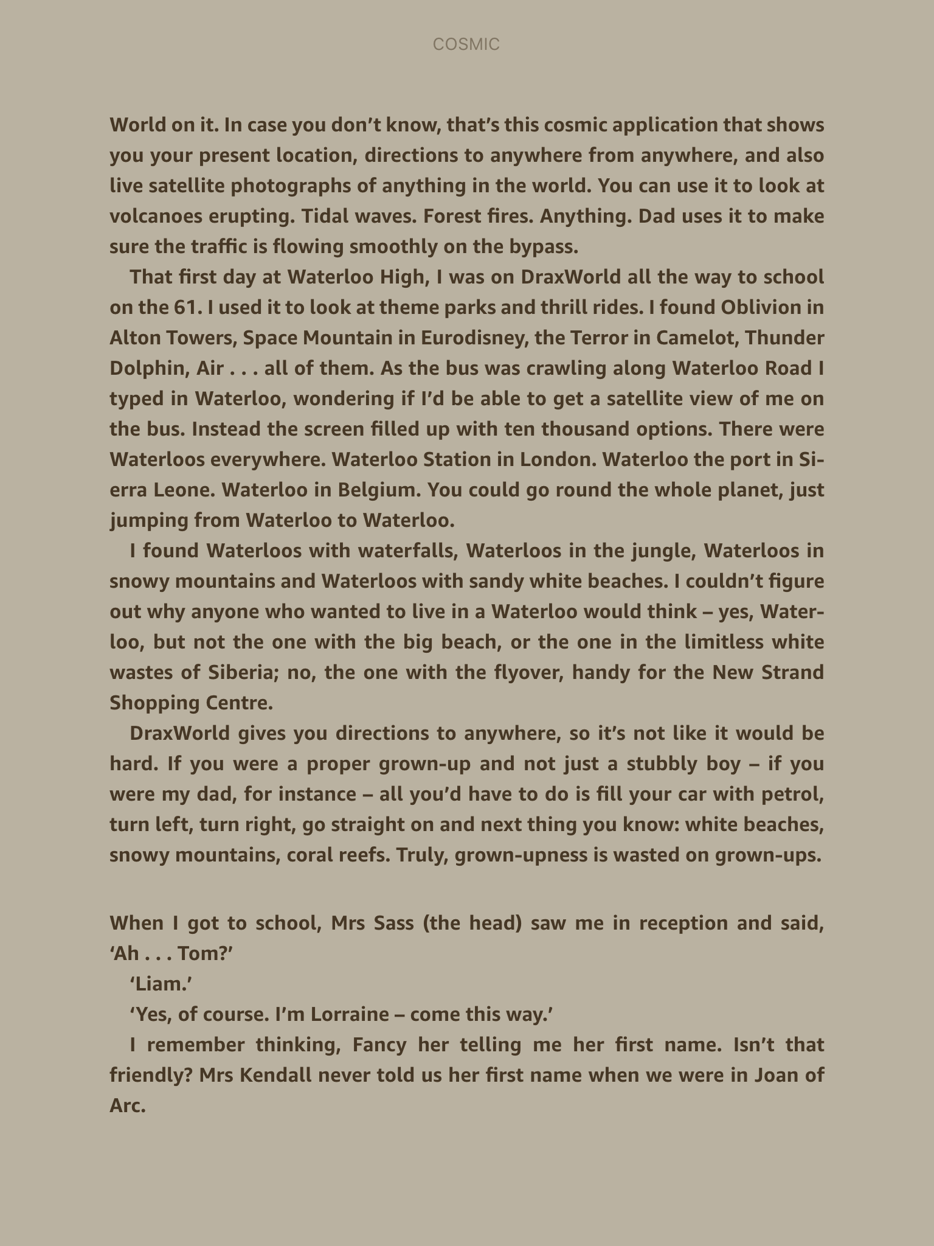

Slide 7
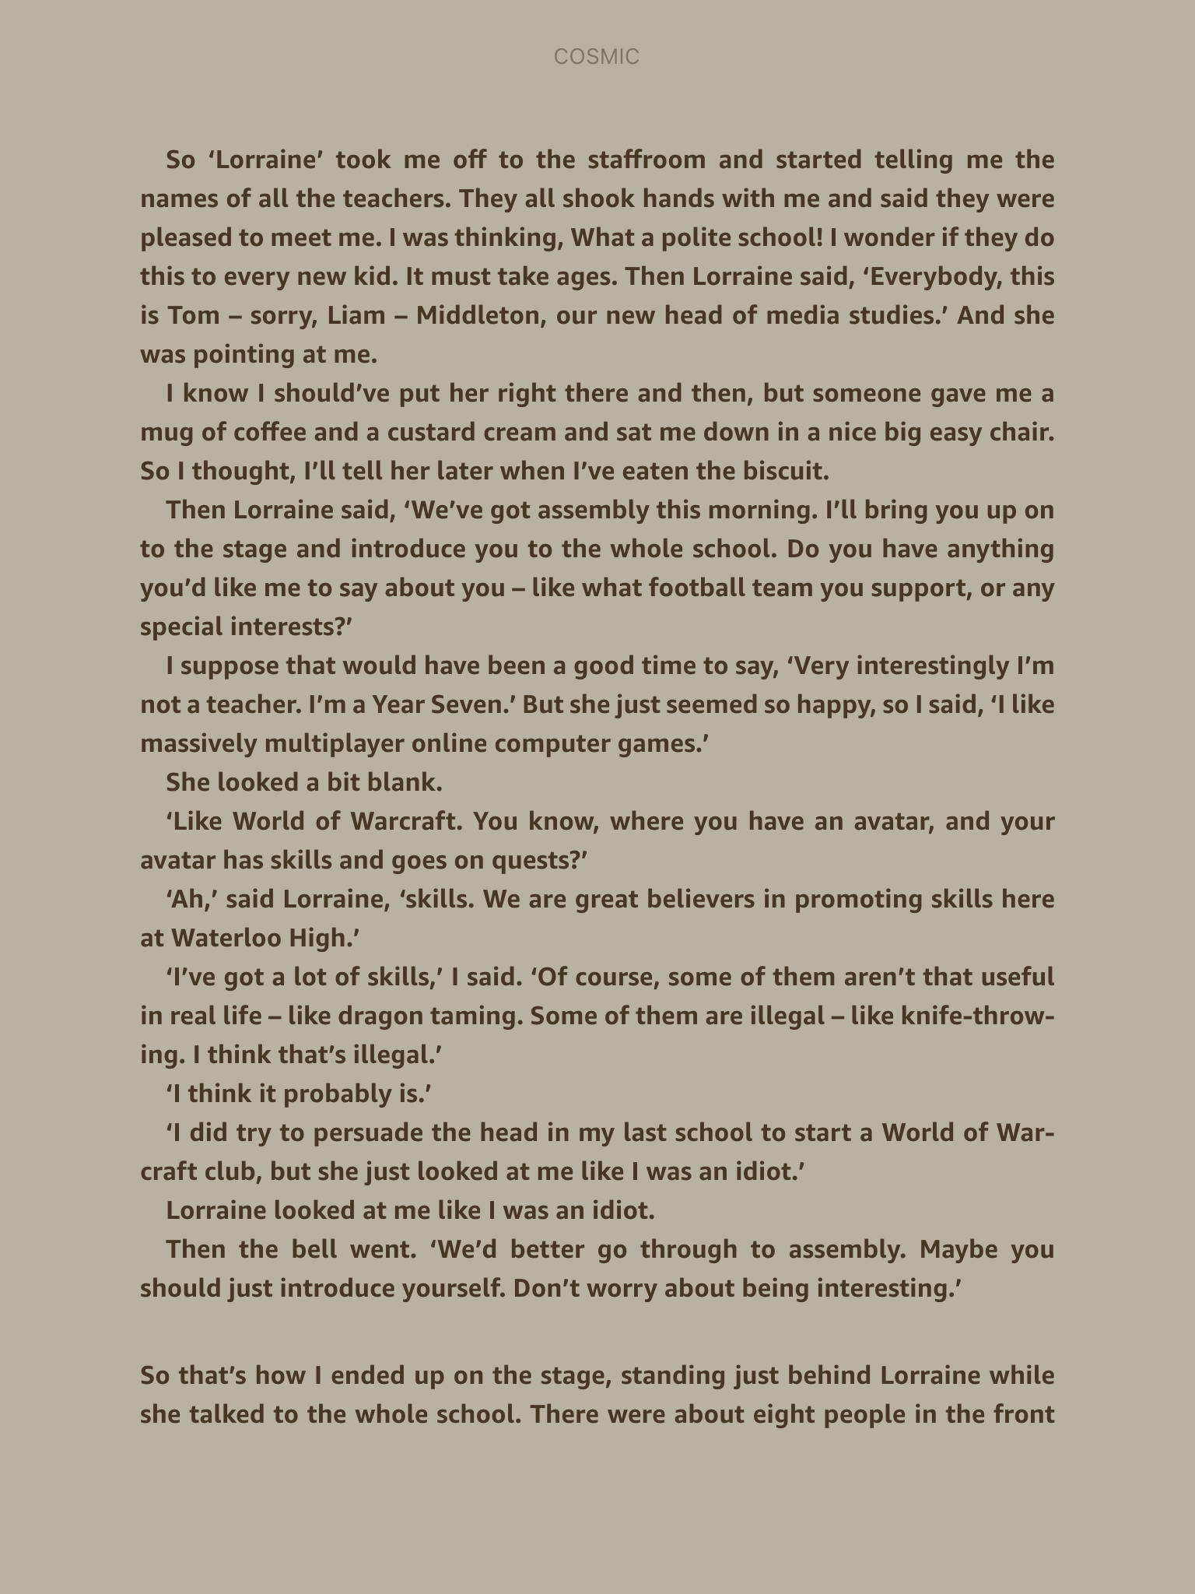

Slide 8
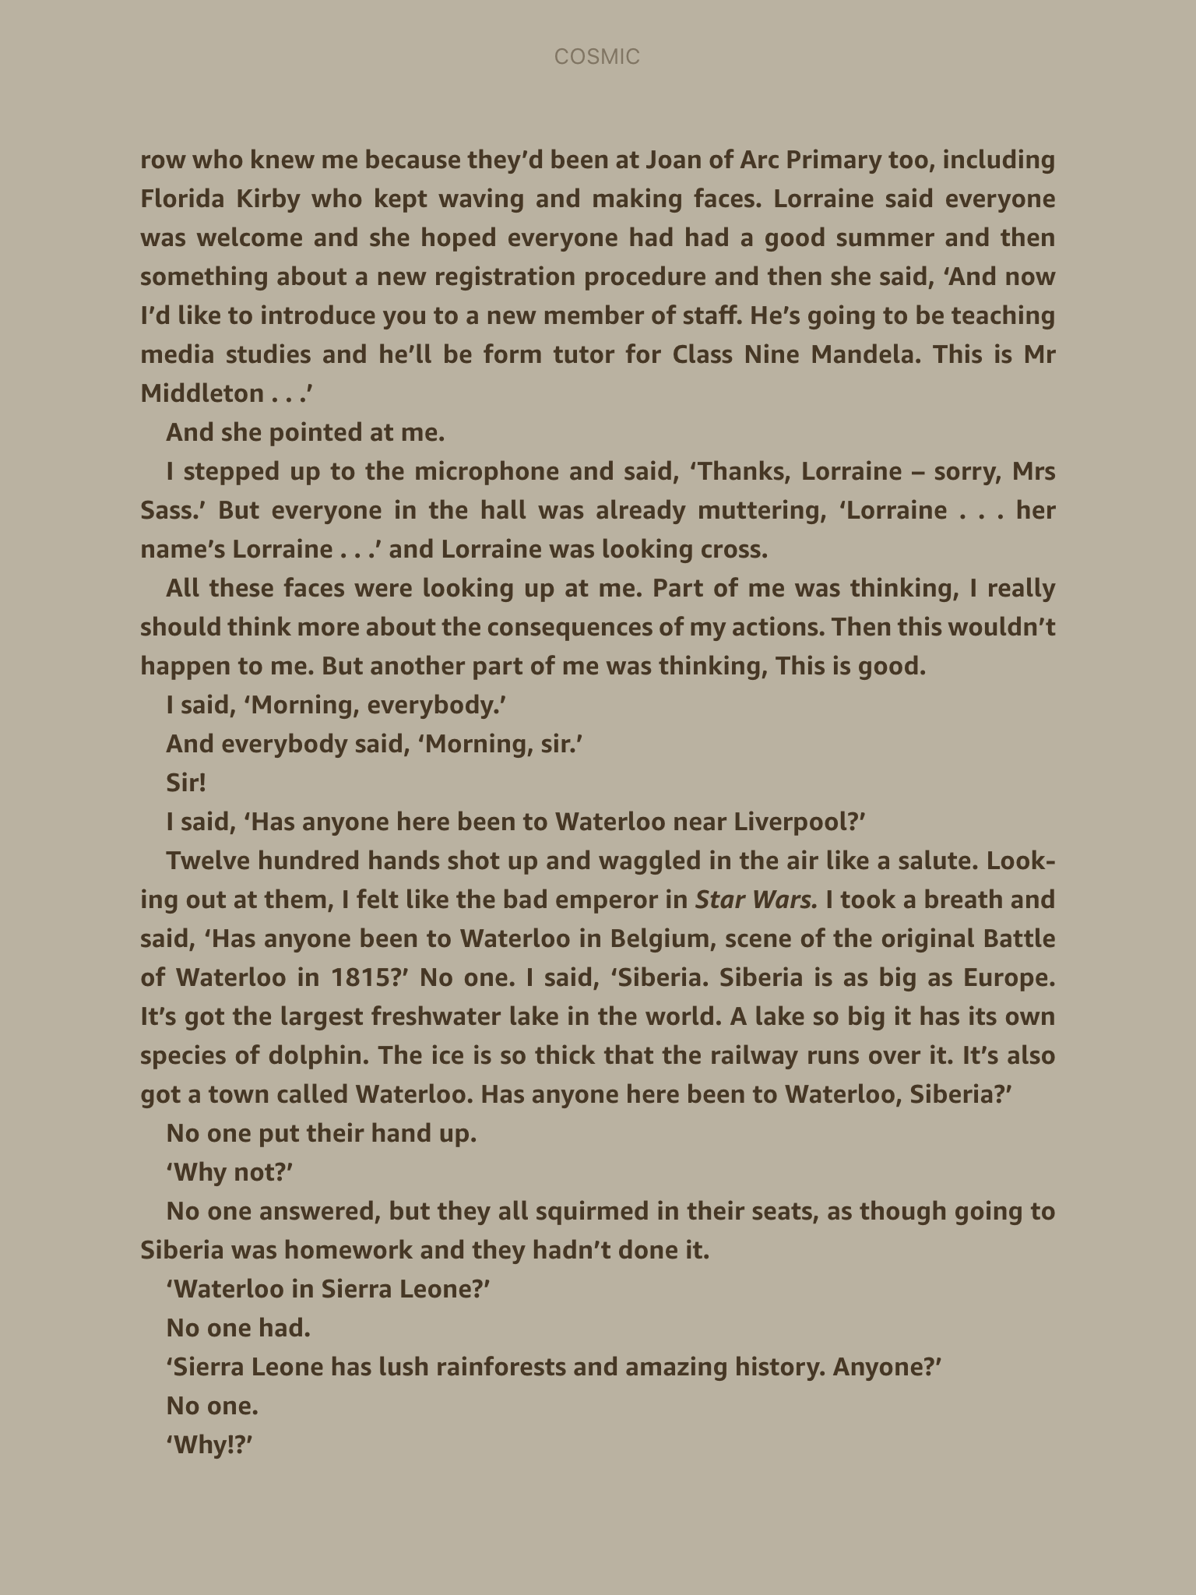

Slide 9
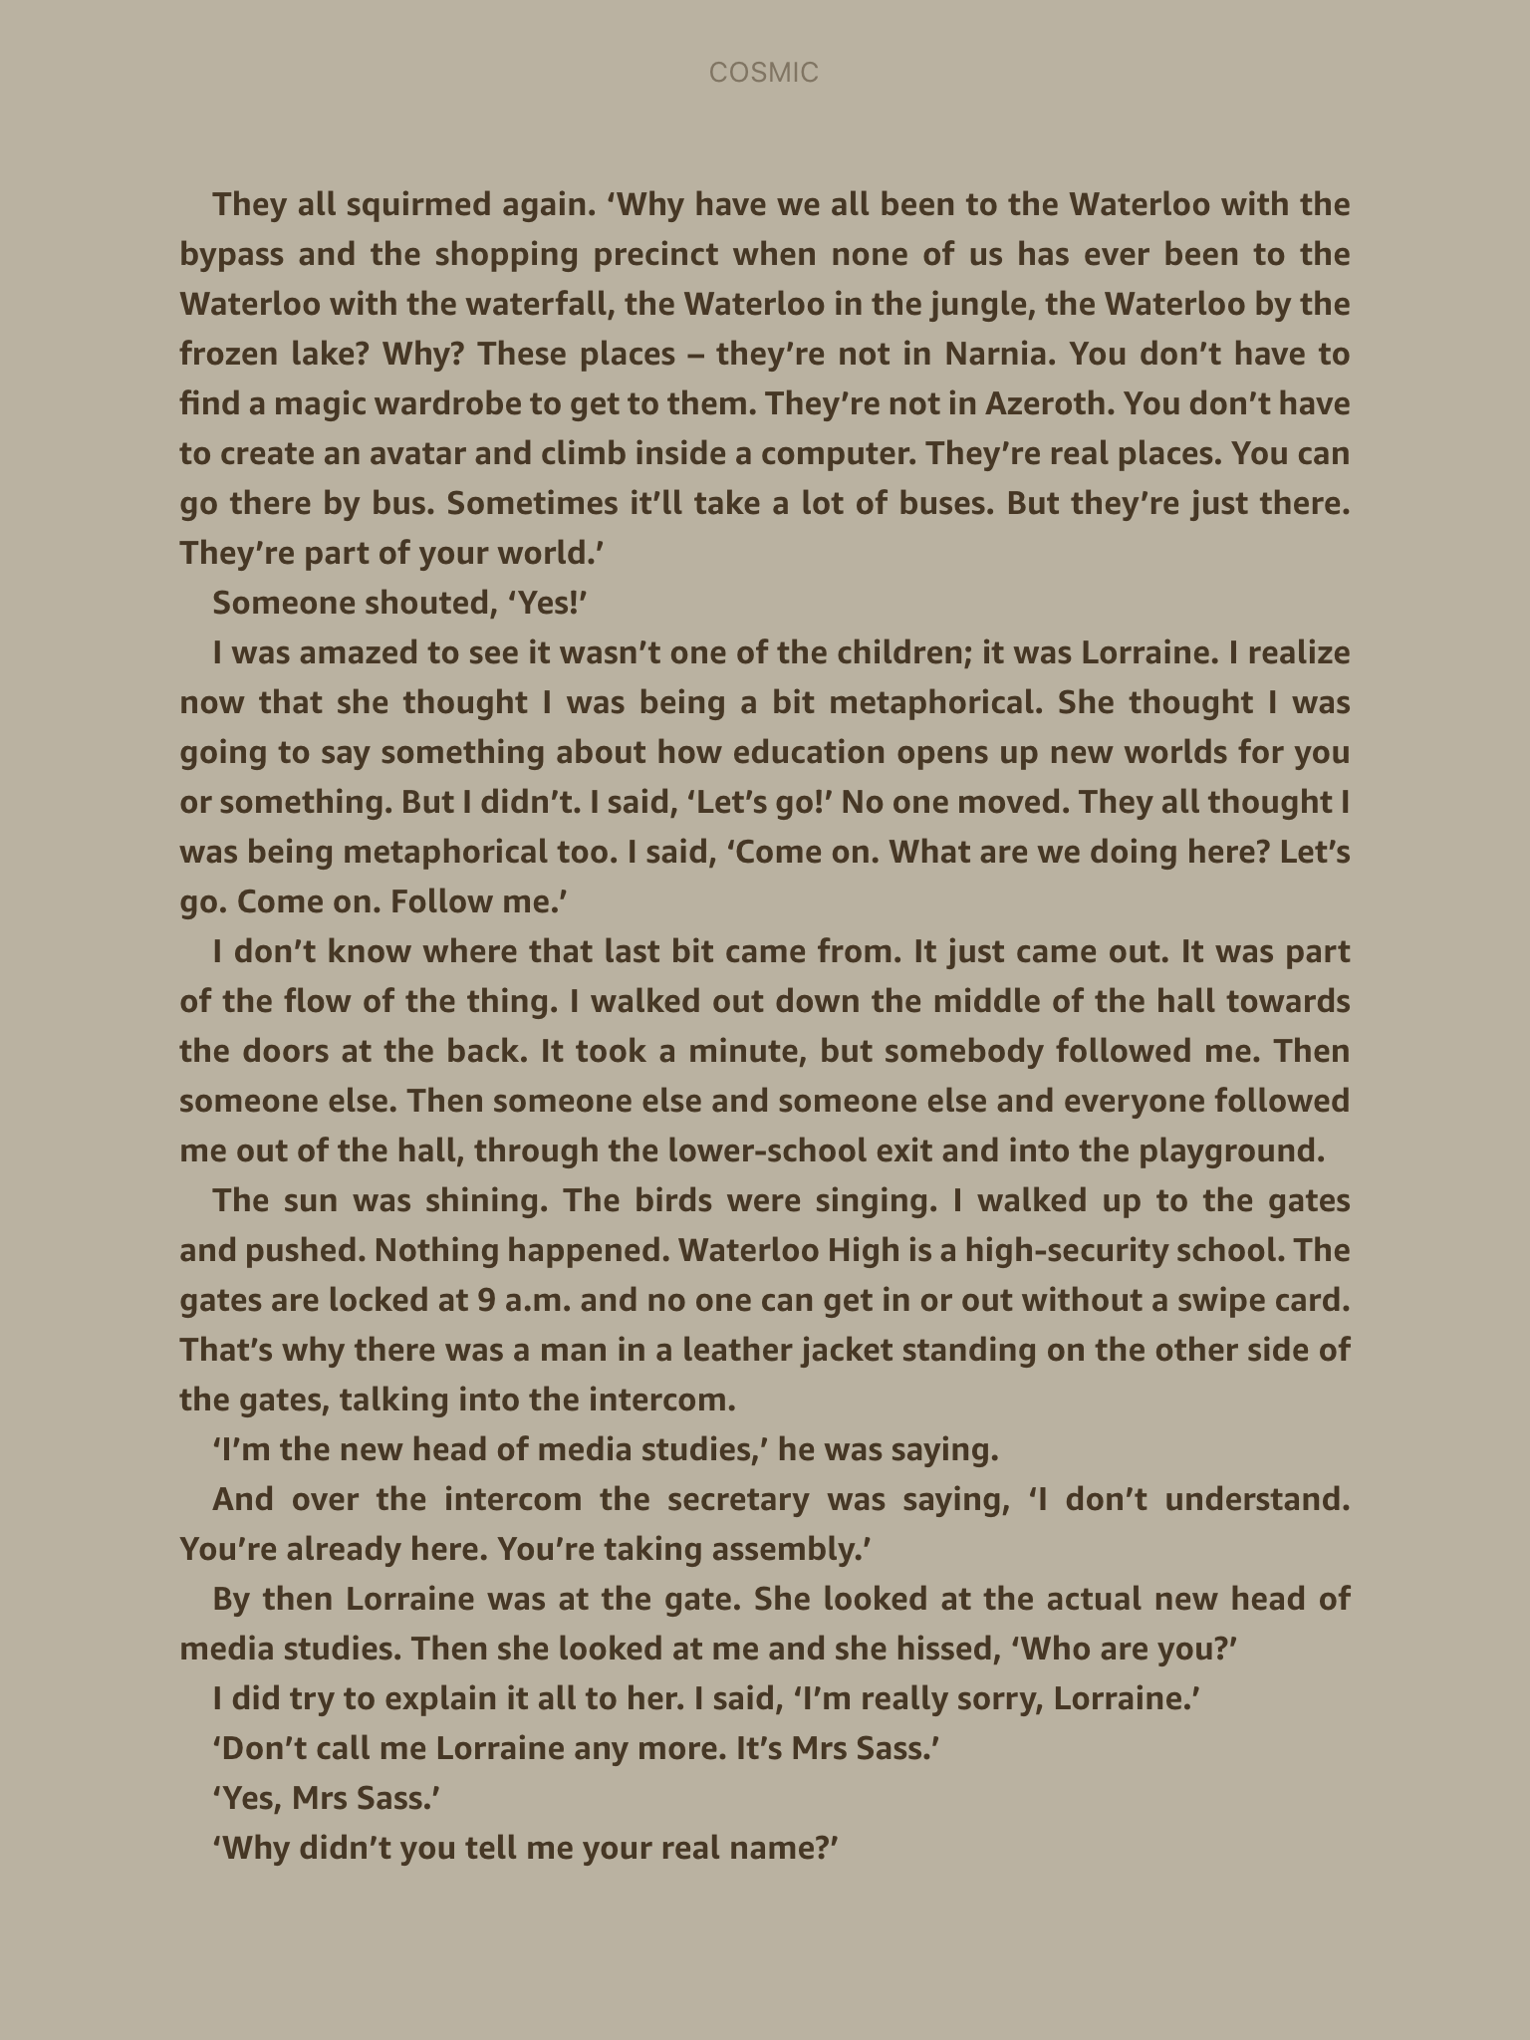

Slide 10
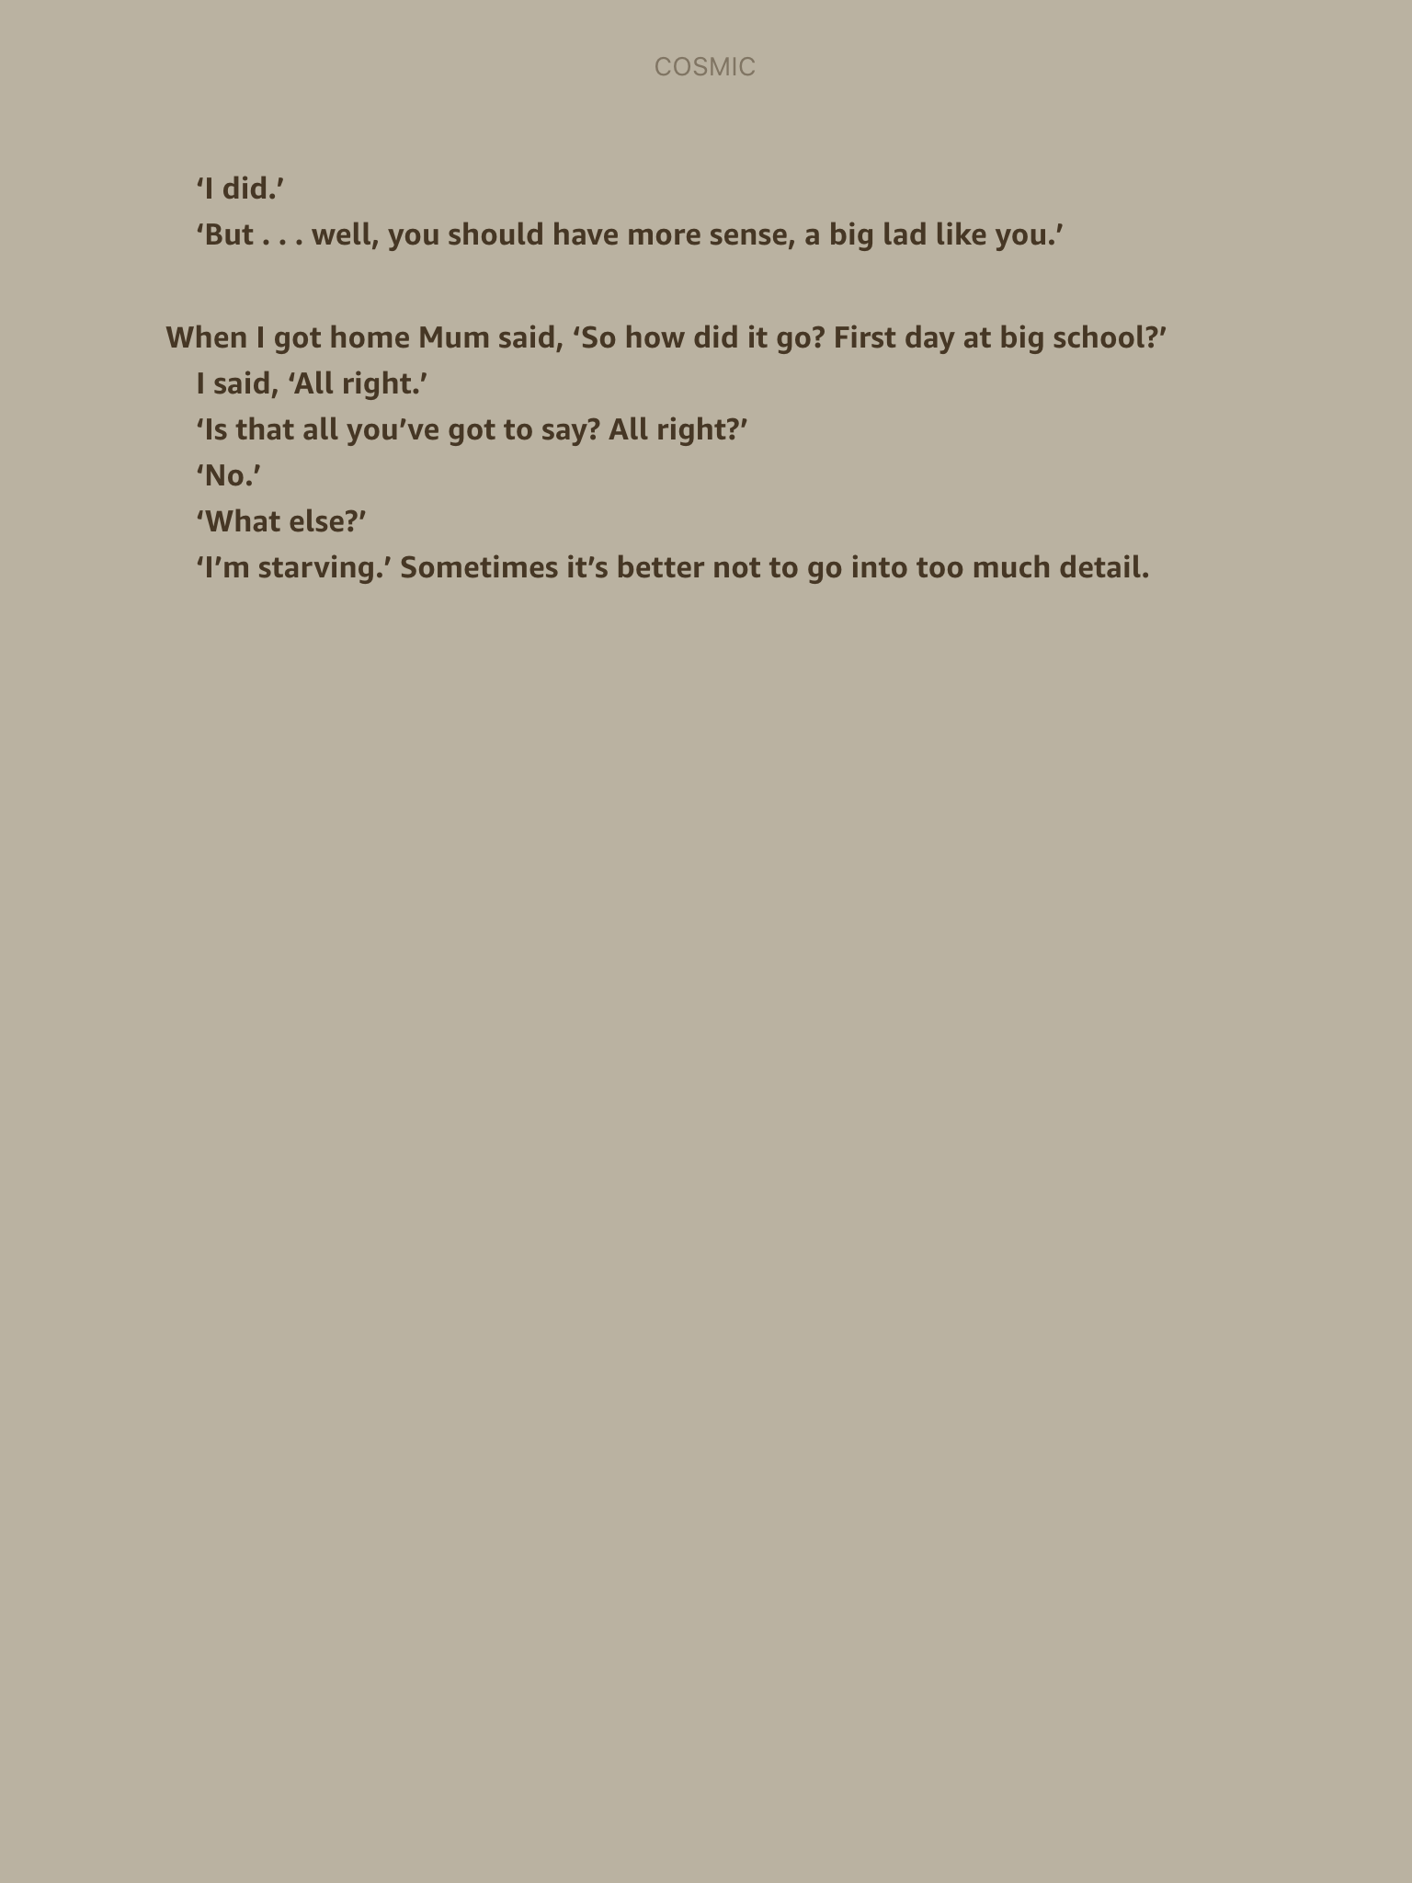

Slide 11
What made chapter 4 so funny?
Can you think of any other stories where there has been a case of mistaken identity?
If you were in Liam’s position, at which point would you have explained ?

Slide 12
generate a list of all the things that have happened to Liam so far as a result of him looking older.
Example:
He was able to ride ‘The Cosmic’ several times.
He has cut himself shaving
You may want to read the first part of chapter 4 again. Refer to the notes you made as you read the chapter.

Slide 13
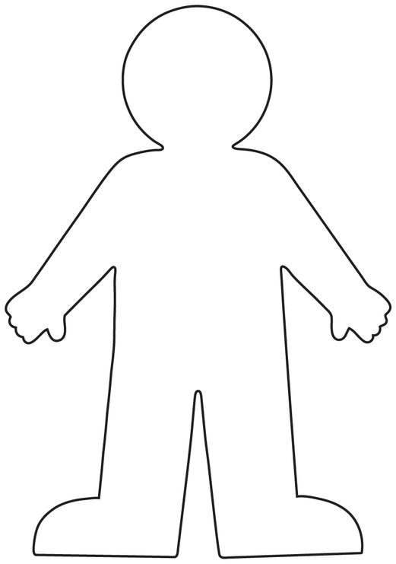
Task:
On the outside of the shape, write all of the positives about looking older.
On the inside of the shape write the negatives about looking older.
Your work should be full of ideas, clear and neatly presented.

Slide 14
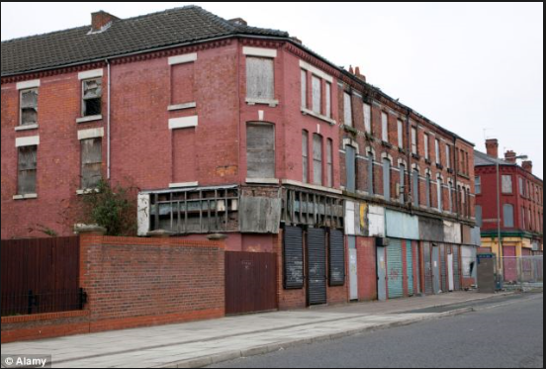
This is Bootle, Liverpool where Liam lives. What can you infer about this area?

Slide 15
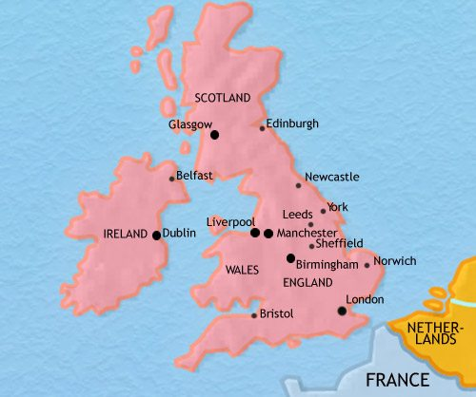
Liverpool is a city in the north of England. People from Liverpool speak with a strong Liverpudlian accent, often called a ‘scouse’ accent.

Slide 16
Starter: read the first page of chapter 5 ‘My Visible Friend.’

Slide 17
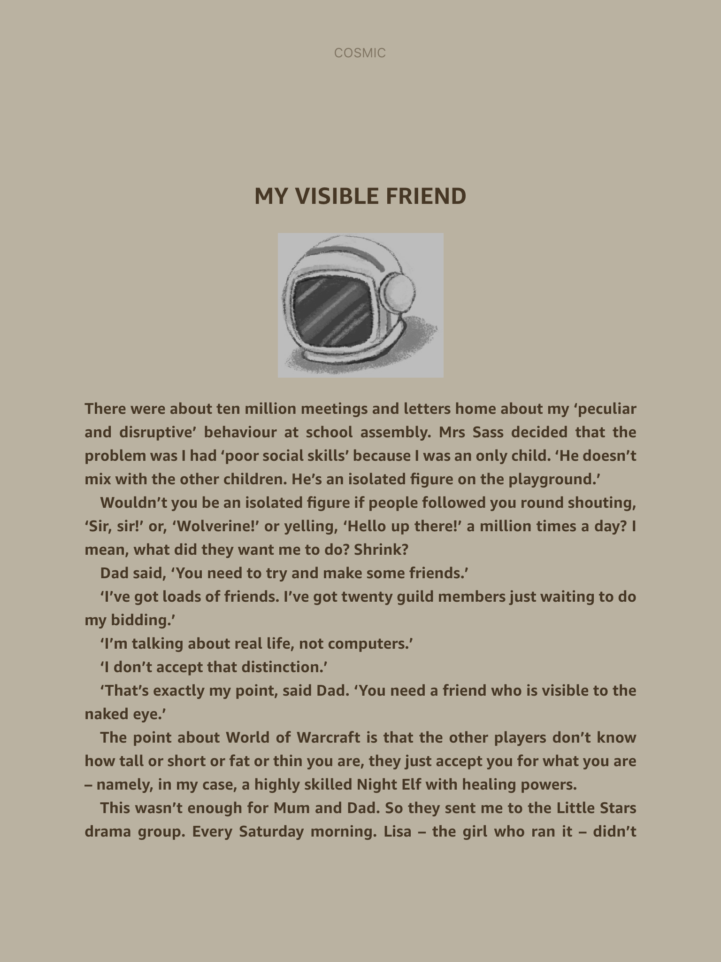

Slide 18
Why do other children shout these things to Liam?
Wolverine!!
Sir! Sir!
Hello up there!
Who does Liam say his friends are when asked by his Dad?

Slide 19
Continue reading chapter 5 up to ‘and she gave them a chomp bar each’

Slide 20
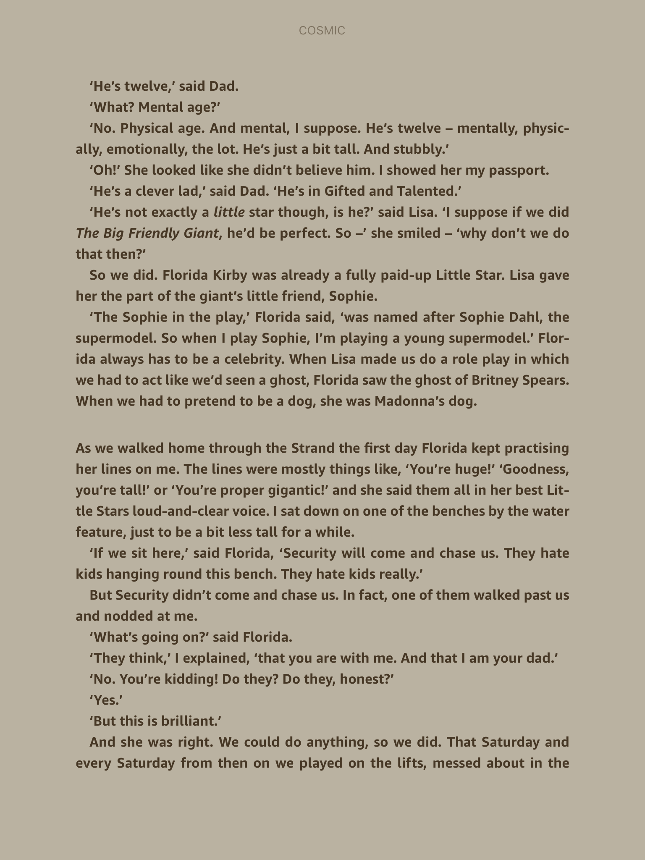

Slide 21
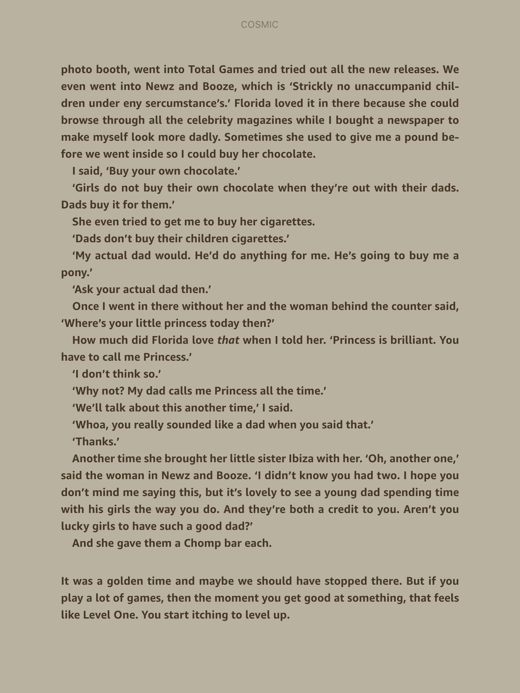

Slide 22
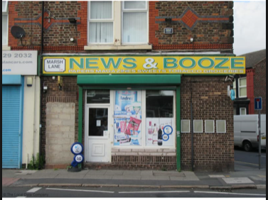
What are your impressions of Florida? Why?
How have Florida and Liam been spending their time?
The shop assistant says ‘Strickly no unaccumpanid children under eny sercumstance’s’
Why did the author write it this way?
Why might he author have chosen the names Florida and Ibiza to be sisters?

Slide 23
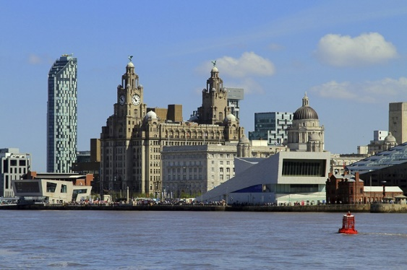
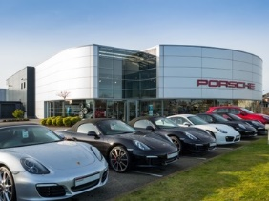
Continue reading up to Florida said, “That would be going to far wouldn’t it?”
What might Florida and Liam do next?
What has made you think that?
Liverpool Waterfront
Liverpool Porsche Centre
Read to the end of the chapter

Slide 24
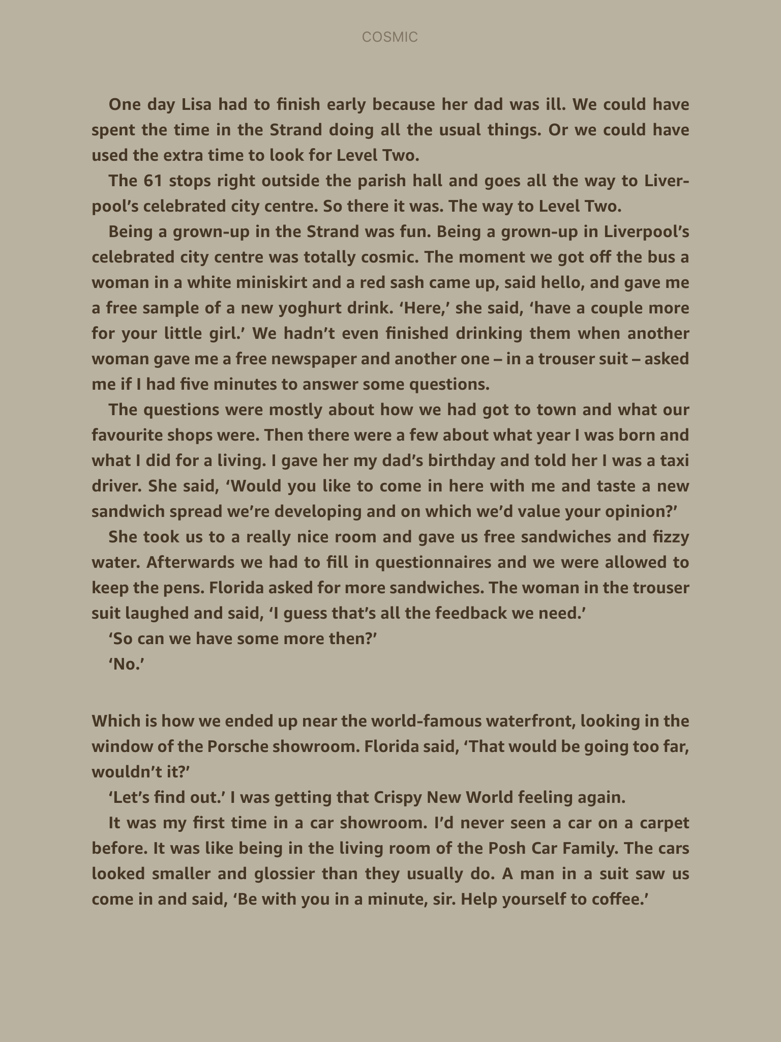

Slide 25
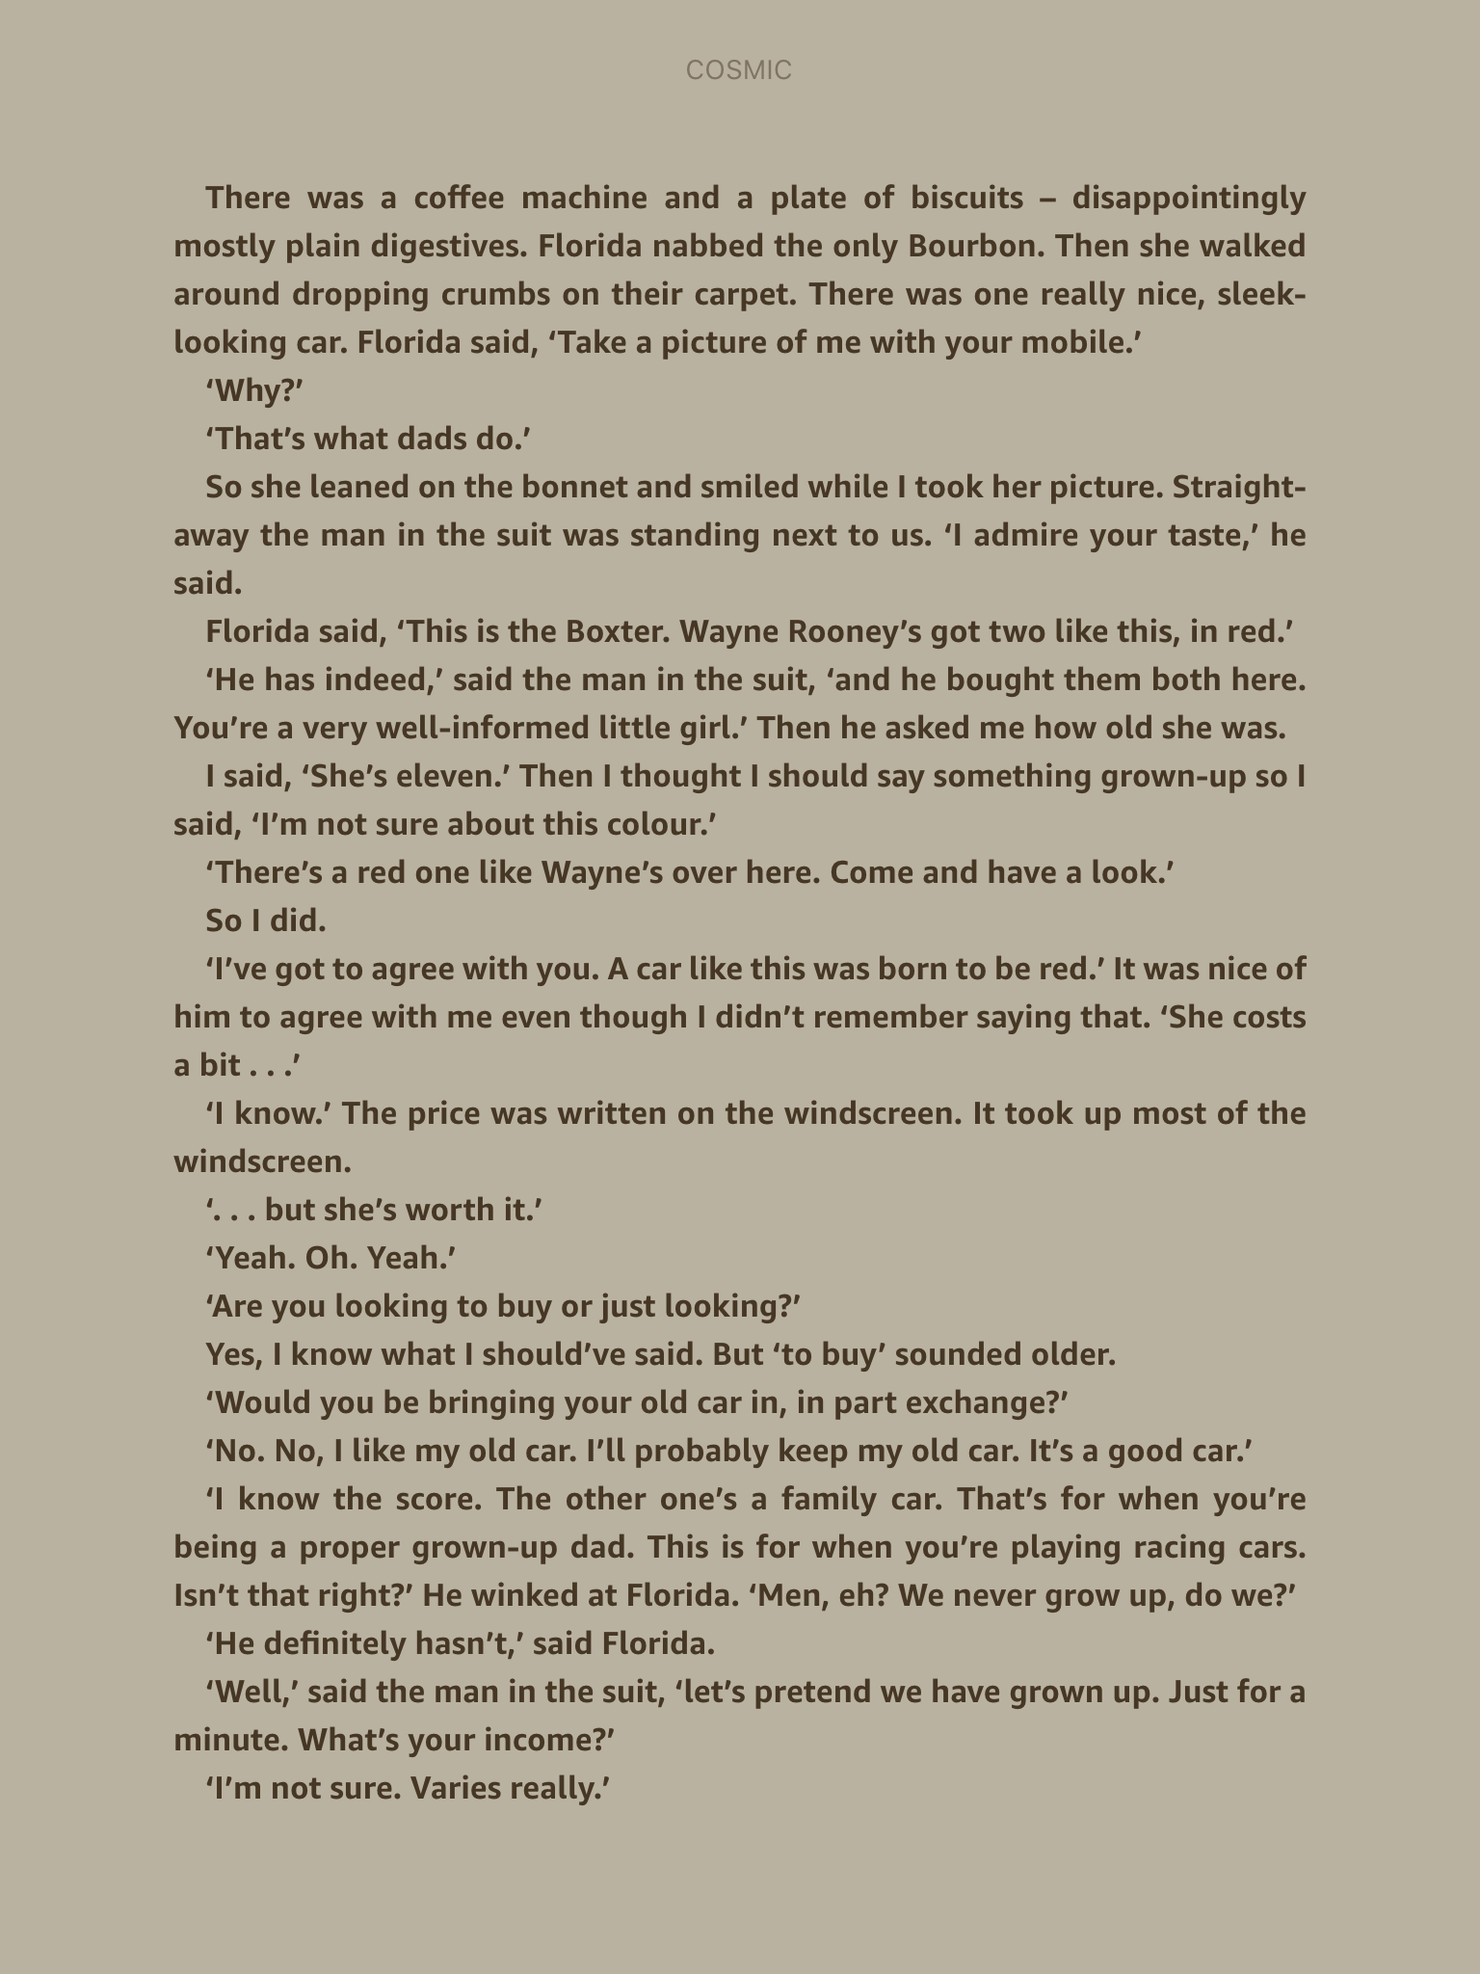

Slide 26
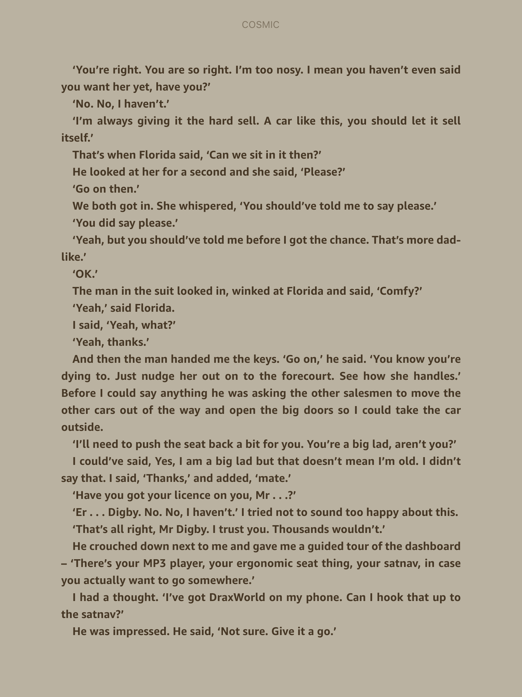

Slide 27
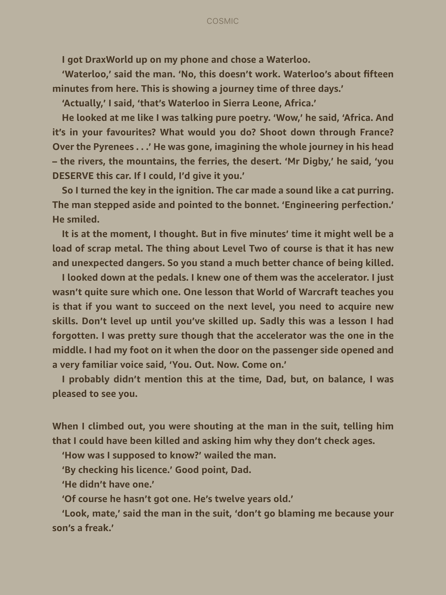

Slide 28
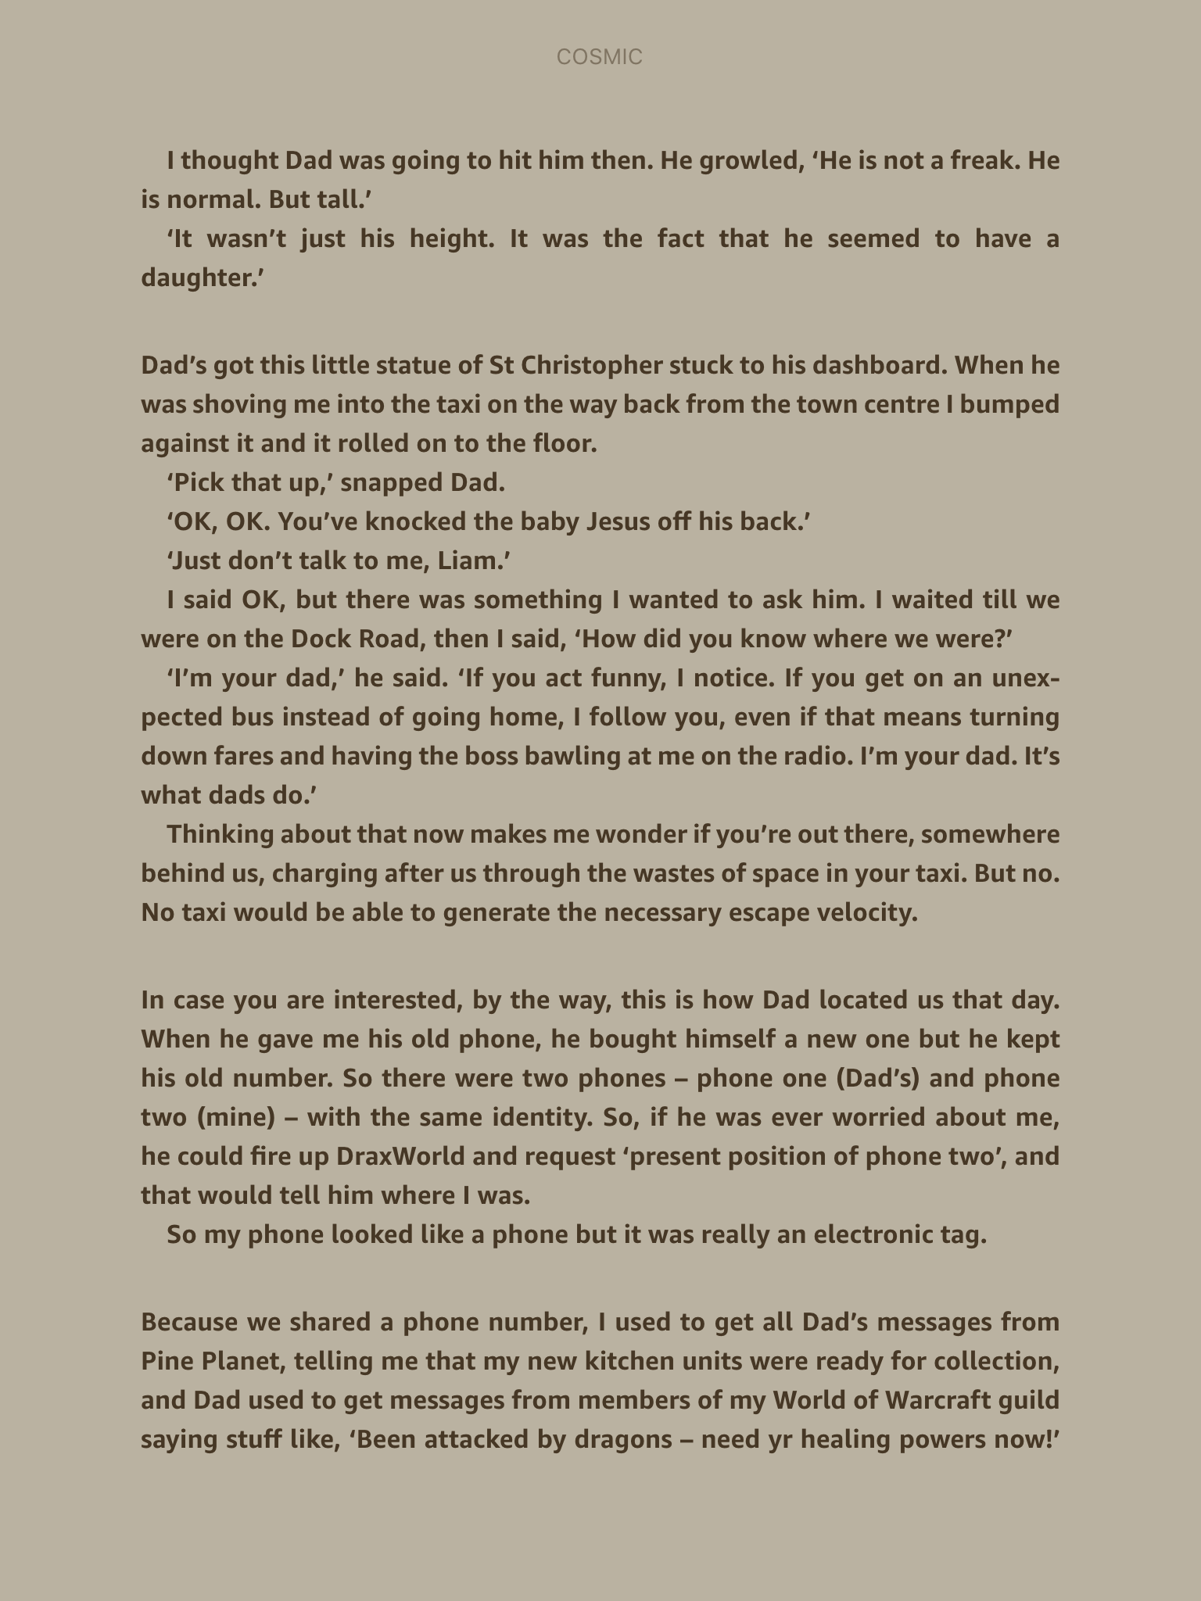

Slide 29


