Slide 1

Geography
The Amazing Americas
Part 3
Year One
Geography | Year 6 | The Amazing Americas | Wonders | Lesson 6

Slide 2

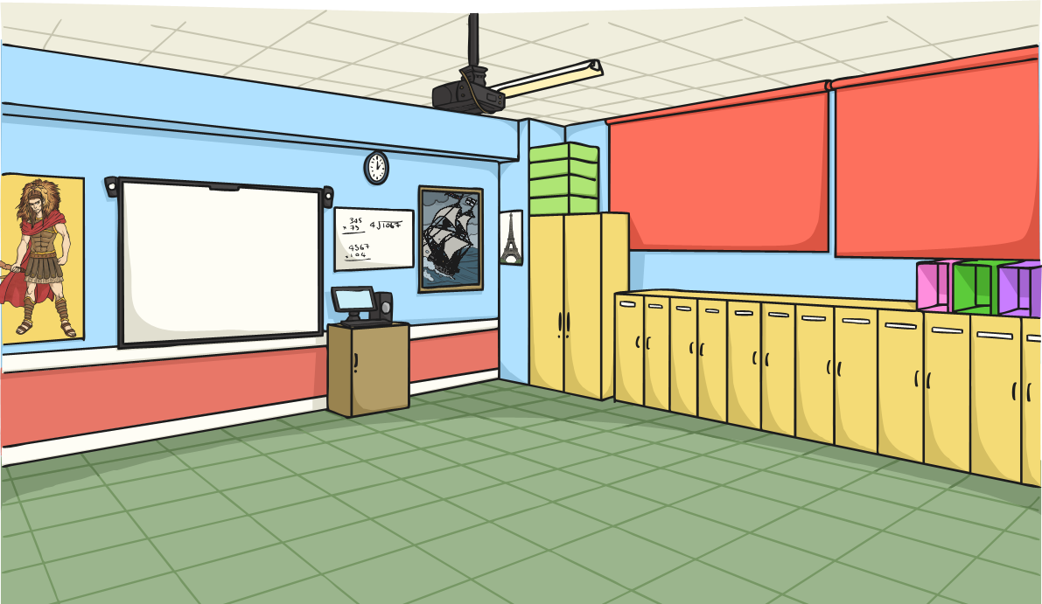
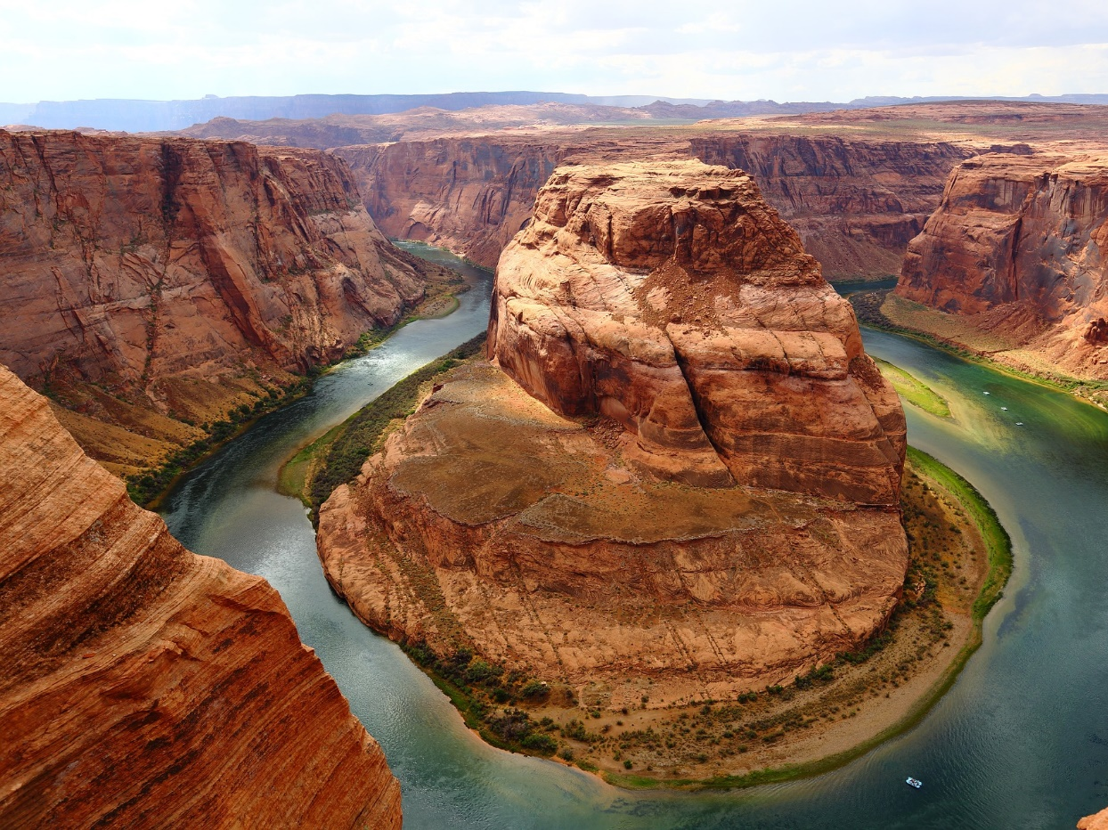
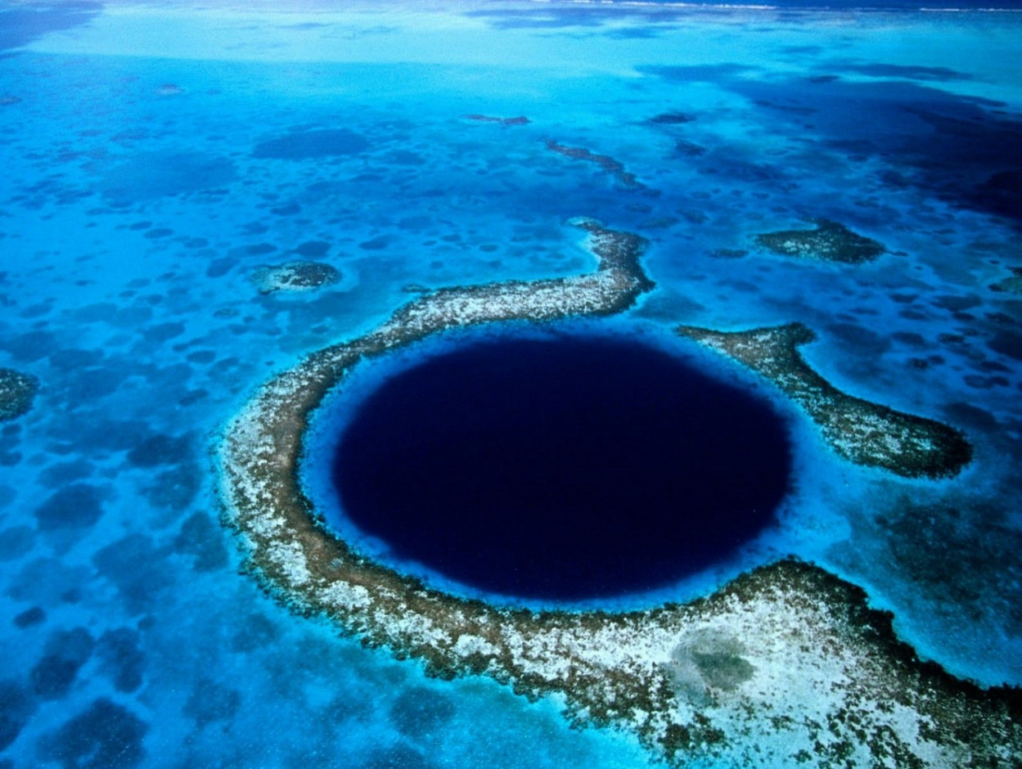
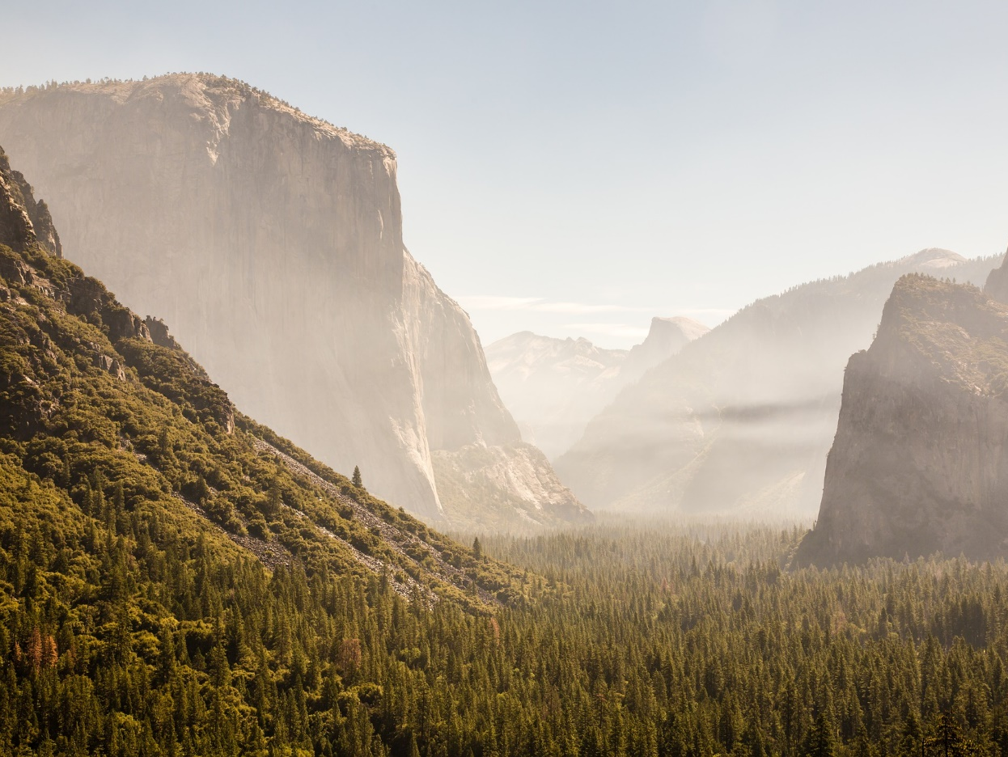
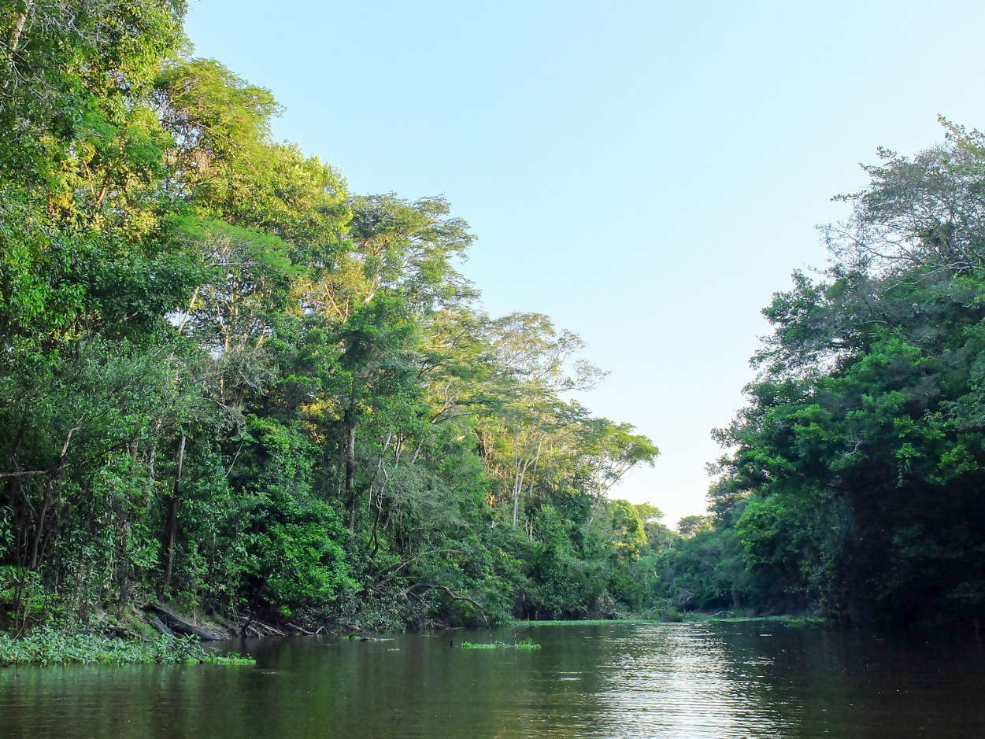
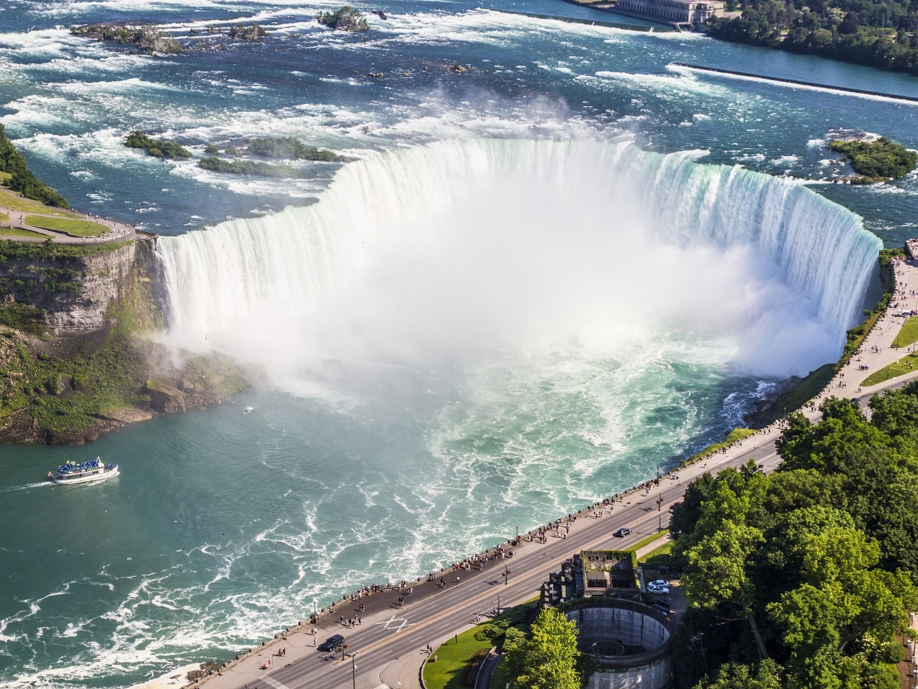
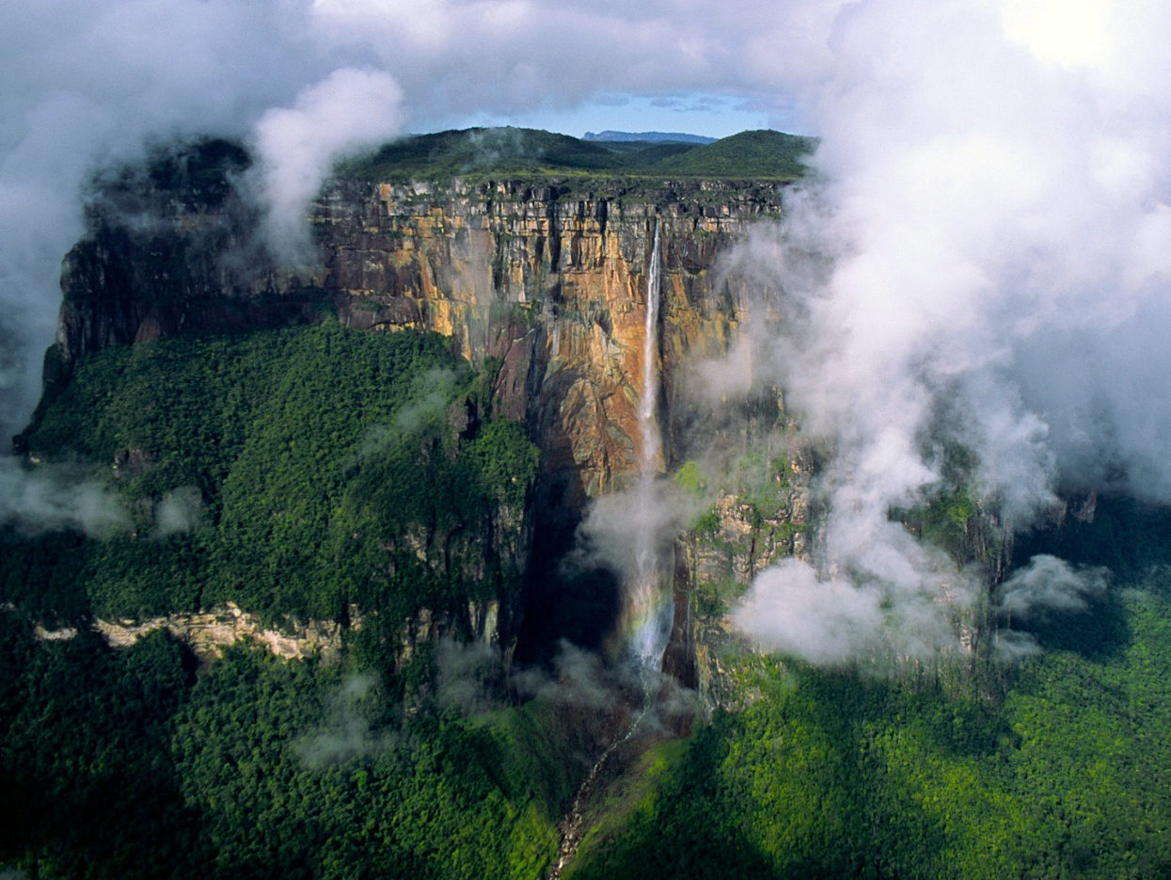
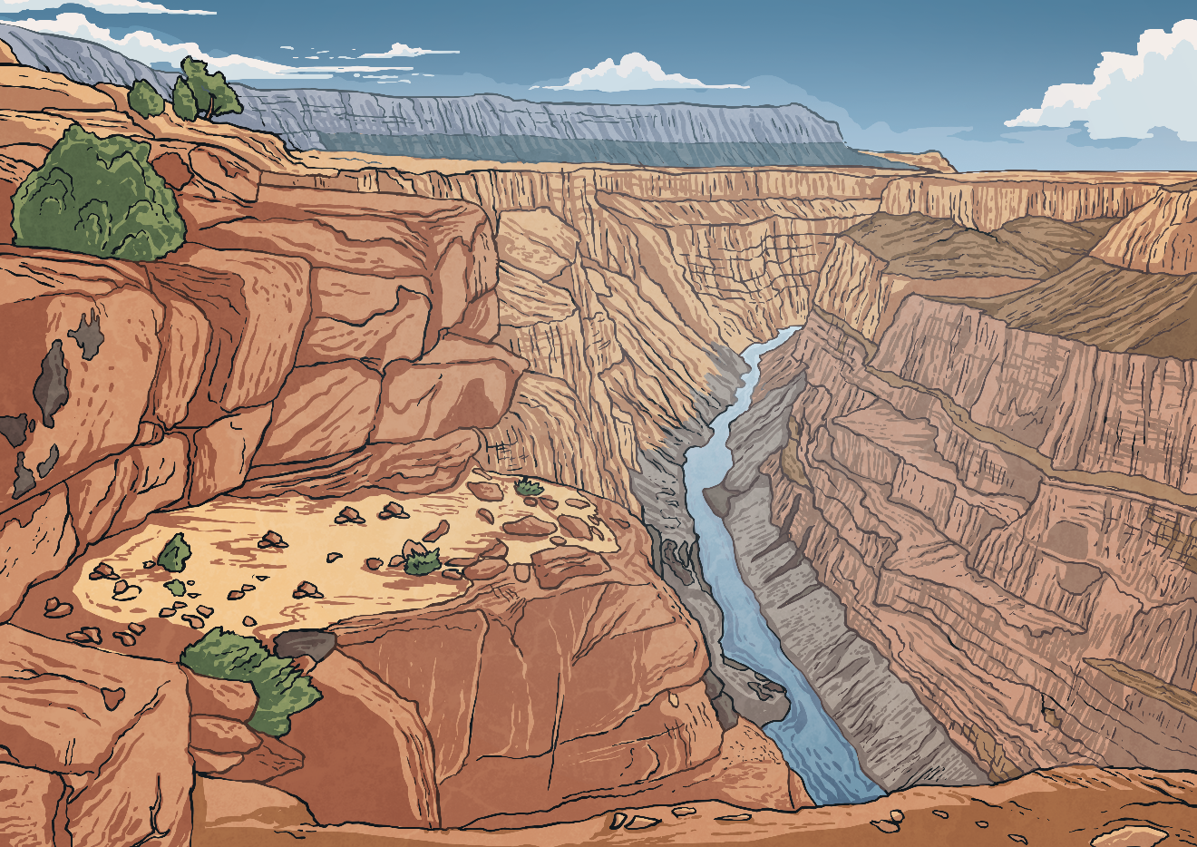
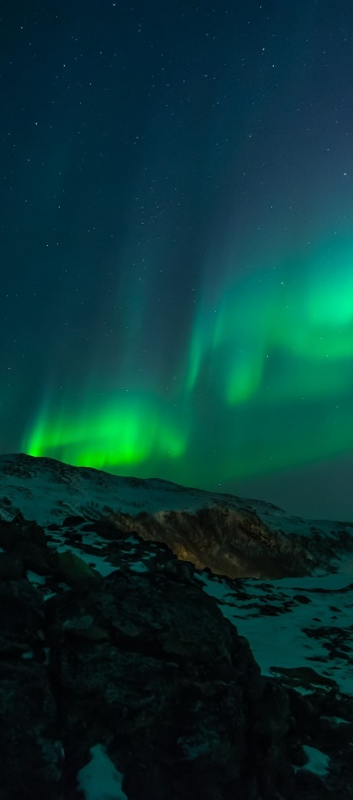
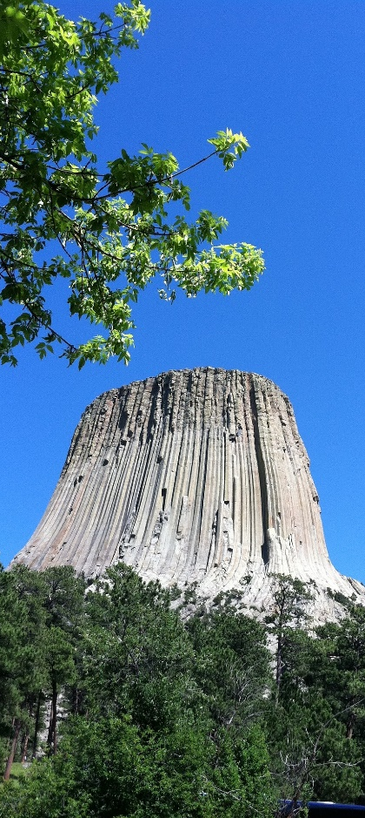
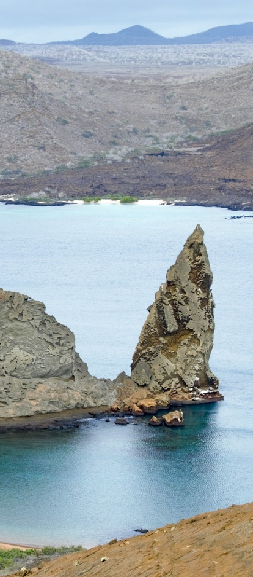
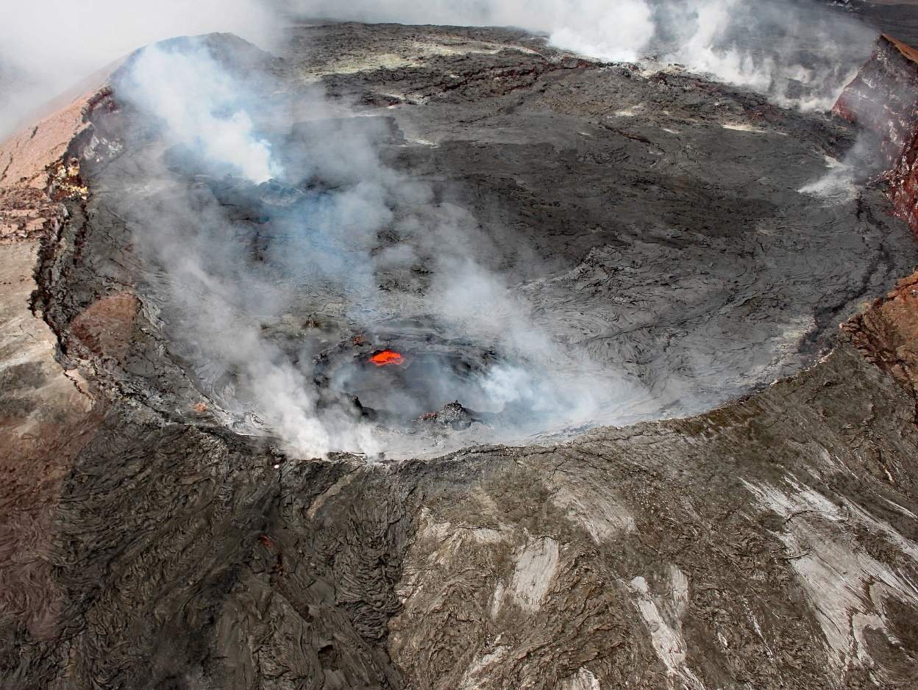
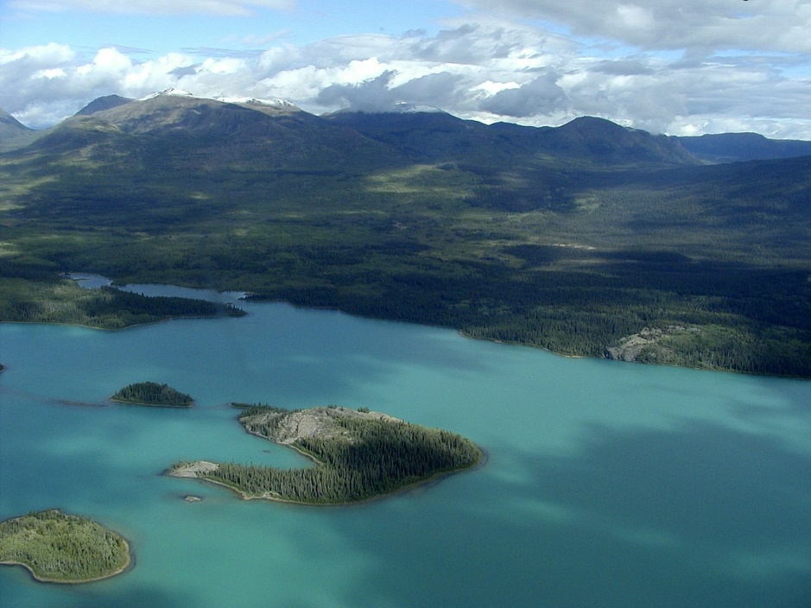
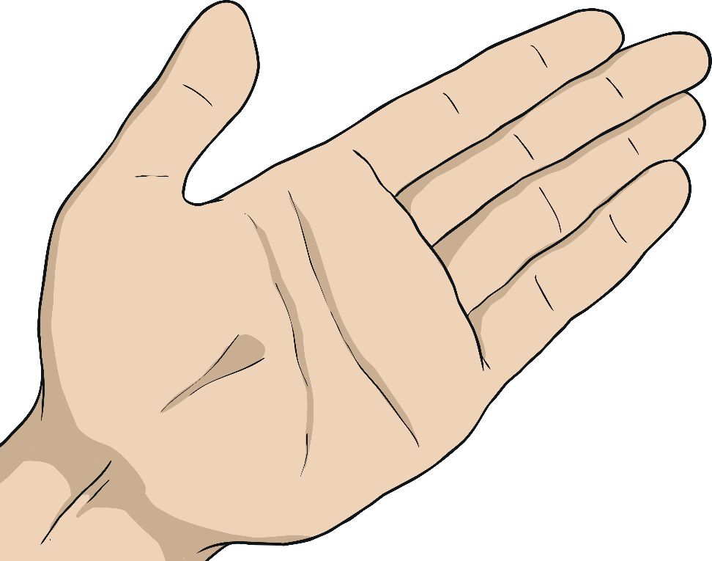
Natural Wonders of the Americas
Possible Contenders:
Use the Natural wonders of the Americas Activity Sheet to help you.
Or will you pick a different wonder
to research?
Grand Canyon, Arizona
Niagara Falls, bordering Ontario and New York
Angel Falls, Venezuela
Yosemite Valley, California
Kilauea, Hawaii
Great Blue Hole, Belize
Amazon Rainforest, Brazil
Yukon, Canada
Photo courtesy of tofoli.douglas (@flickr.com) - granted under creative commons licence
Photo courtesy of Anna & Michal (@flickr.com) - granted under creative commons licence

