Slide 1

Geography
The Amazing Americas
Part 2
Year One
Geography | Year 6 | The Amazing Americas | Wonders | Lesson 6

Slide 2

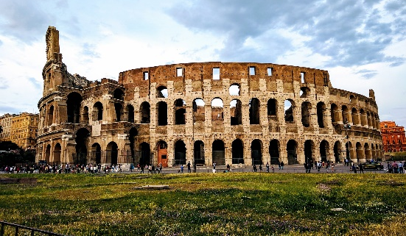
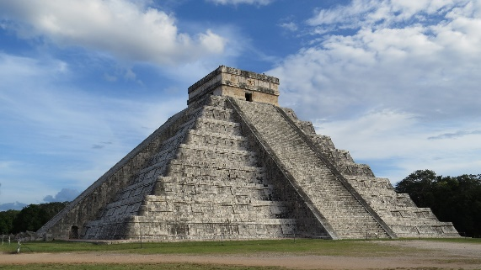
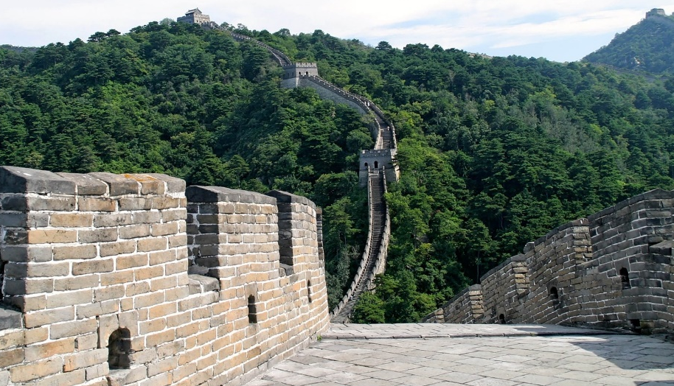

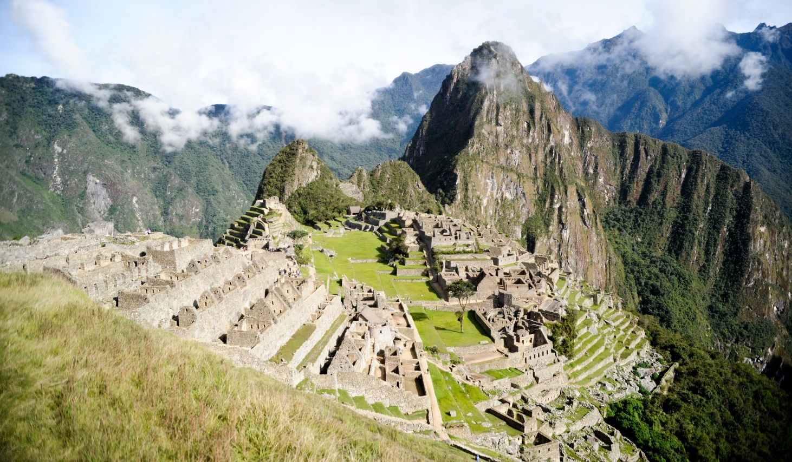

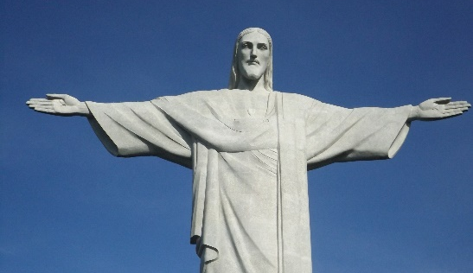
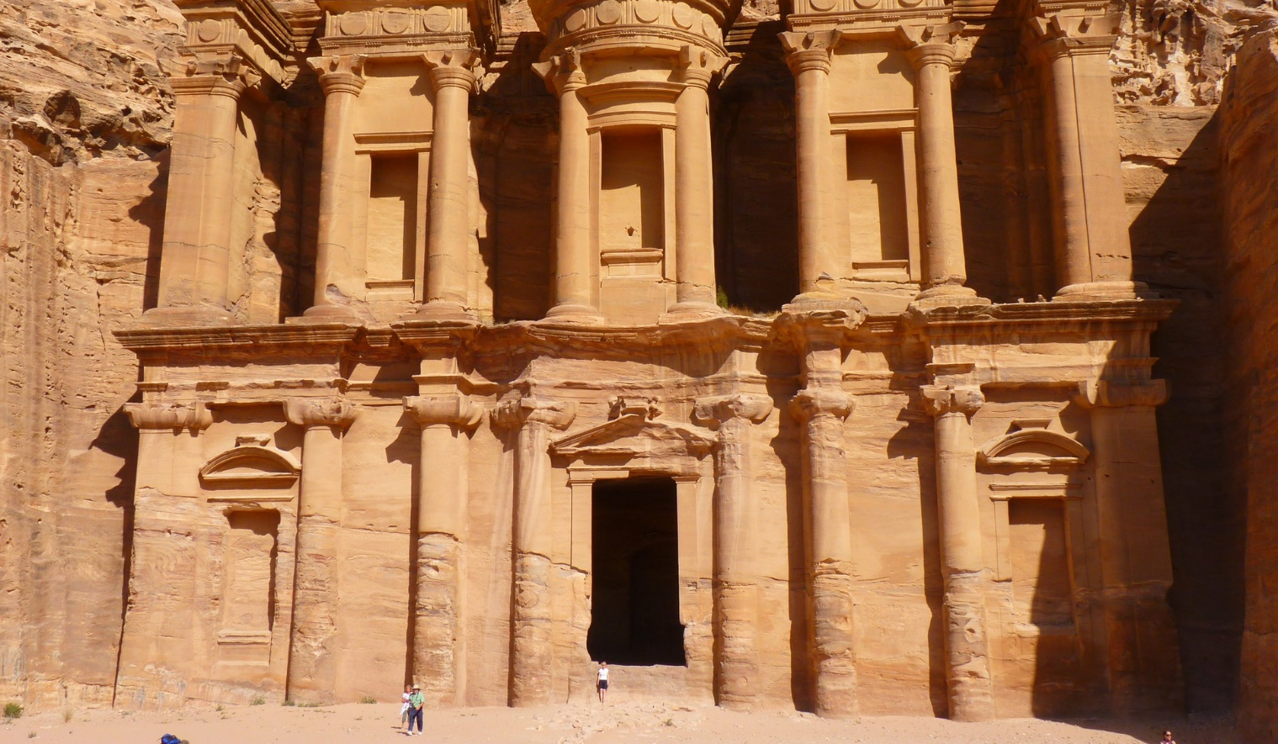
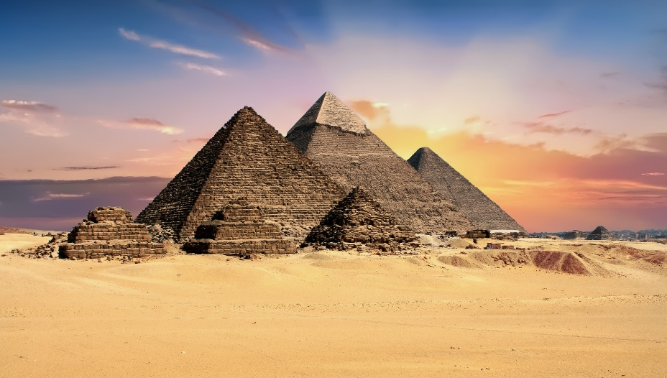
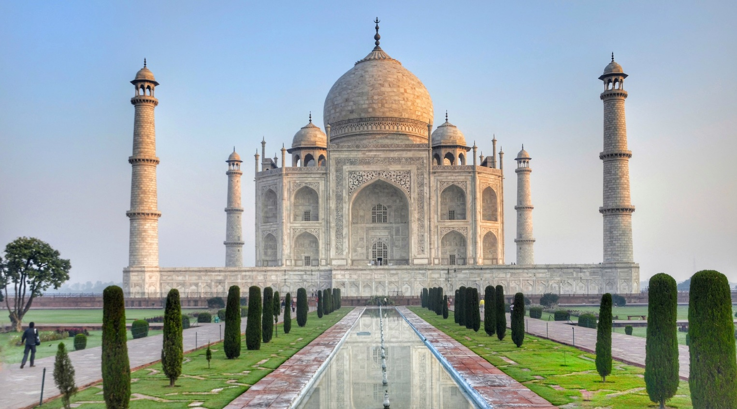






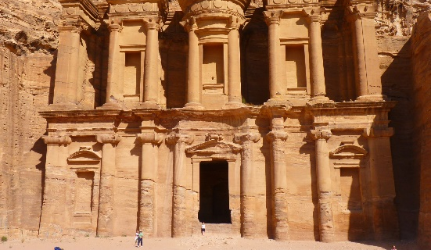
The New 7 Wonders of the World
X
X
X
X
X
Americas
X
X
Americas
X
Americas
Which of the New
7 Wonders are in the Americas?
In which part of the Americas are they located?
Christ the Redeemer Statue,
Rio de Janeiro, Brazil
The Great Pyramid of Giza, Giza, Egypt
– Honorary Status
Chichen Itza, Yucatan, Mexico
The Colosseum, Rome, Italy
Machu Picchu, Cuzco, Peru
Taj Mahal, Agra, Utter Pradesh, India
The Great Wall of China, Beijing, China
Petra, Jordan

Slide 3
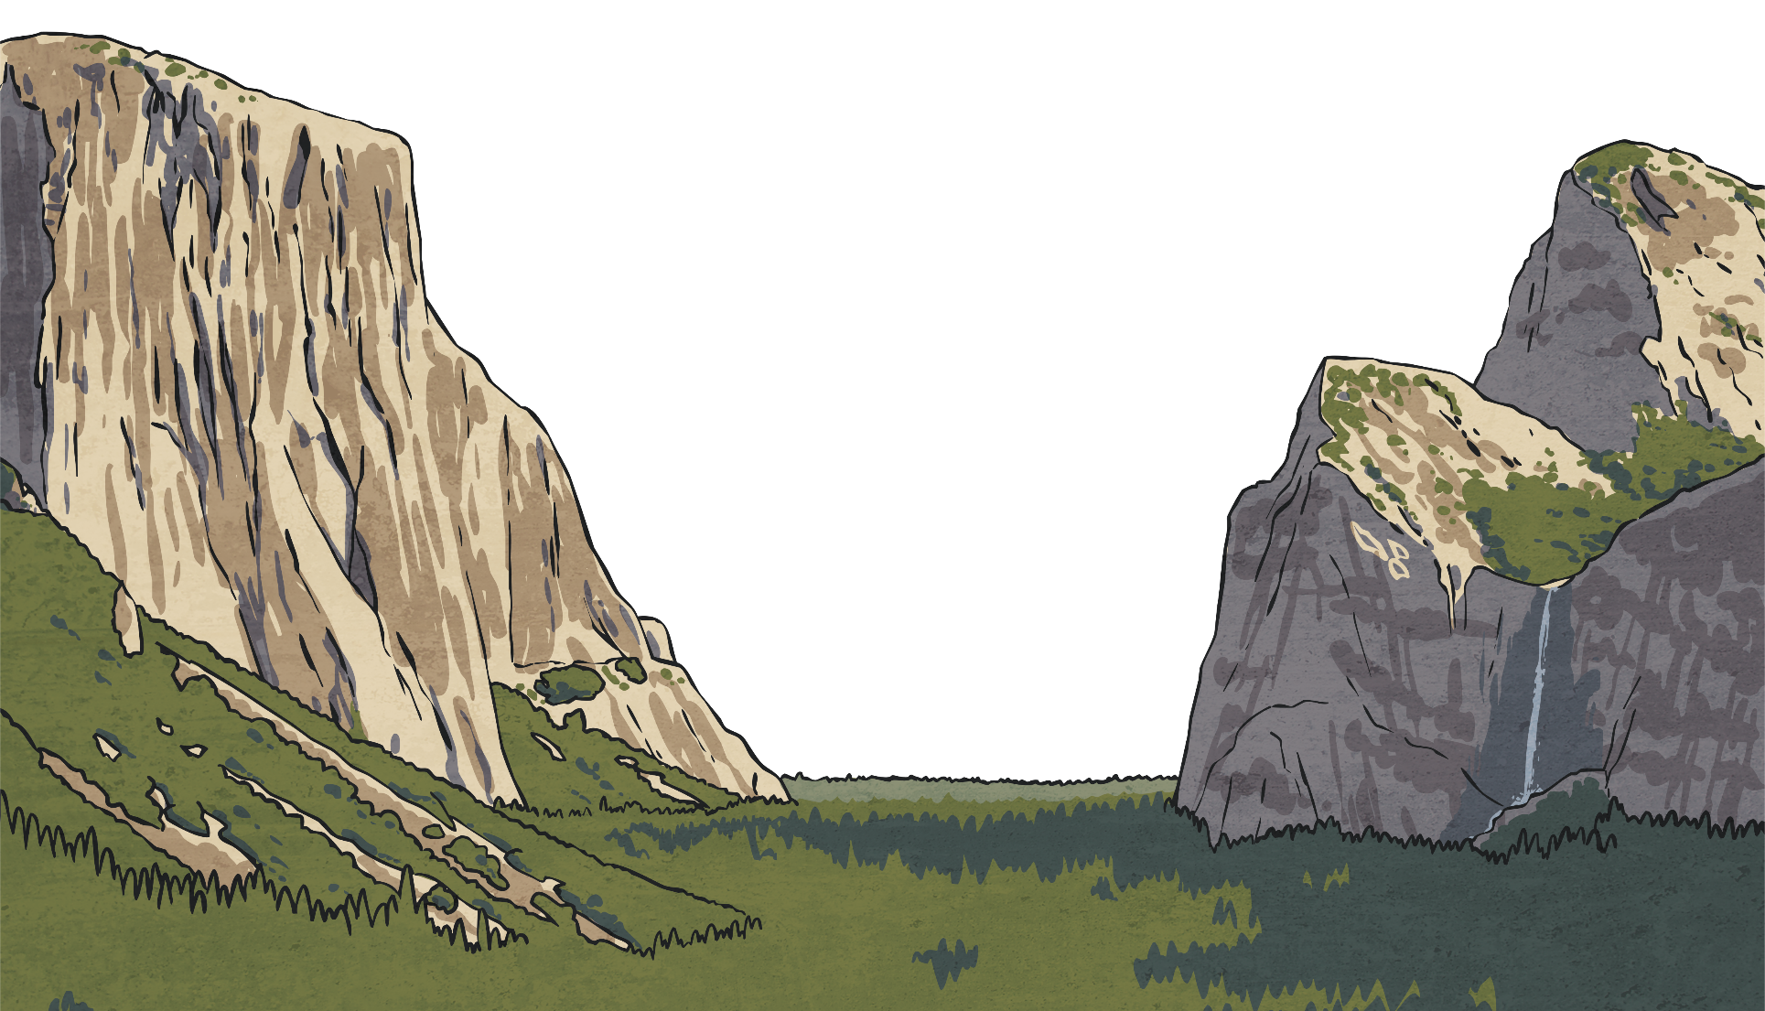
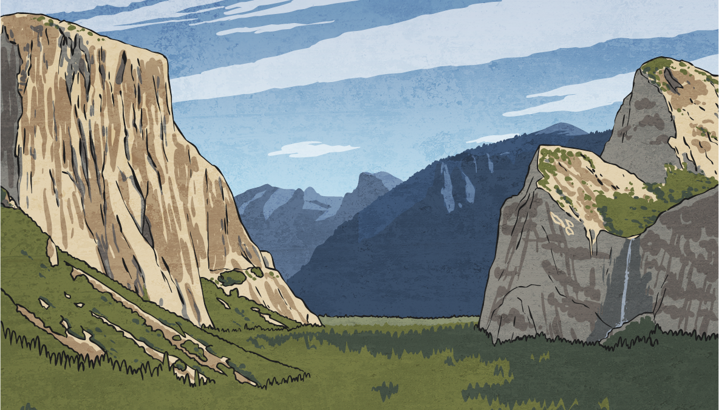
Natural Wonders of the Americas
In addition to man-made structures, there are also many astonishing geological wonders
of the world – carved out by the
power of nature.
Research and prepare a presentation to promote the natural American wonder you think is the best.
Use the Natural Wonders of the Americas Activity Sheet to help you.
You will already have learnt about some of the fascinating natural phenomena of the Americas, like the vast sand dunes of Death Valley in
California, but which of the many natural American wonders do you think deserves to be crowned as the best?

