Slide 1

Geography
The Amazing Americas
Year One
Geography | Year 6 | The Amazing Americas | Wonders | Lesson 6

Slide 2
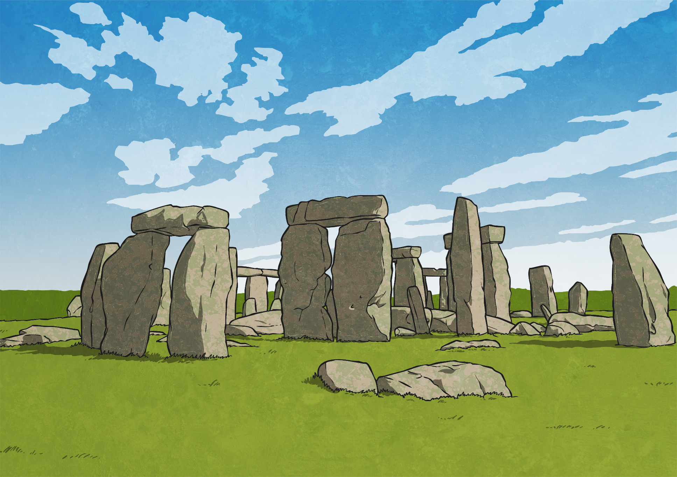

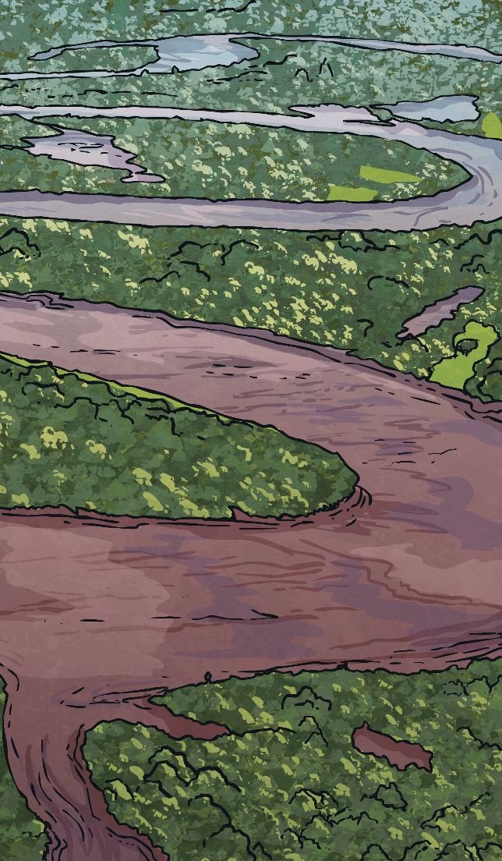
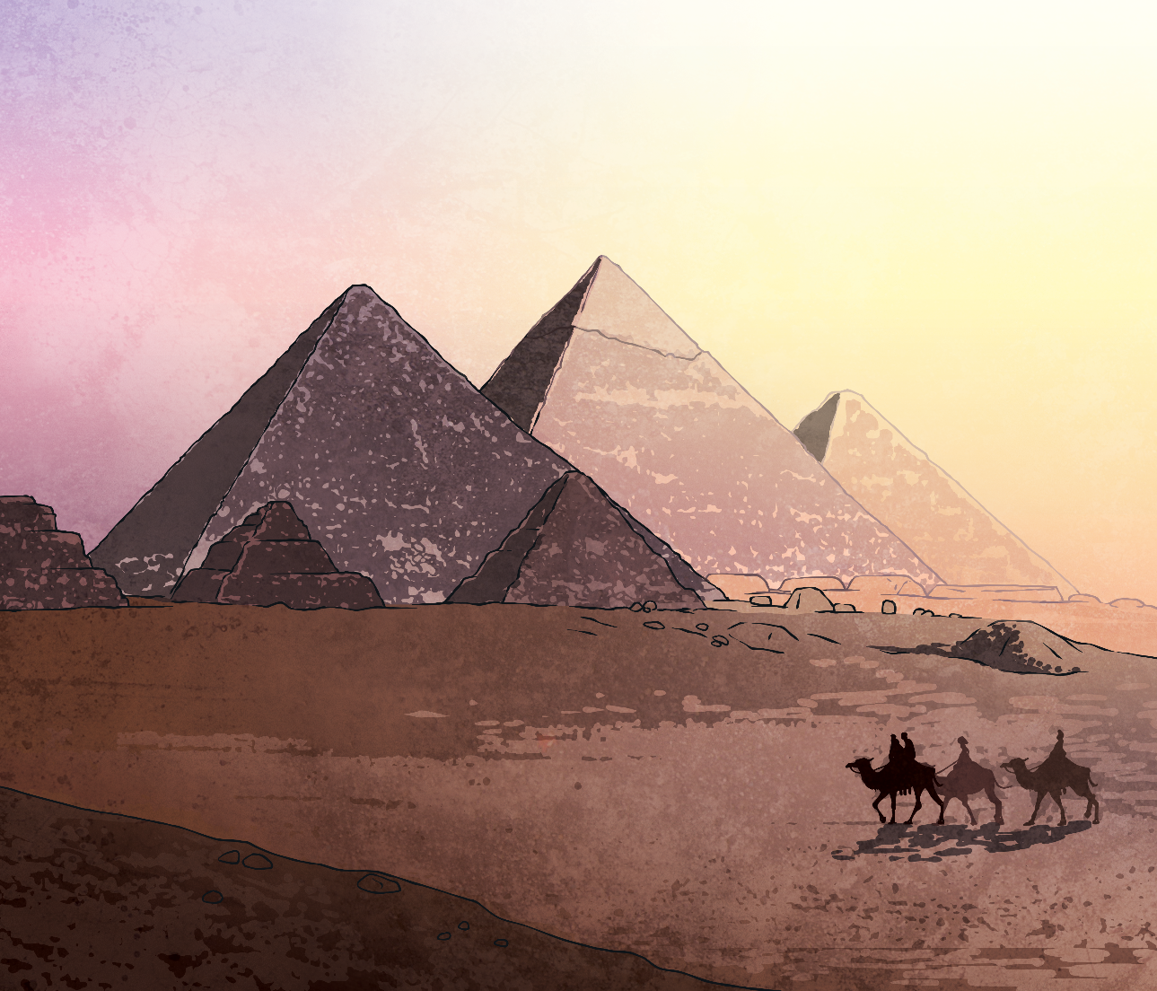



The New 7 Wonders of the World
Do you know any of the new 7 wonders of the world?
Which of the new wonders are in the Americas?
Why do you think there were no wonders from the Americas in the original list?
Of course, the New 7 Wonders of the World represent only a tiny portion of the thousands of remarkable monuments across the world. Did you know that Stonehenge in Britain was one of the New 7 Wonders finalists?
The Great Pyramid of Giza was granted honorary status and is the only one of the original seven wonders of the ancient world in addition to the seven new wonders.
Between 2000 and 2007 a project was carried out to allow people all over the world to vote for which monuments they thought should be on the new seven wonders of the
world list.

