Slide 1

Week 1 Day 4

Slide 2
Read Chapter 6 ‘My Planet Panda Pop’ up to the end of the text message ‘all you have to do is get put through.’
Why do the family not book a holiday?
How can we tell that Liam is ‘gifted and talented’?
What can Liam’s Draxphone do?

Slide 3
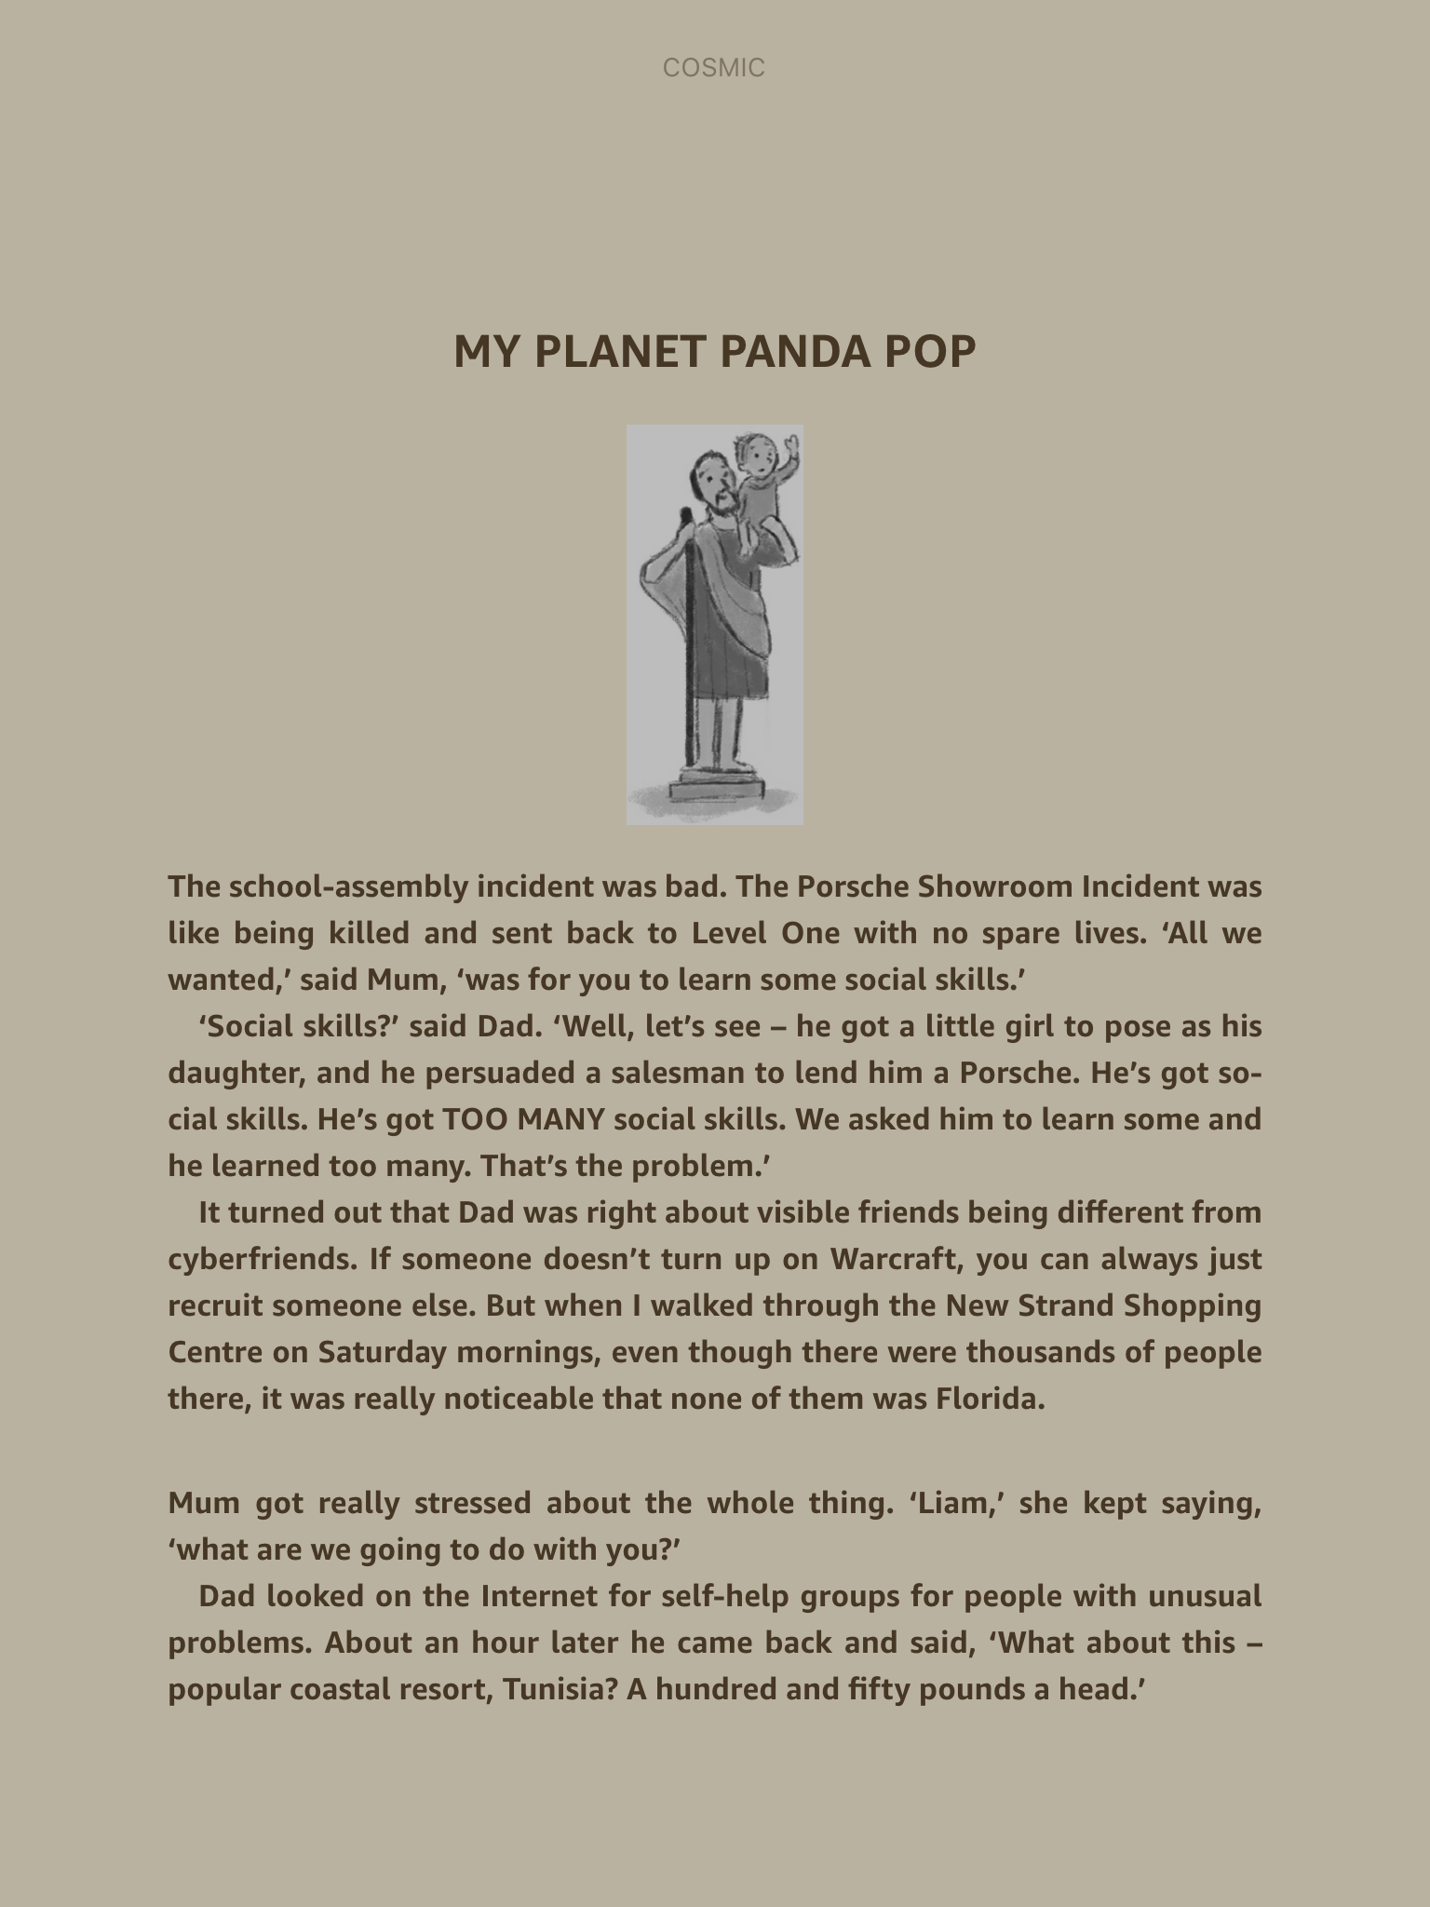

Slide 4
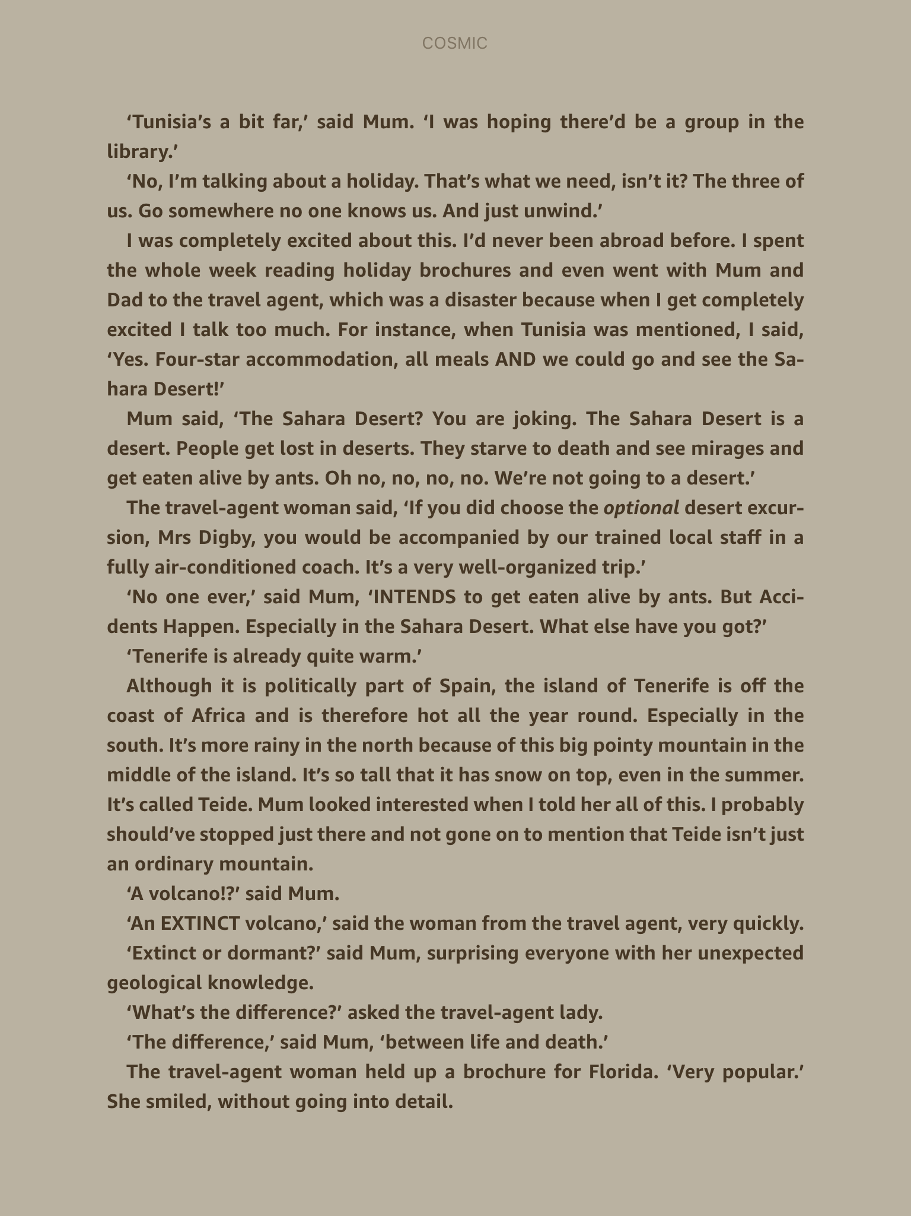

Slide 5
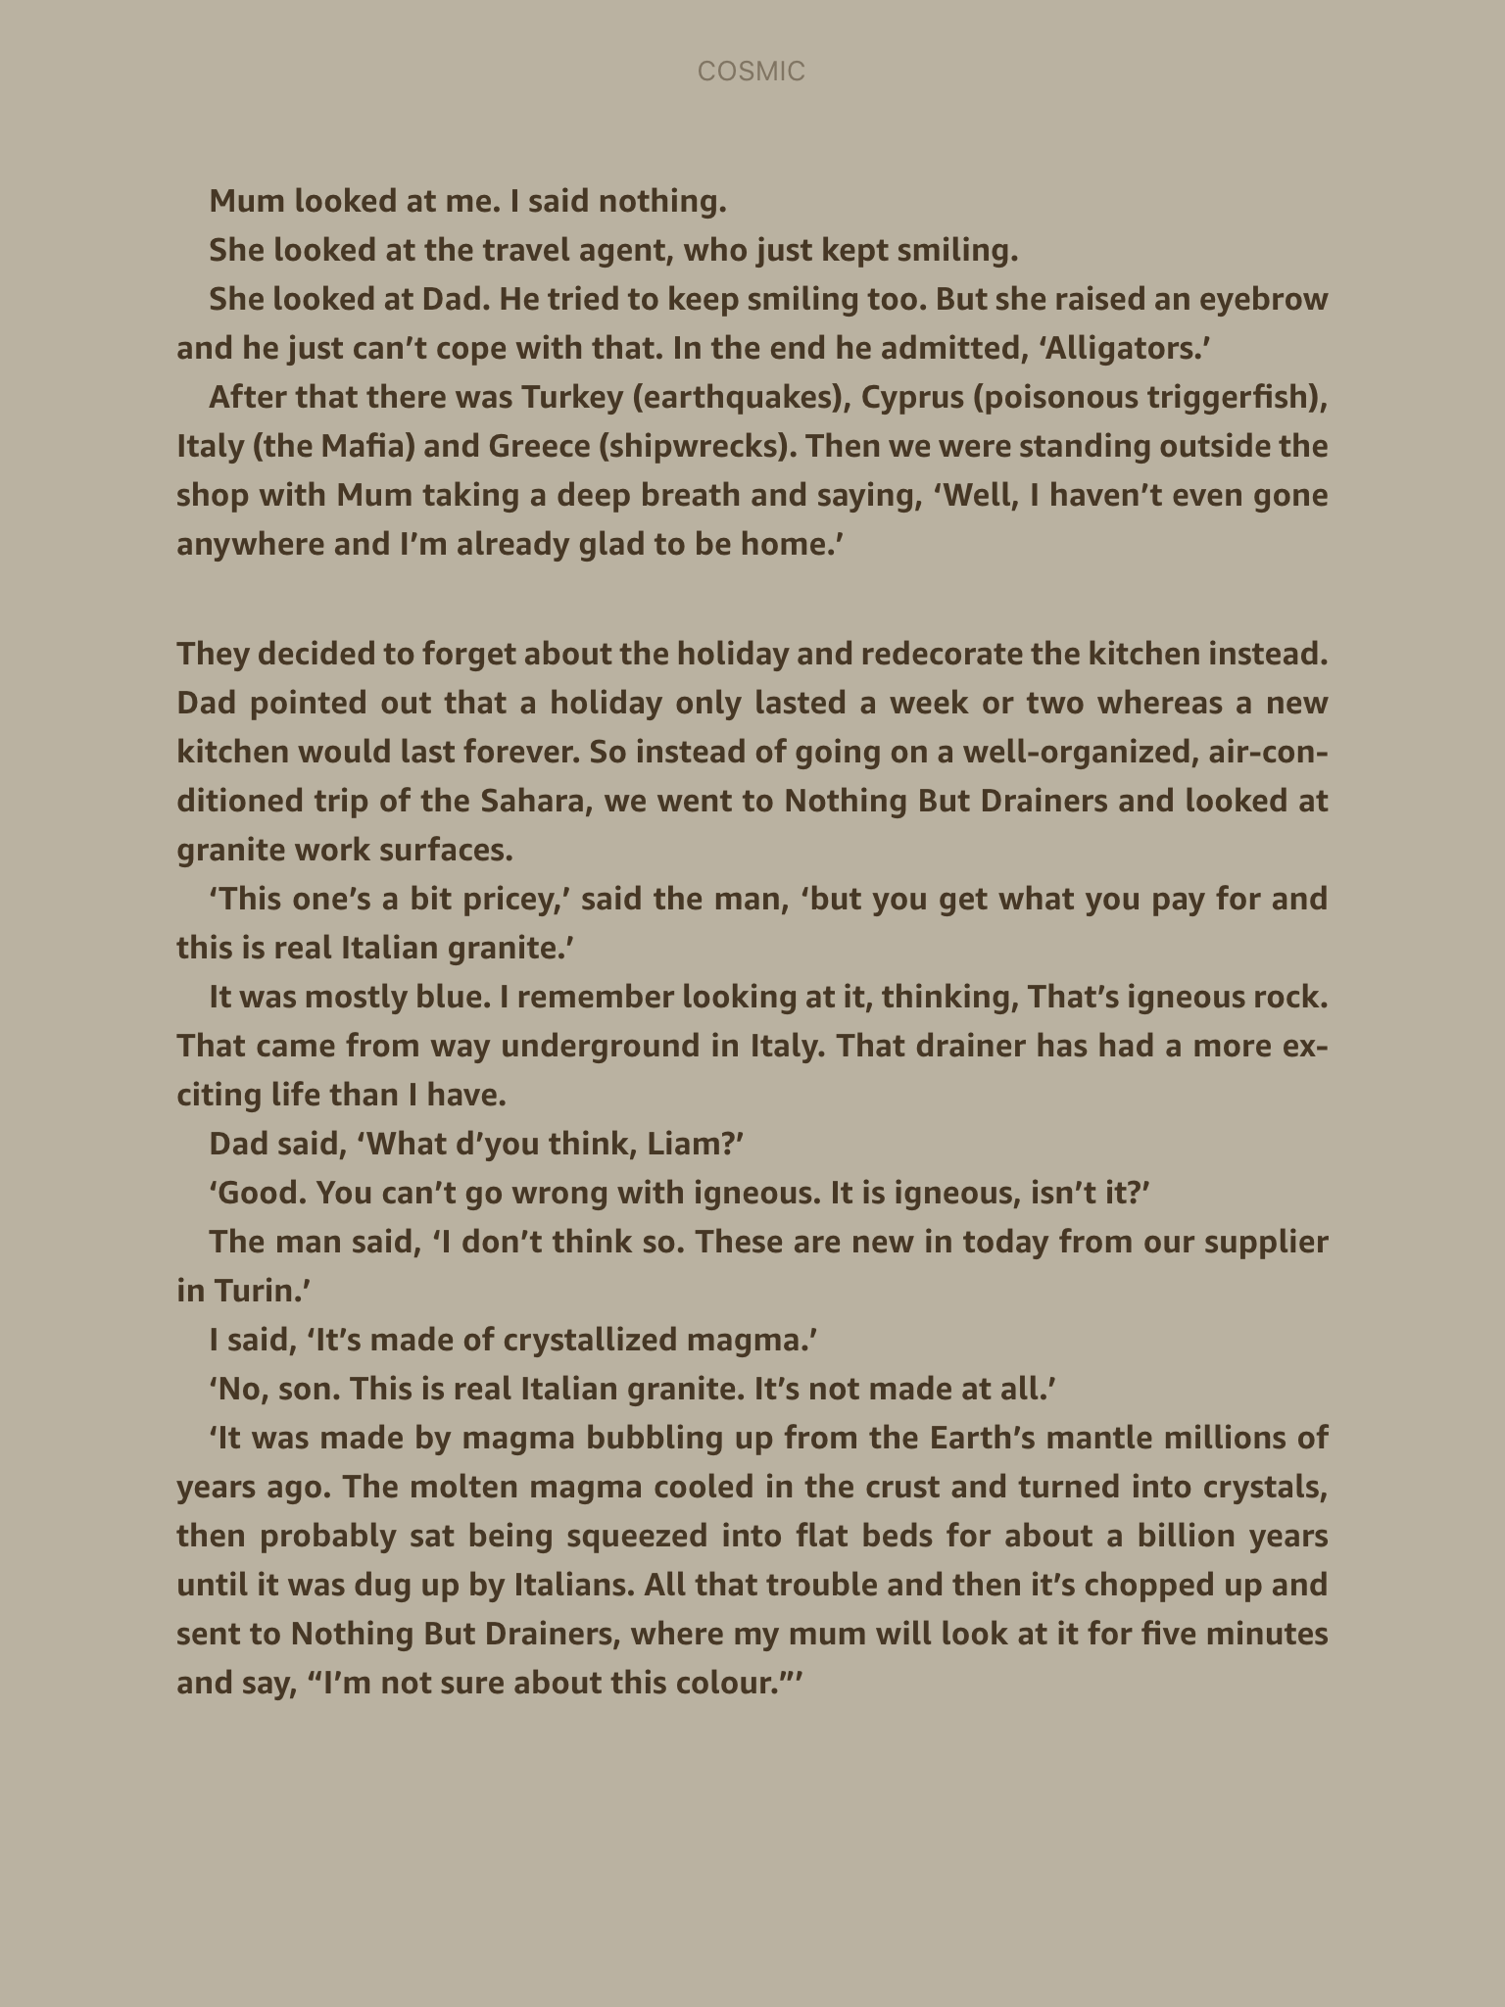

Slide 6
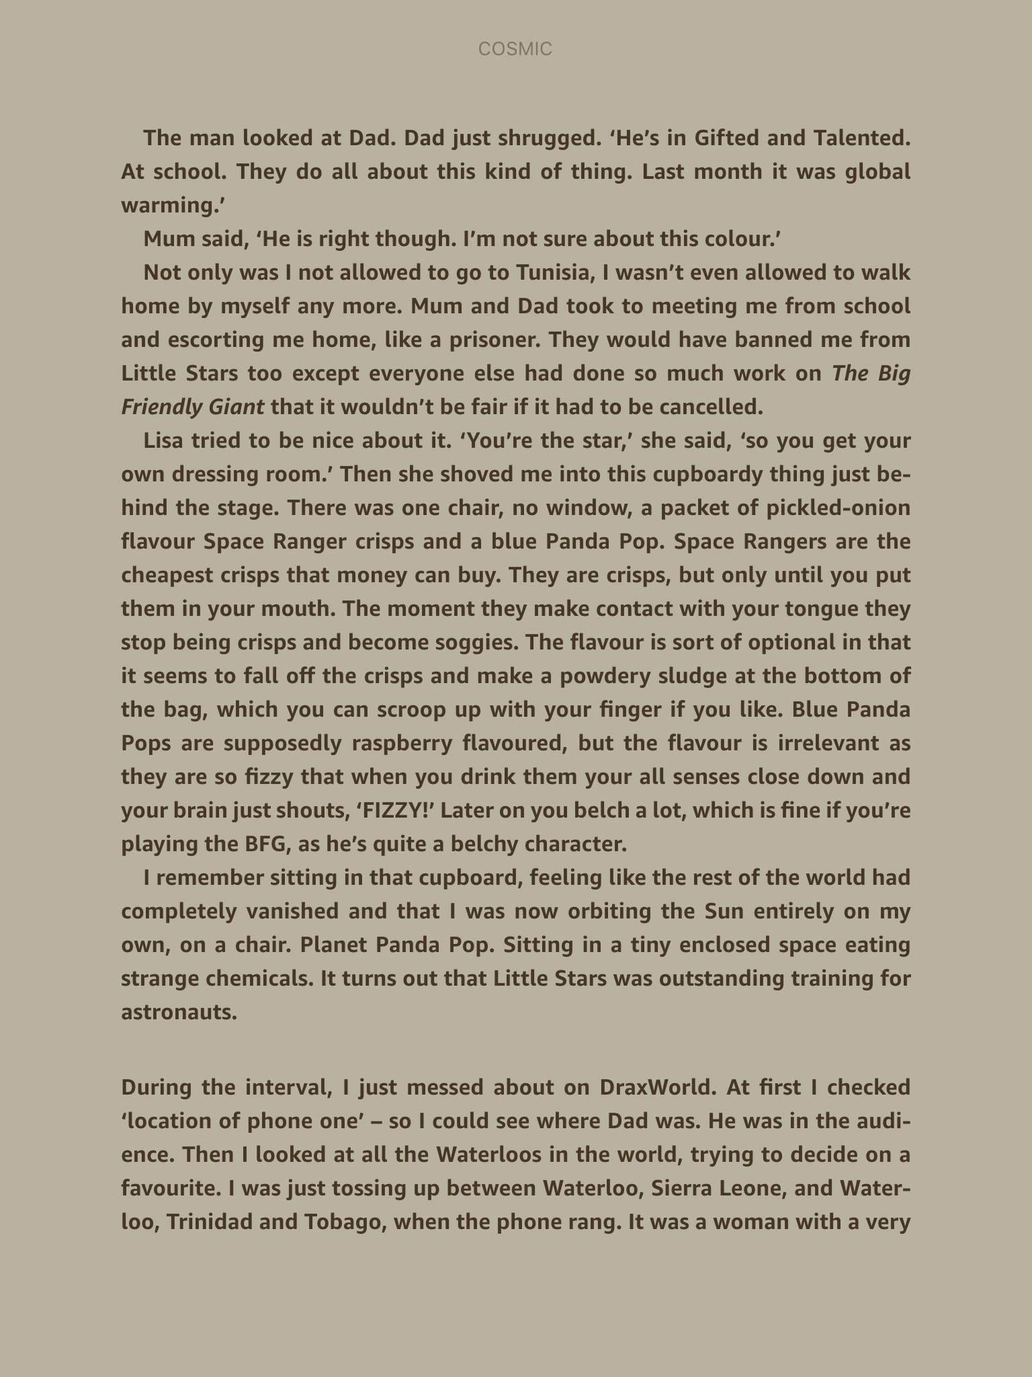

Slide 7
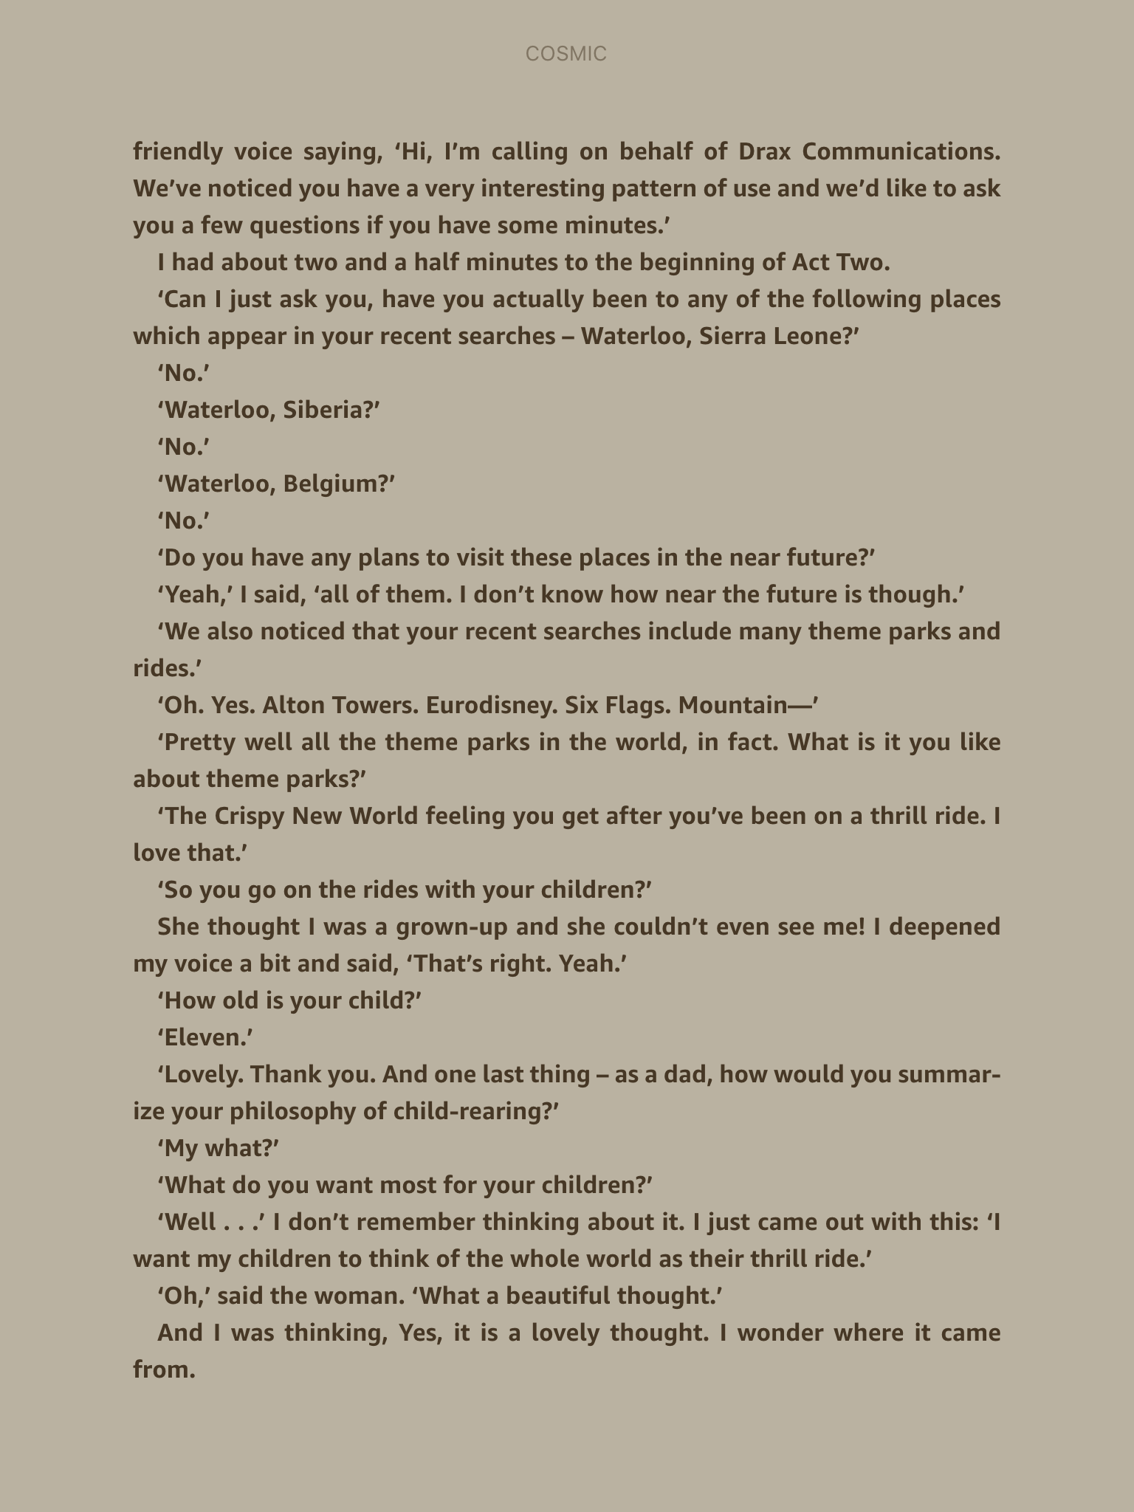

Slide 8
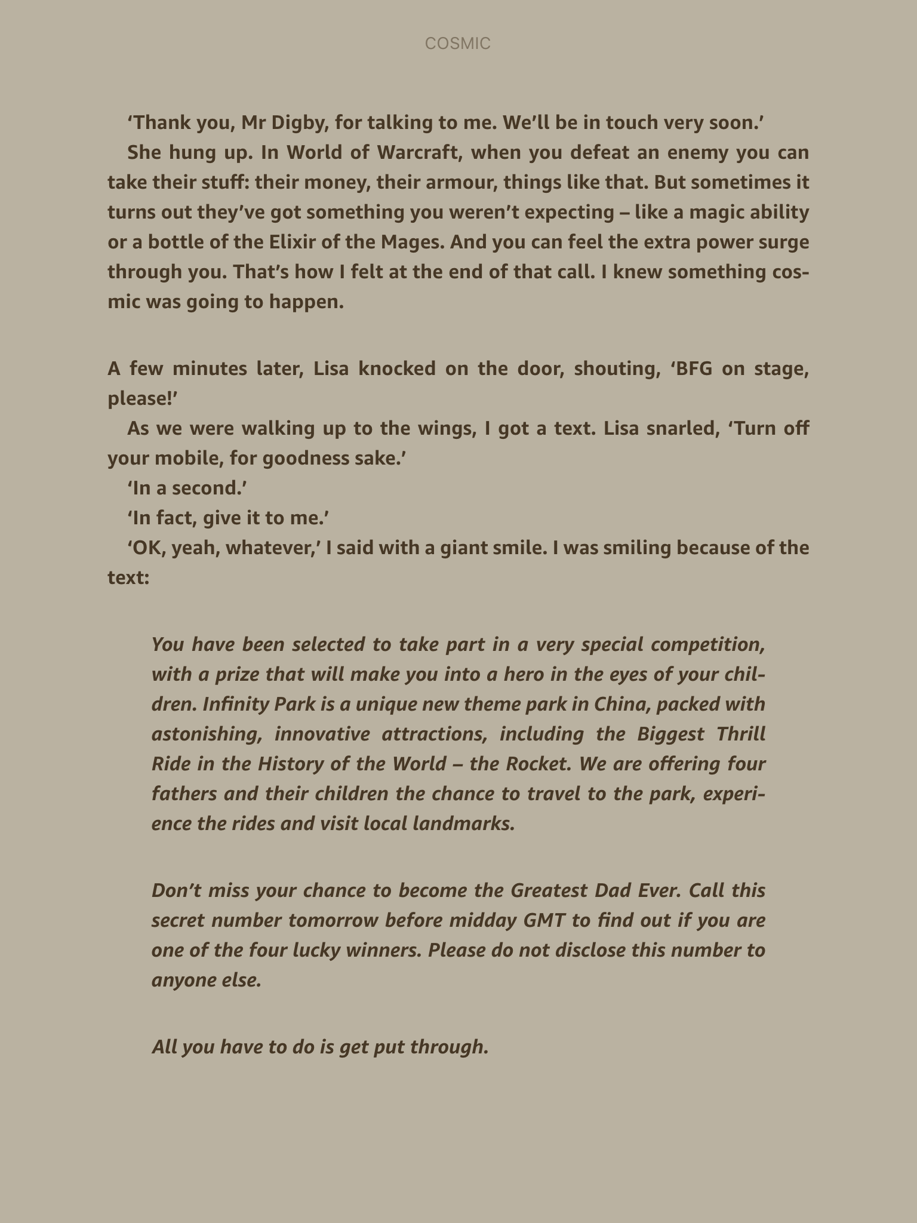

Slide 9
Read the text message that Liam receives on his Drax phone.
You have been selected to take part in a very special competition, with a prize that will make you into a hero in the eyes of your children. Infinity Park is a unique new theme park in China, packed with astonishing, innovative attractions, including the Biggest Thrill Ride in the History of the World – the Rocket. We are offering four fathers and their children the chance to travel to the park, experience the rides and visit local landmarks.
Don’t miss your chance to become the Greatest Dad Ever. Call this secret number tomorrow before midday GMT to find out if you are one of the four lucky winners. Please do not disclose this number to anyone else.
All you have to do is get put through.
What do you think might happen next?

Slide 10

Continue reading until the end of the chapter

Slide 11
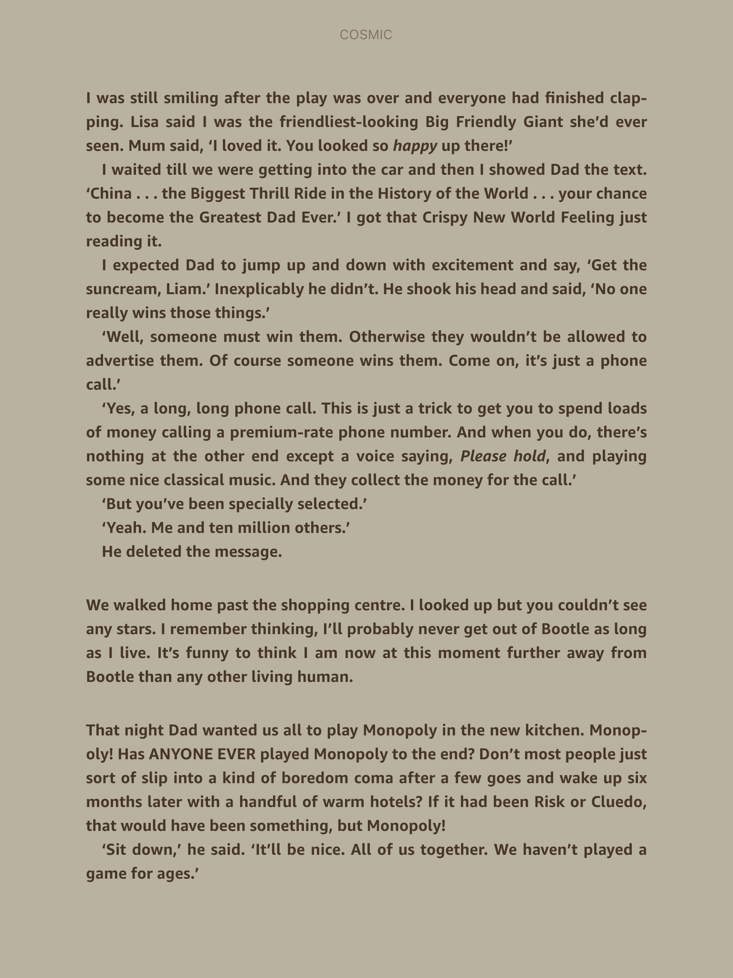

Slide 12
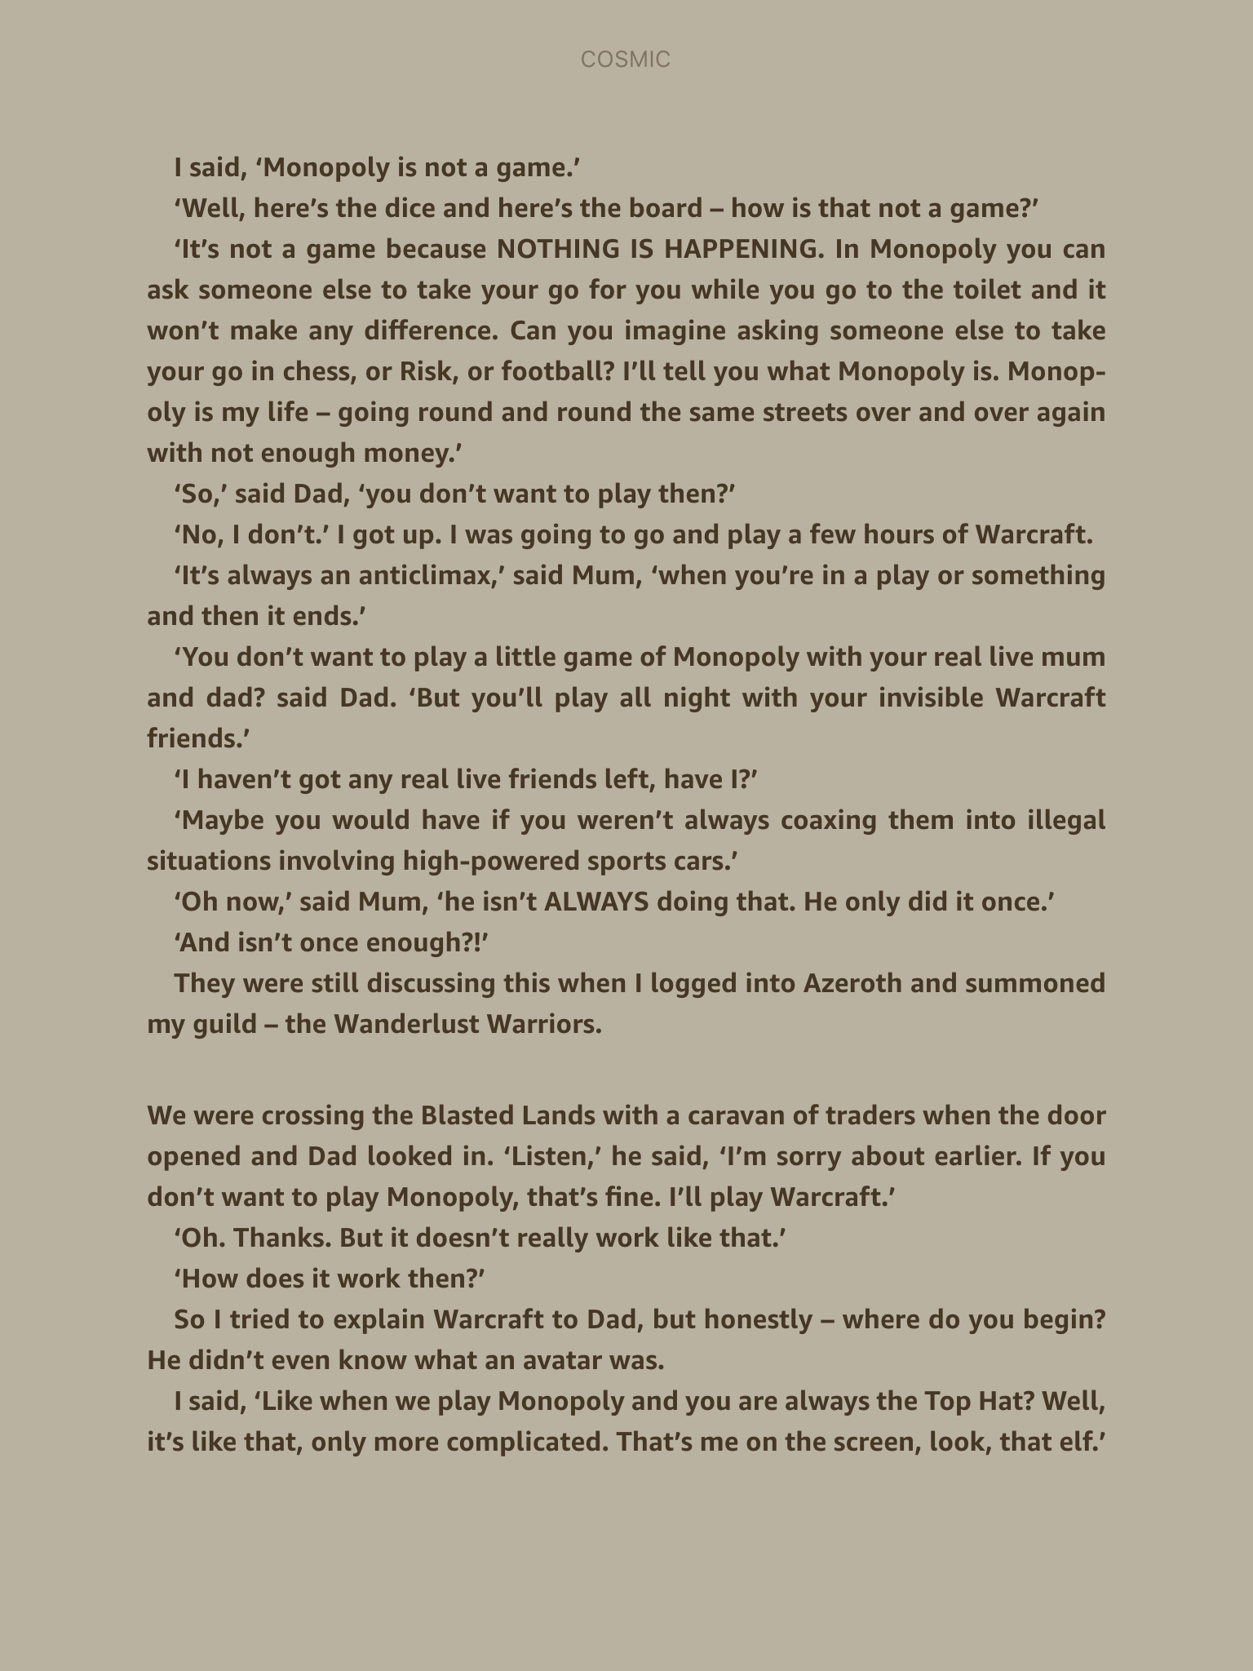

Slide 13
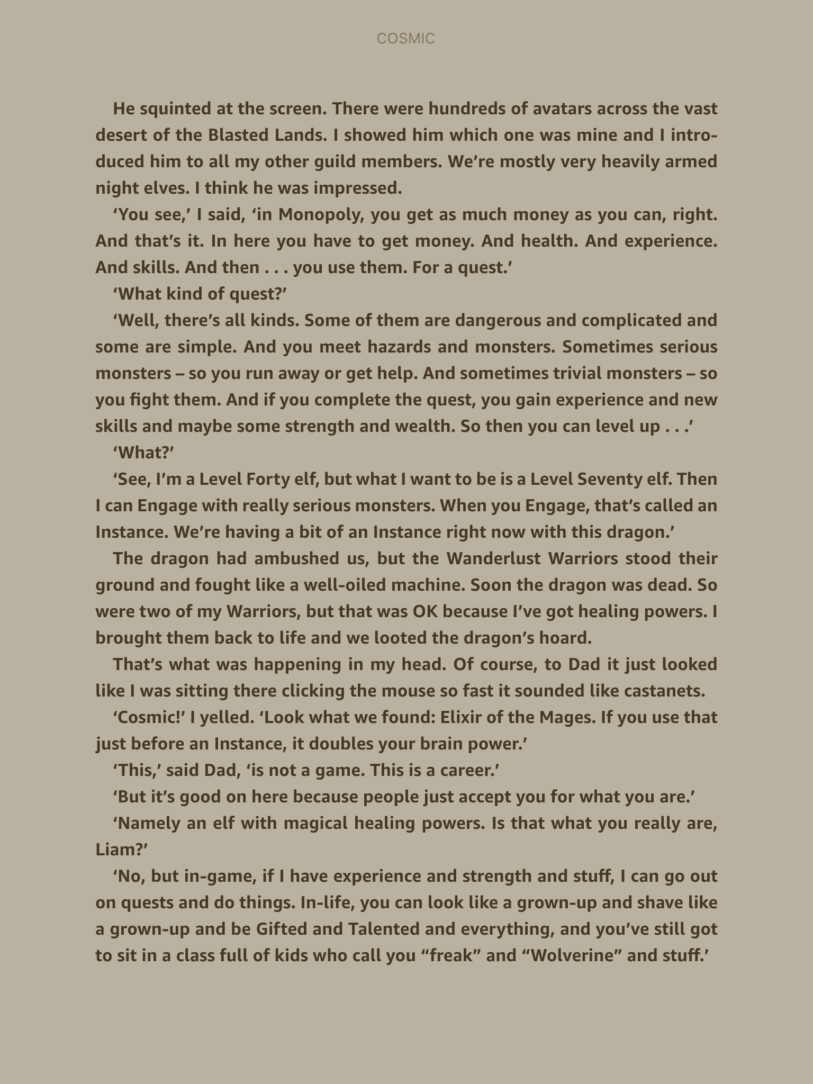

Slide 14
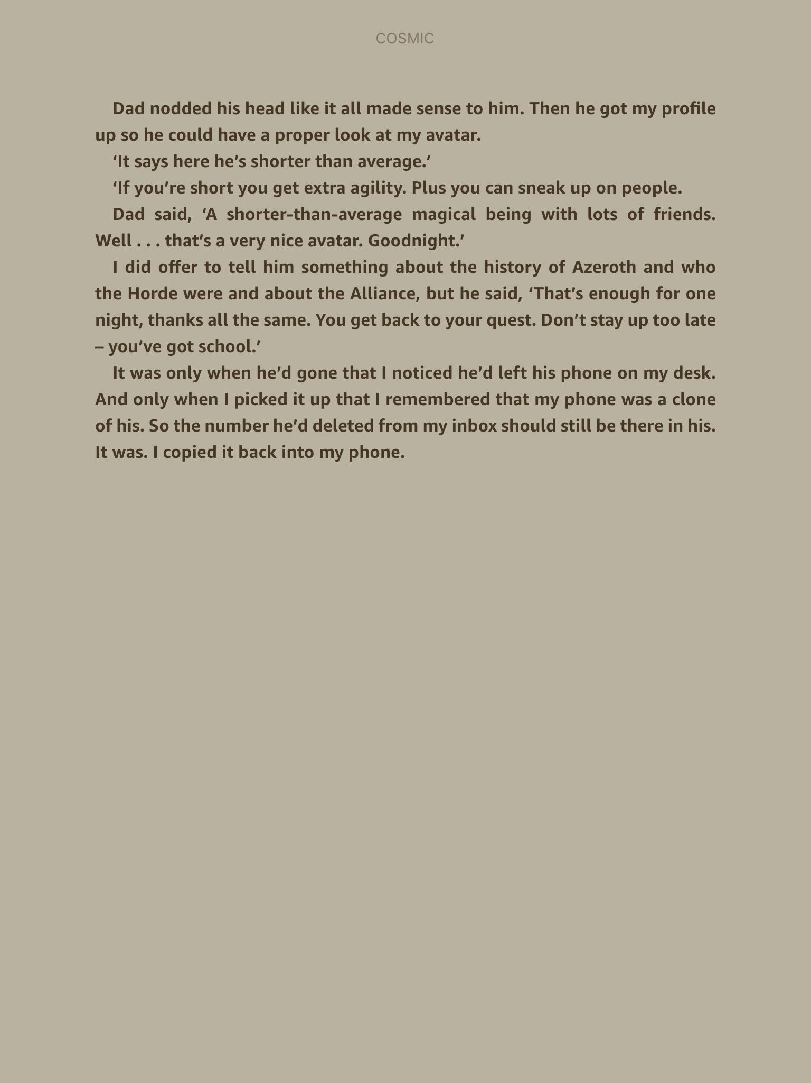

Slide 15
Prediction Time
When you predict, you need to use the knowledge you have from the text plus what you know from your own life experiences. This will help you anticipate what might happen next.
Think about where Liam currently is.
Think about Liam’s previous behaviour.
Think about Liam’s personality and interests.
Now that Liam has the text message back, what might he do?

Slide 16
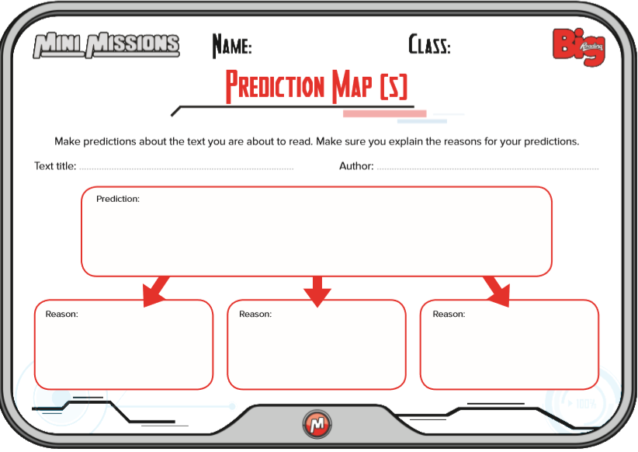
Main Task: Complete Prediction Map 5 in your book or this sheet.

