Slide 1
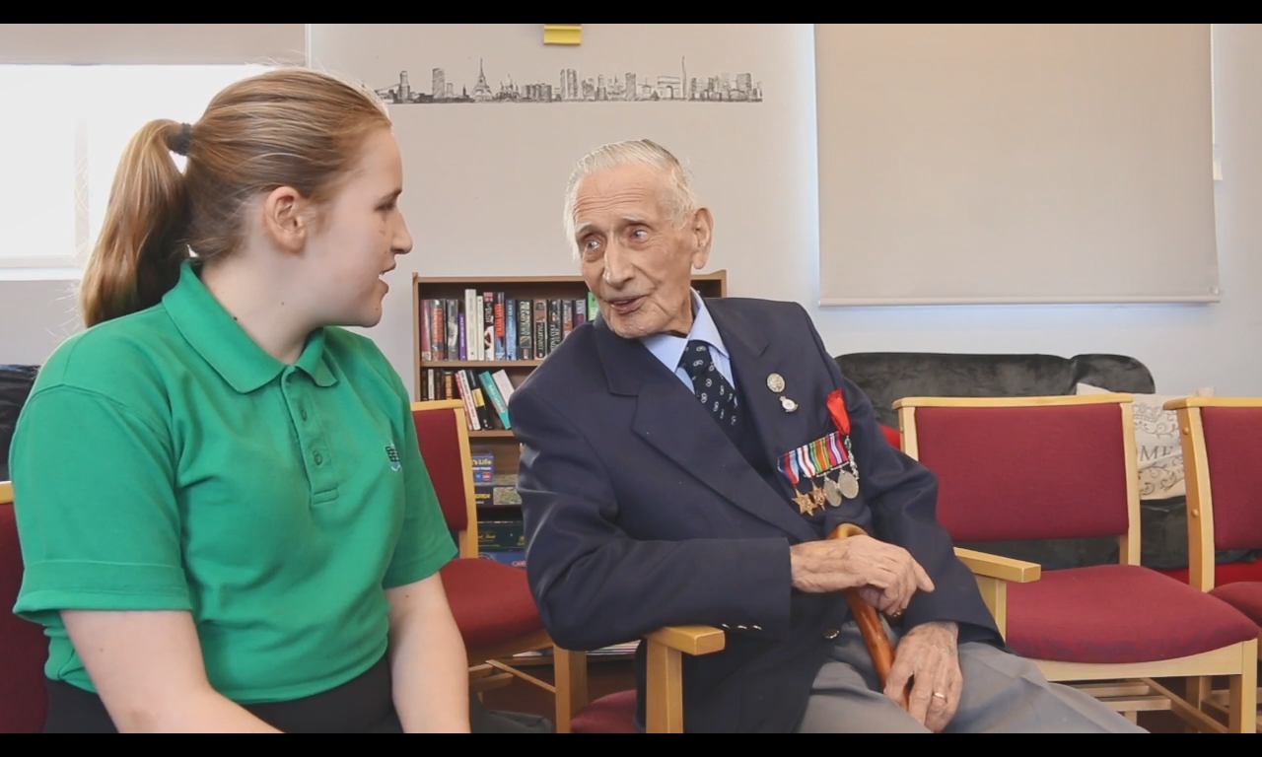
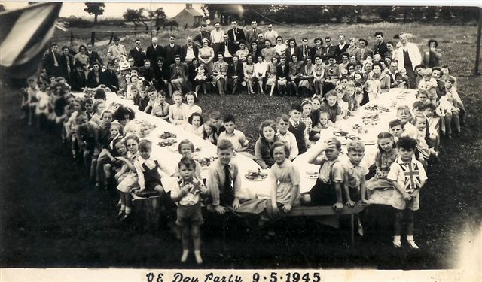
Remembering Alf Smith
Second World War Project
VE Day
8th May 1945
Please view as ‘Slideshow’
Notes:
VE day 9.5.45 Little Thurrock. Blackshots VE day party from Thurrock Museum.

Slide 2
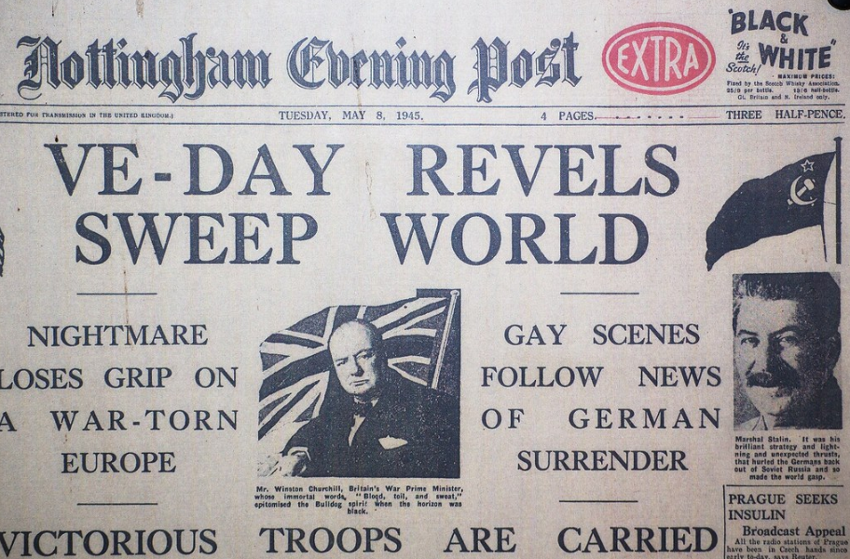
What is VE day?
VE-DAY = Victory in Europe Day
8th May 1945 was declared VE day
Following the death of Adolf Hitler, defeat of the Nazis and unconditional surrender from Germany
War in Europe ended
Notes:
Newspaper image from: https://www.flickr.com/photos/timparkinson/2470808883

Slide 3
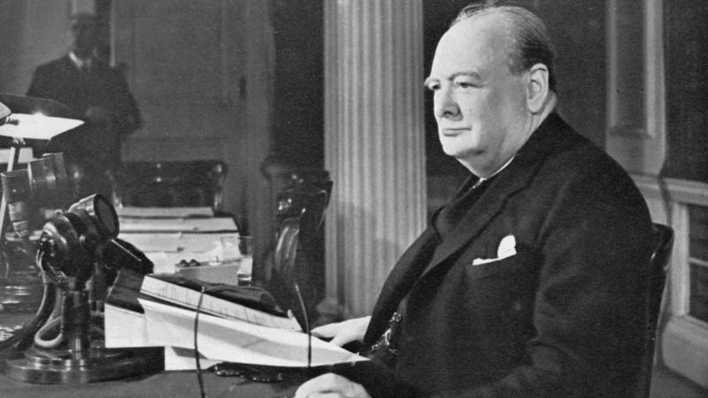
Who was Prime Minister in Britain in 1945?
Winston Churchill
The War was not over, it continued in the Far East and Pacific until 2nd September 1945
Listen to his VE day speeches here:
https://winstonchurchill.org/resources/speeches/1941-1945-war-leader/to-v-e-crowds/
Notes:
Photograph of Churchill about to make a radio broadcast
https://www.bbc.co.uk/newsround/48201749

Slide 4
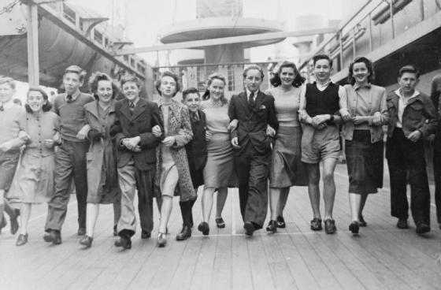
The War was not over, but it did mean:
Evacuees could come home (if they hadn’t already)

Slide 5
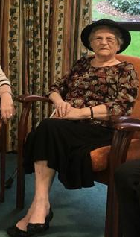

Name: Joan
Age: 87 years old
Age evacuated:5 years old
Age returned: 11 years old
43 seconds
Evacuated at the outbreak of War (1939) aged 5
Came home for VE day
Hadn’t seen her Mum for so long, when she was picked up she had forgotten what she looked like.

Slide 6
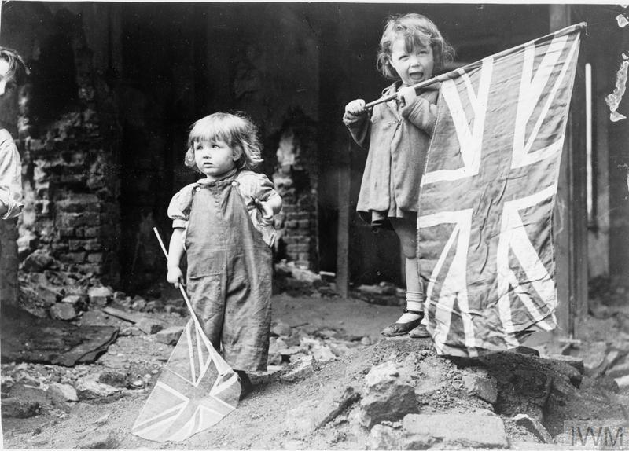
The War was not over, but it did mean:
No more bombs
No more blackout
Notes:
https://commons.wikimedia.org/wiki/File:Ve_Day_in_London,_8_May_1945_HU49414.jpg

Slide 7
Names: Ruth (93) and Joyce (88) - Sisters
Ruth = 18 years old on VE day
Joyce = 13 years old on VE day
28 seconds
They felt “freedom” and safe from bombs
The end of the War bought “delight”
Their brother Tommy, who had served in the Navy and been killed, was not with them, so there was “a lot of sadness as well”

Slide 8
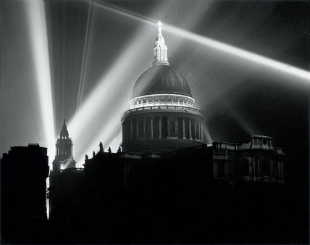
VE day was a time for Remembrance
Between 1939-1945:
18 million
had been killed in military service
45 million civilians killed
40 million refugees displaced around Europe
On VE day St.Paul’s held 10 services attended by 1000s to reflect
St Paul's Cathedral illuminated on the night of VE Day, London, 8 May 1945
© Daily Herald Archive / National Science & Media Museum / Science & Society Picture Library
Notes:
St Paul's Cathedral illuminated on the night of VE Day, London, 8 May 1945
Image Details
Image Ref.
10316097
© Daily Herald Archive / National Science & Media Museum / Science & Society Picture Library
https://www.ssplprints.com/image/95630/st-pauls-cathedral-illuminated-on-the-night-of-ve-day-london-8-may-1945

Slide 9
Winston Churchill announced…
“We may allow ourselves a brief period of rejoicing”
Tuesday 8th May and Wednesday 9th May were declared NATIONAL HOLIDAYS, people celebrated in their own ways.
Notes:
Photograph of Churchill about to make a radio broadcast
https://www.bbc.co.uk/newsround/48201749

Slide 10
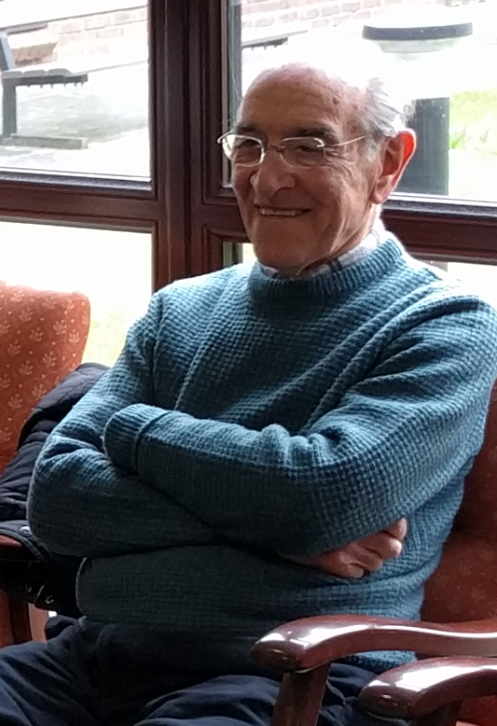
Name: Norman
Age: 82 years old
6 years old on VE day
BIG PARTY ON HIS STREET
57 seconds
“The Court” belonged to the biggest house in Norman’s street
There was a “big bonfire”, music, food and dancing
“Everyone was invited”
The atmosphere was “wonderful”

Slide 11
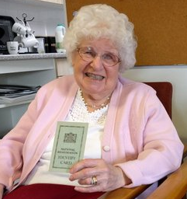
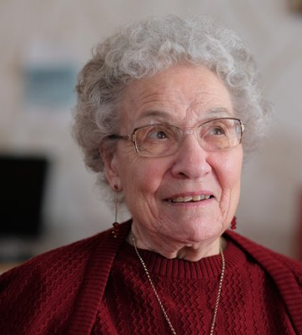
Names: Betty and Margaret –sisters
NO PARTY, but Betty went into nearby town
39 seconds
Betty = 15 years old on VE day
Margaret = 12 years old on VE day
The end of War was “lovely”
When hearing it was VE day “everyone went mad”
Betty went from her home in Shoeburyness to nearby Southend where people were “walking along and shouting to each other and cheering”
Margaret remembers there were no street parties in Shoeburyness.

Slide 12
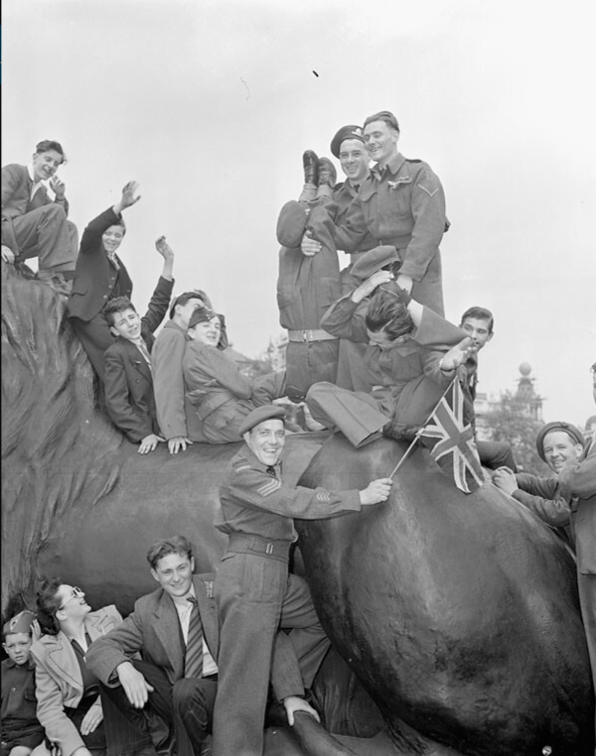
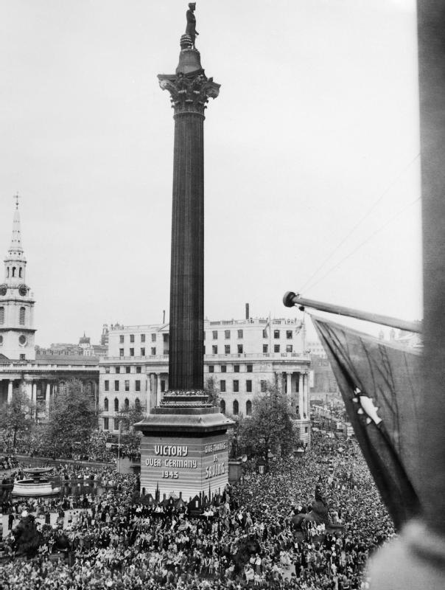
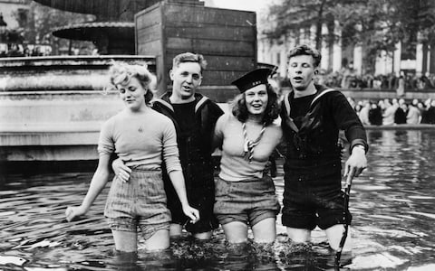
These famous photographs were taken on VE day in Trafalgar Square in London
Notes:
Nelsons column: https://www.telegraph.co.uk/news/0/ve-day-nation-celebrated-pictures/thousands-gather-londons-trafalgar-square-mark-ve-day-1945/
Lions: https://www.flickr.com/photos/lac-bac/6924693228
In the fountain: https://www.telegraph.co.uk/content/dam/news/2017/04/24/TELEMMGLPICT000068529227_trans_NvBQzQNjv4BqZjISHais5ATXNXBxYLUW-9IJE02JsGoaa6o9EAMjCC8.jpeg?imwidth=1400

Slide 13
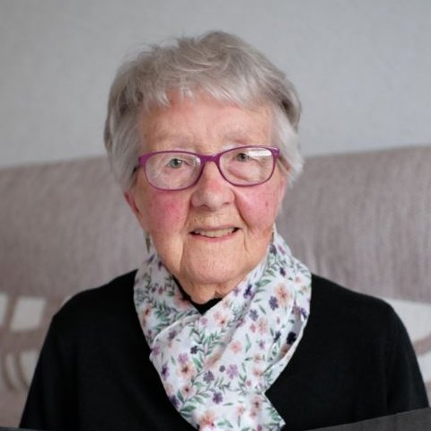
Name: Robbie
Age: 22 on VE day
WENT TO TRAFALGAR
SQUARE TO CELEBRATE.
Went to London with her sister
Found that it was “packed” and overcrowded
There was “drinking, singing, dancing”
Robbie felt “a bit frightened”, due to the crowds and feared being crushed
She heard later that Princess (now Queen) Elizabeth and Princess Margaret had secretly joined the party
Around her people “seemed to enjoy themselves”
For her it was a “damp squib” – she thought it would be more exciting than it really was
Robbie?

Slide 14
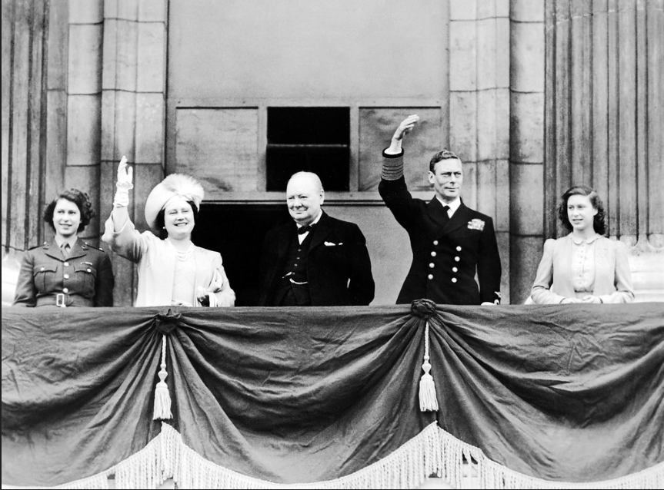
Queen Elizabeth, a princess on VE day described the celebration as “one of the most memorable nights of my life”
Queen Elizabeth
Winston Churchill
(Prime Minister in 1945)
King George VI
(King in 1945)
Princess Margaret
Princess Elizabeth (in 1945, now Queen)
Notes:
Photograph from: https://www.flickr.com/photos/levanrami/47810218531

Slide 15
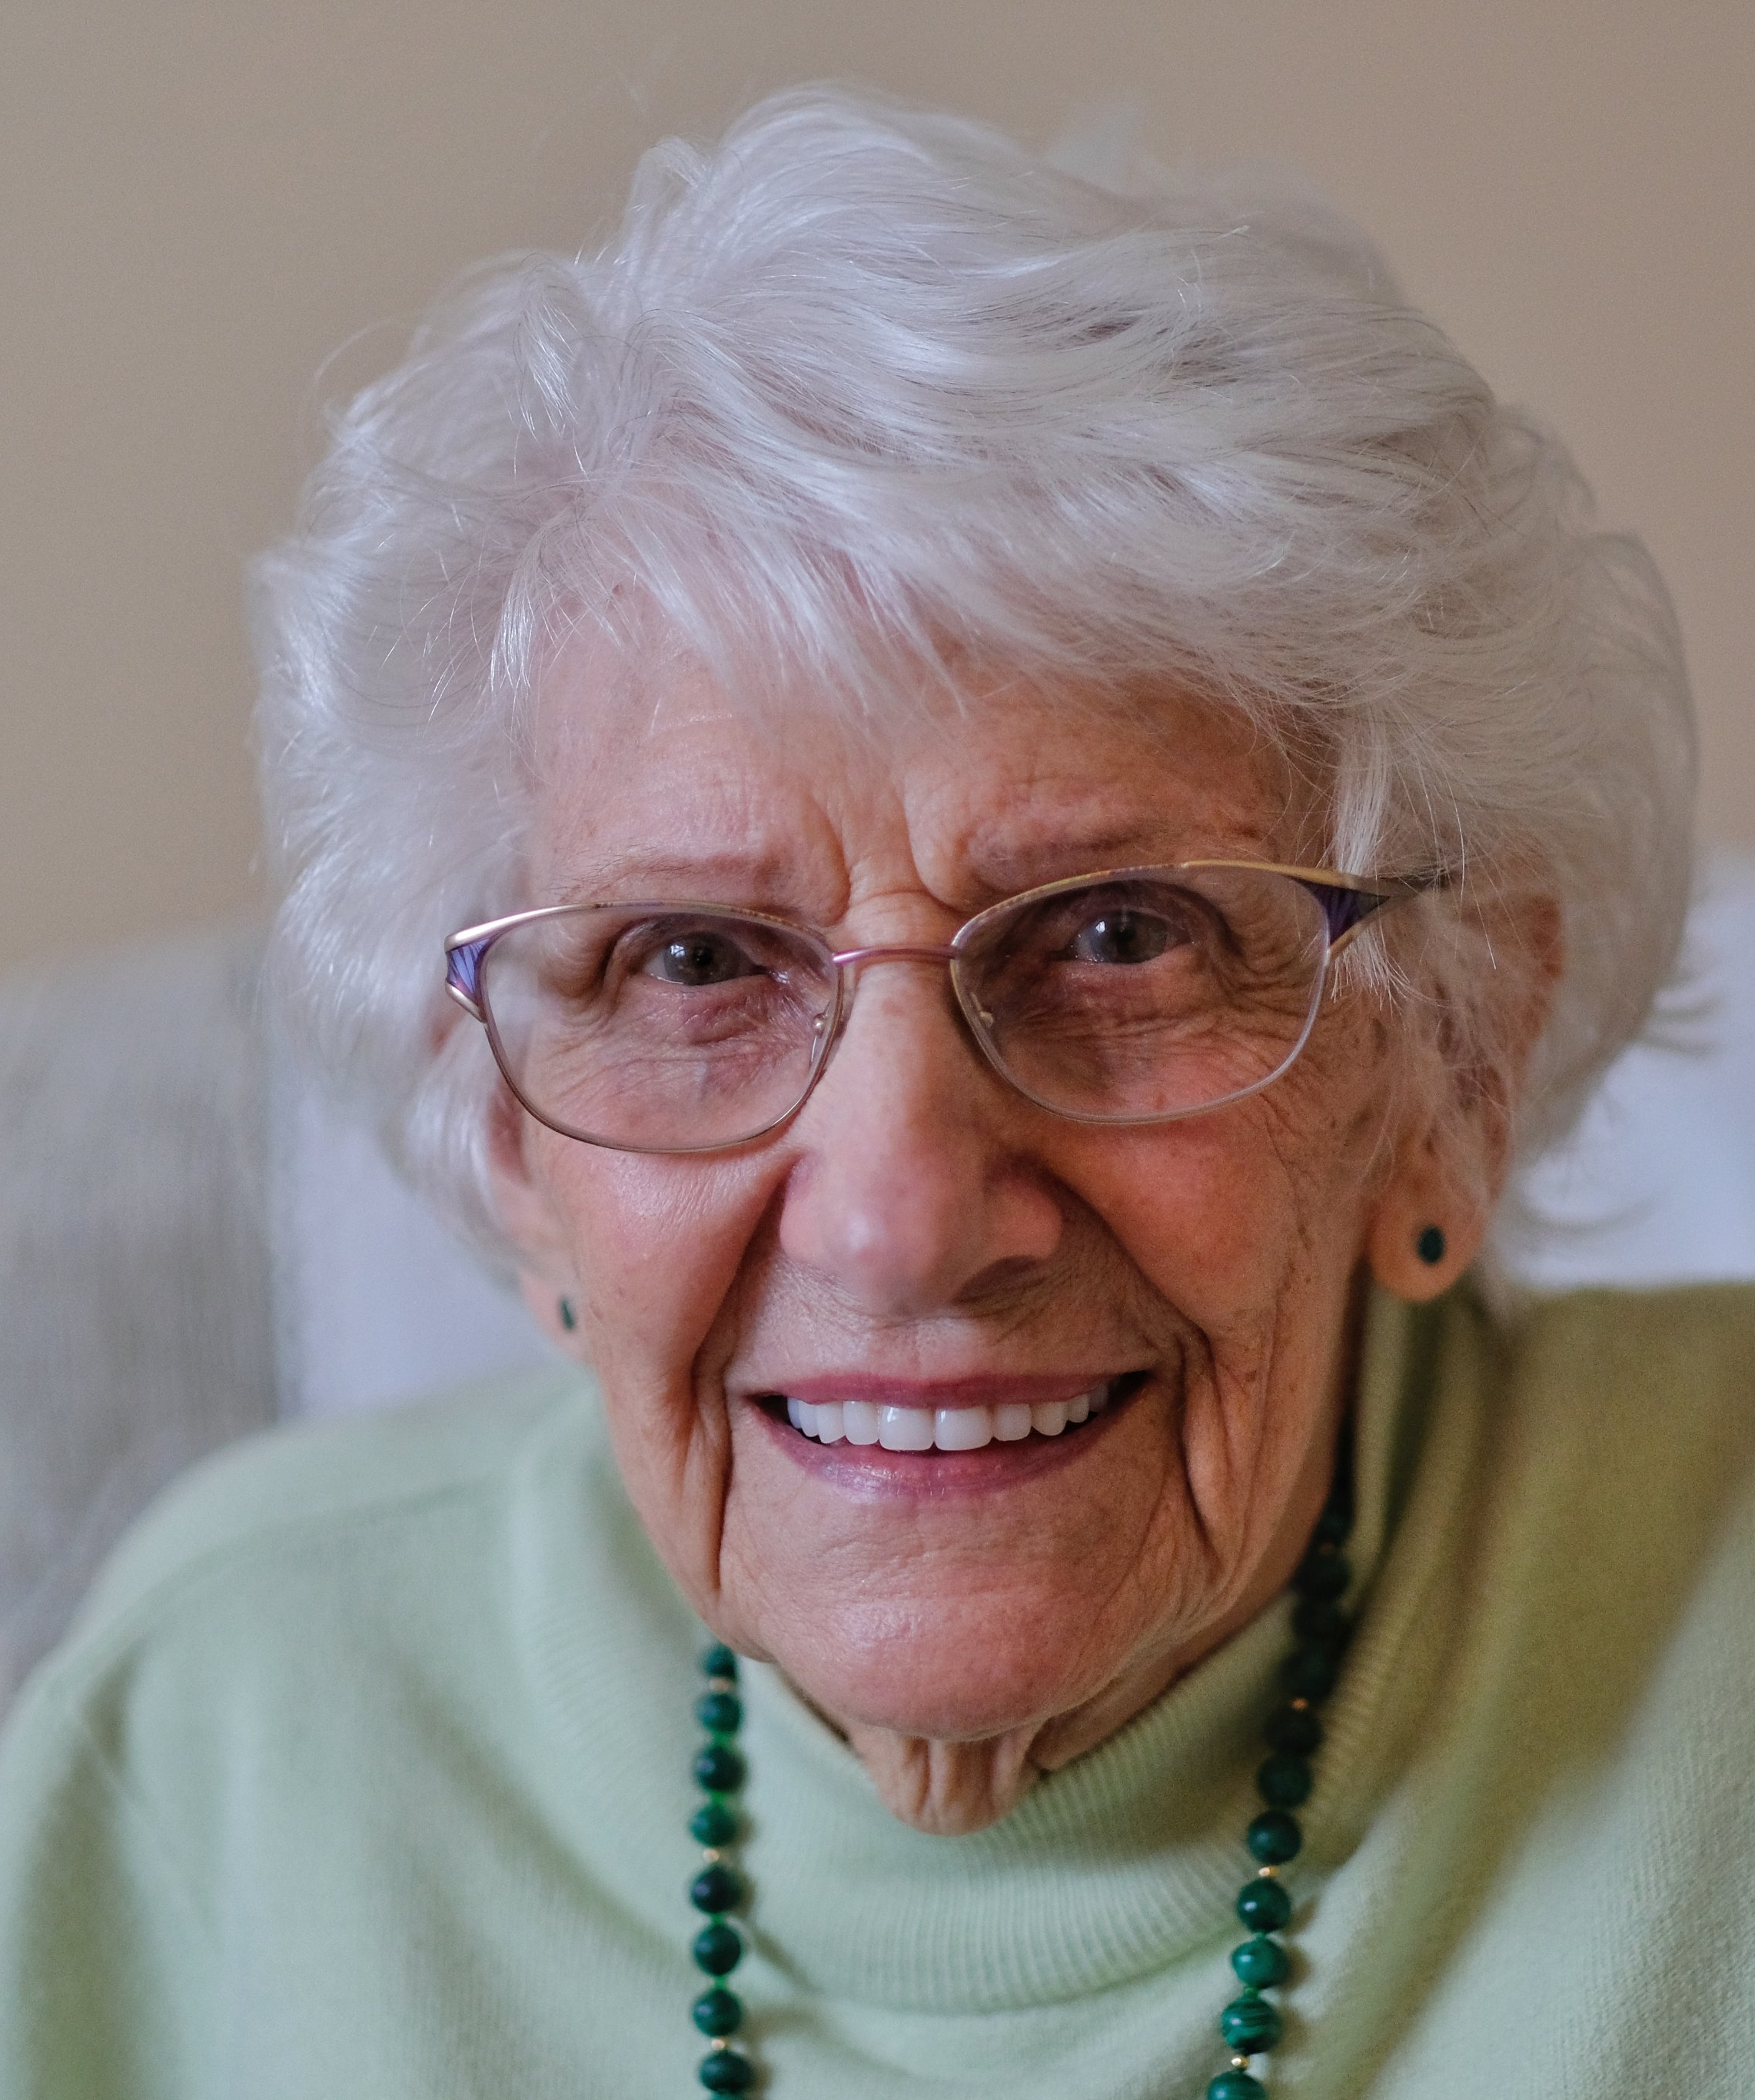
Name: Doreen
19 years old on VE day
CELEBRATED IN LONDON & HAD ALCOHOL (cherry brandy) FOR THE FIRST TIME
1 minute, 29 seconds
Did you celebrate? “Oh yeah!”
Went to the West End and Piccadilly in London
Was dancing around Eros statue (a famous statue in Piccadilly)
Never touched cherry brandy again

Slide 16
Name: Joan
Age: 87 years old
11 Years old on VE Day had some nice homemade cake
20 seconds
There were tables all down the street
People (still on rationing) shared ingredients needed
Joan’s Dad made big cakes, going back to his pre-war job as a baker.

Slide 17
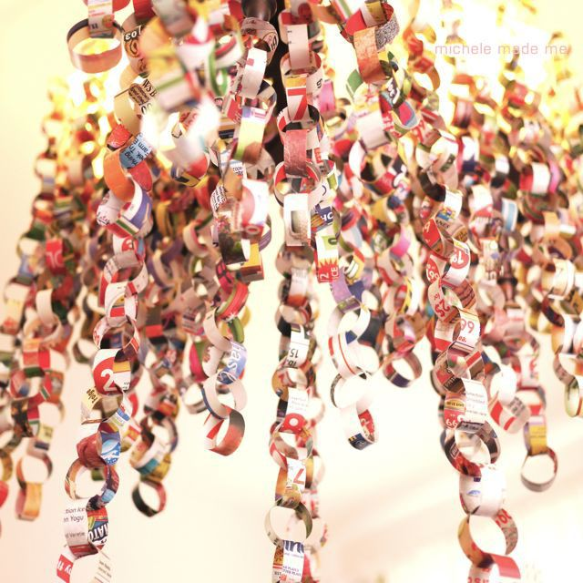
Activities to try:
Make-Do decorations
Rationing continued, so the best decorations re-used and recycled.
Use paper and card from your recycle bin to make decorations.
Notes:
Junk mail paper chains
https://www.pinterest.co.uk/pin/134967320054614799/

Slide 18
Activities to try:
The bright colours of VE day are not captured by the black-and-white photography of the time.
People sometimes wore red, white and blue.
Find clothes in these colours and dress up.

Slide 19
Activities to try:
Design a Peace Flag that all countries can use to celebrate peace

