Slide 1
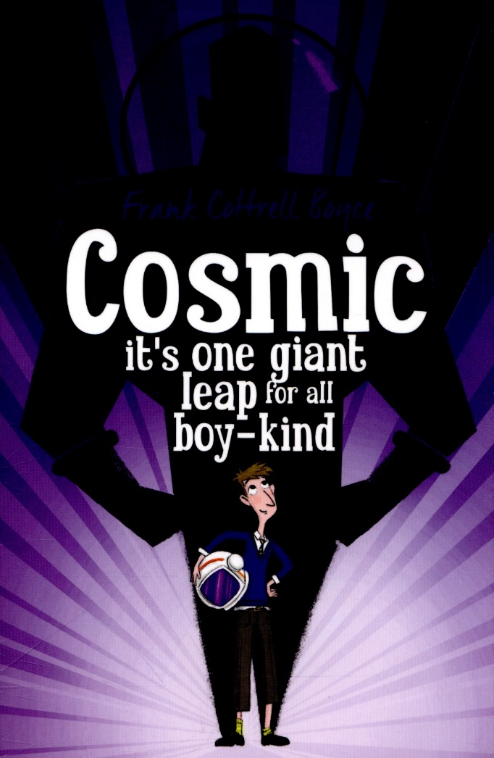
Week 2 Day 1

Slide 2
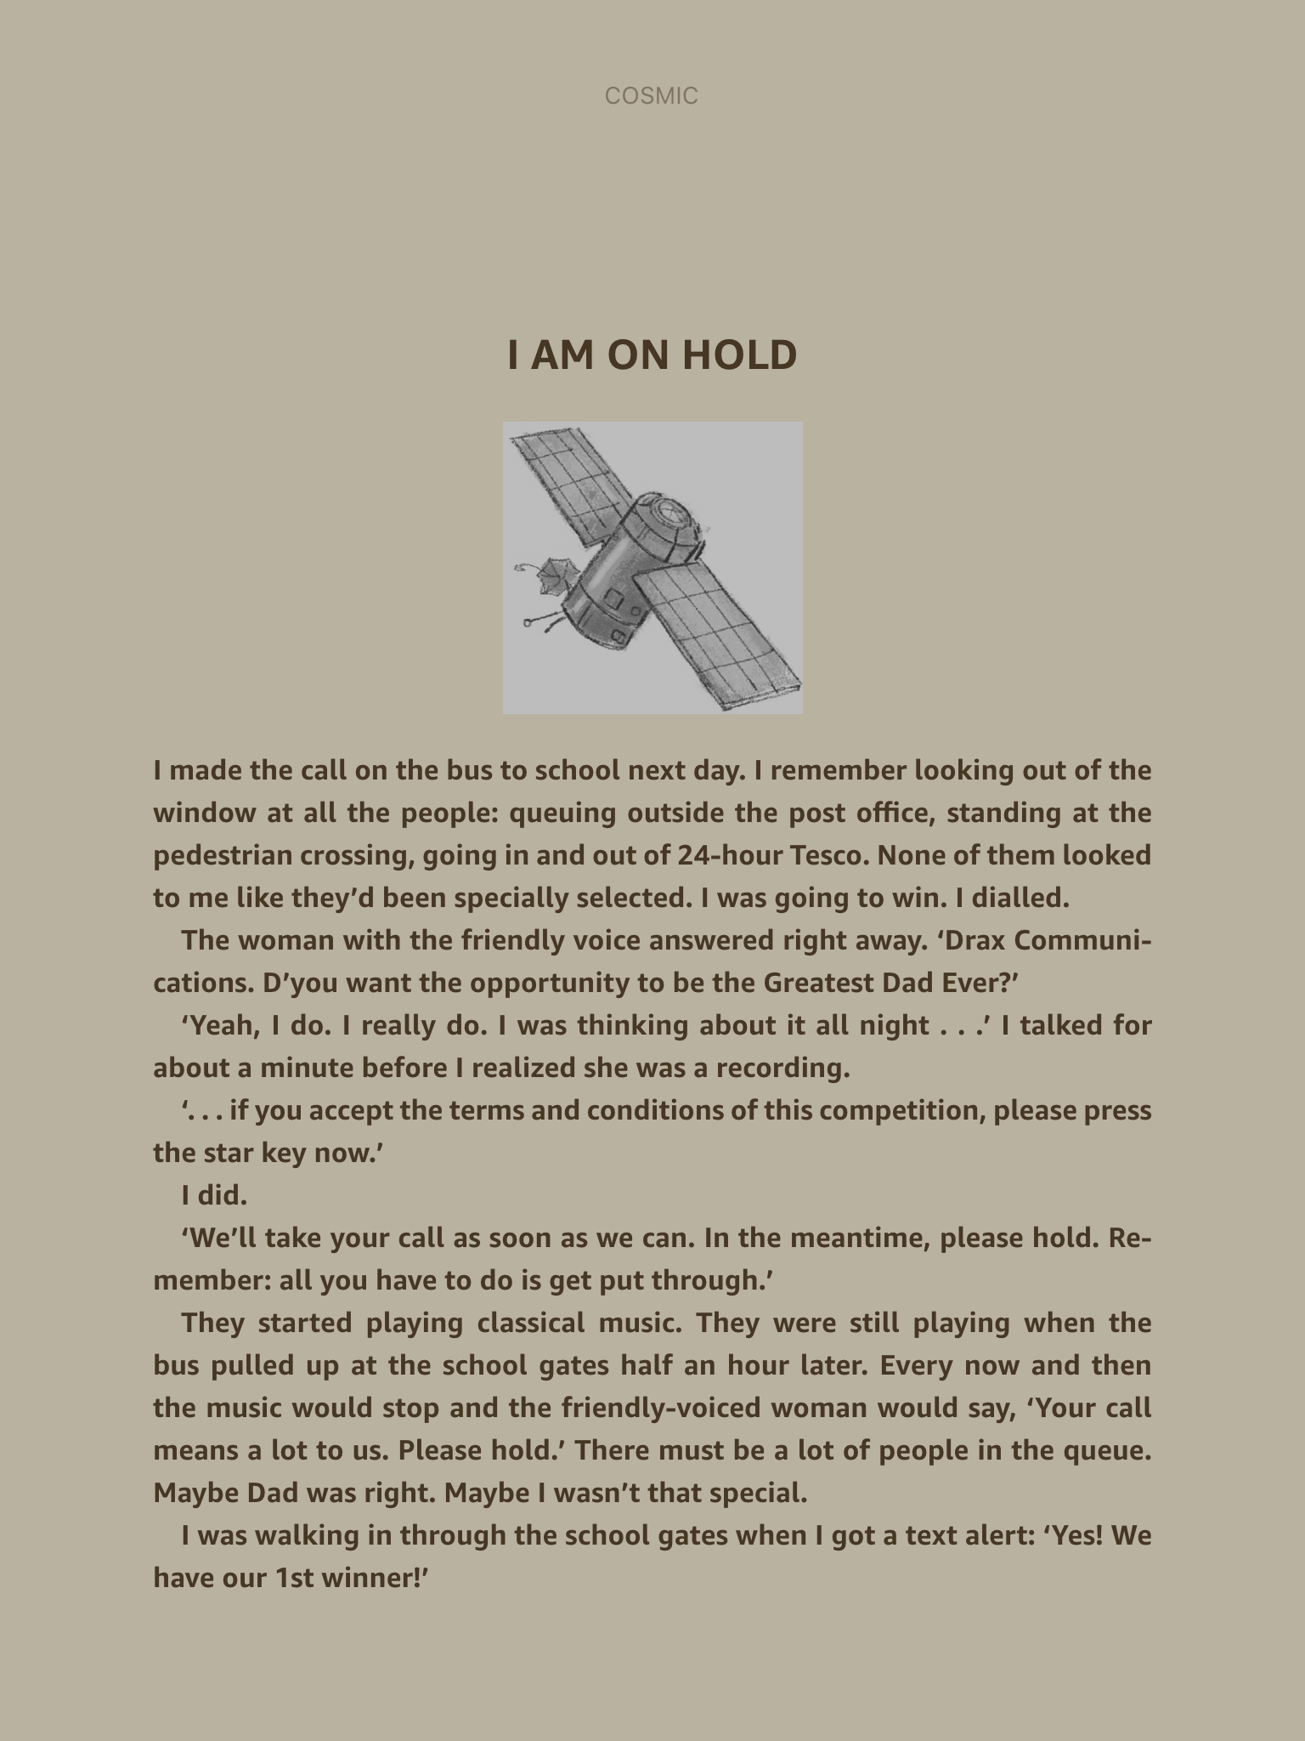
Read Chapter 7 ‘I am on hold’ up to ‘in other words she cheated.’
Does this part of the text remind you of any other stories? (Hint – Roald Dahl)

Slide 3
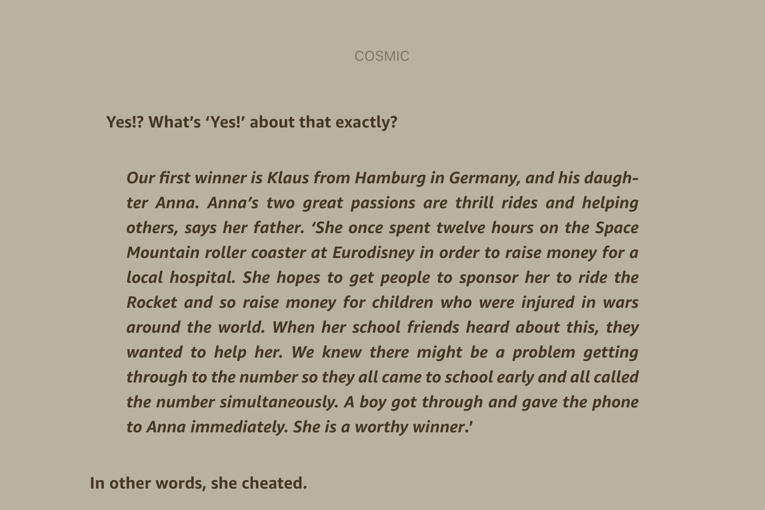
Read the rest of Chapter 7 - How many similarities can you find?

Slide 4
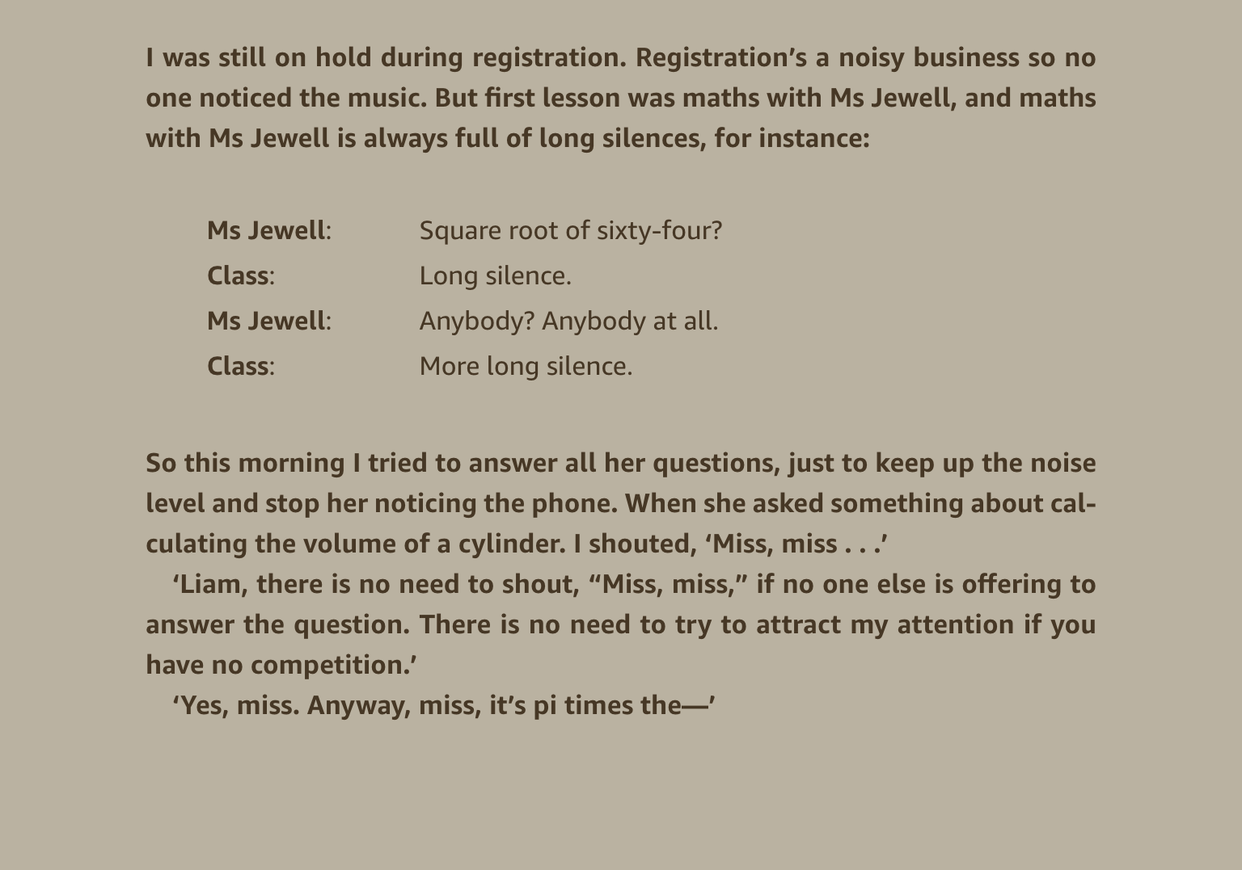

Slide 5
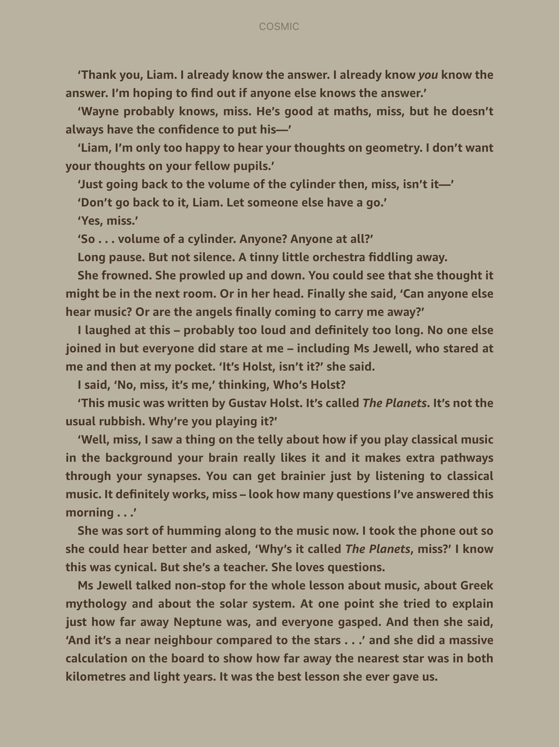

Slide 6
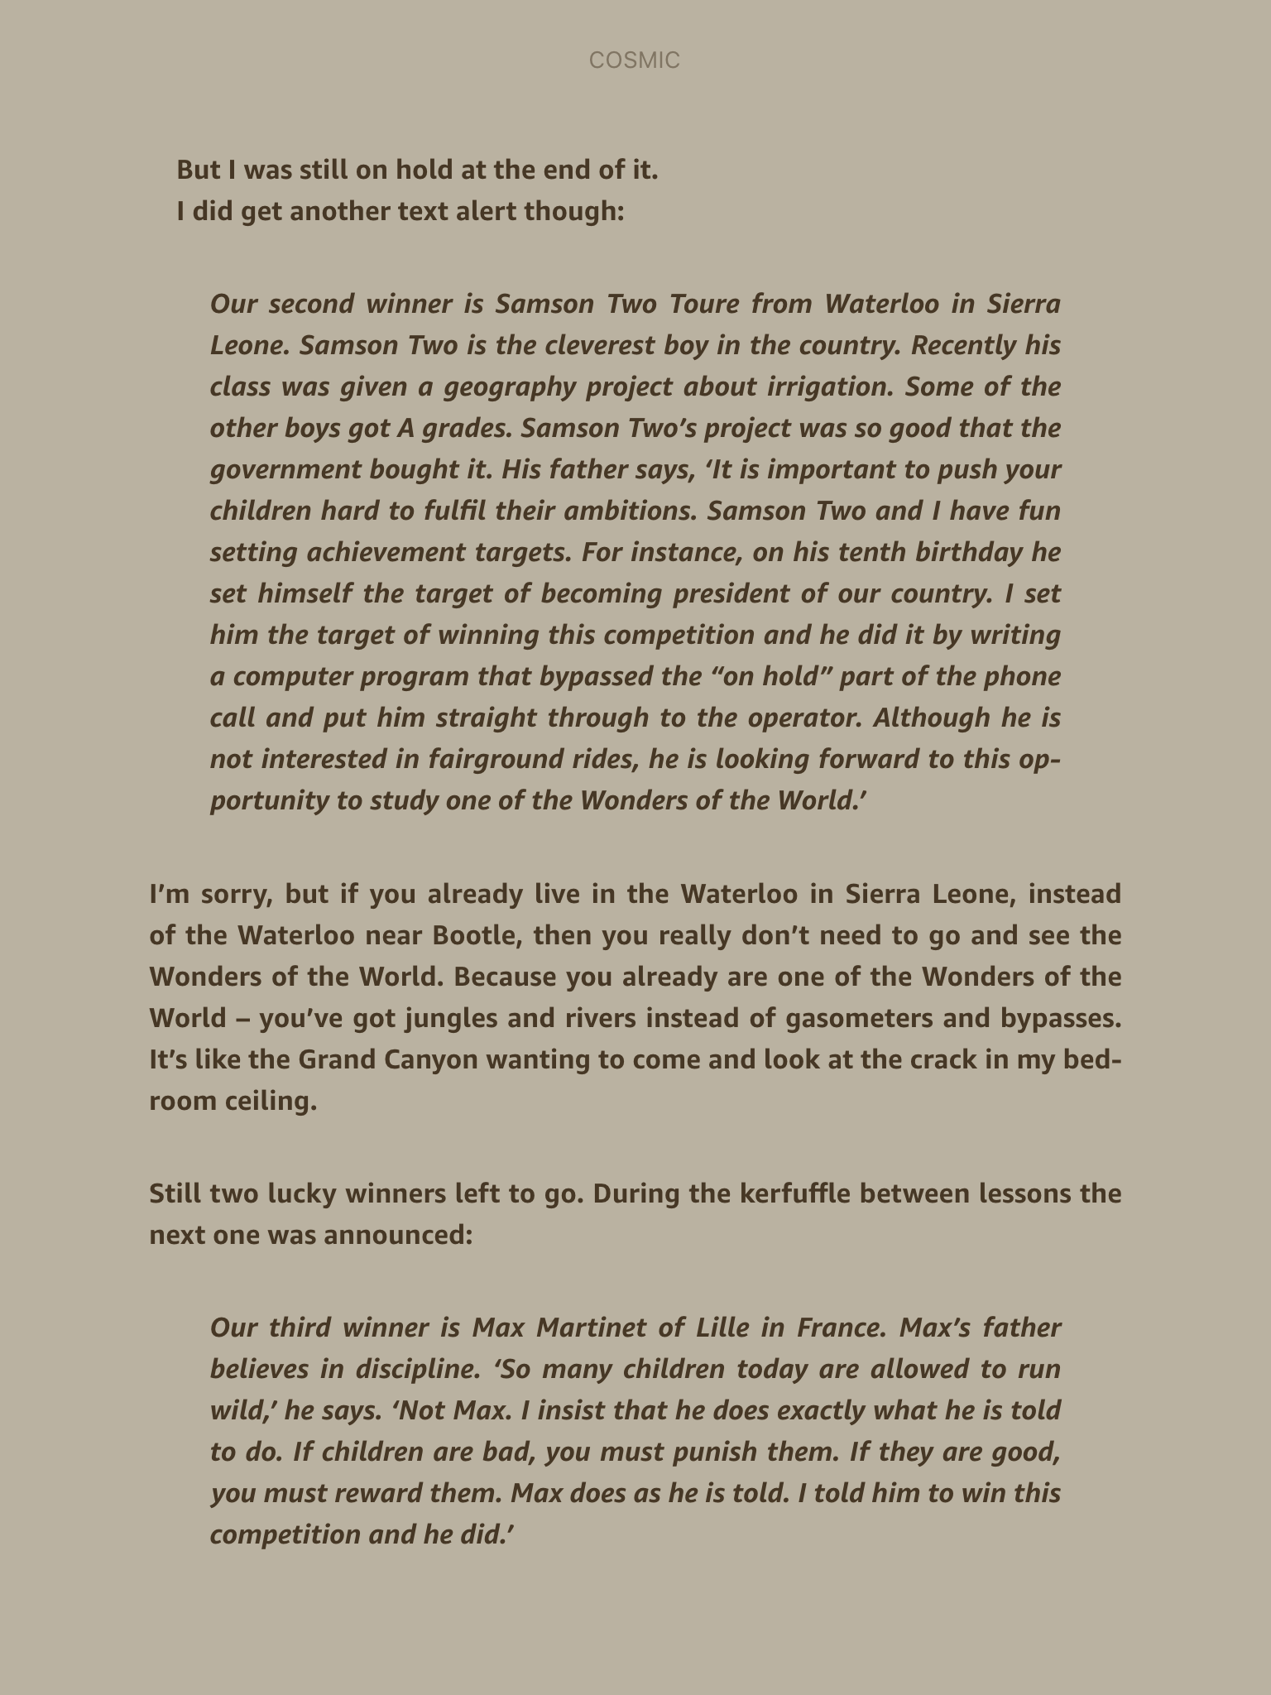

Slide 7
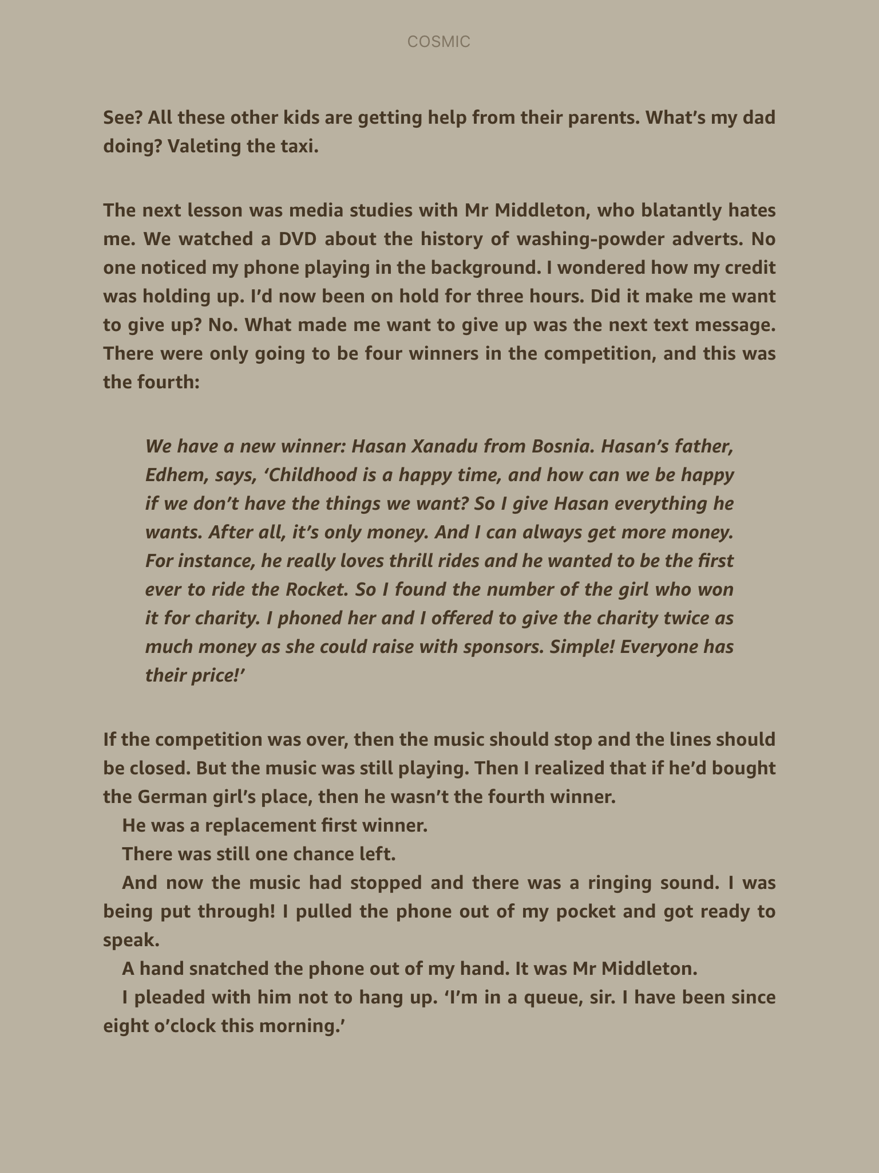

Slide 8
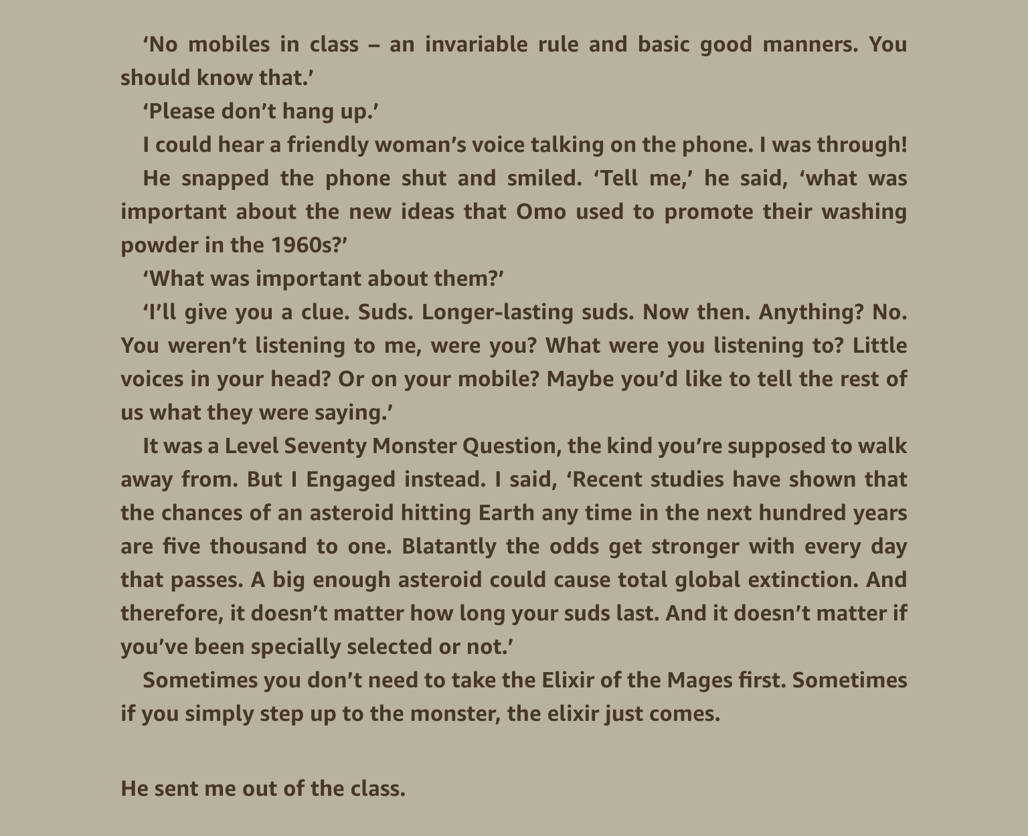

Slide 9
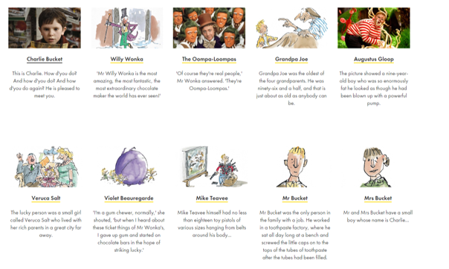
Use the provided resource and the link below to think about what happens in Charlie and the Chocolate Factory (Powerpoint needs to be in presentation mode for the link below to work.)
Focus on the golden tickets and how each family win them.
The four rotten children
How is this similar to Klaus and Anna in Cosmic and how they win their ticket?

Slide 10
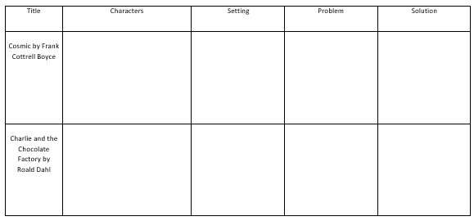
Main Task - Complete the comparison table in your books or on the sheet.
Which characters are similar? How? What about the setting? The problems and solutions that characters face?

Slide 11
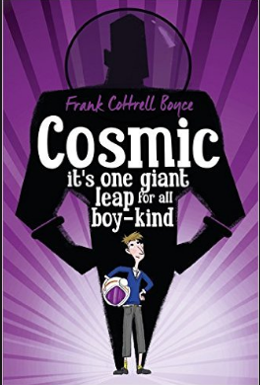
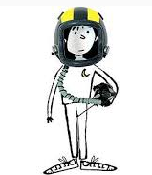
Plenary
Which parts of each story are similar? What parts are different?

