Slide 1


Science
Light
Year One
Science | Year 6 | Light | Shadow Theatre | Lesson 6

Slide 2
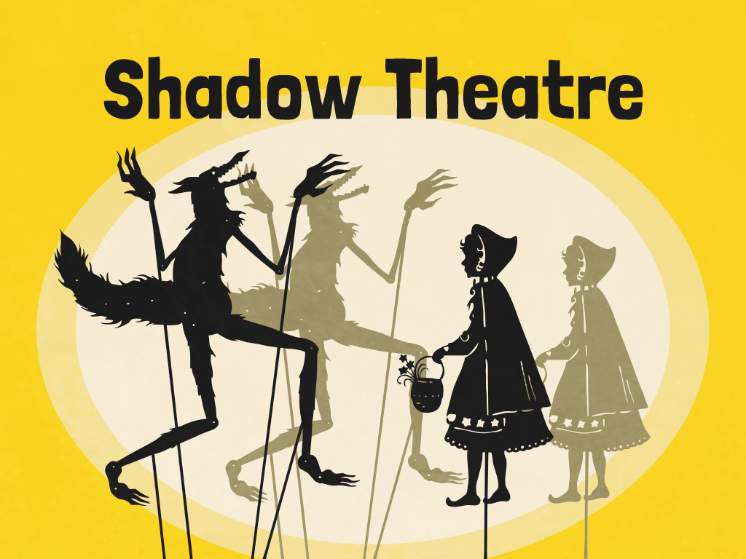


Slide 3
Aim
I can explain why shadows have the same shape as the object that casts them.
Success Criteria
I can explain how a shadow is formed.
I can explain why shadows are the same shape as the object that casts them.
I can use my knowledge of Isaac Newton's ideas about light to create a shadow puppet play.

Slide 4
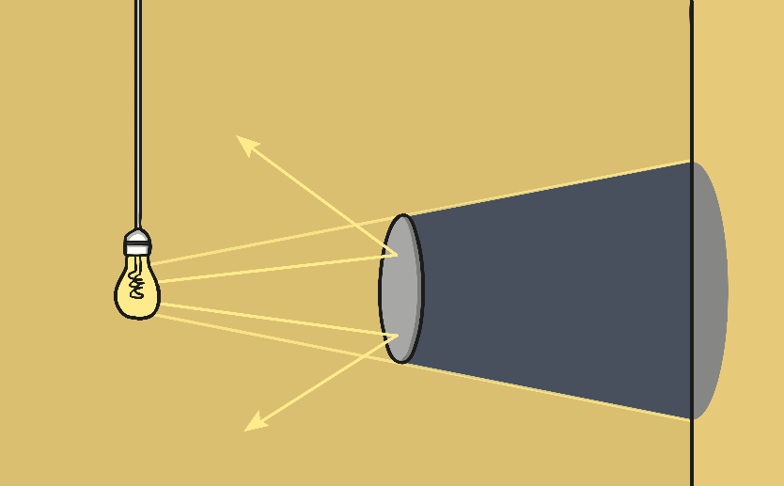
Shadows
Shadows are formed when an opaque object blocks a ray of light.
Is a shadow always the same shape as the object that casts it?
A shadow can change size depending on the distance the object casting it is from the light source. Shadows can also be elongated or shortened depending on the angle of the light source.
However, a shadow is always the same shape as the object that casts it. This is because when an object is in the path of light travelling from a light source, it will block the light rays that hit it, while the rest of the light can continue travelling. Therefore, the shadow it casts is exactly the same shape.

Slide 5


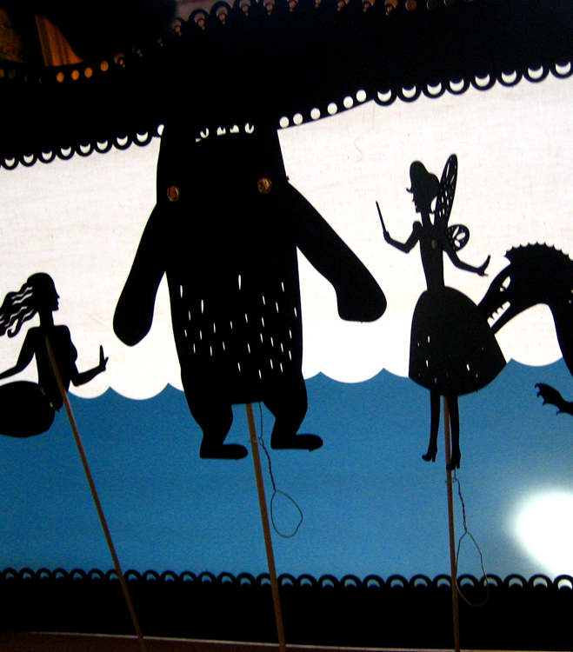
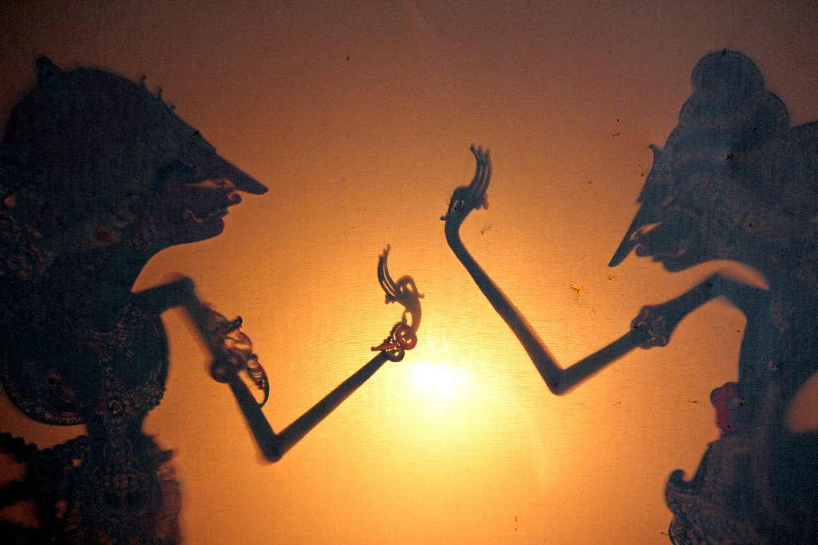
Shadow Theatre
Watch this video to see shadow puppeteer Manju Gregory explain how to perform a shadow puppet show.
Photo courtesy of kara brugman, Magalie L'Abbé (@flickr.com) - granted under creative commons licence – attribution

Slide 6
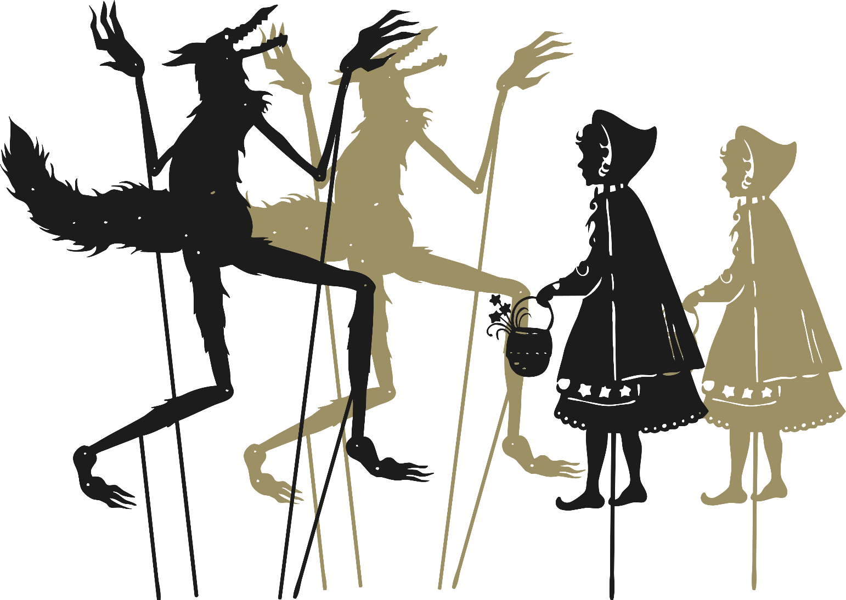
Shadow Theatre
Can you remember these acts from Britain’s Got Talent? They used shadows to create these wonderful performances.
https://www.youtube.com/watch?v=l8ae9NCwHWs
https://www.youtube.com/watch?v=JOZS_Vq6eKw
https://www.youtube.com/watch?v=x1r9qNVqSrk

Slide 7

Aim
I can explain why shadows have the same shape as the object that casts them.
Success Criteria
I can explain how a shadow is formed.
I can explain why shadows are the same shape as the object that casts them.
I can use my knowledge of Isaac Newton's ideas about light to create a shadow puppet play.

