Slide 1
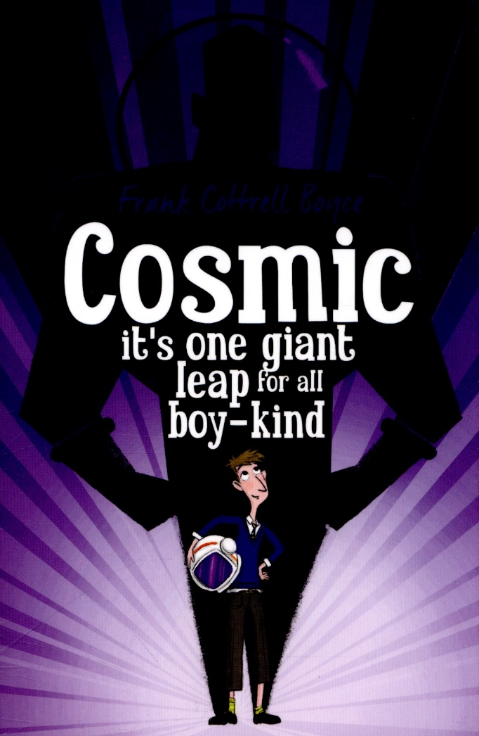
Week 2 Day 2

Slide 2
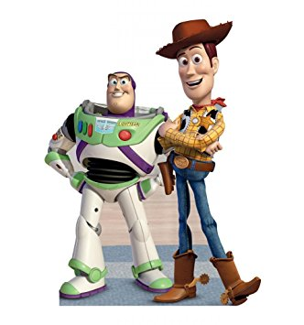
Starter Activity
Watch the clip:
https://www.youtube.com/watch?v=4HaxwTT4Iko
Retrieve – Where did Woody and Buzz’s
argument take place?
Interpret - How was each character feeling?
How could you tell this?
Choice - Do you prefer the character of
Woody or Buzz? Why?

Slide 3

Read Chapter 8 ‘Fathers have children’ and the first two paragraphs of Chapter 9 ‘you’ll like it when you get there.’
How did Liam suggest he was similar to the planet Pluto?
What can keep a teenager at the table for longer?
Dads talk about 5 things, how many can you list?
Explain why Liam has to know how to talk and act like a Dad

Slide 4
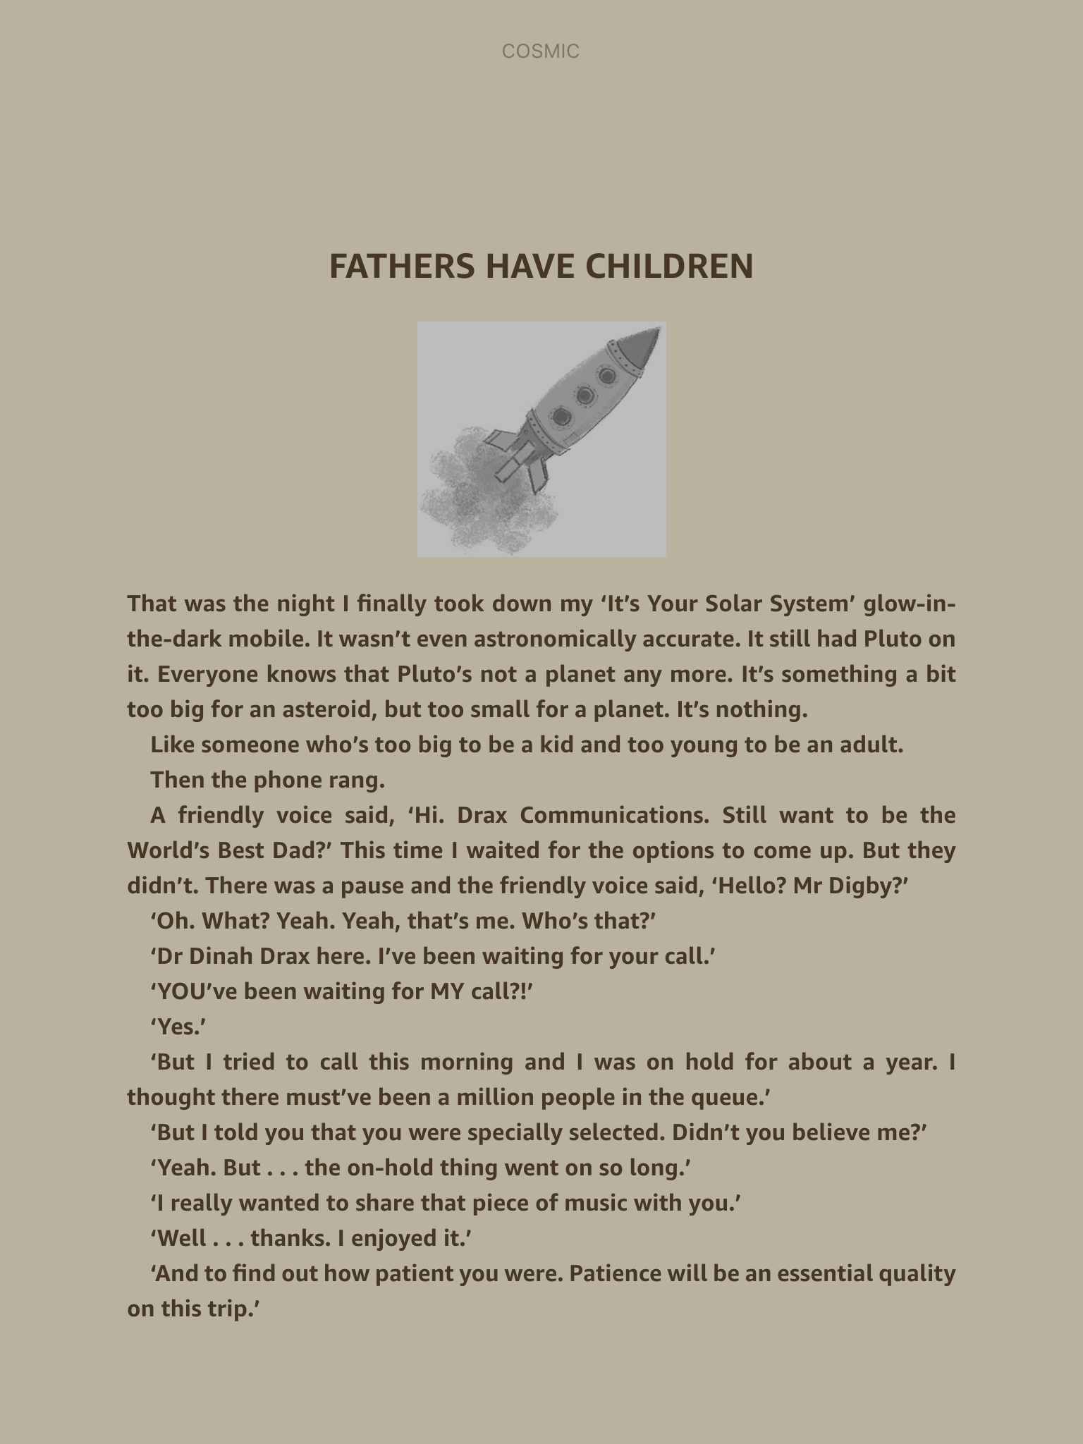

Slide 5
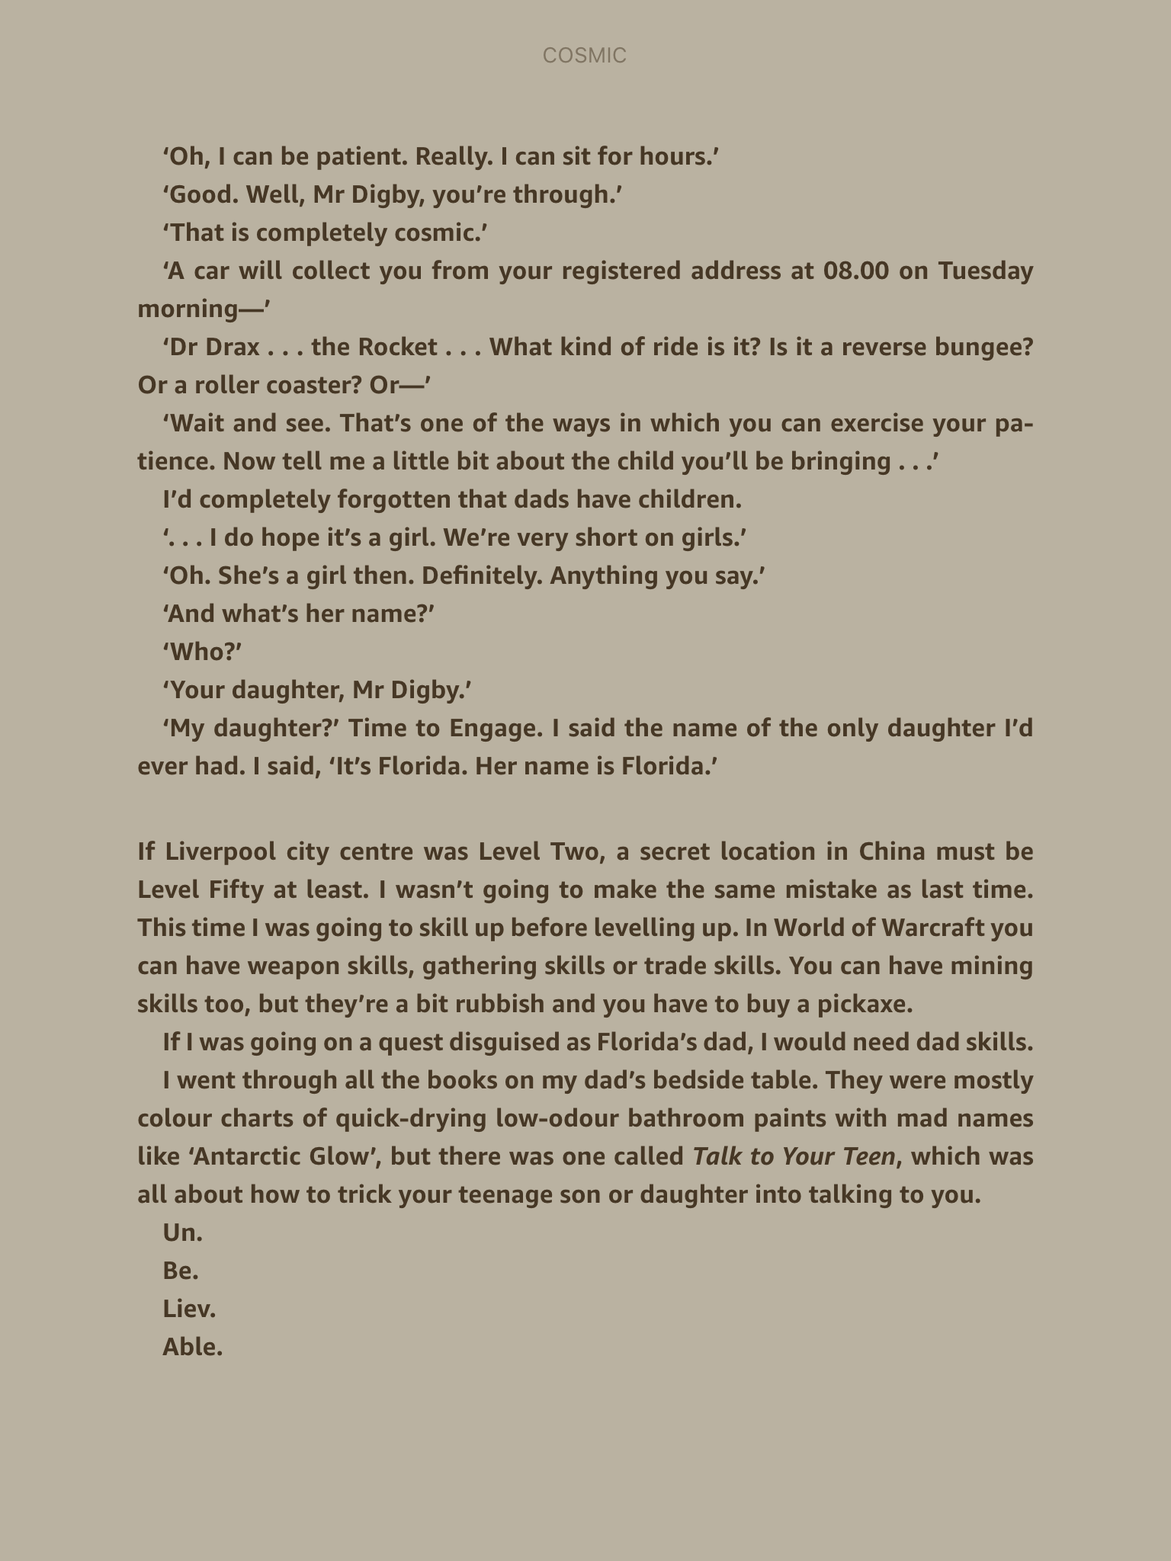

Slide 6
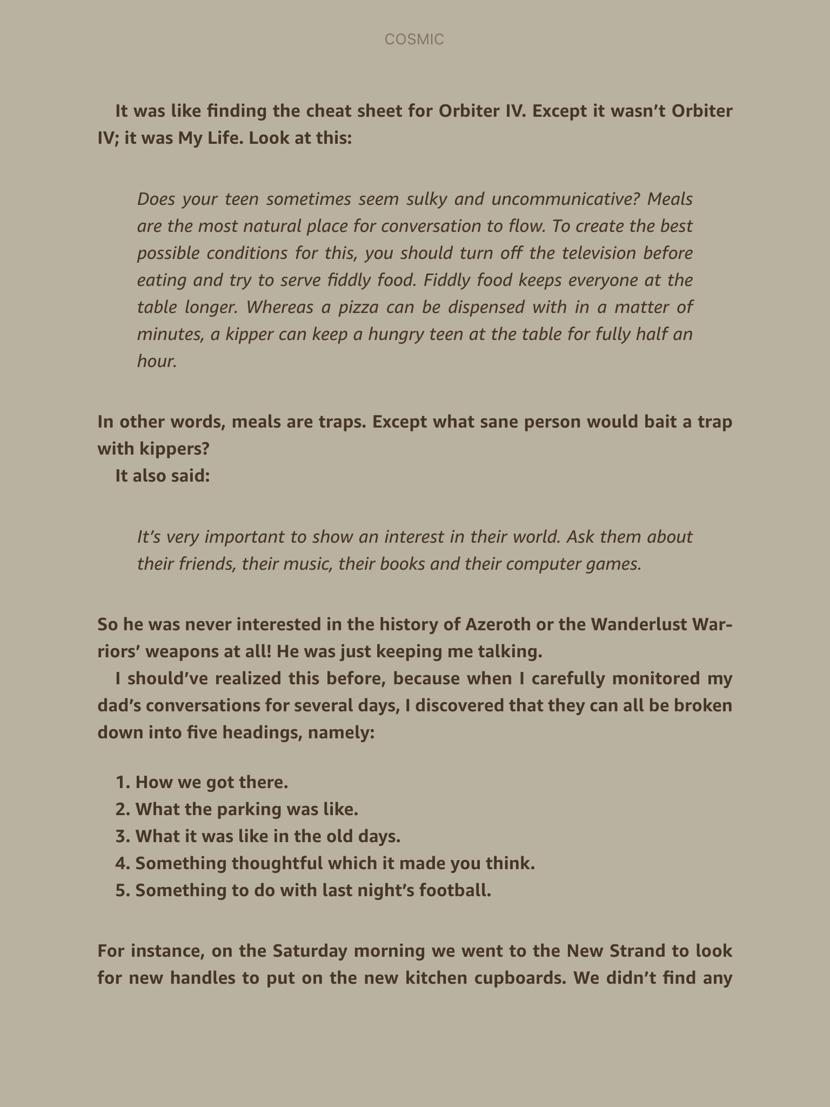

Slide 7
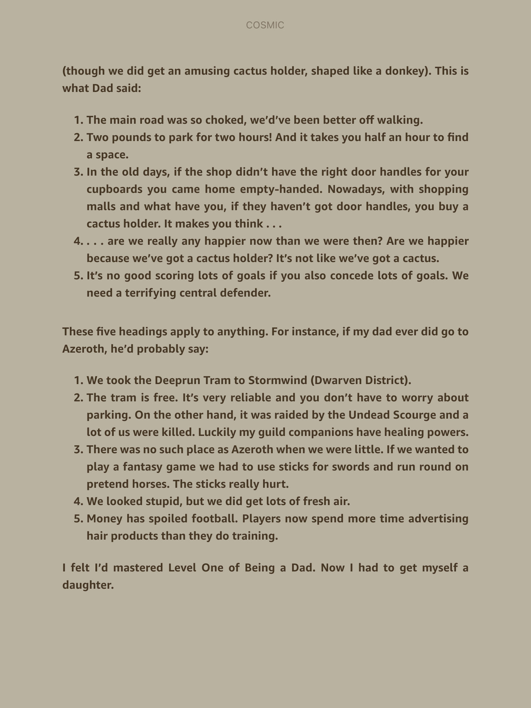

Slide 8
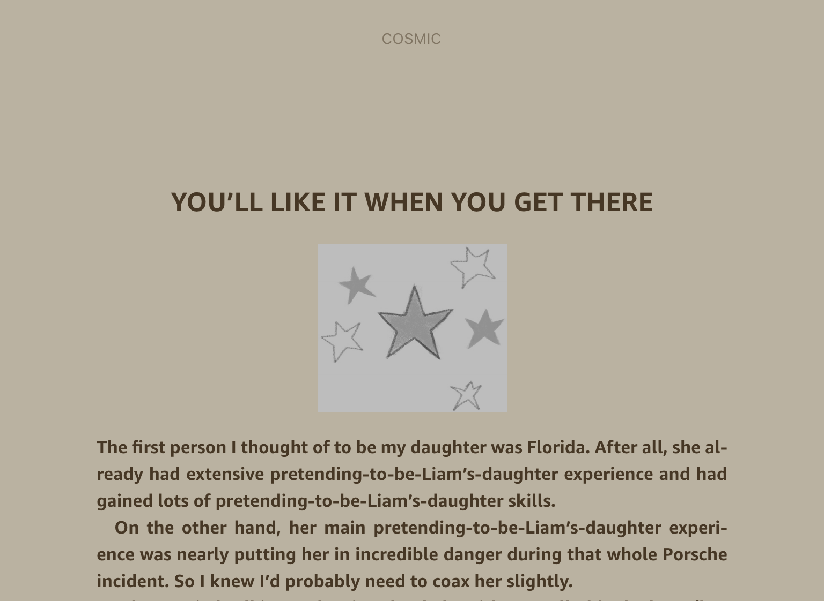

Slide 9
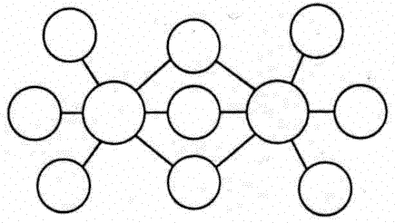
Main Task: compare and contrast key characters.
Complete the double bubble to compare and contrast the characters of Liam and Florida.
Things they have similar go in the joined bubbles, the contrasts in the un-joined.

Slide 10
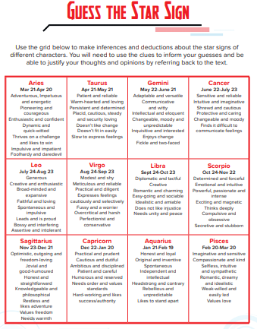
Challenge
Use the ‘Guess the Star Sign’ resource to decide which star sign Florida would be and which Liam would be. You must justify your reasoning.

