Slide 1

Week 2 Day 3

Slide 2
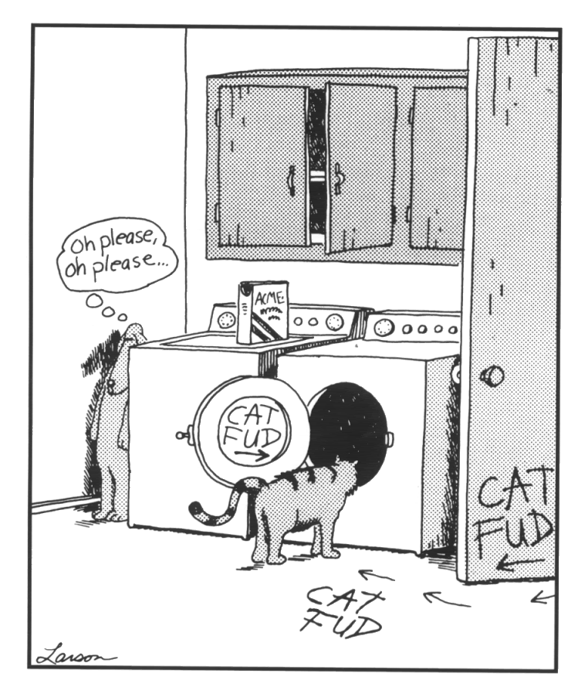
Starter Activity
Look at the picture
Retrieve – How many door handles and
Buttons are in the picture?
Interpret - Who has written on the walls?
How did you come to your decision?
Choice – Are you on the dogs side
or the cats side? Why?

Slide 3
Read the rest of Chapter 9 – ‘You’ll like it when you get there’
Key Questions:
What did Florida do when Liam tried to talk to her in school?
Where was the only place that he could talk to her?
How did he manage to speak to her in Little Stars?
Why did the Little Stars teacher leave the room?
At what point did Florida begin to show some interest?
How is Liam planning to lie to their parents?
How is Florida’s Dad different to Liam’s?

Slide 4
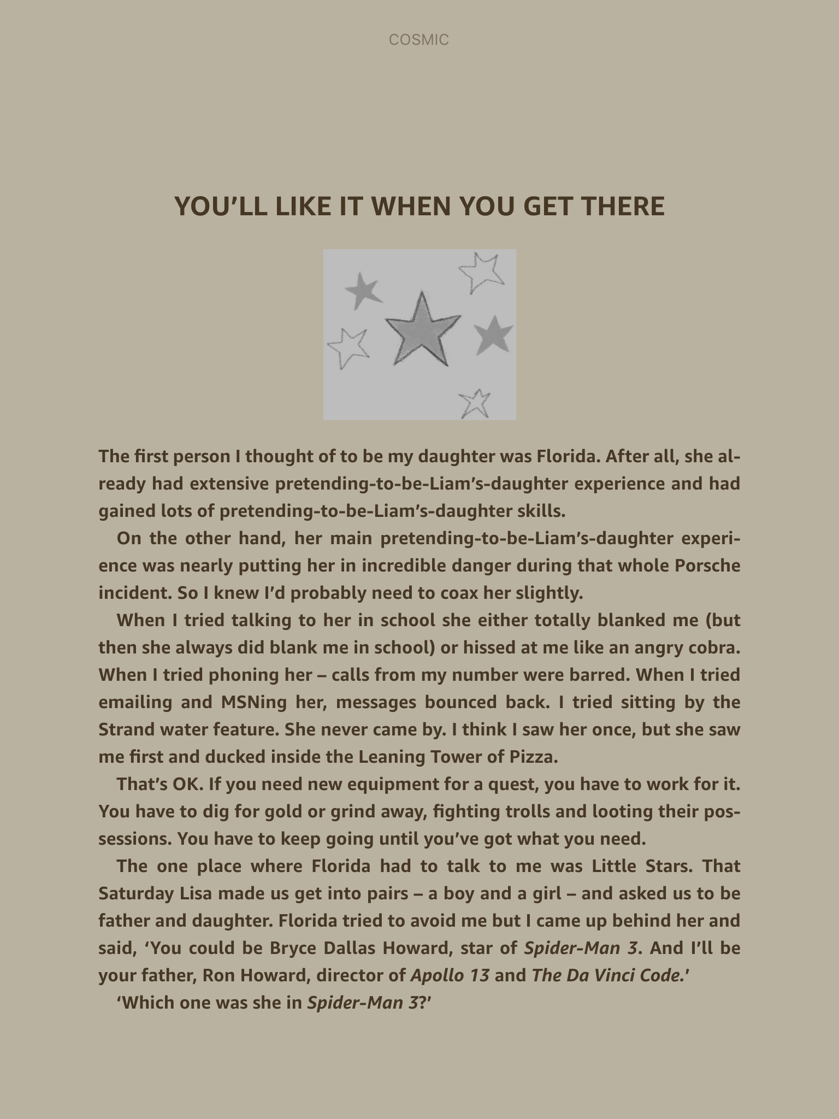

Slide 5
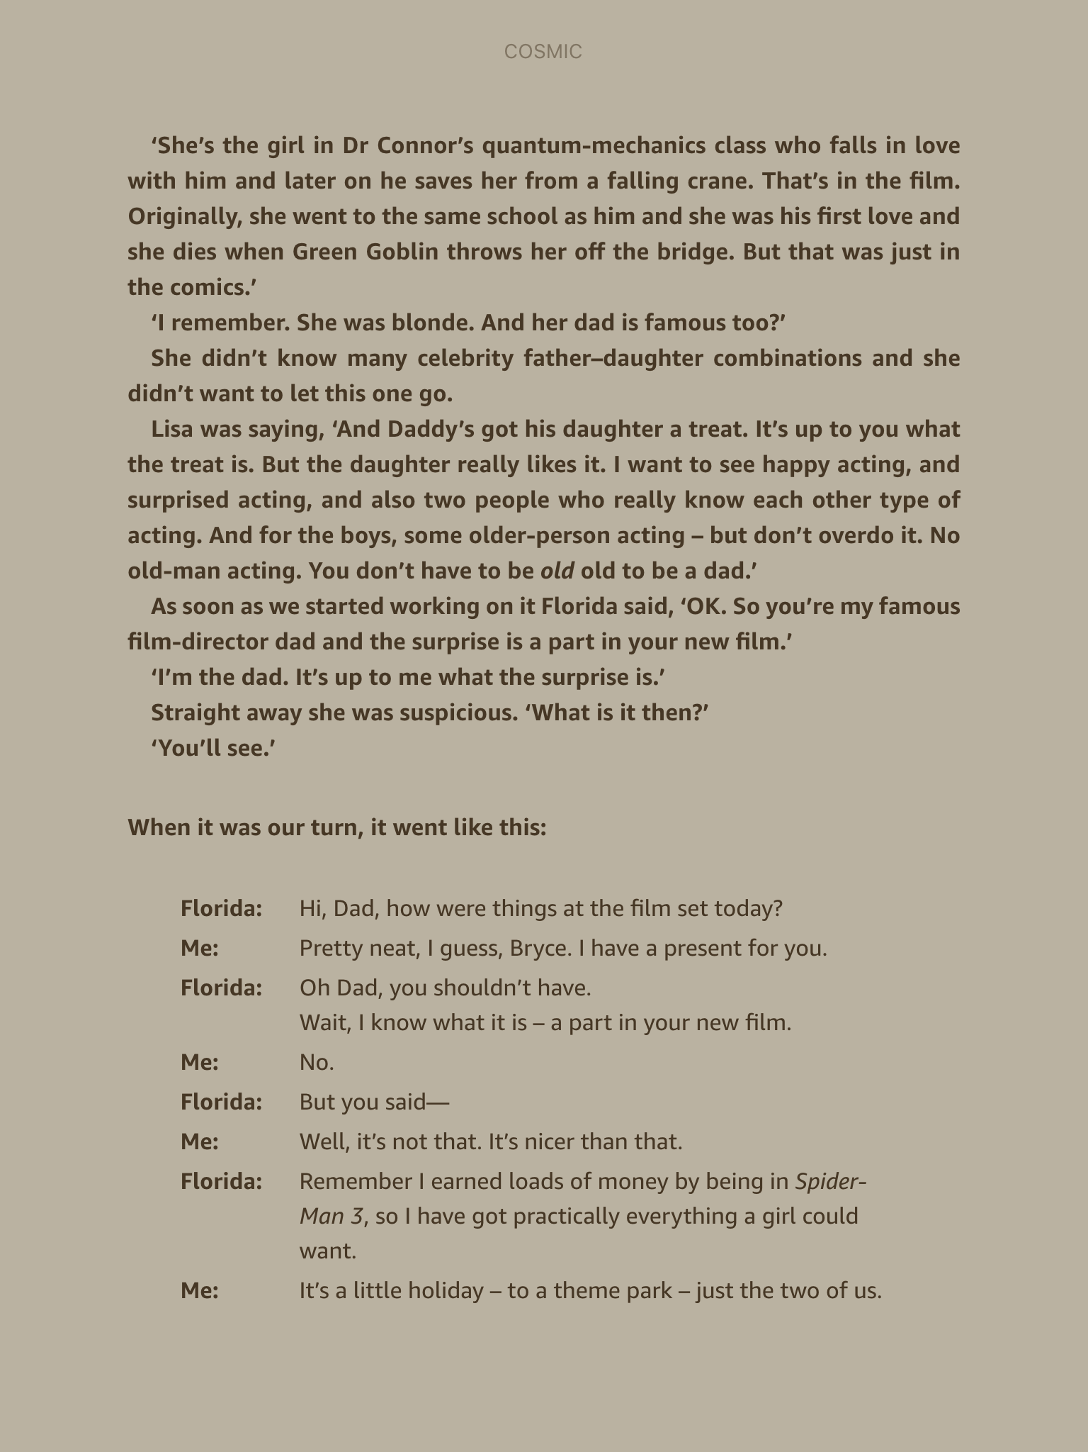

Slide 6
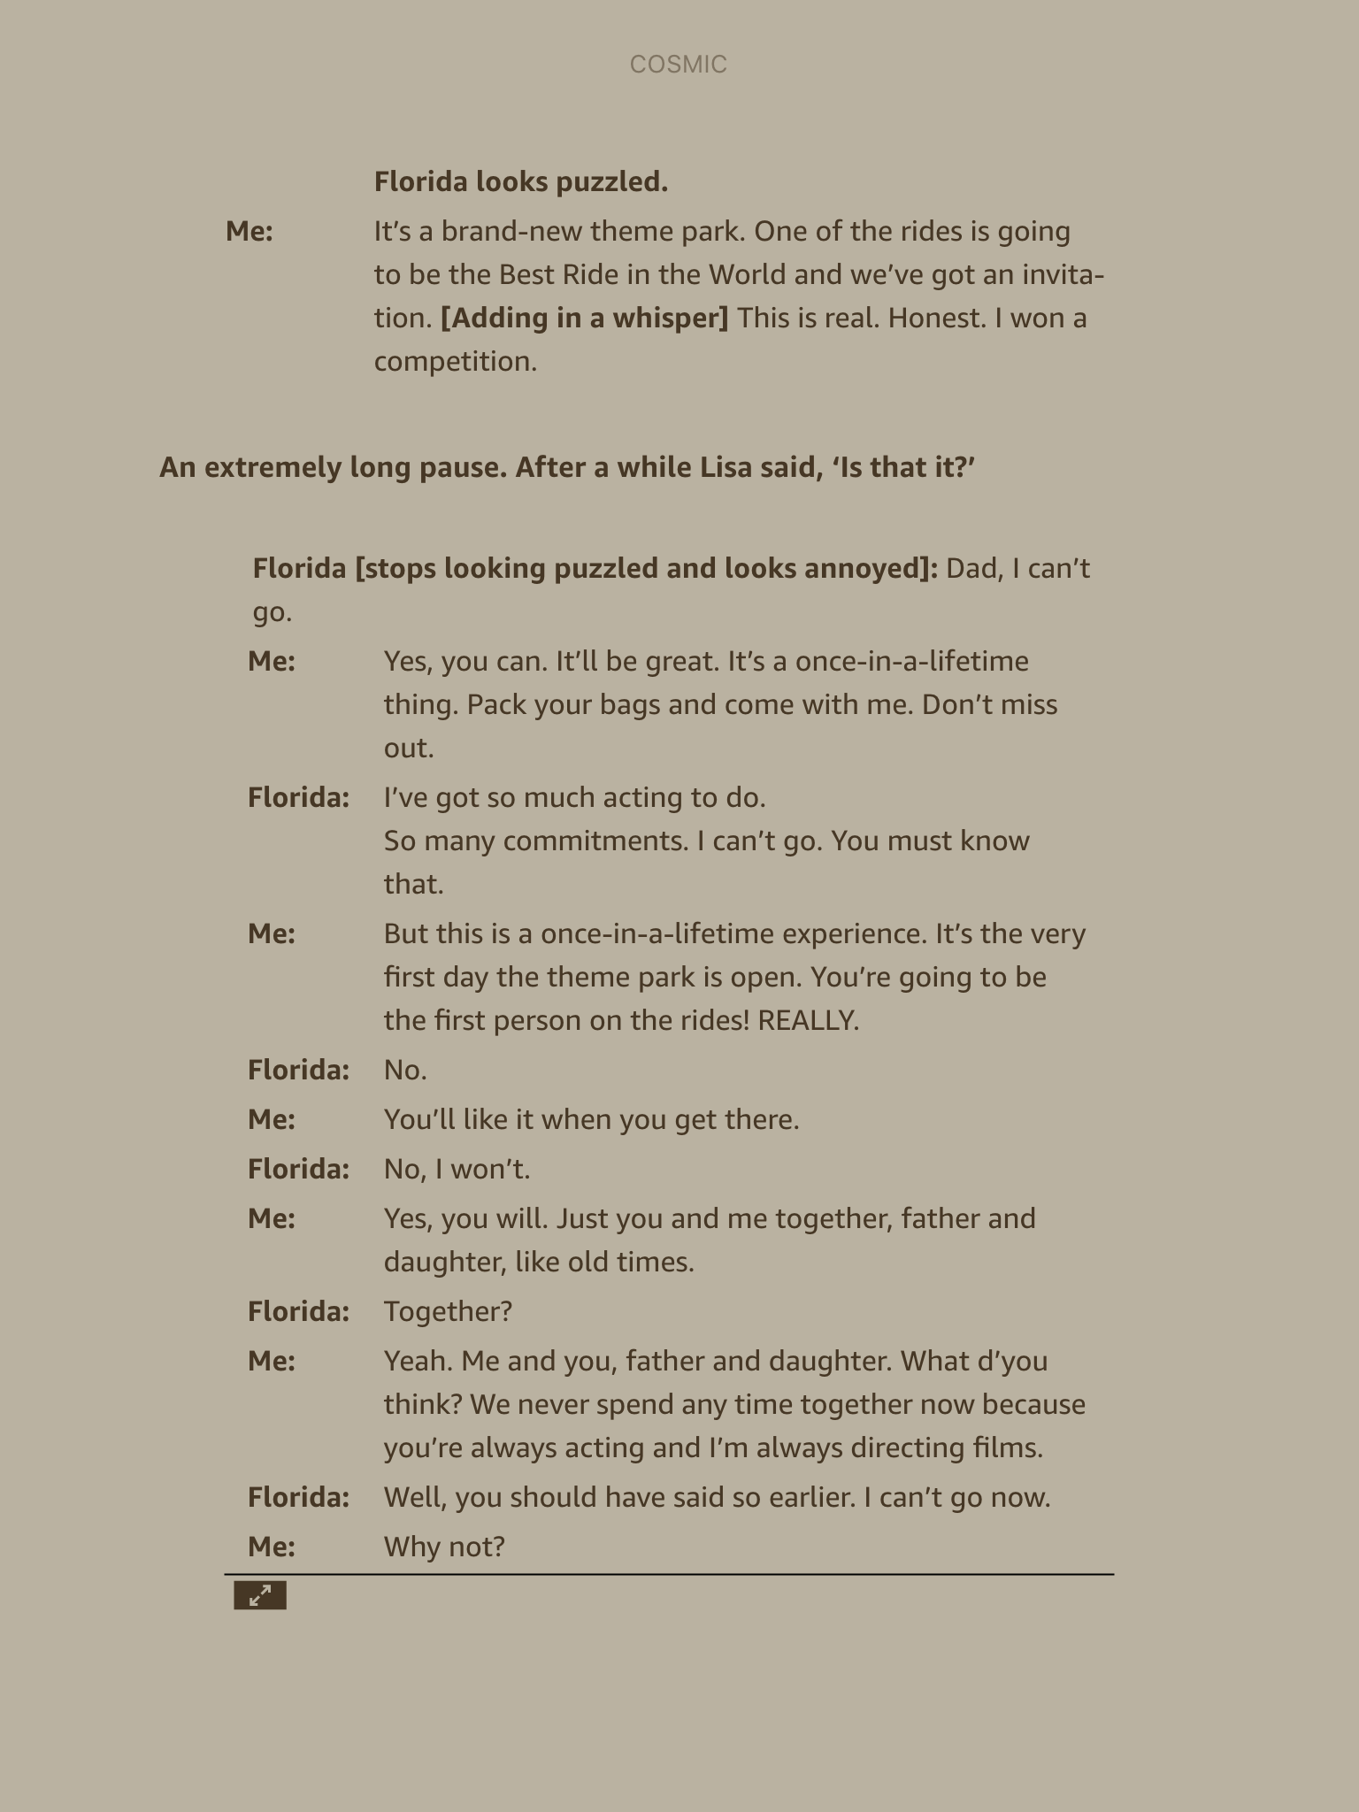

Slide 7
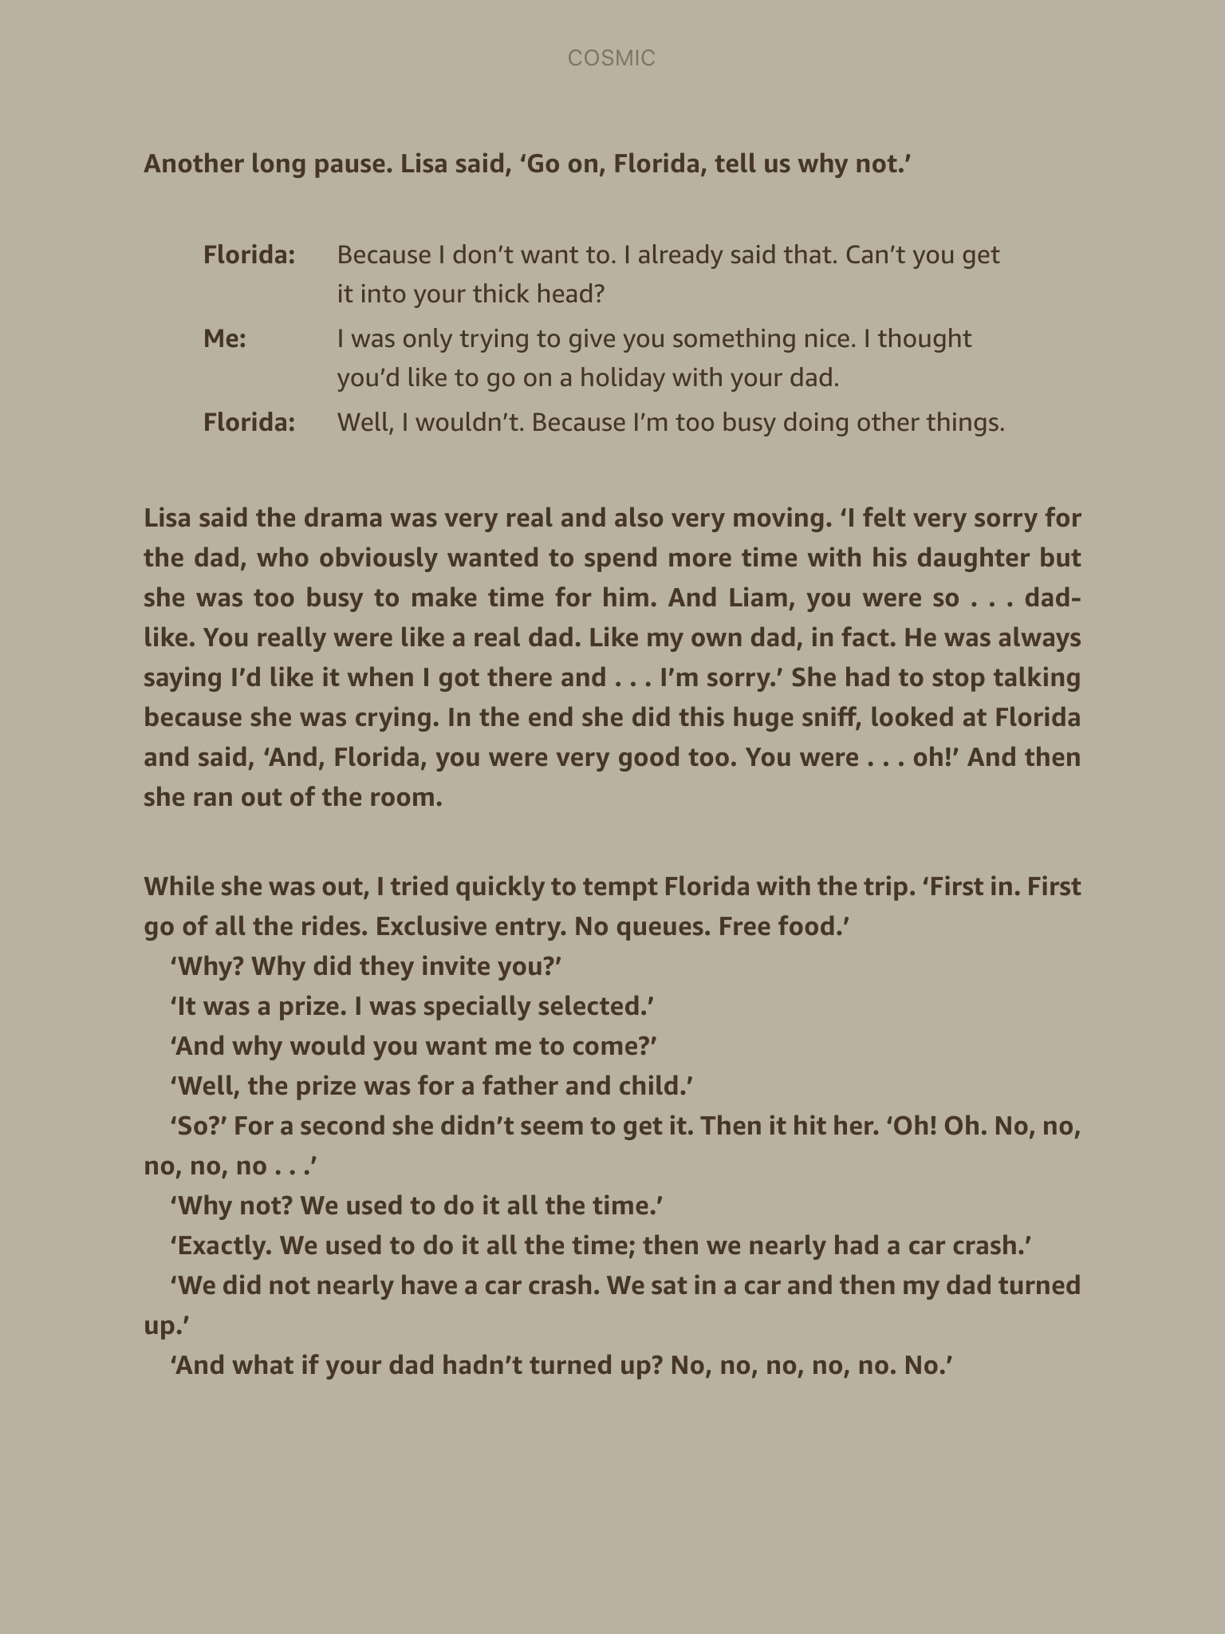

Slide 8
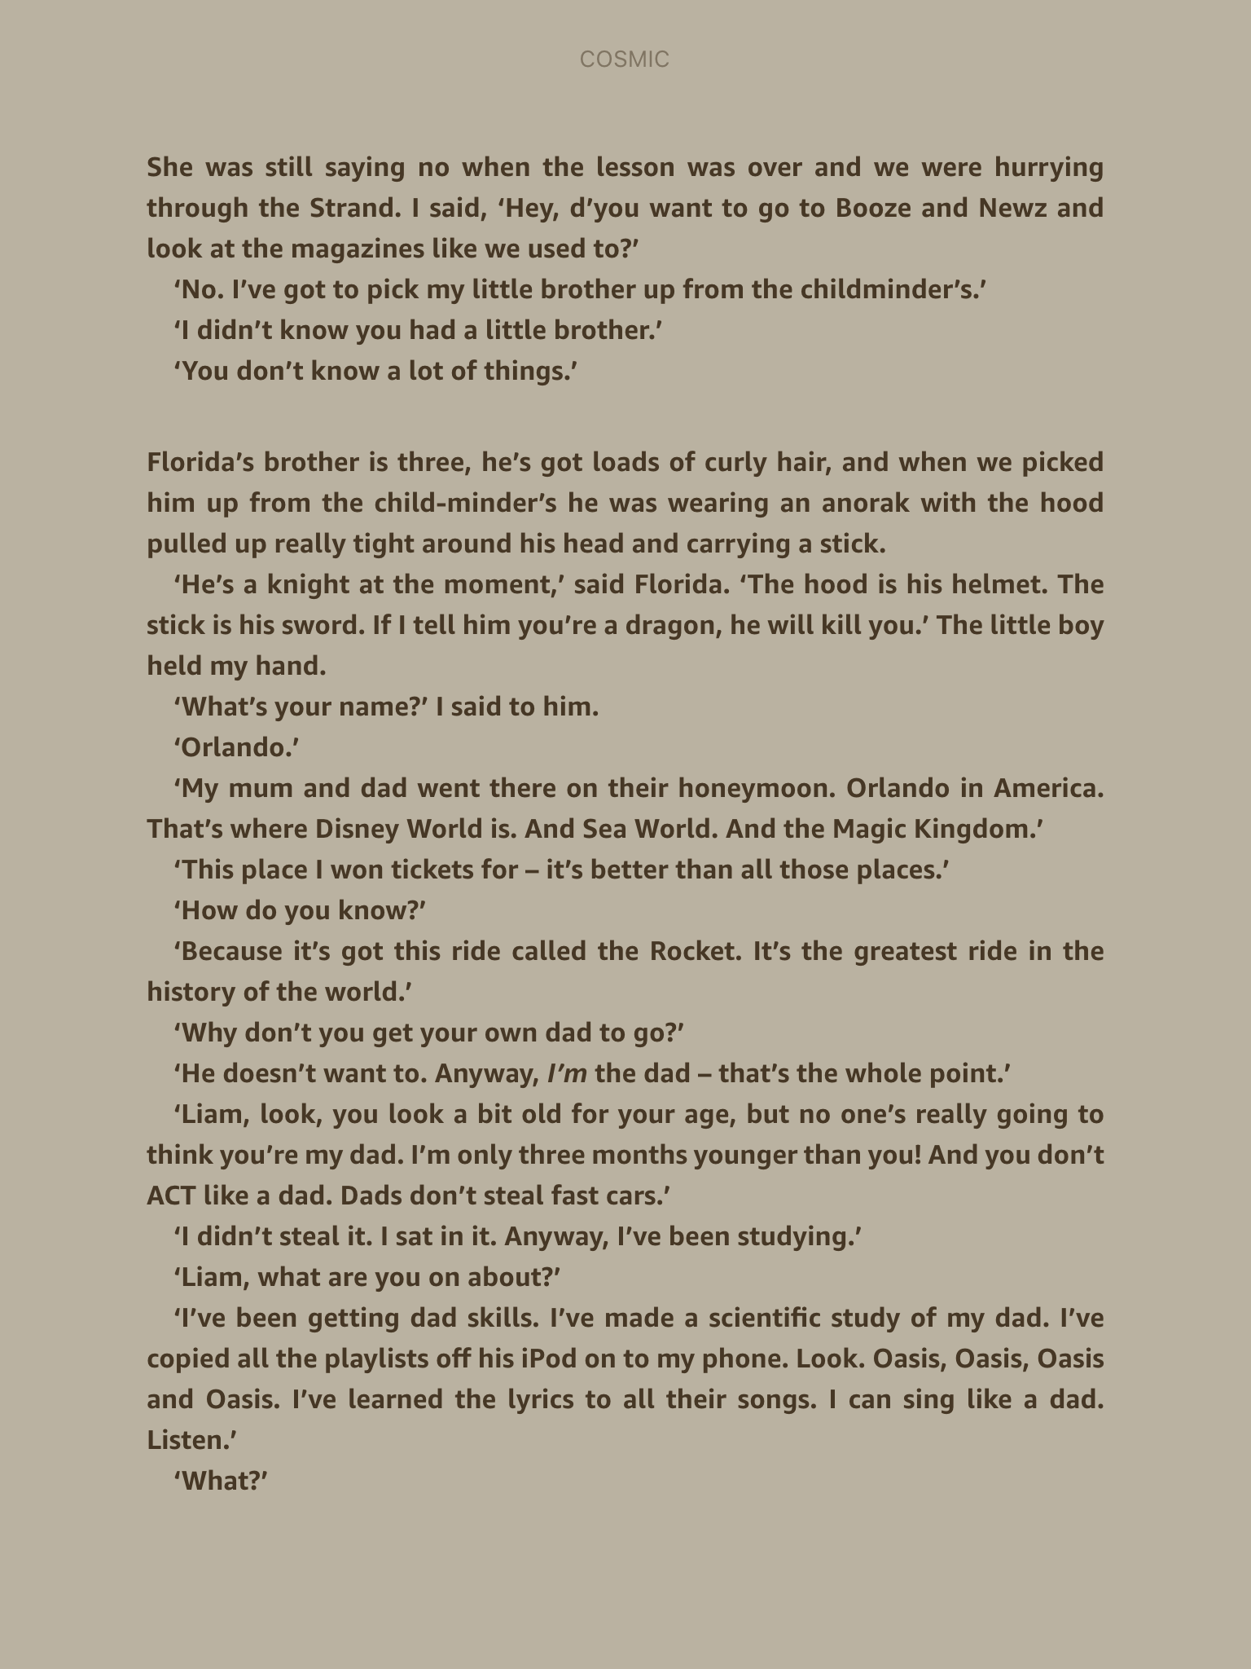

Slide 9
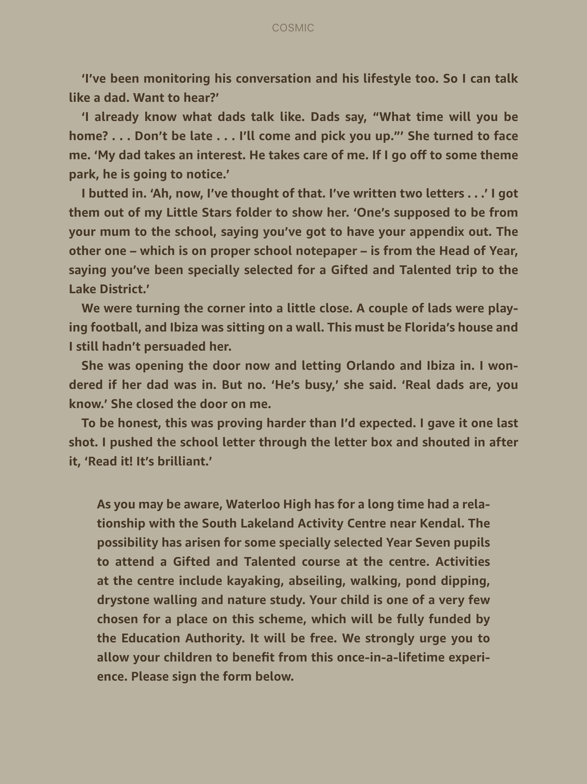

Slide 10
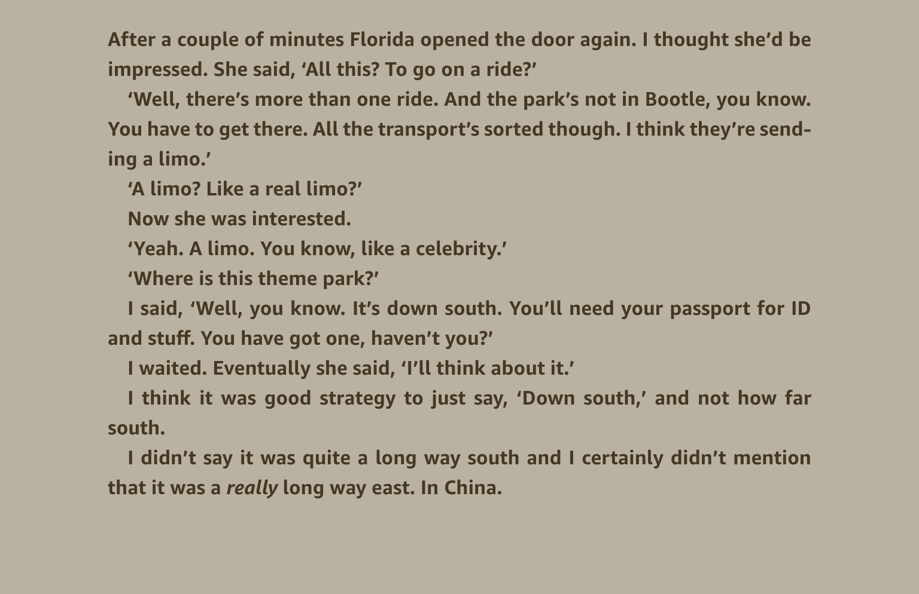

Slide 11
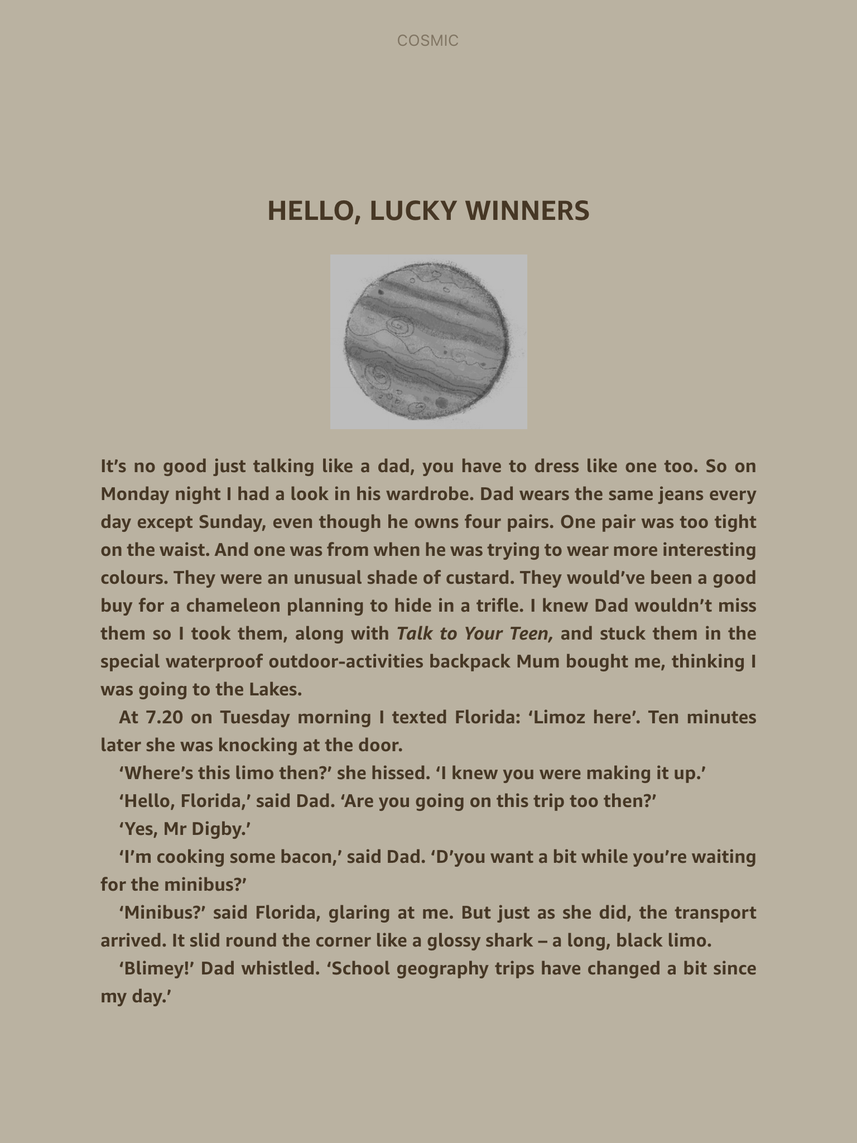
Read Chapter 10 – Hello, lucky winners
Up to half way on page 99, to the line ‘from your host Dr. Drax’

Slide 12
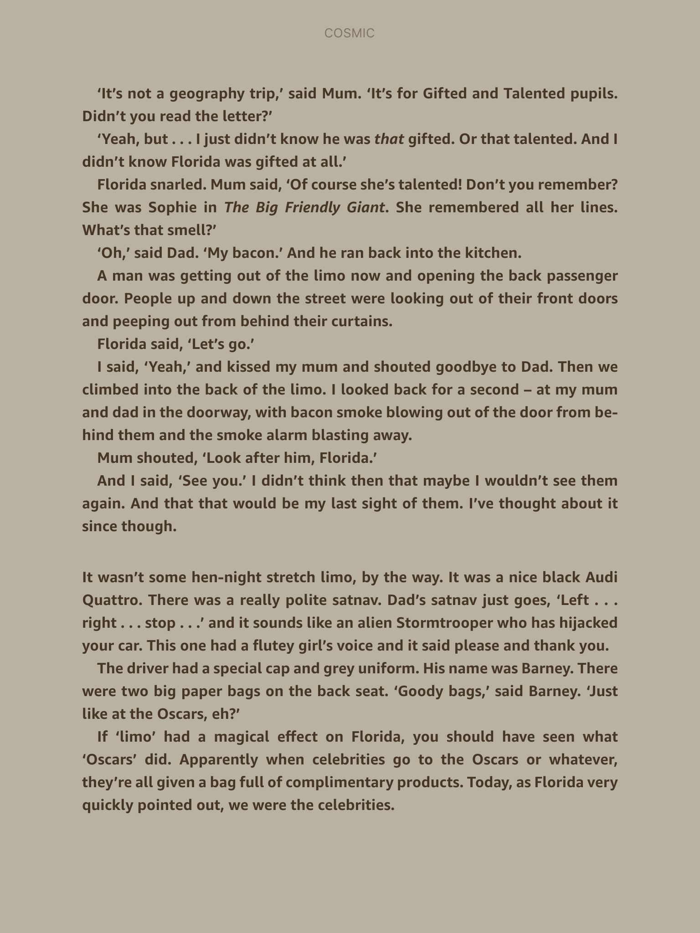

Slide 13
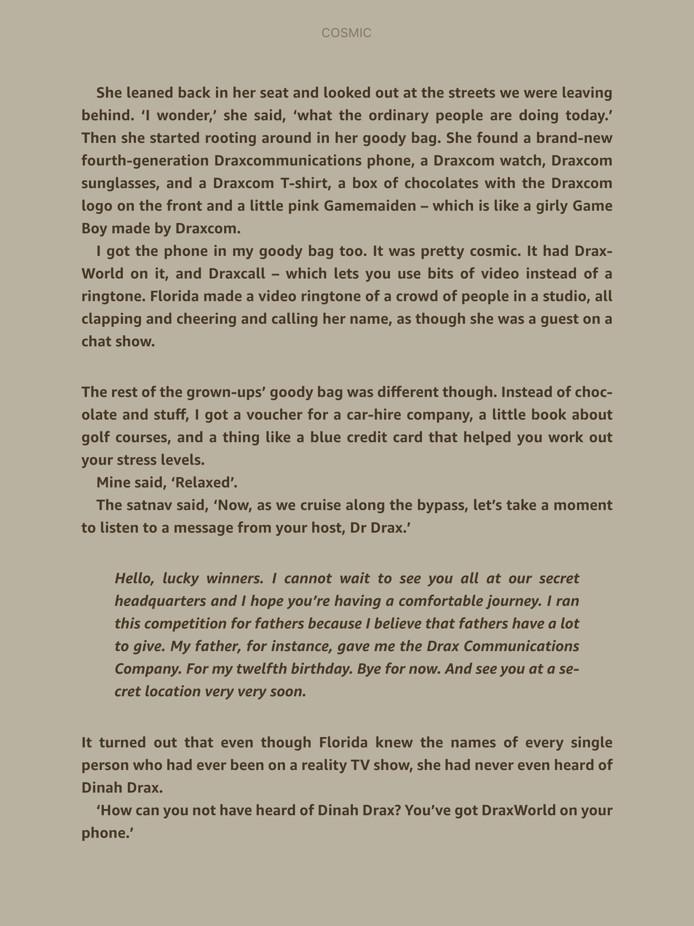

Slide 14

Now listen to the recording that is played in the limo to Liam and Florida:

Slide 15
Task – Decide whether you would want to go on this trip or not?
Think of three reasons why you SHOULD go on the trip and three reasons why you SHOULD NOT.
Summarise your conclusion on whether you would or would not join this trip. Your answer should be balanced, and include reasons for and against.
Read to the end of chapter 10.

Slide 17
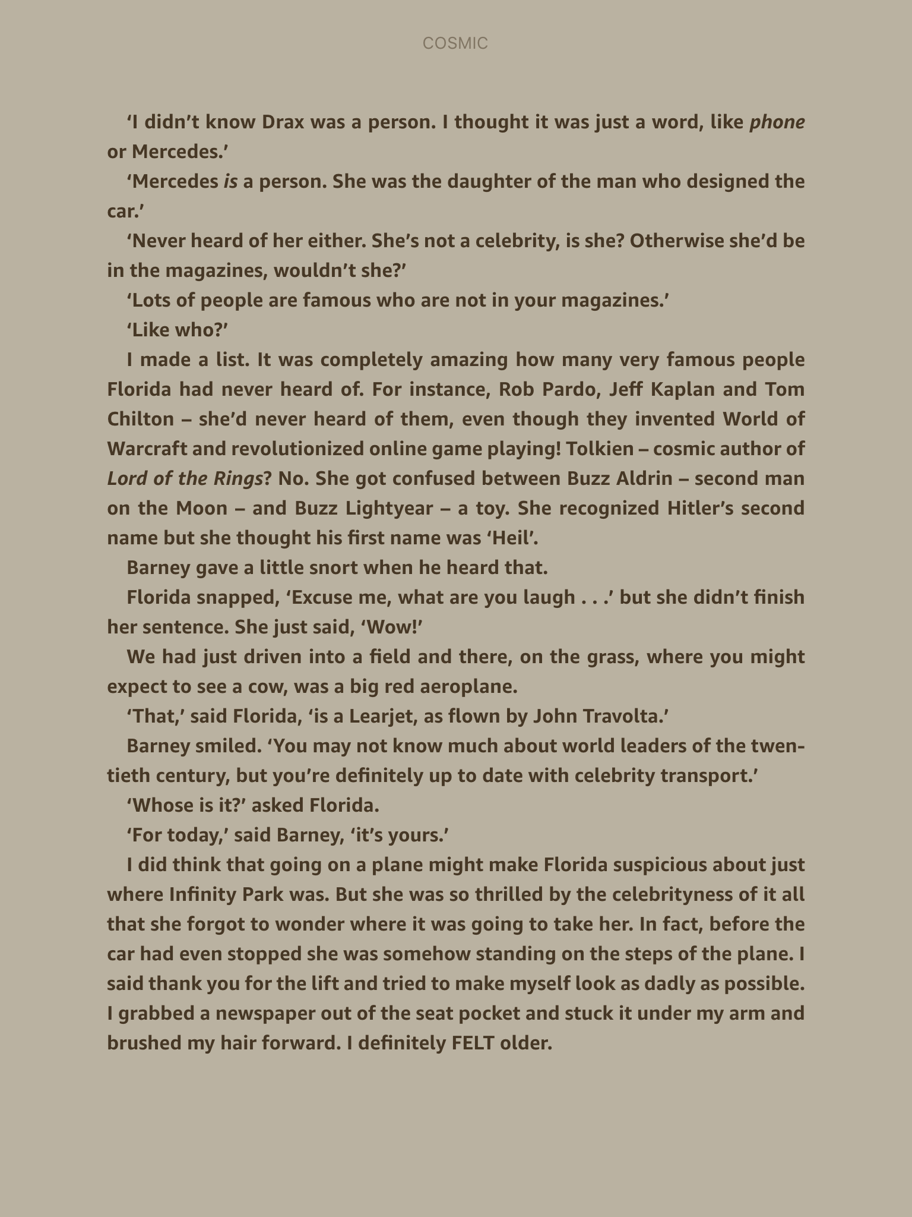

Slide 18
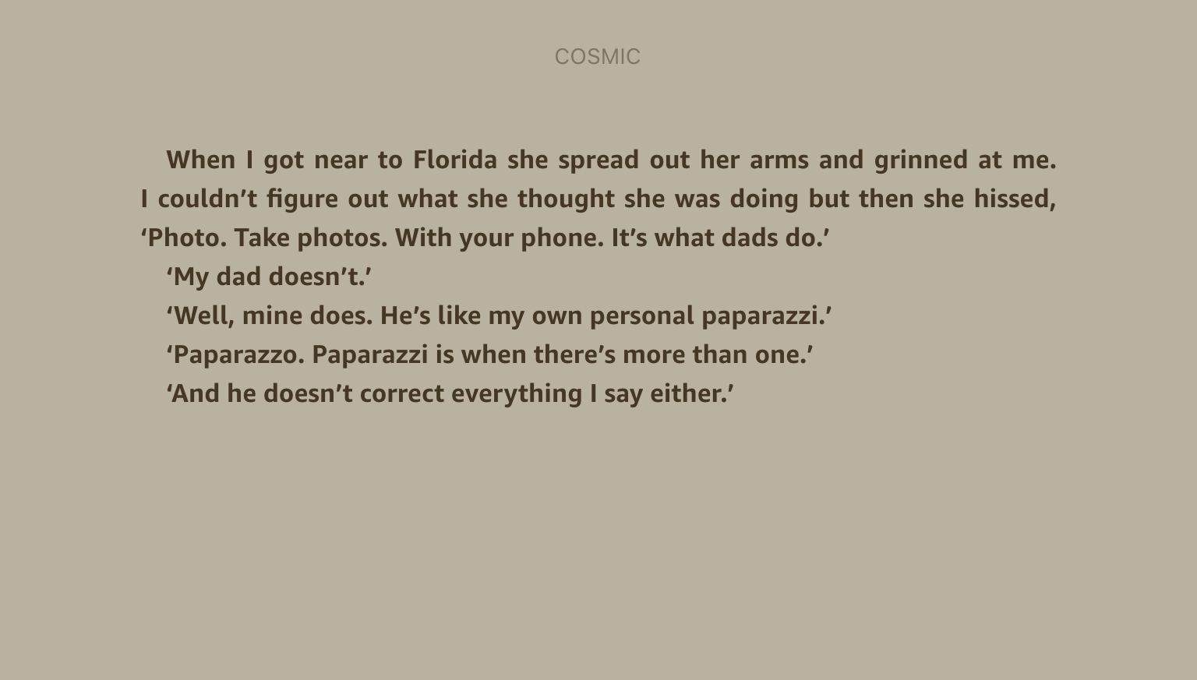

Slide 19

Considering the information you have now, do you have any ideas how Liam might have ended up in space?

