Slide 1

Week 2 Day 4

Slide 2
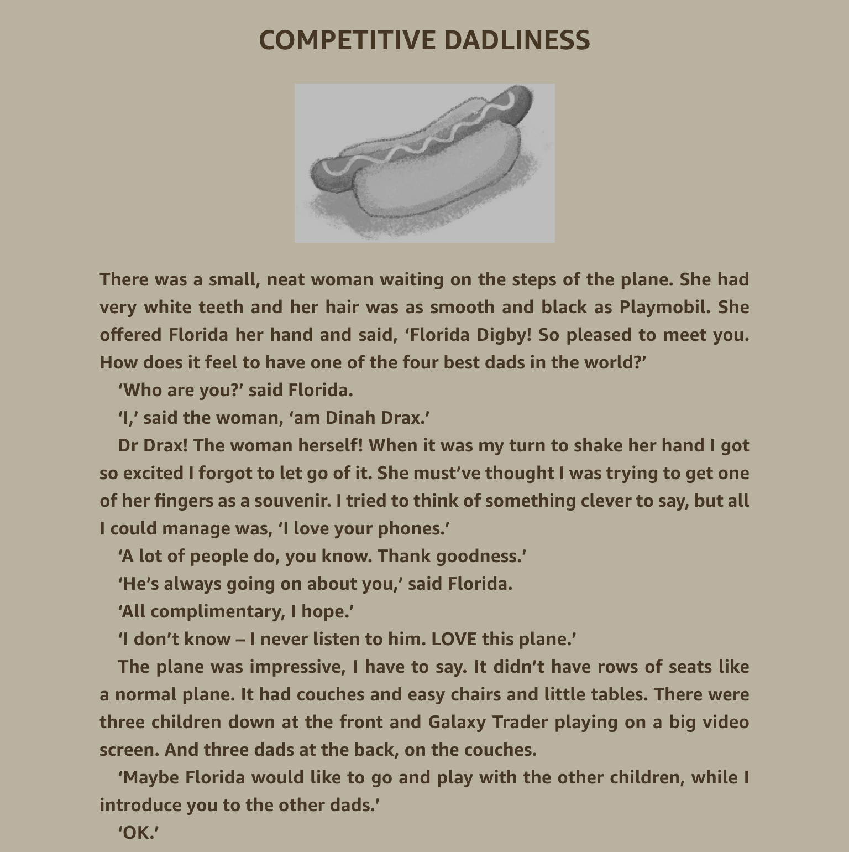
Read Chapter 11 – Competitive Dadliness

Slide 3
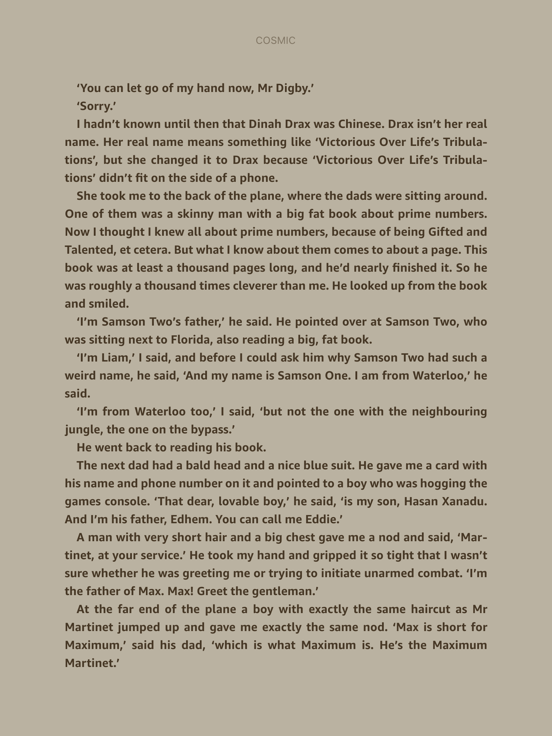

Slide 4
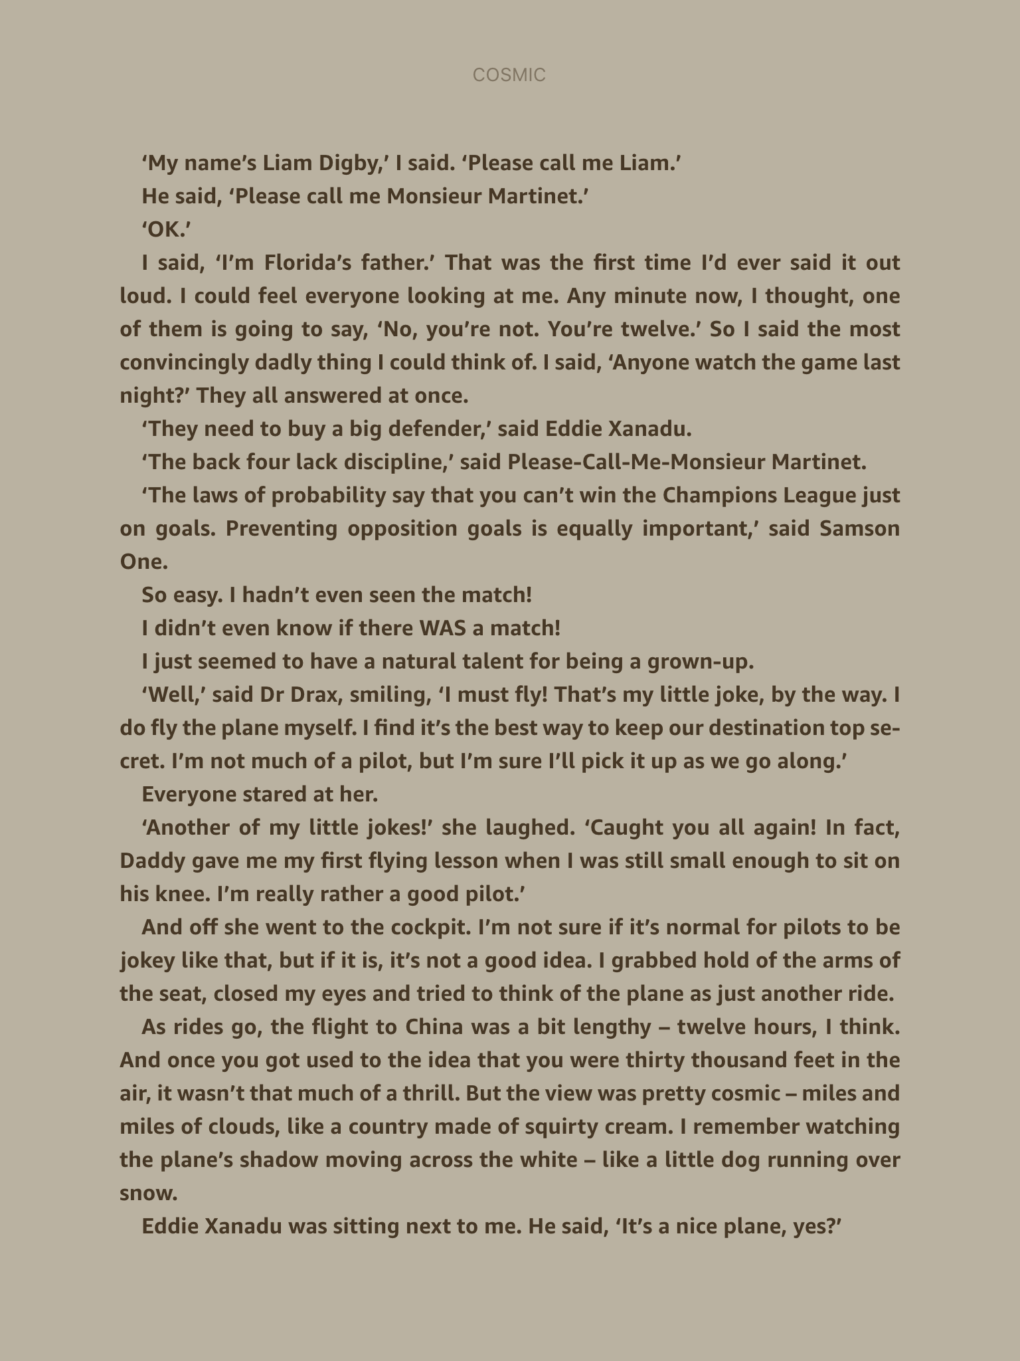

Slide 5
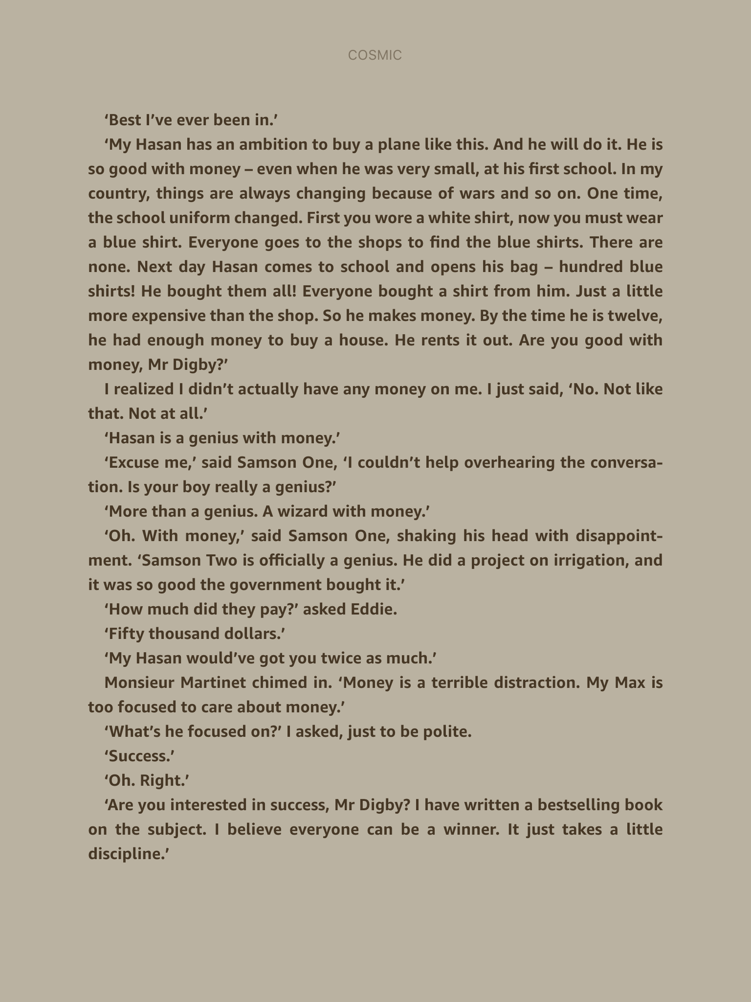

Slide 6
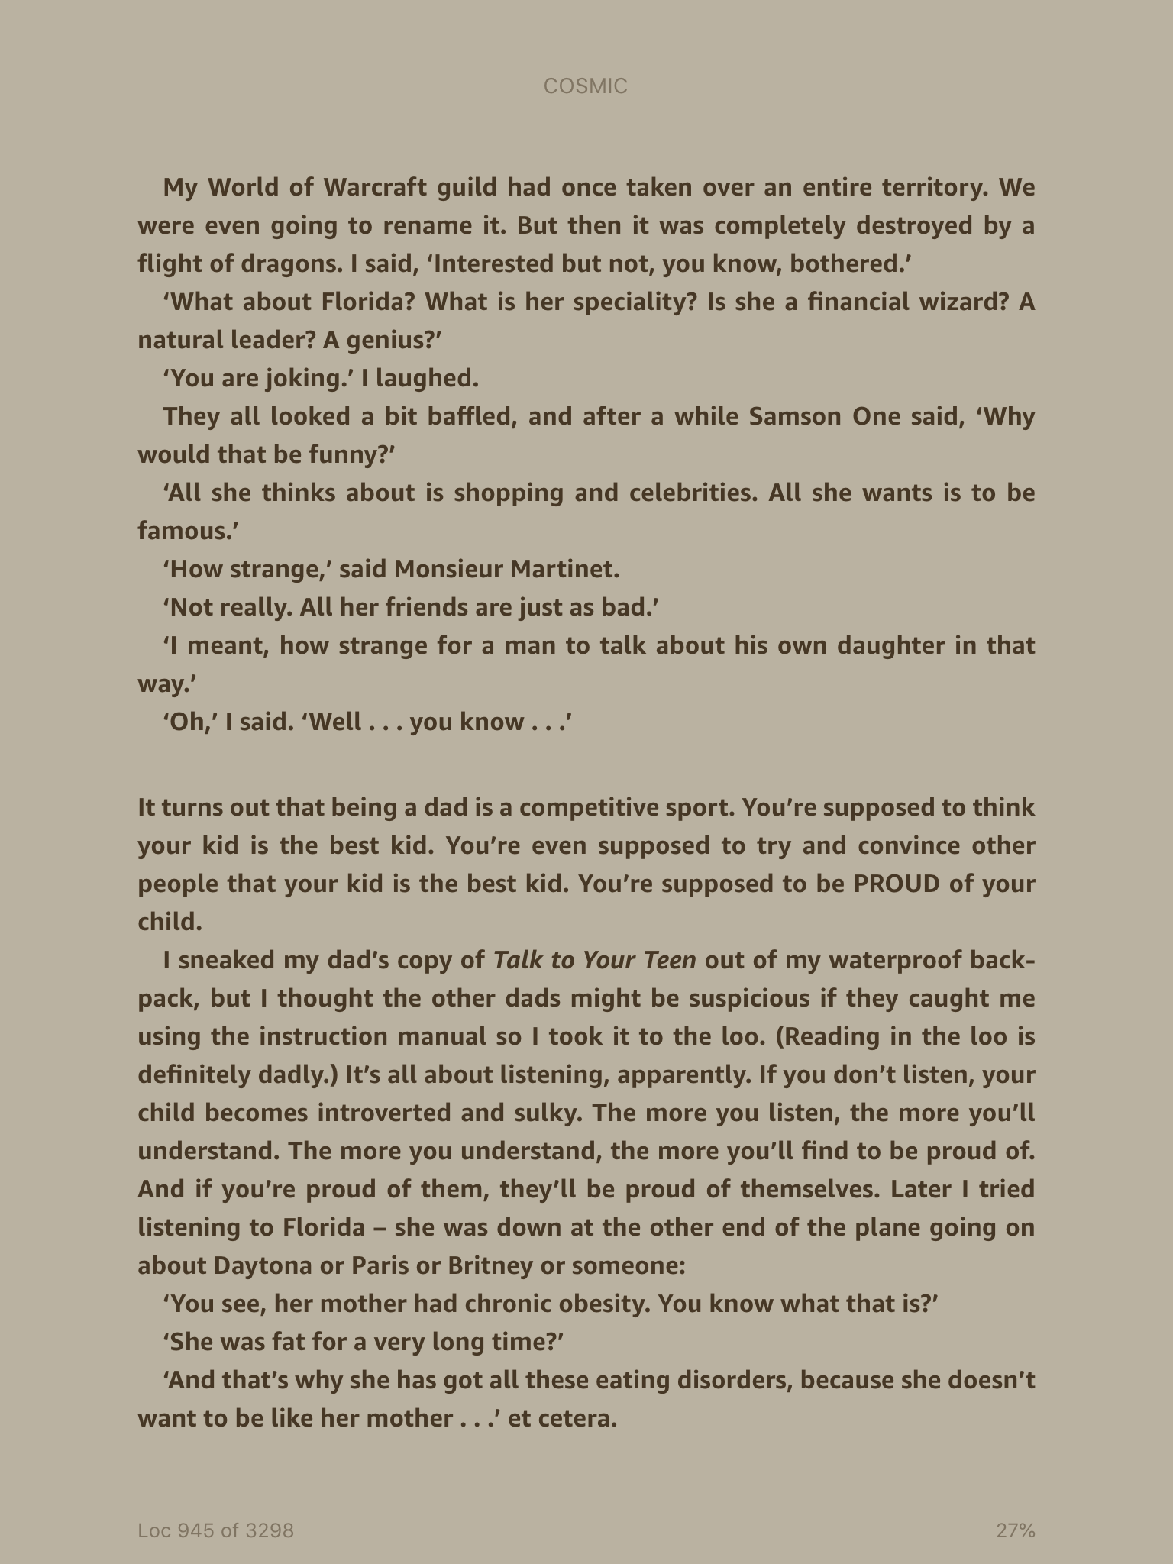

Slide 7
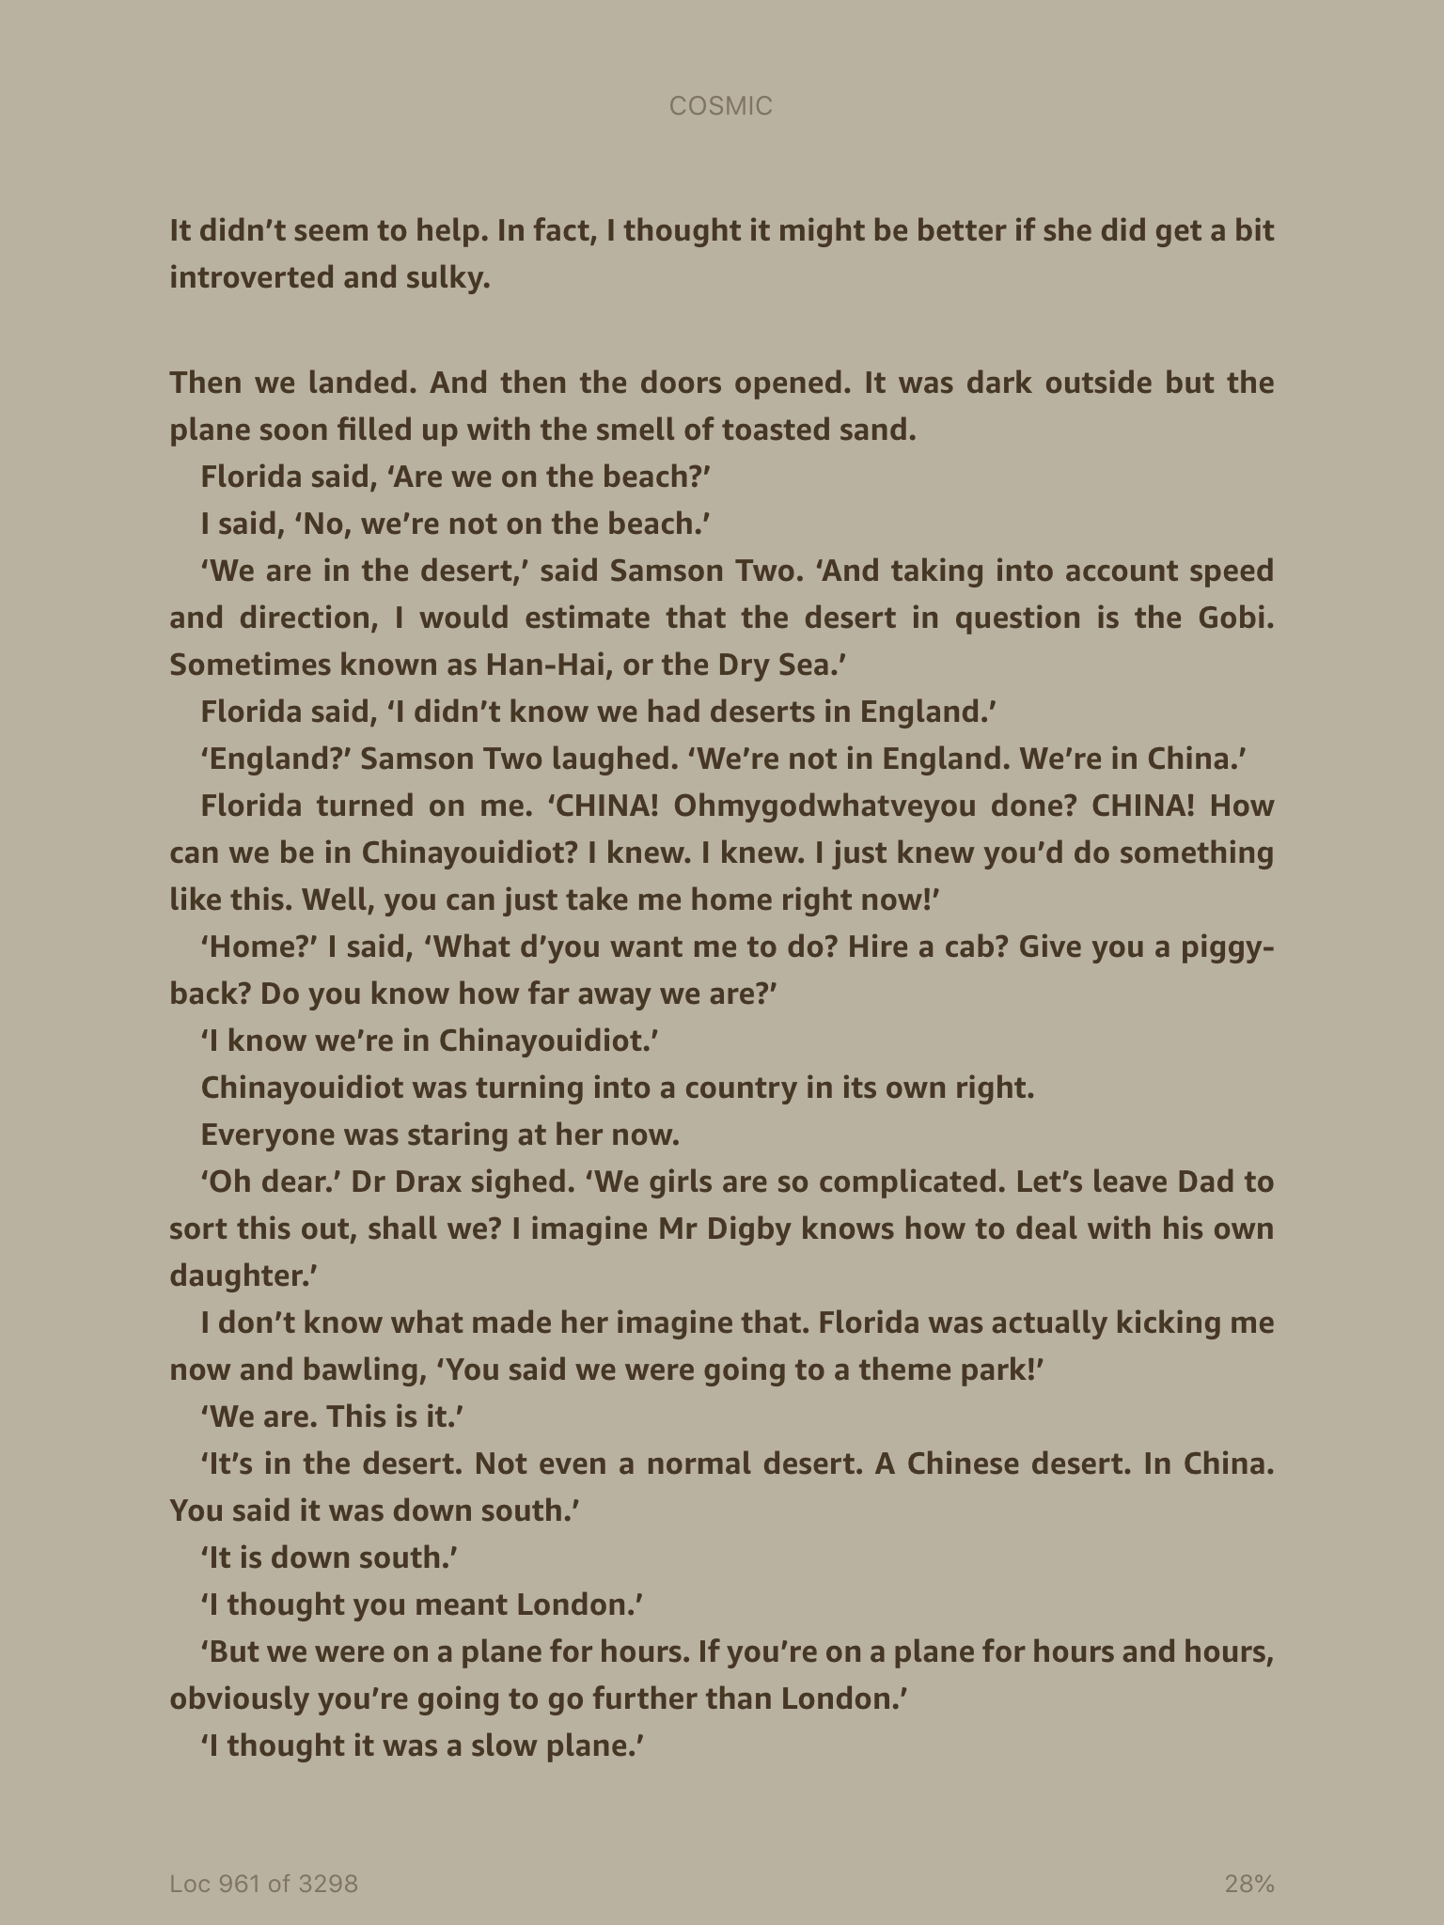

Slide 8
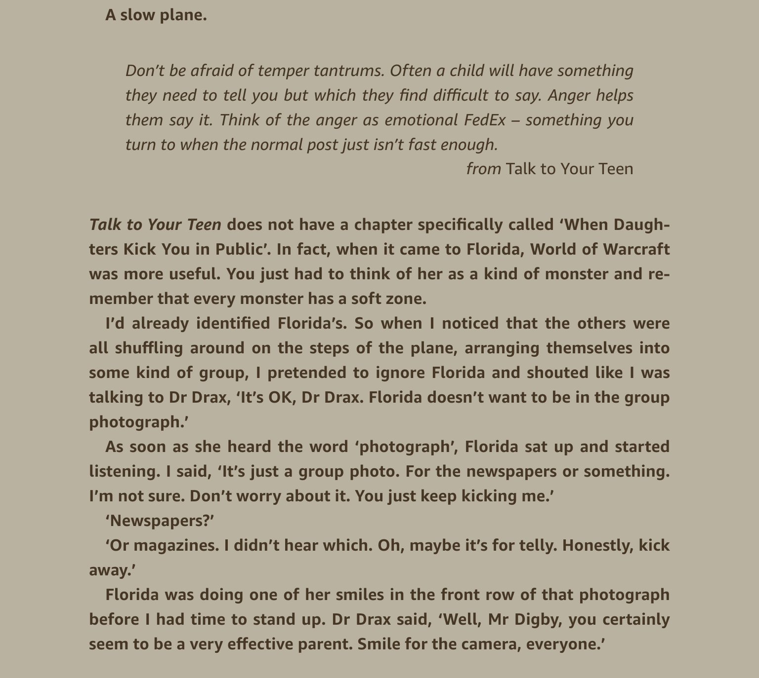

Slide 9
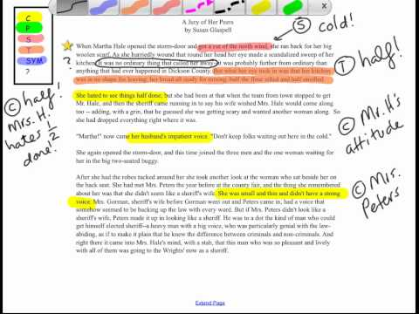
Look at the title of the chapter – what might his tell you?
What clues are given to what the Dads think of each other?
Jot down any phrases in the chapter that give clues about characters and what the characters might think of each other.
Challenge – what do the Dads think of each other?

Slide 10
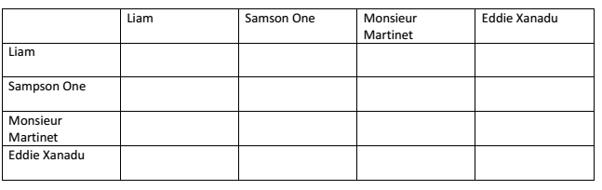
Main Task: Complete the table to show what the Dads think of each other. Use the text to help form an opinion. Include a quote from the text if you can.

