Slide 1

Week 2 Day 5

Slide 2
Read Chapters 12 and 13 –In Chinayouidiot and Thrill Ride of the Century

Slide 3
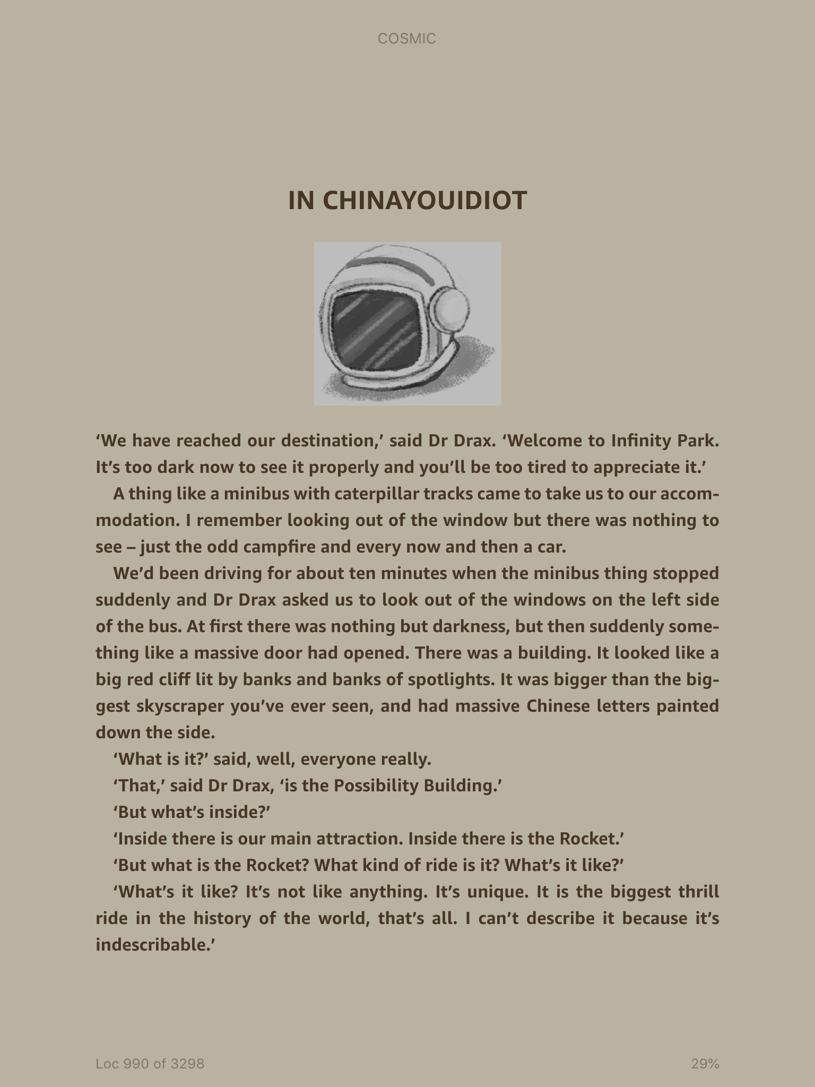

Slide 4
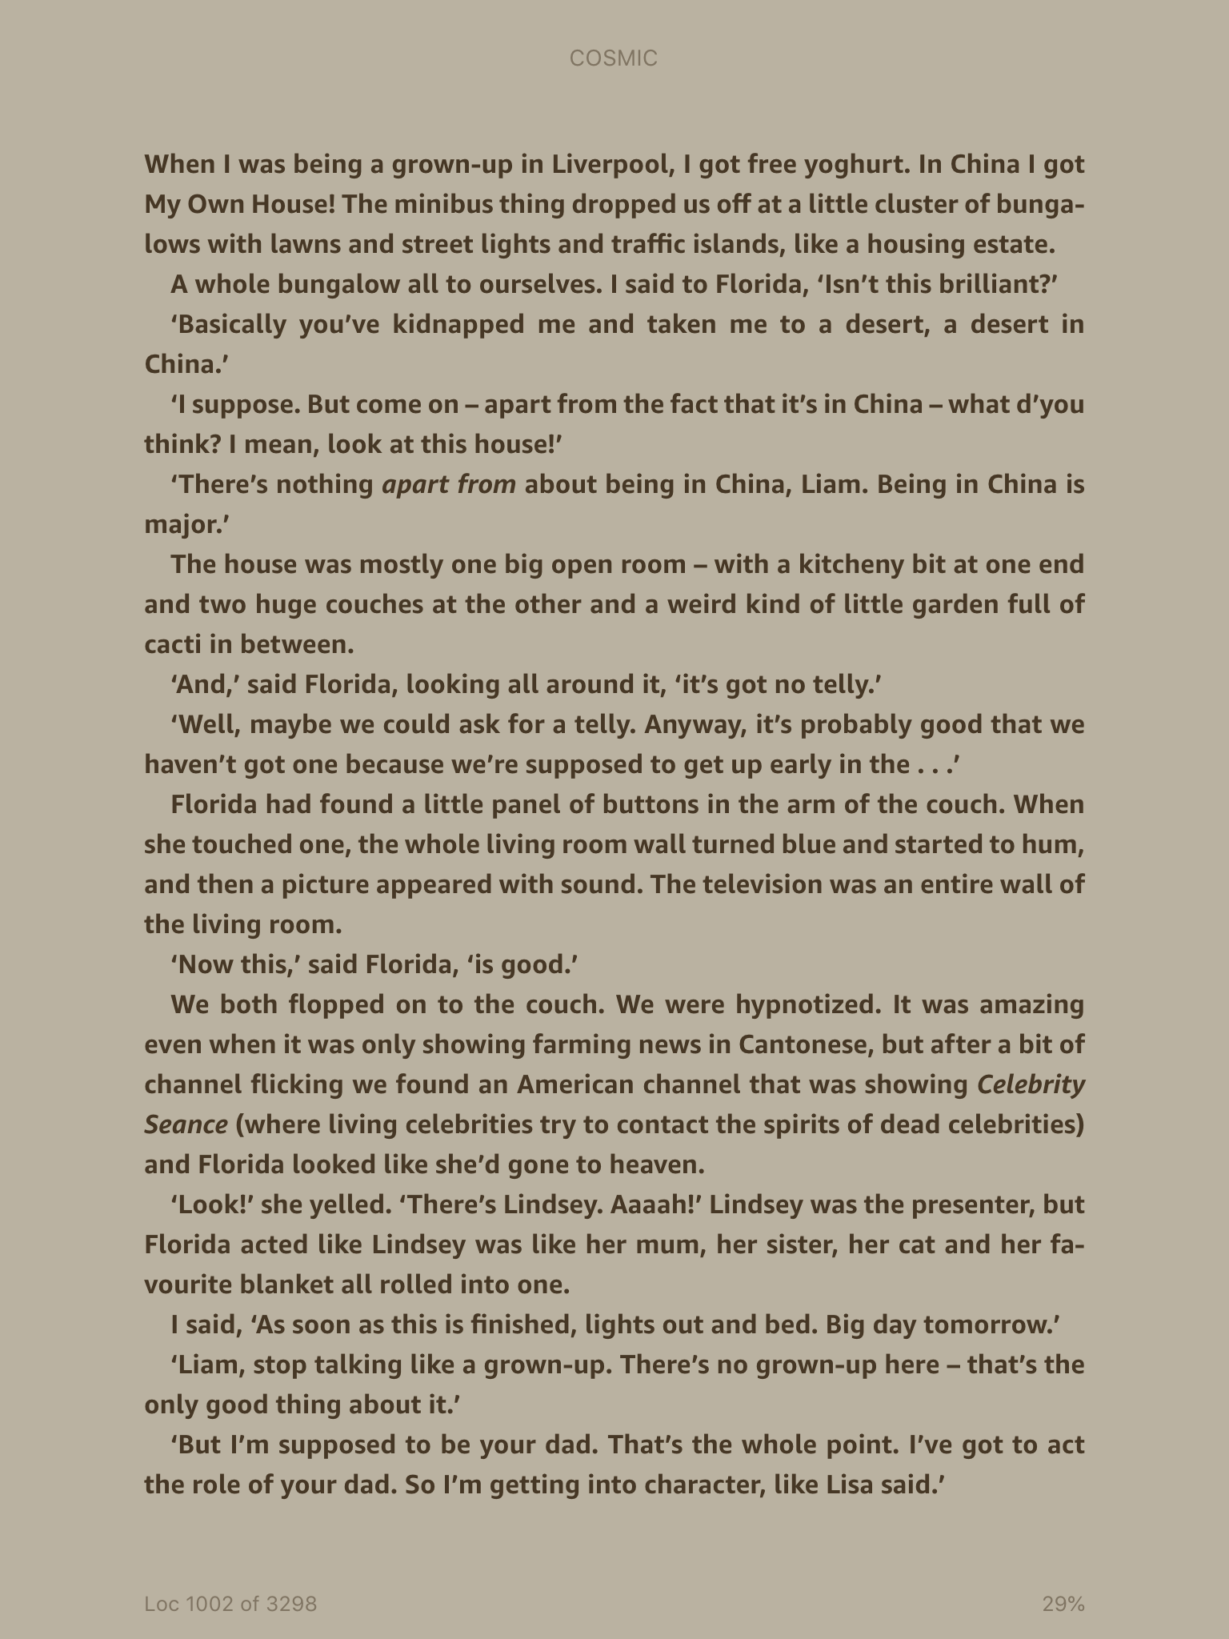

Slide 5
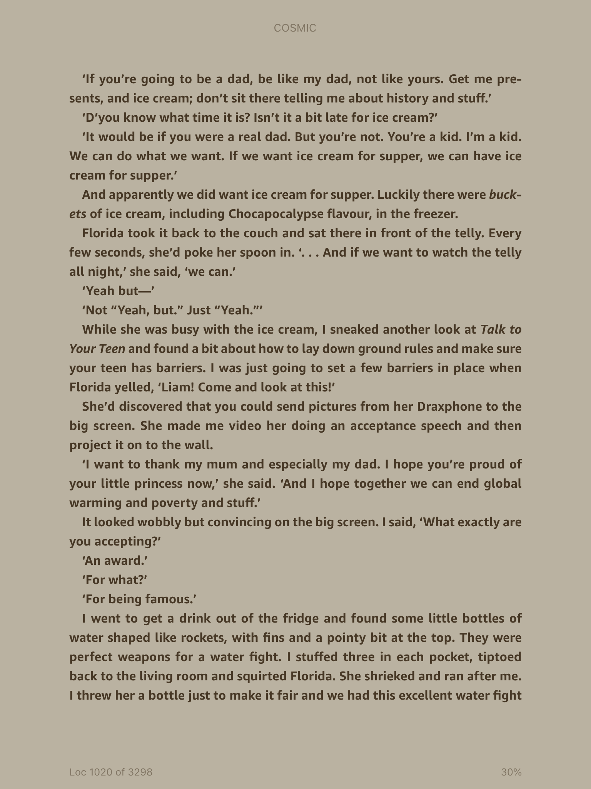

Slide 6
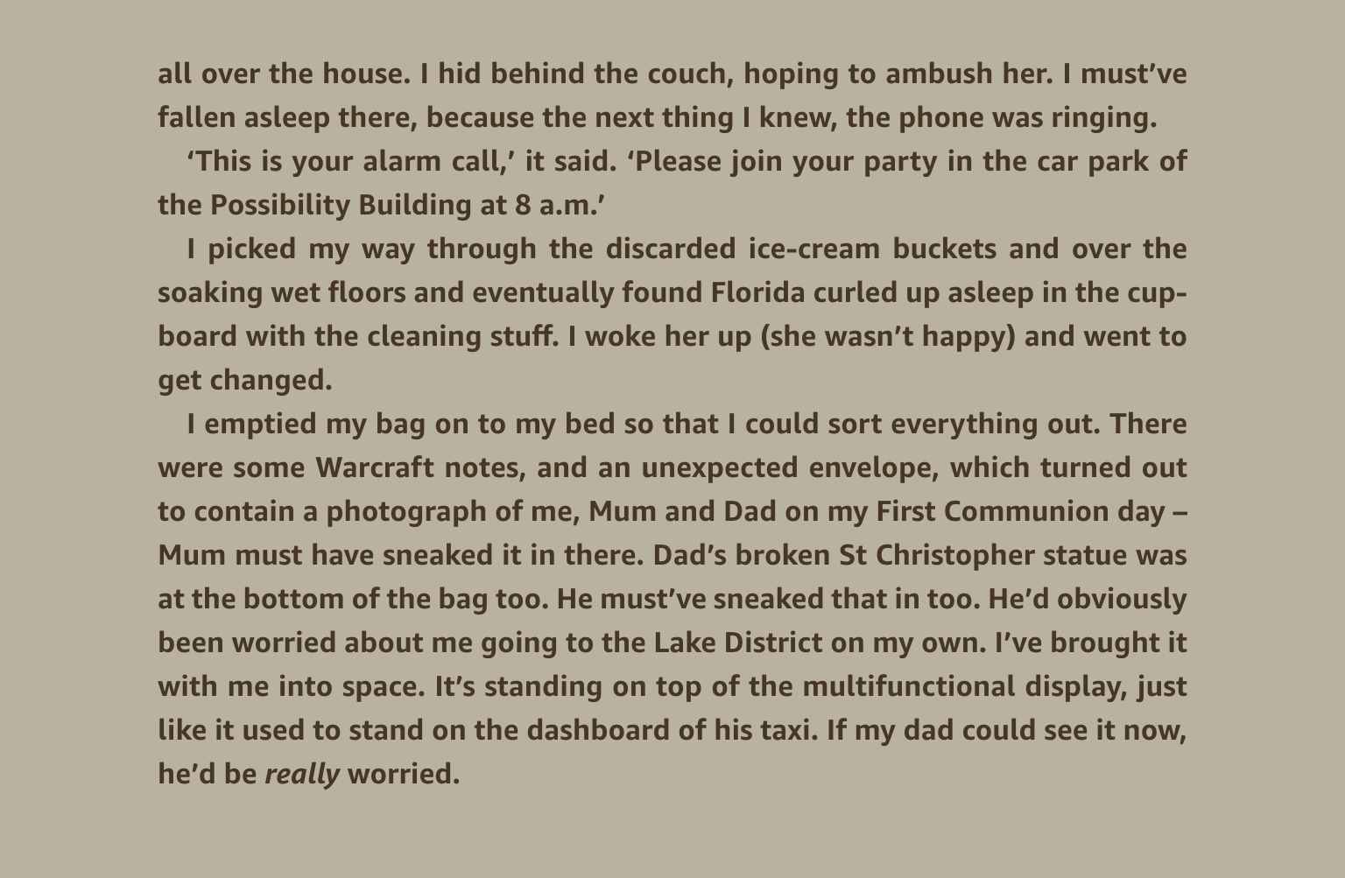

Slide 7
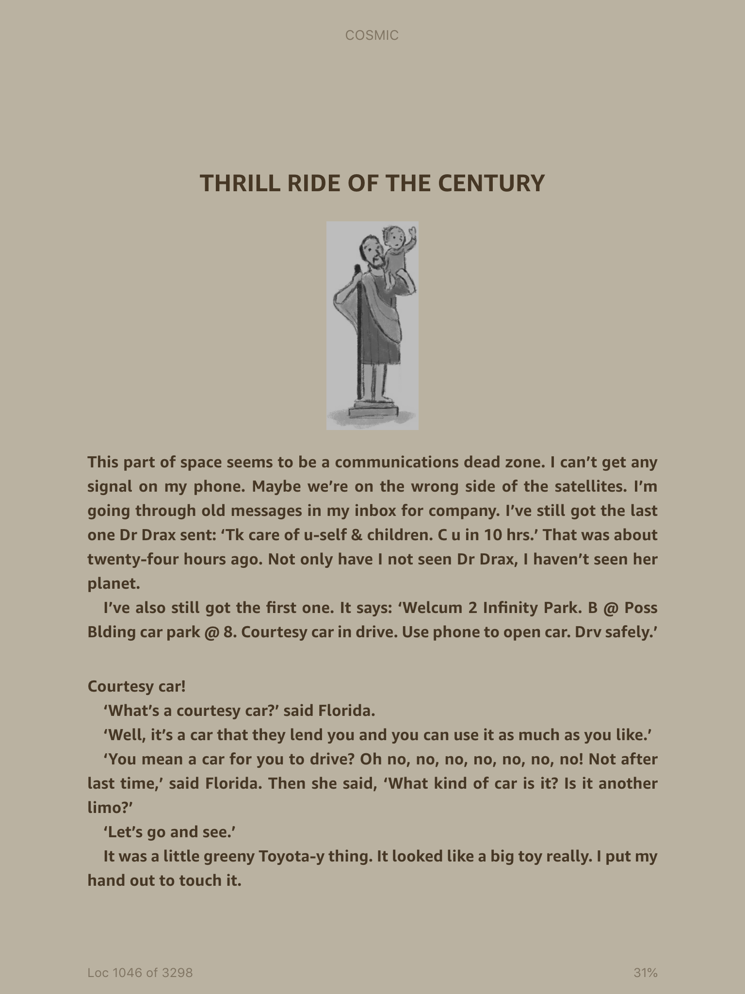

Slide 8
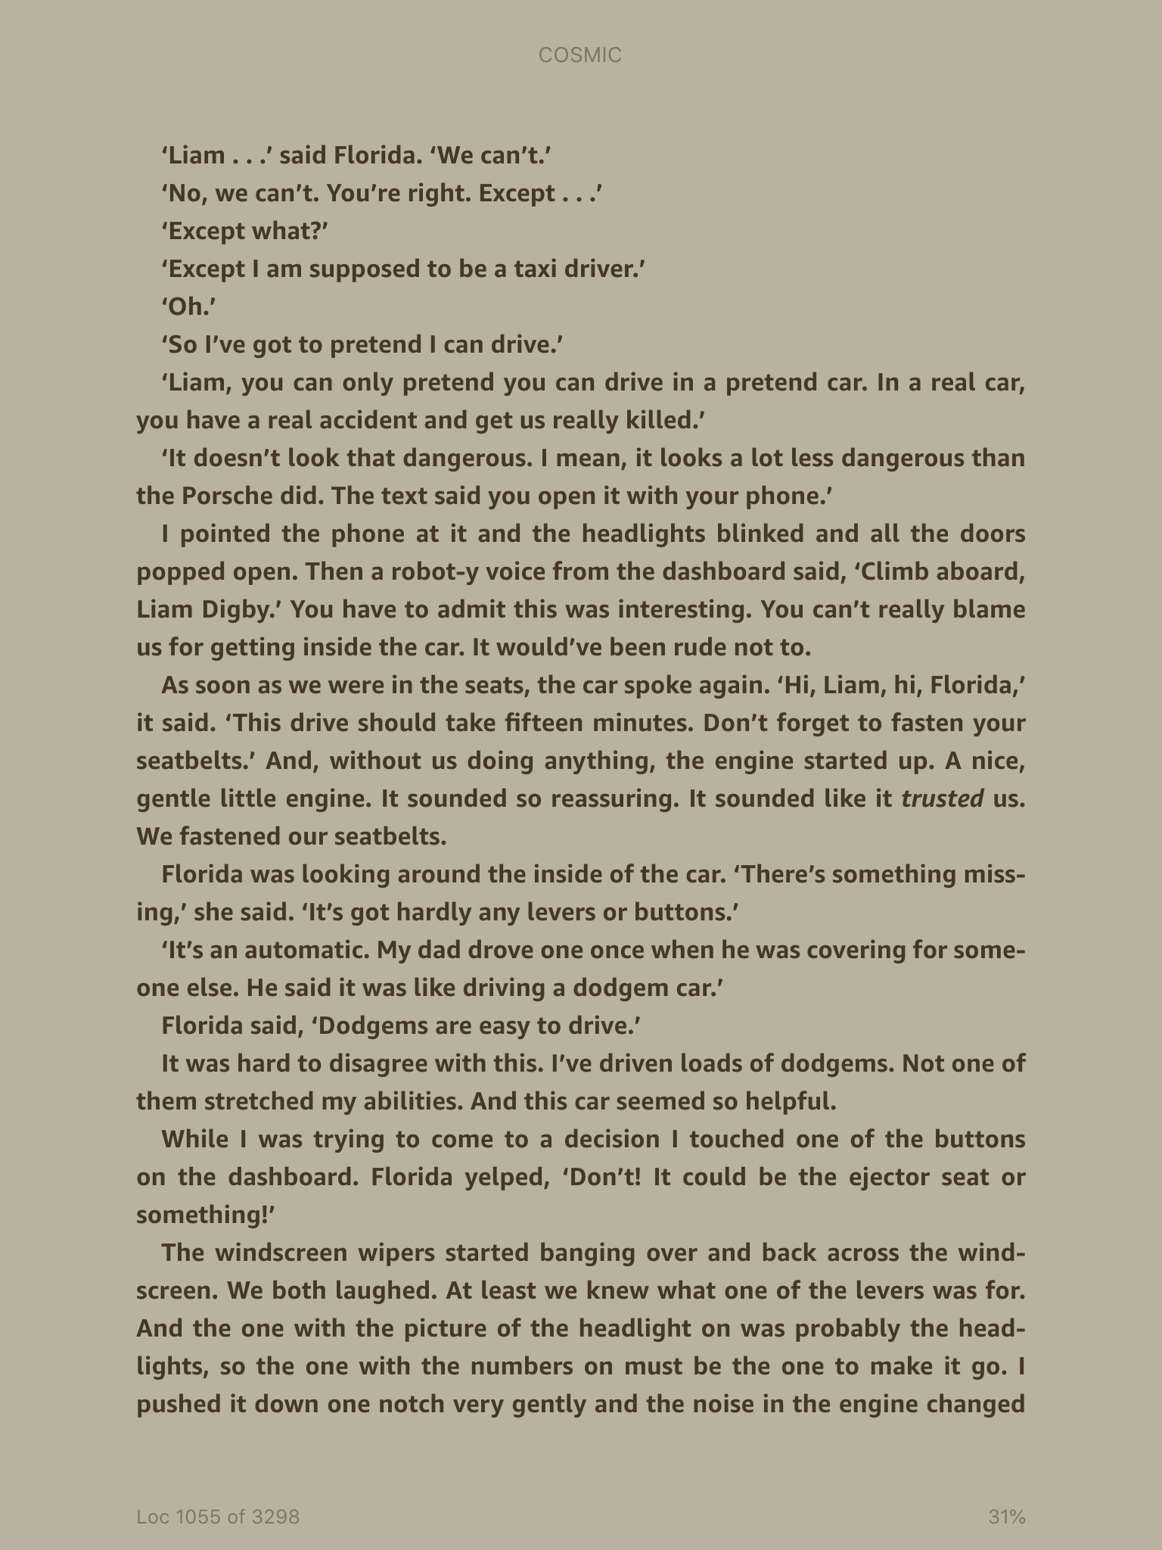

Slide 9
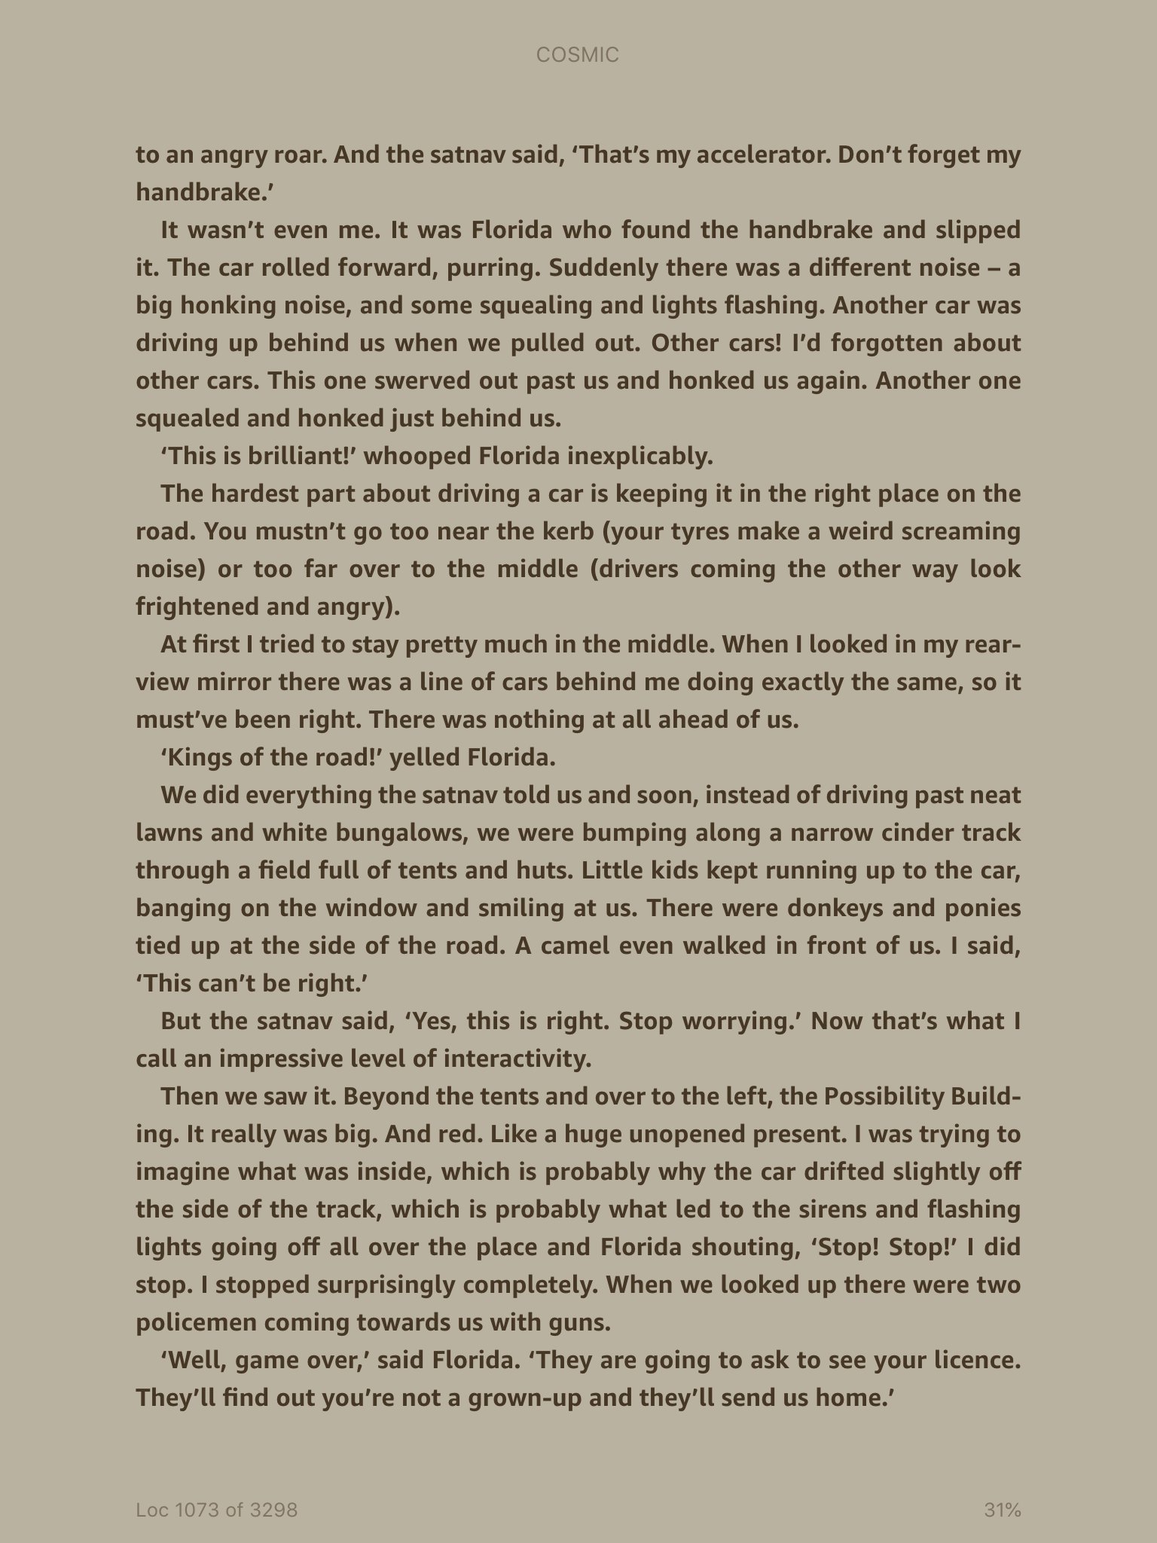

Slide 10
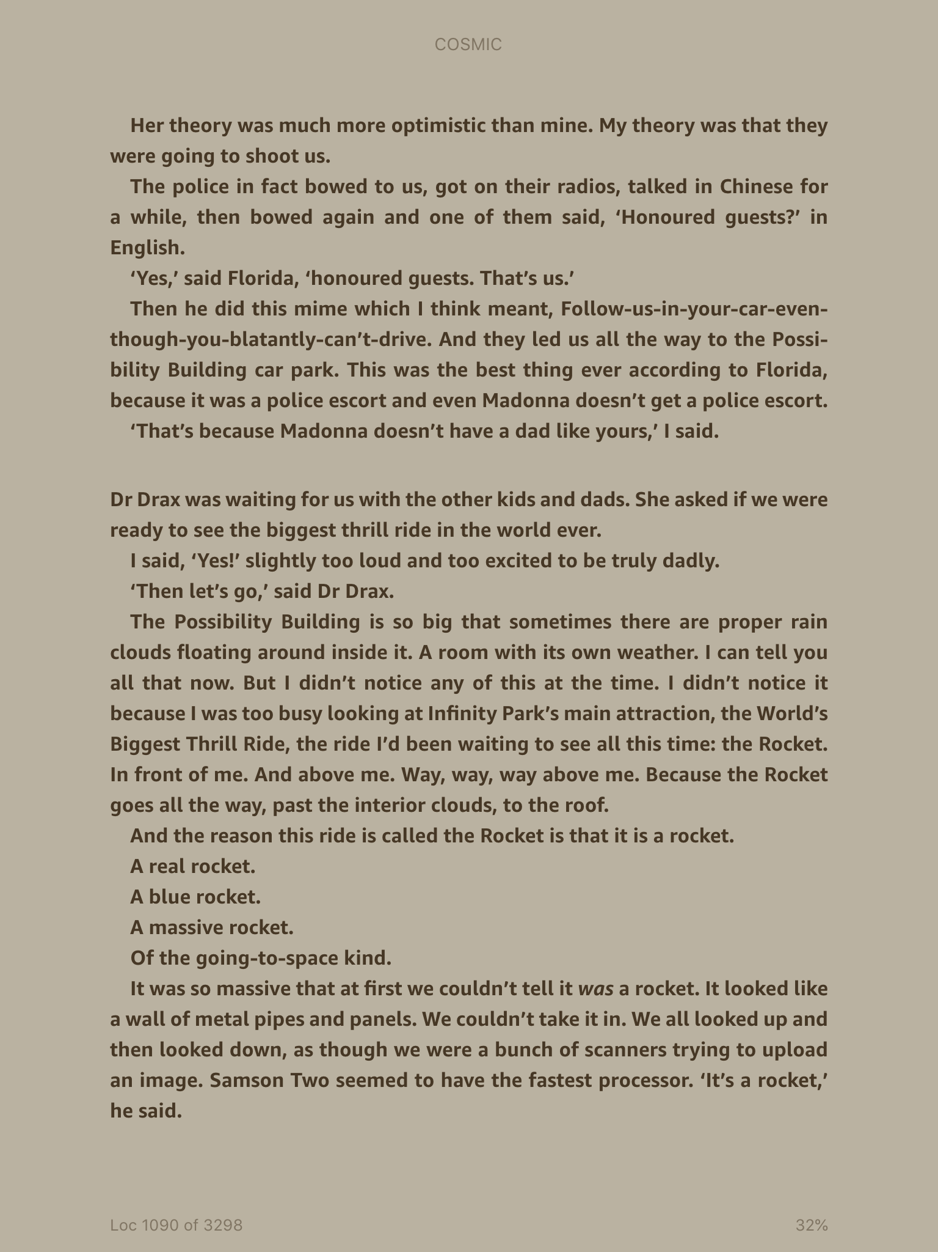

Slide 11
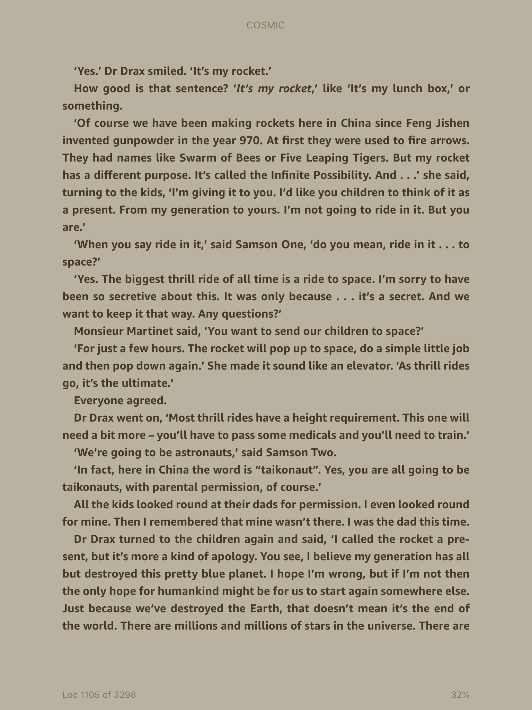

Slide 12
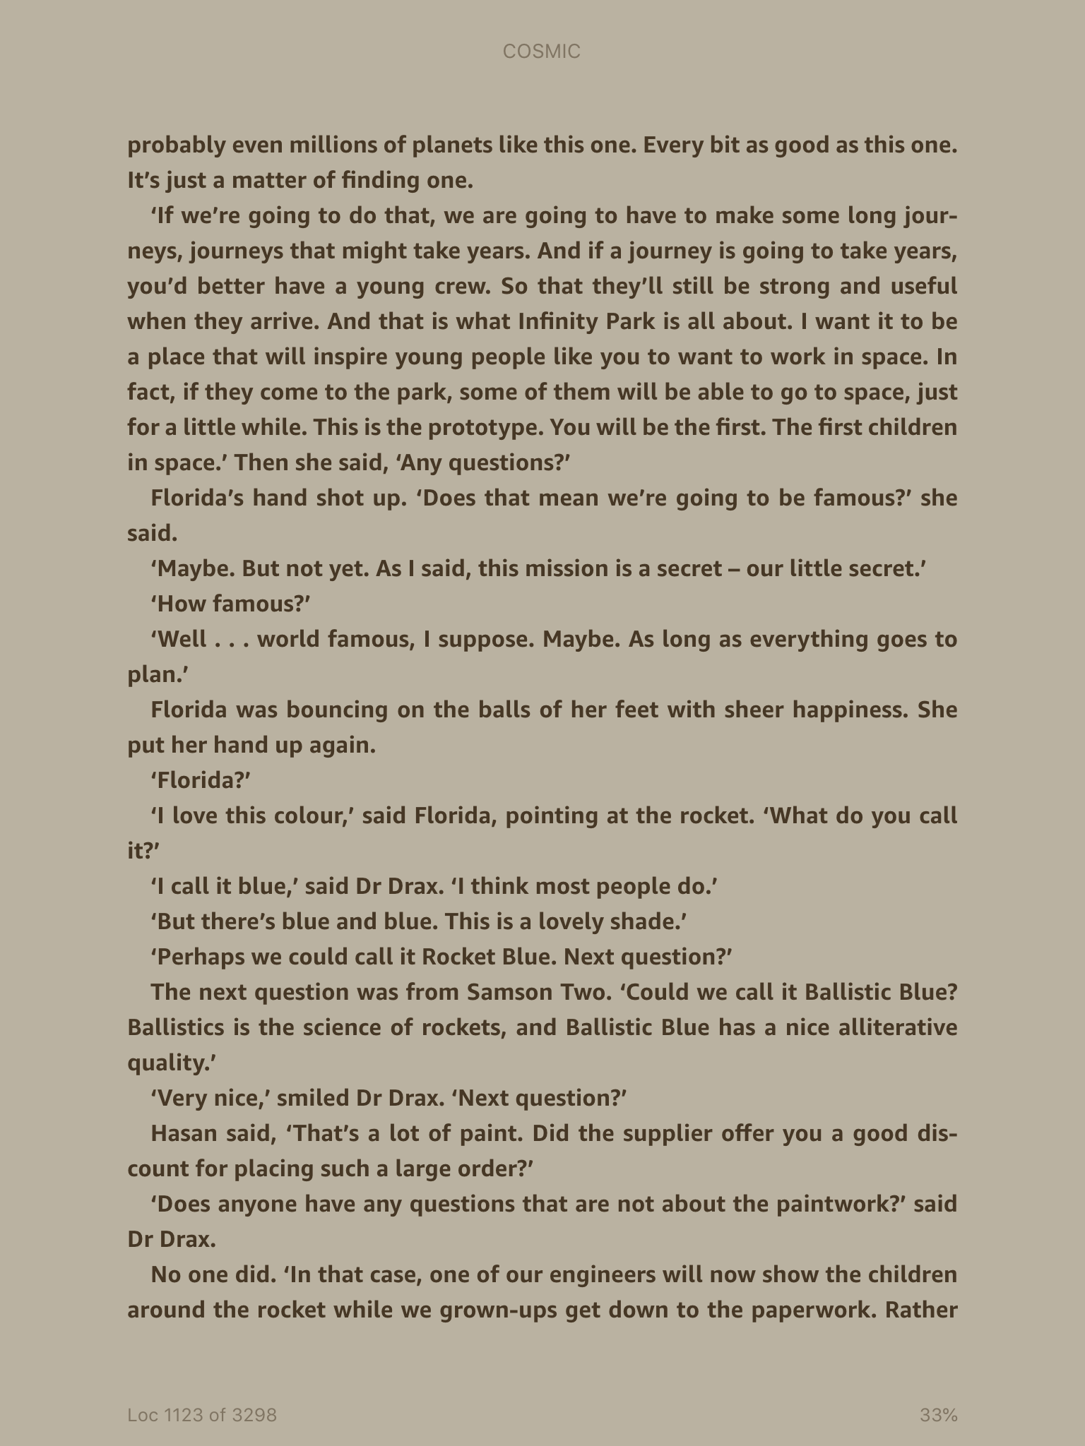

Slide 13
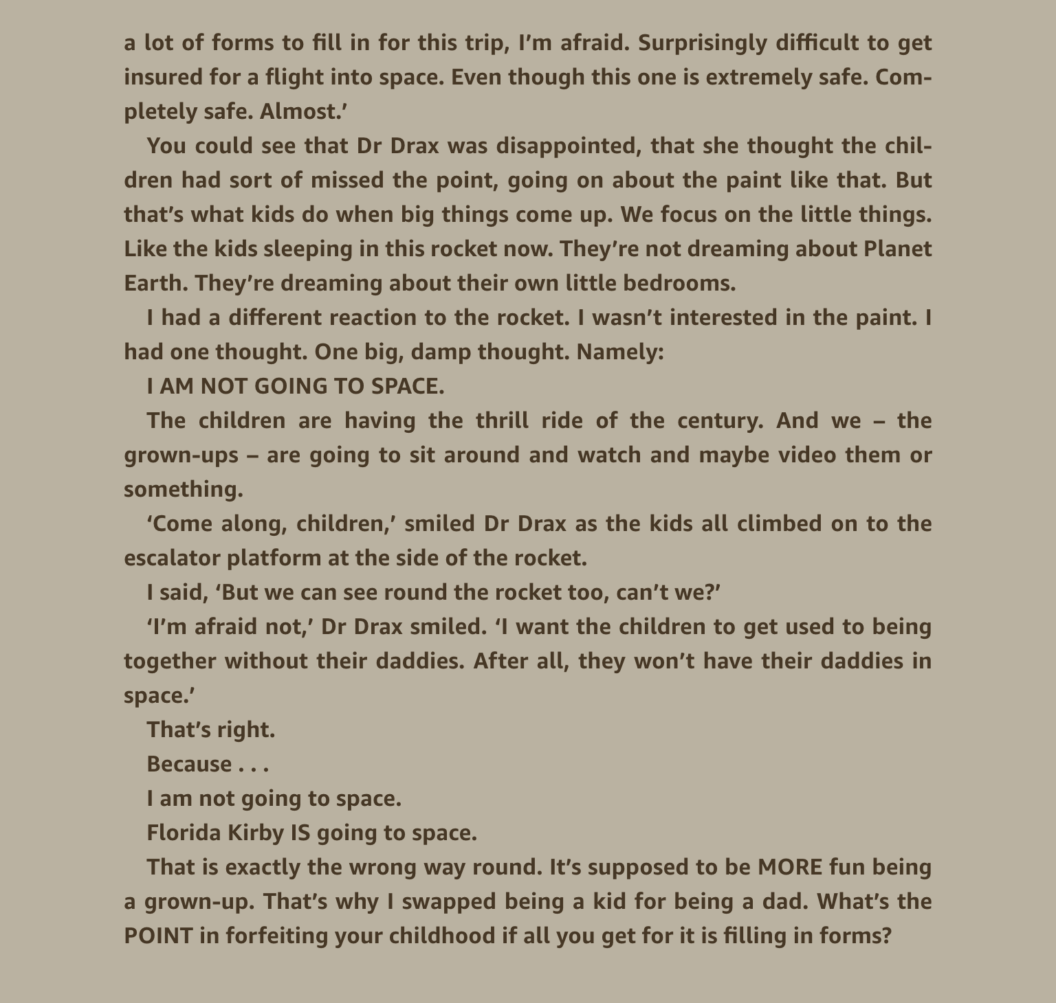

Slide 14
What is the thrill ride of the century?
Why does Dr. Drax want the children to go to space?
How long did she say they would be gone for?
What do the grown ups have to do?
Do you trust Dr. Draz? Give an explanation for your answer.

Slide 15
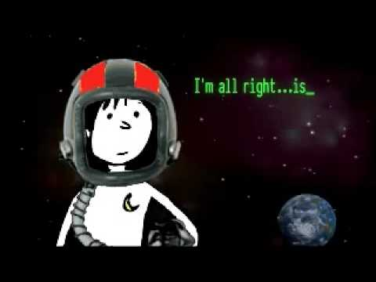
Read Chapter 14 – I am the space Daddy
What difficulties has Liam faced in pretending to be a Dad so far?
List as many as you can.

Slide 16
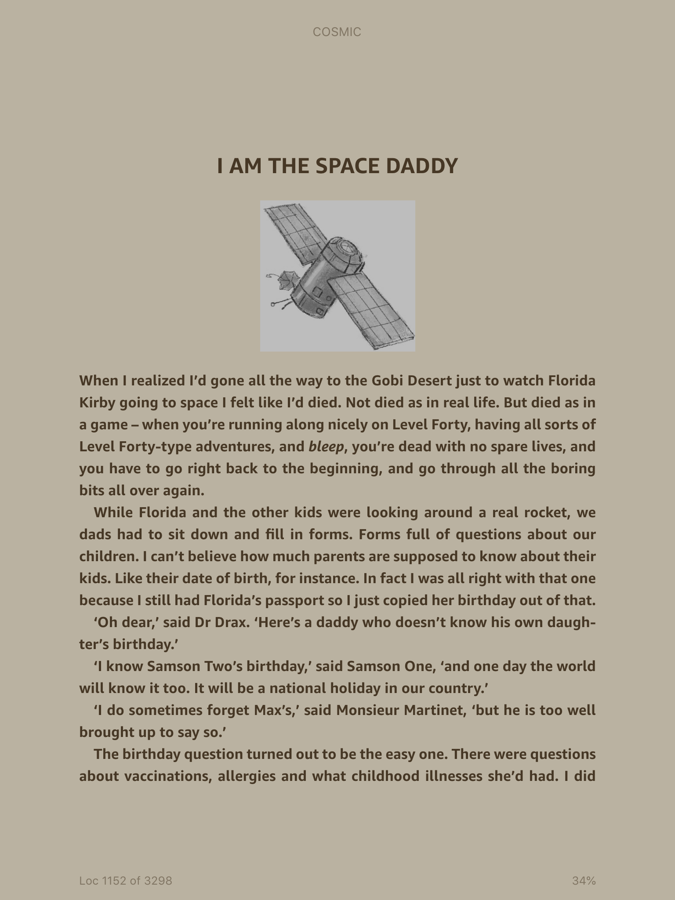

Slide 17
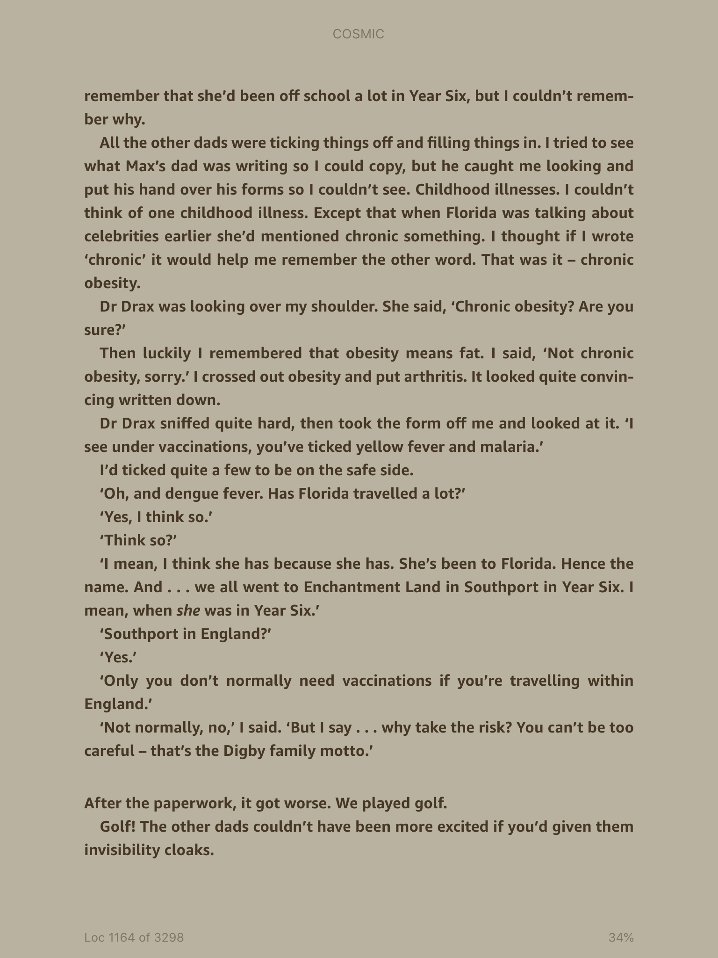

Slide 18
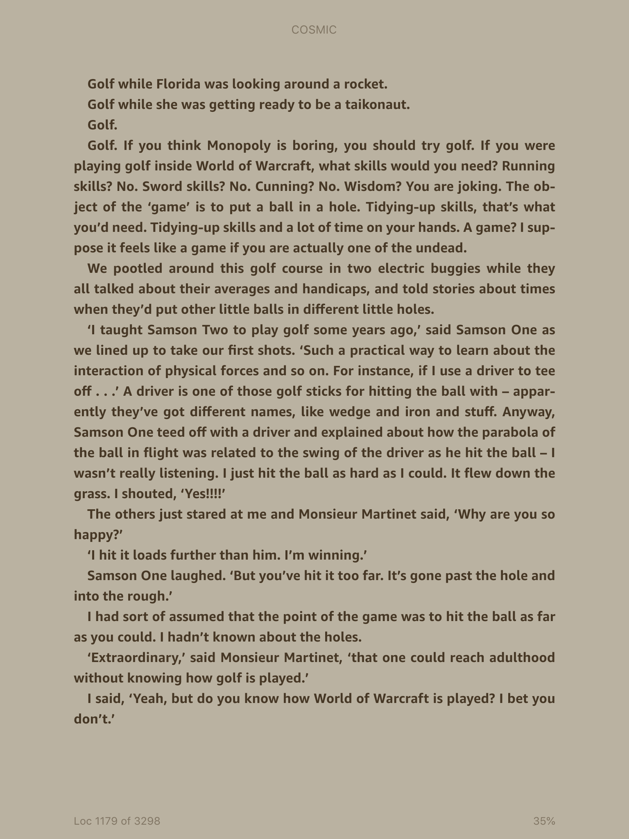

Slide 19
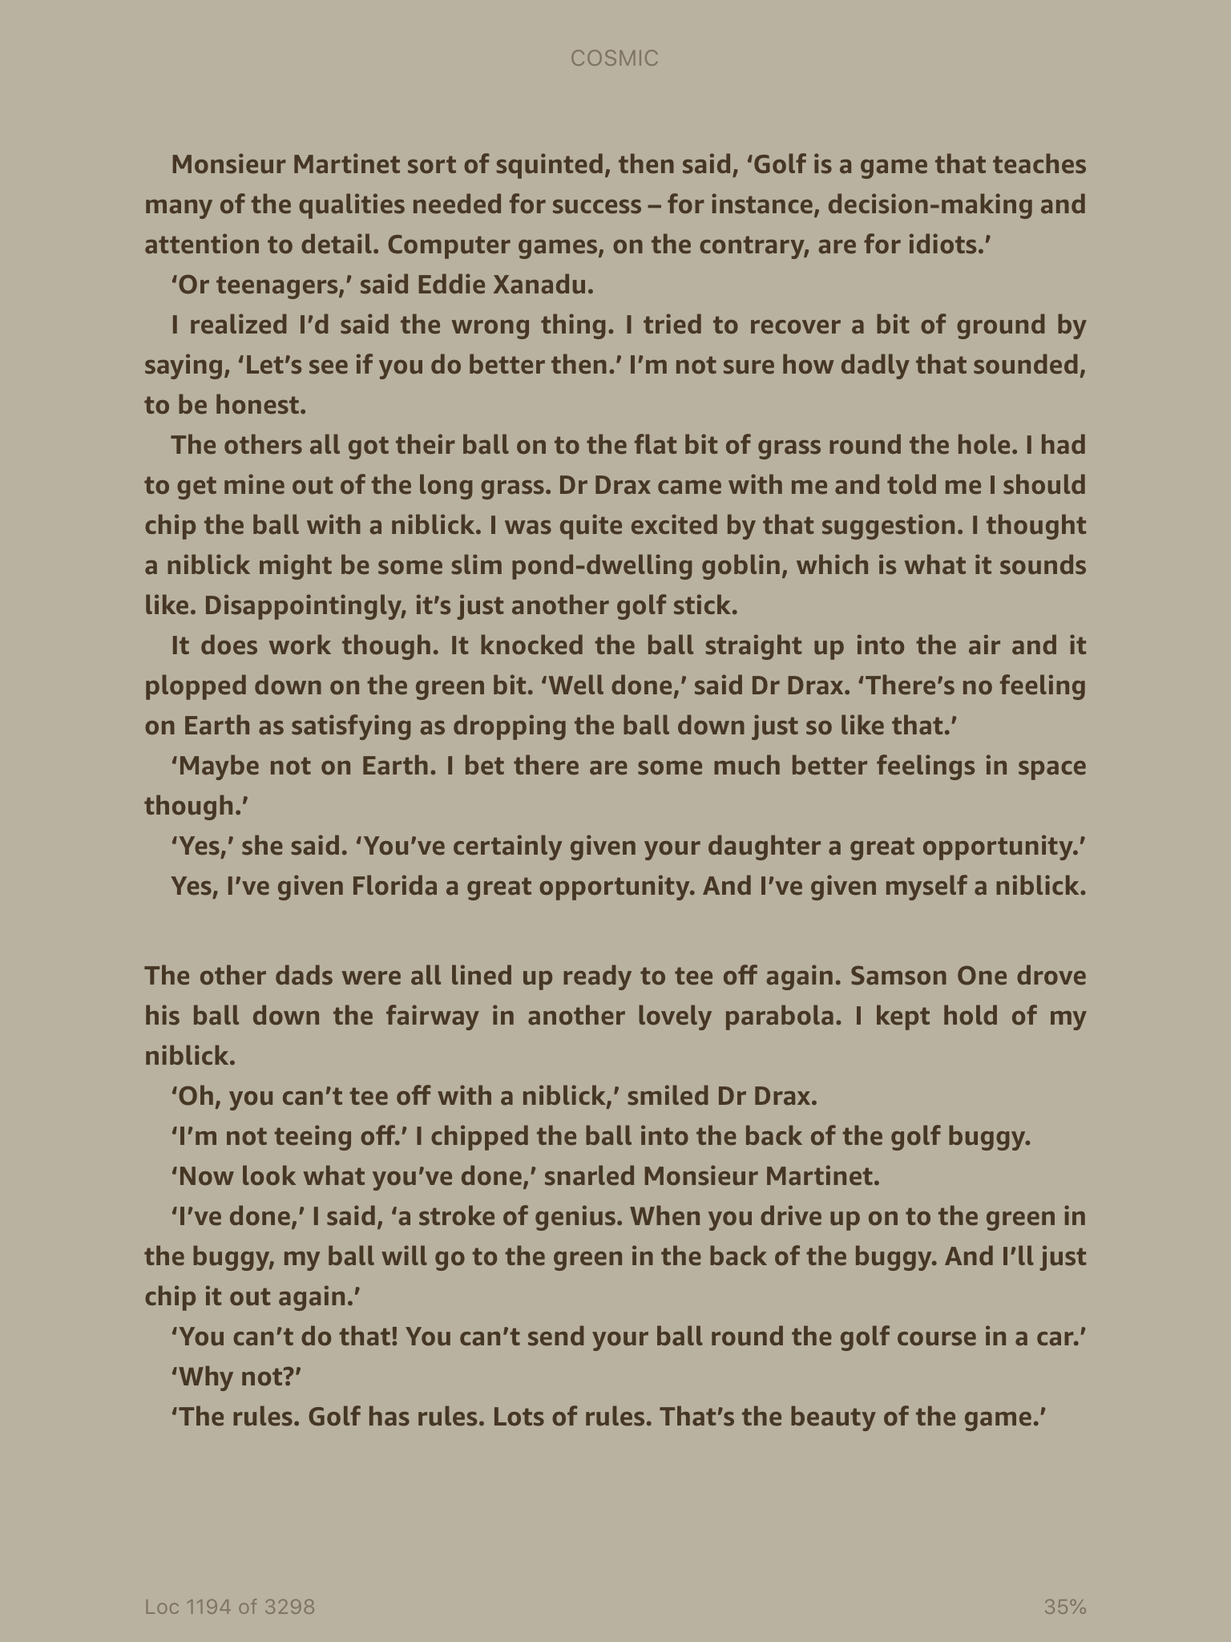

Slide 20
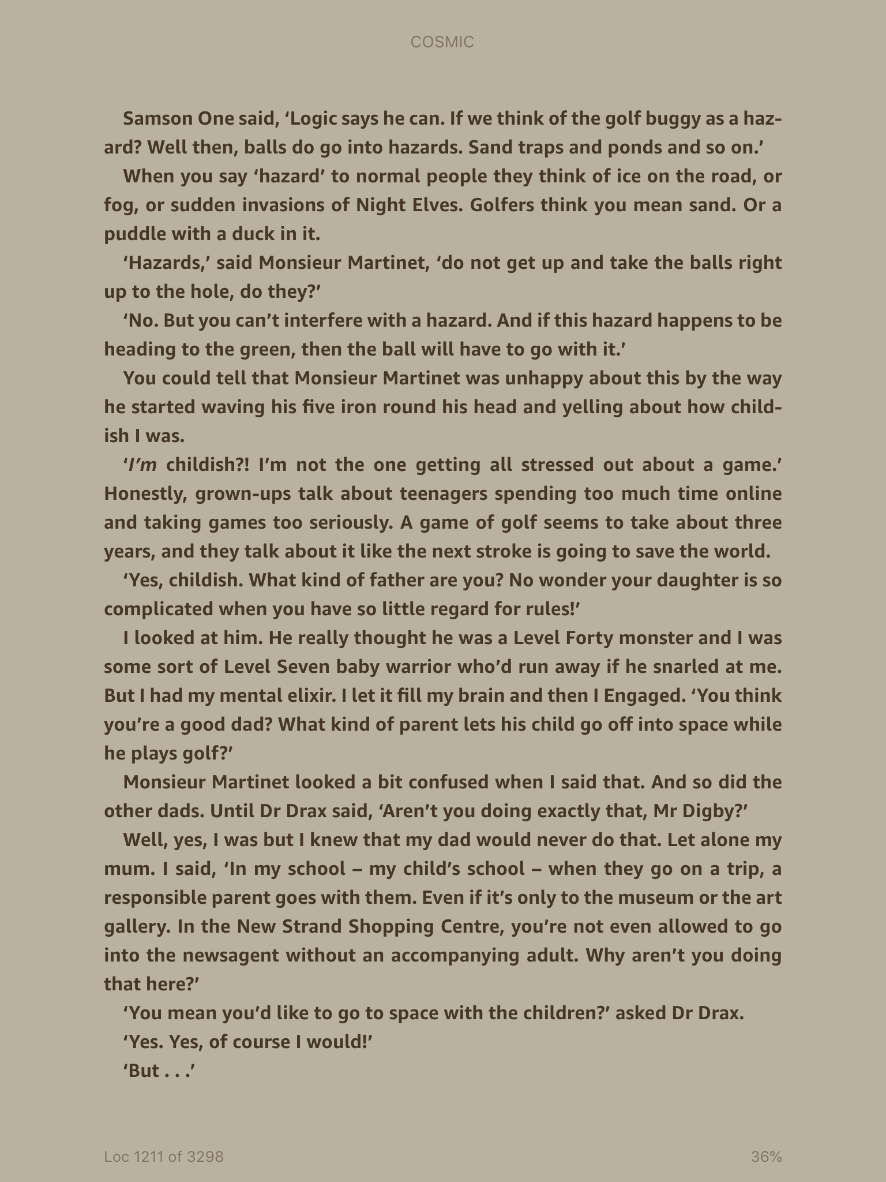

Slide 21
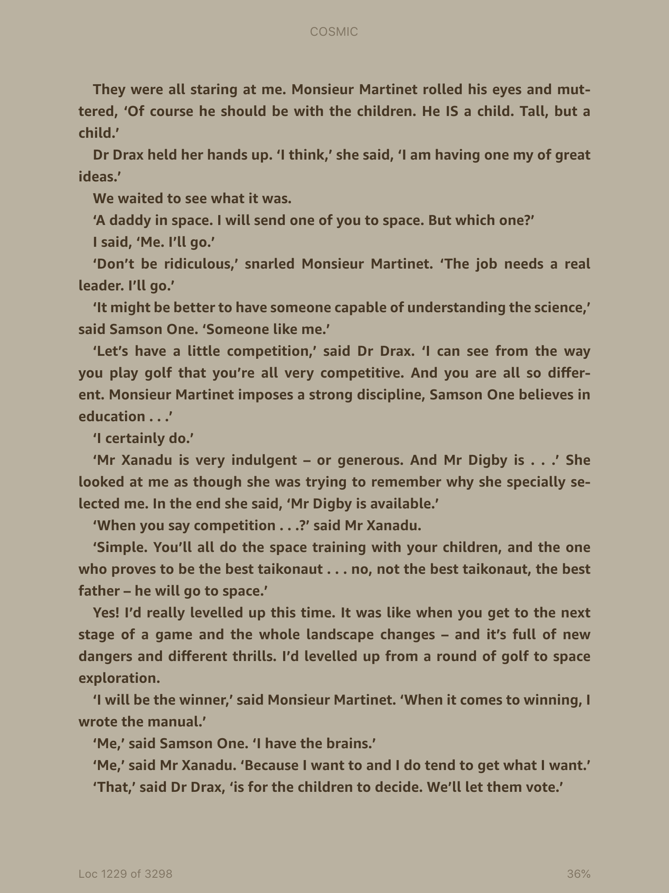

Slide 22
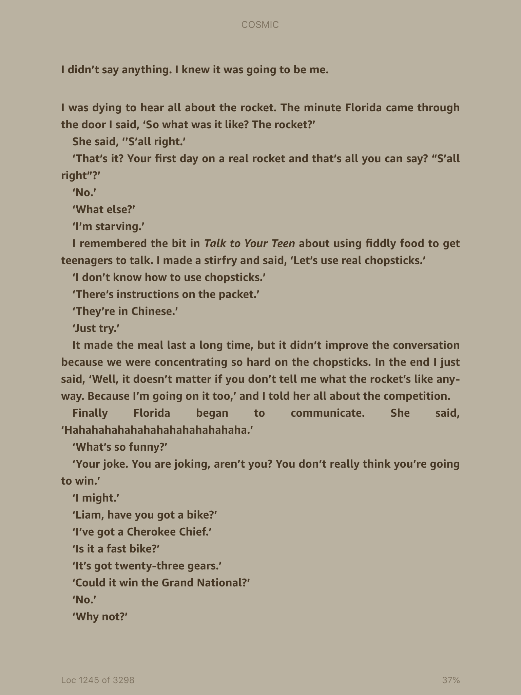

Slide 23
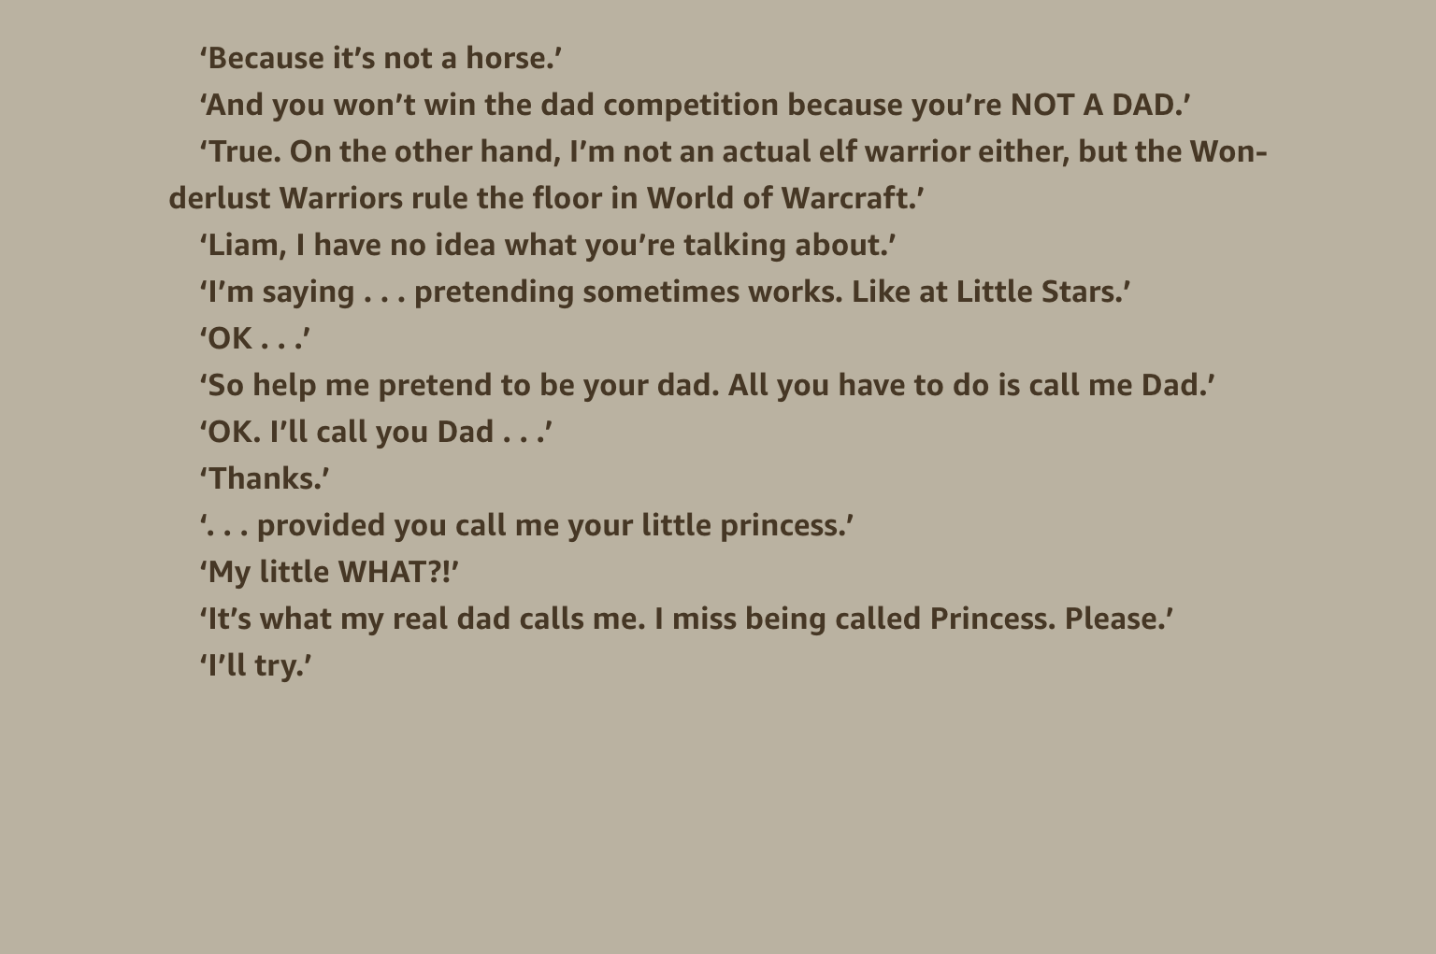

Slide 24

Main Task – Around the outside of each character, write how Liam and Florida appear/seem to the other characters.
List key words and phrases to describe how each character is acting and feeling. Add quotes from the text to support your ideas.

Slide 25
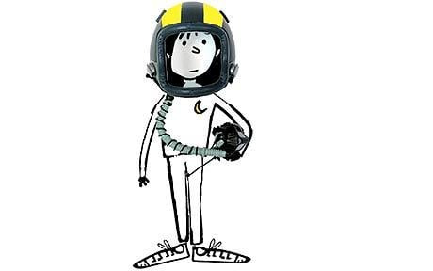
Plenary
We know that Liam ends up on the space ship.
Predict – Why do you think he got picked?

