Slide 1

Welcome To Wollaton

Slide 2
New for 2019/20
Meet the team
Year 6 curriculum
Home Learning
Expectations
SATs
Trips
Questions

Slide 3
Meet the team
Your child is lucky to have 2 experienced Year 6 teachers this year: Mrs Baker and Miss Clark.
Mrs Baker – Monday/Tuesday/ Wednesday
Miss Clark - Thursday/Friday
We also have 3 T.As who work with us across the week – Mrs Somerville, Mrs Davey and Mrs King.

Slide 4
New for 2019/20
Library cards- Bronze, Silver, Gold
Mobile phones/devices in school.
Healthy snacks (nuts)

Slide 5
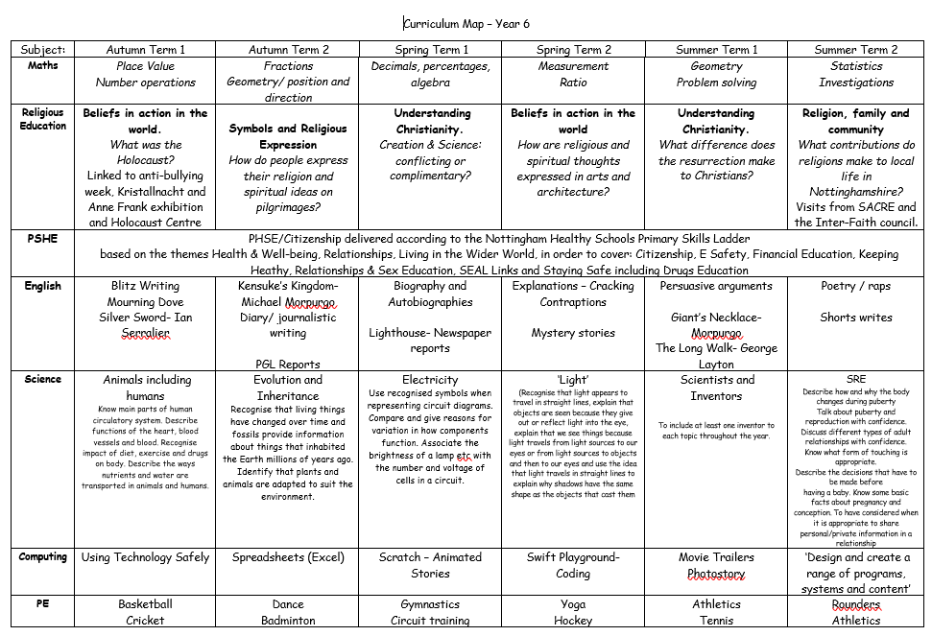
Year 6 Curriculum

Slide 6
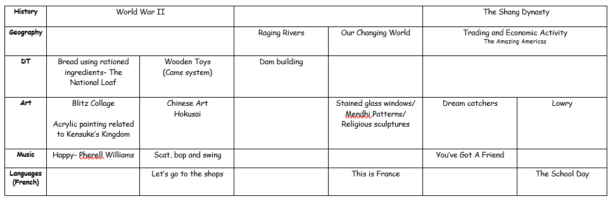
This can be found on our web page

Slide 7
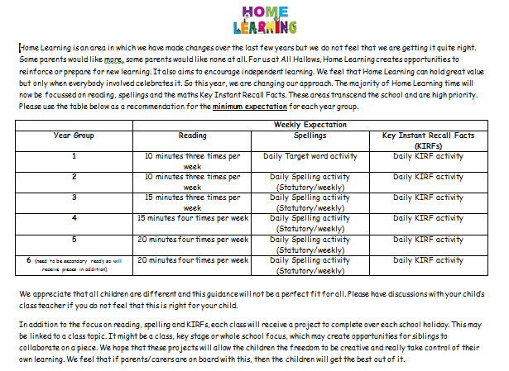
Home Learning
Renewed focus on reading, spelling and Key Instant Recall Facts across KS2
More topic-based home learning throughout the term
Year 6 will receive additional SPAG and maths
There’s always something to do every night – reading, TT RockStars and going over anything they weren’t sure about from the day’s learning.

Slide 8
Expectations
One of the roles of Year 6 is to help prepare the transition to secondary school: ‘secondary-ready’
Children in Year 6 will be expected to work hard, putting in maximum effort and, being the oldest children in school, set a good example to others with regard to behaviour and attitude.
These expectations apply to Home Learning: the children can expect us to prepare, mark, give feedback and support them with their Home Learning; we expect them to complete it on-time and to a high standard.

Slide 9
Trips
Library
PGL
National Holocaust Museum
End of year trip
Prom

Slide 10
SATS
Week beginning 11th May 2020
Monday – SPAG
Tuesday – Reading
Wednesday/Thursday – Maths
Writing internally assessed in July

Slide 11
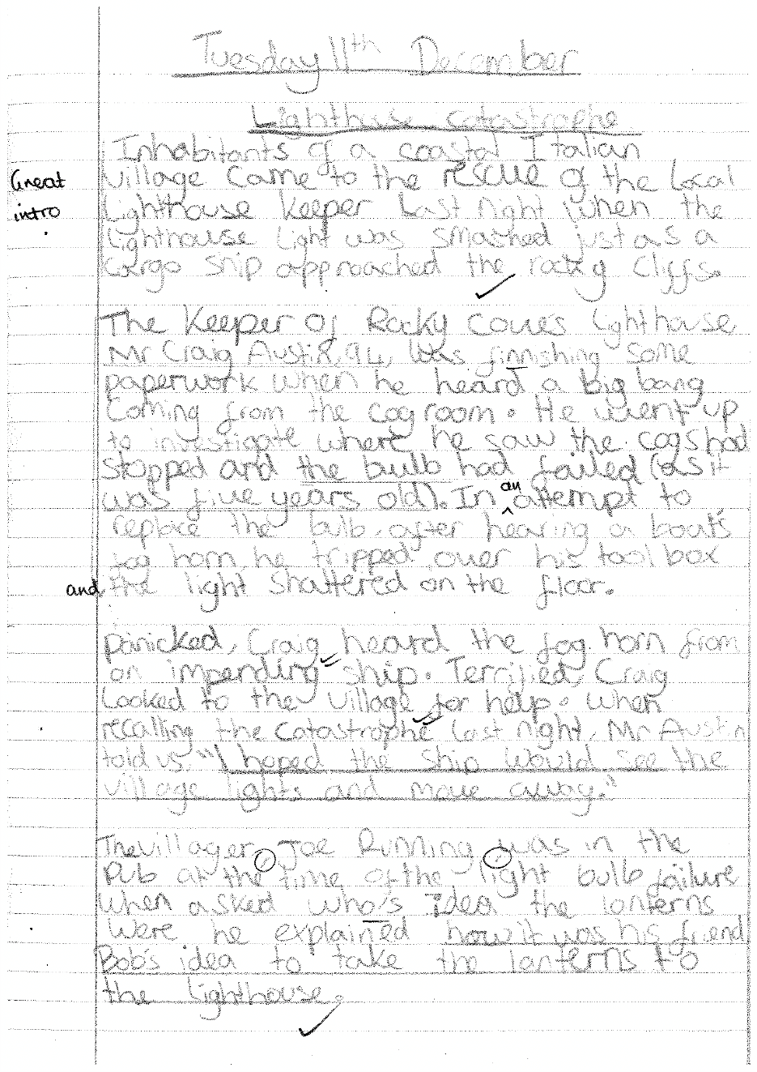
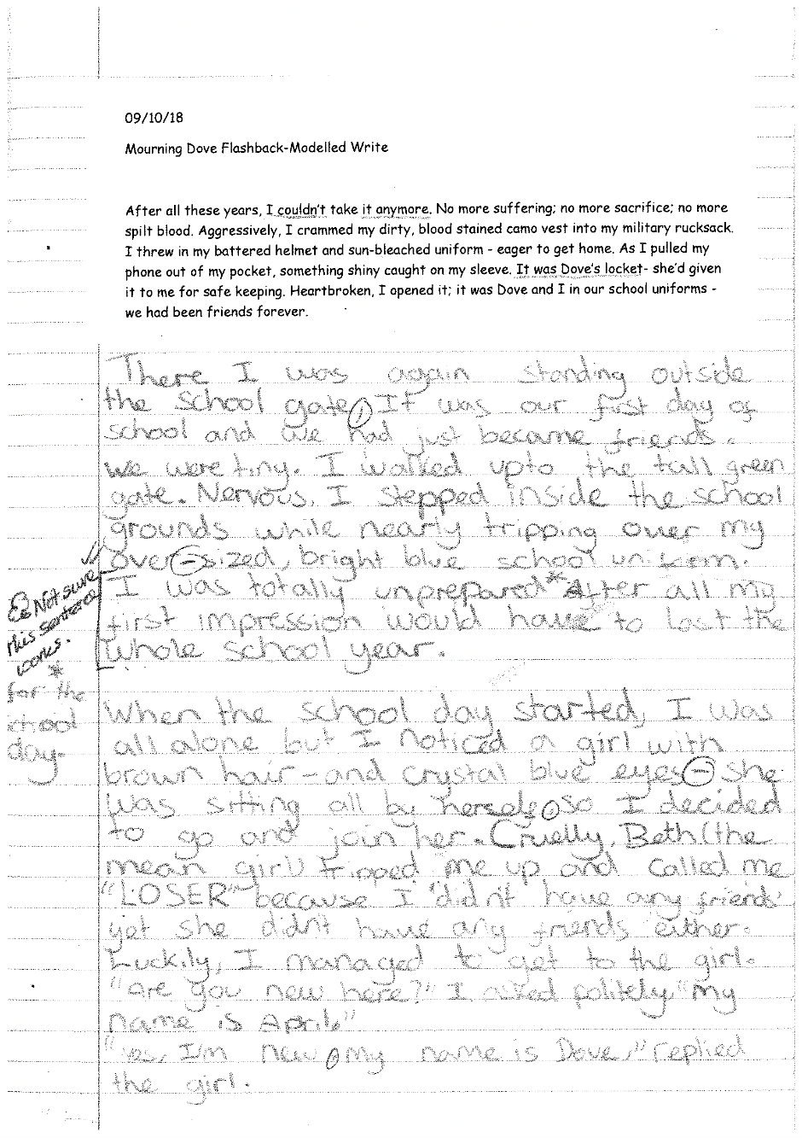
Expected writing standards

Slide 12
Carlton-Le-Willows Catchment

Slide 13
Questions

