Slide 1

Shakespeare poems
By Freya

Slide 2

Which Shakespeare play am I?
Family enemies
Man hugger
Lady lover
Romance revealers
Kind kissers
Secret wedders
Cousin killer
Death faker
Poison gulper
Life taker
Peace makers
This is a Kenning poem: each line contains two words – a noun followed by a verb.

Slide 3
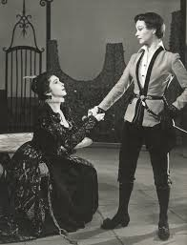
Girl in Disguise
Vi mimics a man
Alas falls in love with Duke
Lives happily now.
This is a Haiku poem and it has three lines. The first line has five syllables, the second, seven syllables and the last line has five syllables.

Slide 4

“Get it Right, Puck!”
The king told Puck, “Put a love potion on their eyes,
So that they fall in love when they arise.”
Puck got it wrong - he was mistaken:
They loved the wrong people when they awaken.
When the queen woke up in her woodland bed,
She fell in love with Bottom, a man with a donkey’s head..
Then Oberon reversed the harm,
With his very own simple charm.
Helena finally got her way
And married Demetrius when he said,” Okay.”
Hermia and Lysander also got their way,
And a double wedding took place that day.
Hermia and Lysander want to marry,
They don’t want to wait, they don’t want to tarry.
“Marry Demetrius,” said her Dad.
Demetrius was glad but Hermia was sad.
Helena was upset for Demetrius did not love her.
He was happy to go along with Hermia’s father.
Hermia and Lysander ran away,
Hoping to keep the wedding at bay.
They got lost in the wood,
Which wasn’t that good…
…they did not they know,
Which way to go.
Meanwhile, fairies Queen Titania and King Oberon were having a spat,
About a boy whom the queen loved but the king thought a brat.
The queen departed from him soon after,
And walked through the wood with no sign of laughter.
The arguing Helena and Demetrius were overheard by the king,
“I must help them“ he thought and instantly started scheming.
This is a rhyming couplet poem. It is made up of pairs of lines that rhyme with each other.

Slide 5

Hamlet’s ghostly dad asked him to
Avenge his murder committed by Hamlet’s
Mean and greedy Uncle Claudius.
Later, mad Hamlet dumped his girlfriend, Ophelia, who
Ends her life by drowning in a stream.
Then Hamlet stabbed the king before dying from a poisoned rapier scratch.
This is an acrostic poem and they each start with the letters from the title..

Slide 6
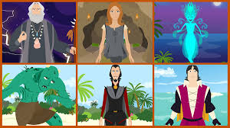
Wizard!
Tempest
Windswept, raging
Usurped, released, tricked
Prospero sets Erial free
Applause.
This is a cinquain poem and has five lines. The first line has one word to introduce the subject e.g. Tempest. The second line has two or three adjectives and uses four syllables. The third line has two or three actions and has six syllables. The fourth line has a phrase or short sentence about the subject and has eight syllables. The last line has one or two words to sum up the poem and has two syllables.

Slide 7

The Witches’ Plot
There once was a guy called Macbeth
Who sentenced the king to his death.
His wife’s not disgusted
Macbeth was mistrusted
And death is the result for Macbeth.
This is a limerick poem in which the first, second and last lines rhyme, while the third and fourth lines are shorter and share a different rhyme.

Slide 8
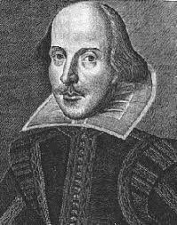
Did you know that?:
Shakespeare’s Father was a glove-maker.
Shakespeare died on the 23rd April - the day that his birthday is celebrated around the world. He was 52 years old.
Shakespeare went to a local Grammar School.
Shakespeare didn’t go to university; if he did go, his plays might be very different.
He performed his plays in front of Queen Elizabeth.
Before he started school, Shakespeare’s mum told him stories and fables and they are referred to in his plays.
This is William Shakespeare; he is a very famous playwright.

