Slide 1
Fractions of amounts
What is ½ of 12?

Slide 2
Fractions of amounts
What is ½ of 12?
12 ÷ 2 = 6
6 | 6

Slide 3
Fractions of amounts
What is ¼ of 12?

Slide 4
Fractions of amounts
What is ¼ of 12?
12 ÷ 4 = 3
3 | 3 | 3 | 3

Slide 5
Fractions of amounts
What is ¾ of 12?

Slide 6
Fractions of amounts
What is ¾ of 12?
12 ÷ 4 = 3
3 x 3 = 9
3 | 3 | 3 | 3

Slide 7
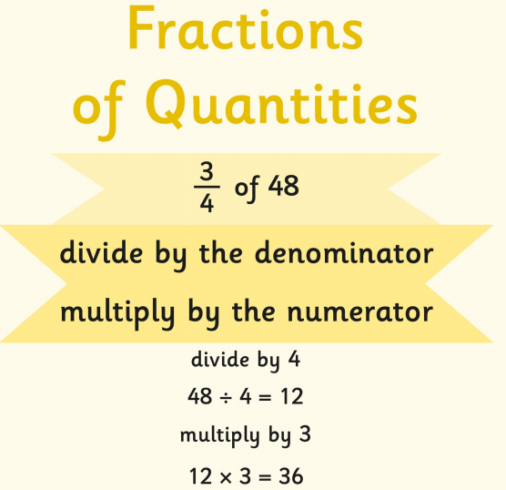

Slide 8
Would you rather have…?
2/3 of £18 | or | 3/5 of £20

Slide 9
Would you rather have…?
2/3 of £18 | or | 2/5 of £25
2/3 of £18 is £12
2/5 of £25 is £10
So I would rather have 2/3 of £18
Your turn…

Slide 10
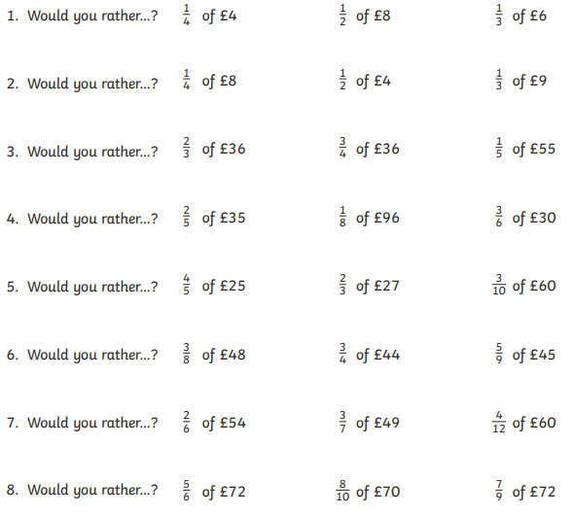

Slide 11
Answers on next slide

Slide 12


