Slide 1
The beginnings of ballet
By Anna Rose
Moynihan-case

Slide 2
How did Ballet start?
Ballet began in the 1500s in the Italian Renaissance courts and spread from Italy to France, where most people think it started for the language that is used today, by the help of Catherine de’ Medici. Later it developed into a concert dance form in France and Russia . King Louis XIV founded the Academie Royale de Musique from which the Paris opera developed as first professional ballet company.

Slide 3
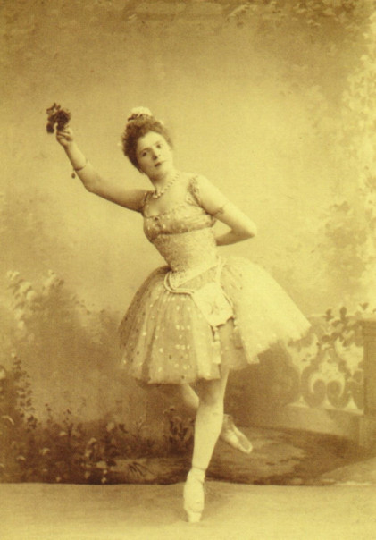
Pierina Legnani
Pierina Legnani was born on the 30th of September 1868 in Milan, Italy, and died on the 15th of November 1930. She was an Italian ballerina who introduced the 32 fourettes en tournant to the ballet world in 1893. From 1893 until 1901, she was prima ballerina assoluta at the Mariinsky Theater, St. Petersburg, she was the highest ranking for a woman!

Slide 4
What was the first ever performance?
The ballet comique de la Reine ( at the time spelled Balet comique de la Royne) was an elaborate court spectacle performed on October 15th, 1581, during the reign of Henry III of France, in the large hall of the Hotel De Bourbon, adjacent to the Louvre Palace in Paris. It is often referred to as the first ballet de court.

Slide 5
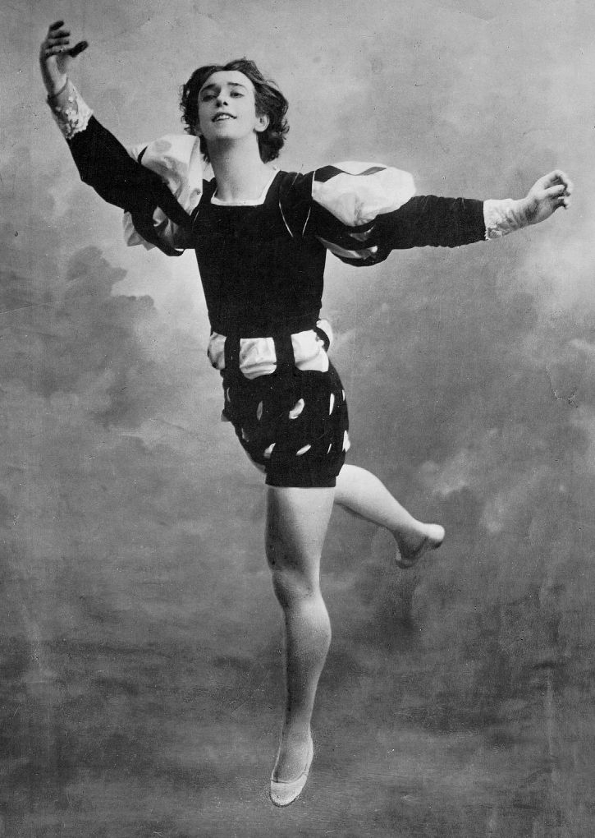
Vaslav Nijinsky
Vaslav Nijinsky was born on March 1889 and died on the 8th of April 1950. He was of Polish descent. Nijinsky was a well-known choreographer and a ballet dancer. Due to his prowess in ballet dancing, he was regarded as one of the best male dancers during the 20th century.

Slide 6
Why is ballet important?
Ballet teachers work ethic, perseverance, dedication, motivation, stamina, flexibility and strength. Dancers work hard in ballet but the results are worth it. Ballet help dancers grow- it gives students what they need to spread their wings and fly in all dance classes.

Slide 7
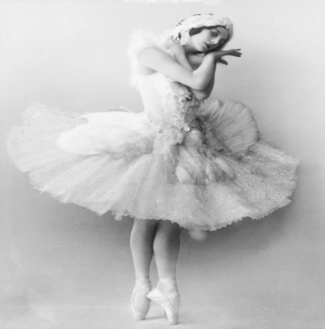
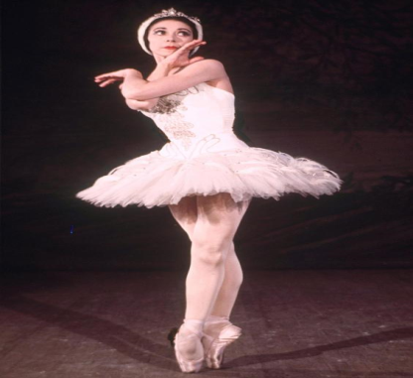
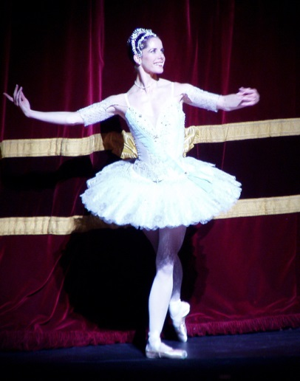
3 of the most famous ballerinas in the world!
Anna Pavlova was a Russian prima ballerina in the late 19th and the early 20th centuries. After attending the Imperial Ballet School, she made her company debut in 1899 and quickly became a prima ballerina. Her breakthrough performance was in The Dying Swan in 1905, which became her signature role.
Dame Margot Fonteyn was an outstanding and beloved classical ballerina with an extensive career, from 1934 to 1979 she danced for England’s Royal Ballet, putting British ballet on the international map. Margot Fonteyn was born in Reigate, on May 18th, 1919 and died on 21st of February 1991.
Dame Darcy Bussell was born on the 27th of April 1969, she is a British ballet dancer and celebrity of the late 20th century. Renowned for the energy and passion of her performances, she was one of the youngest artists to serve as principal dancer in the Royal Ballet of London.

Slide 8
Dances derived from classical ballet

Slide 9
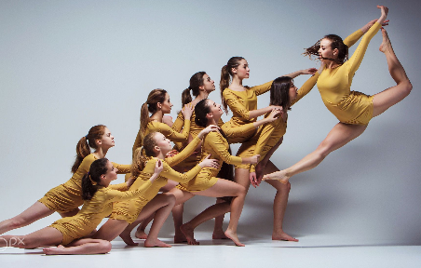
Contemporary
When did Contemporary dance start?
Contemporary dance began at the start of the 20th century when US dancer Isadora Duncan ( 1878- 1927) broke away from ballet and developed her own, more natural style. Contemporary dance has many different styles, some of them closely linked to music, such as Jazz, rock and roll and hip-hop.

Slide 10
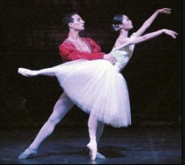
Romantic Ballet
When did Romantic Ballet start?
The romantic era in ballet began with The Ballet of the Nuns in 1831 and was followed by La Sylphide in 1832. The genre began a slow decline. Coppellia of 1870 is said to mark the end of the romantic ballet , although the three ballets composed by Tchaikovsky are romantic ballets.

Slide 11
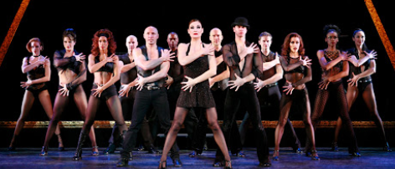
Jazz
When did Jazz start?
Jazz dance originated from the African American vernacular dance of the late 1800s to the mid-1900s. An early popular “jazz dancer” was vaudeville star Joe Frisco in the 1910s. He danced in a loose-limbed style close to the ground while his derby, hat and cigar.

Slide 12
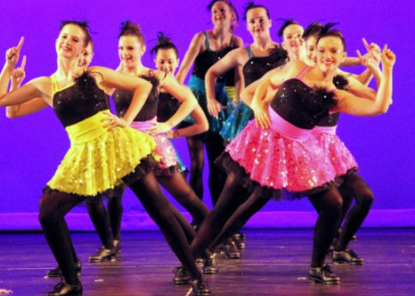
Tap
When did tap start?
Tap dance originated in the untied in the early 19th century at the crossroads of African and Irish American dance forms. When slave owners took away traditions African percussion instruments, slaves turned to percussive dancing to express themselves and retain their cultural identities.

Slide 13
Famous ballets

Slide 14
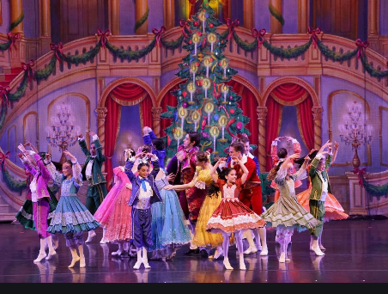
The Nutcracker
The Nutcracker is a classical ballet in two acts. It’s based on E.T.A. Hoffmann’s 1816 fairy tale The Nutcracker and the Mouse King. It tell the story of a little girl who goes to the land of sweets on Christmas Eve.

Slide 15
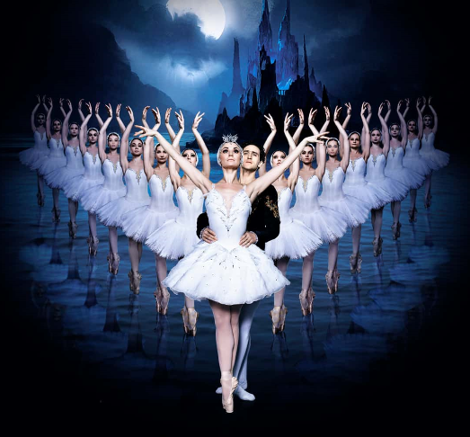
Swan Lake
Swan lake is about a prince named Siedfried. He falls in love with the Swan princess, Odette. She is a Swan by day, but a young Woman at night. She is under a magic spell that can only be broken by a man who will promise to love her for all time.

Slide 16
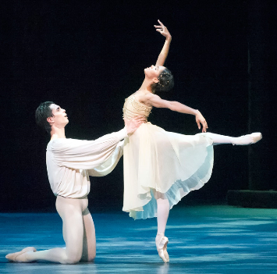
Romeo and Juliet
In 1785, the first ballet that was based on Shakespeare’s tale, Giulietta e Romeo, was performed with the music of Luigi Maewscalchi. Eusebio Luzzi choreography the five-act ballet at the theatre Samueenin Venice, Italy. Many people believe that prokofiev’s Romeo and Juliet is the greatest ballet score ever written.

Slide 17
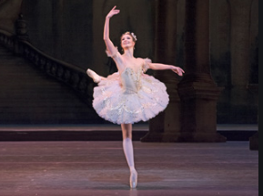
Sleeping Beauty
Sleeping beauty is a ballet in a Prologue and three acts, first performed in 1890. the music was composed by Pyotr Llyich Tchaikovsky. The score was completed in 1889, and is the second of his three ballets.

Slide 18
Cakes Inspired by Ballet

Slide 19
What did I do?
What we had to do was find a cake or cupcake and create it with each different stage. I decided to make a plane sponge cupcake with an vanilla frosting and I know what your thinking- Anna that has nothing to do with that- Well I decided to make a tutu on the top this is how it ended up looking…………..

Slide 20
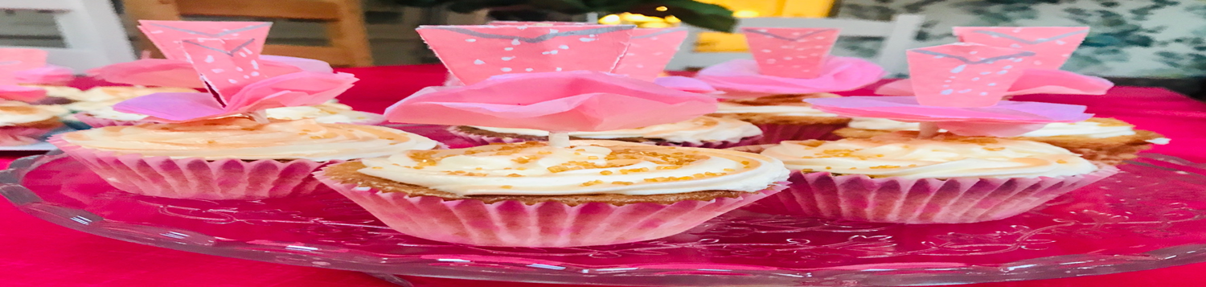

Slide 21


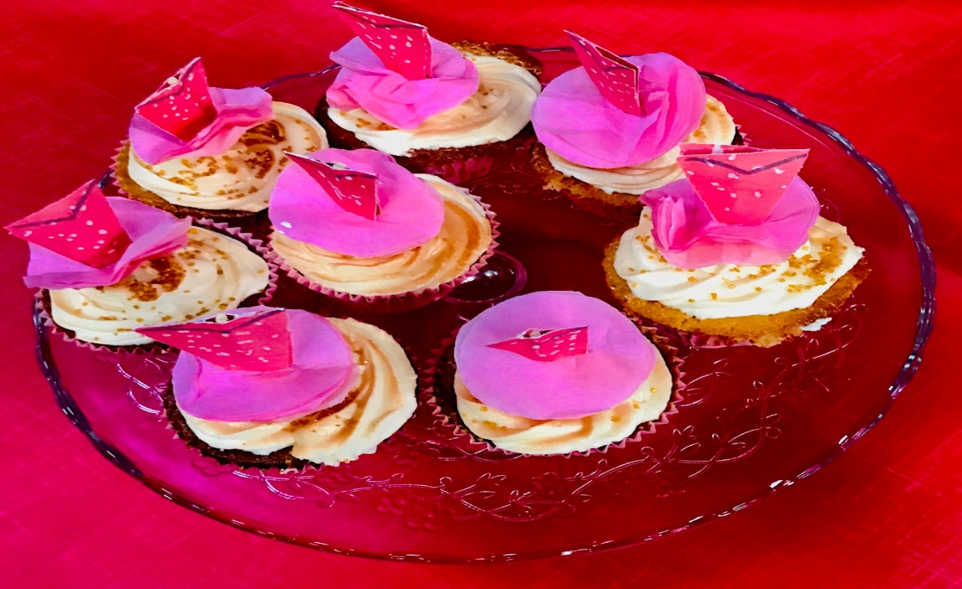
Here are the stages I went through!

Slide 22
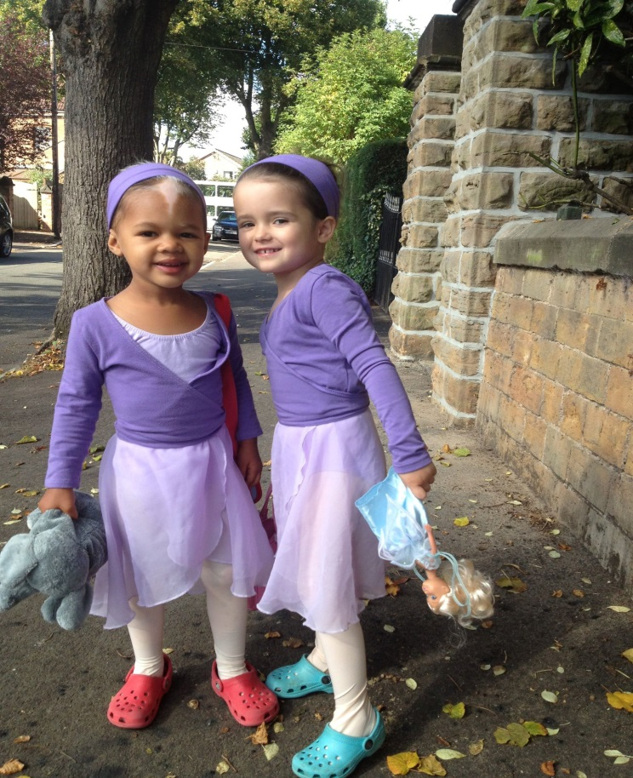
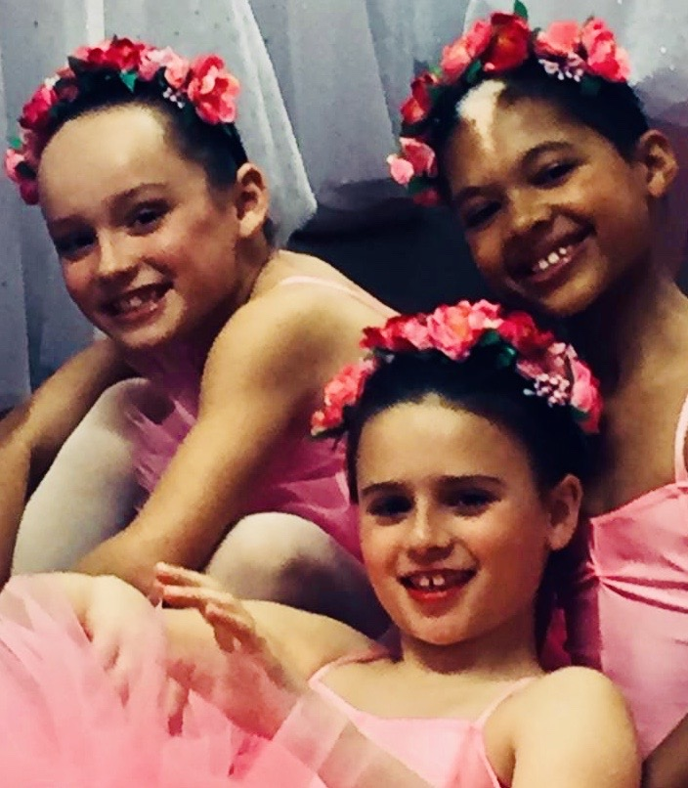
My experience with ballet!
I first started ballet when I was 2 and ¾ with my best friend Isla!
I then have carried on and I am 10 so I have been doing ballet for 8 and a bit years with 2 of my best friends Charlie and Isabella!
Charlie
Isabella

