Slide 2
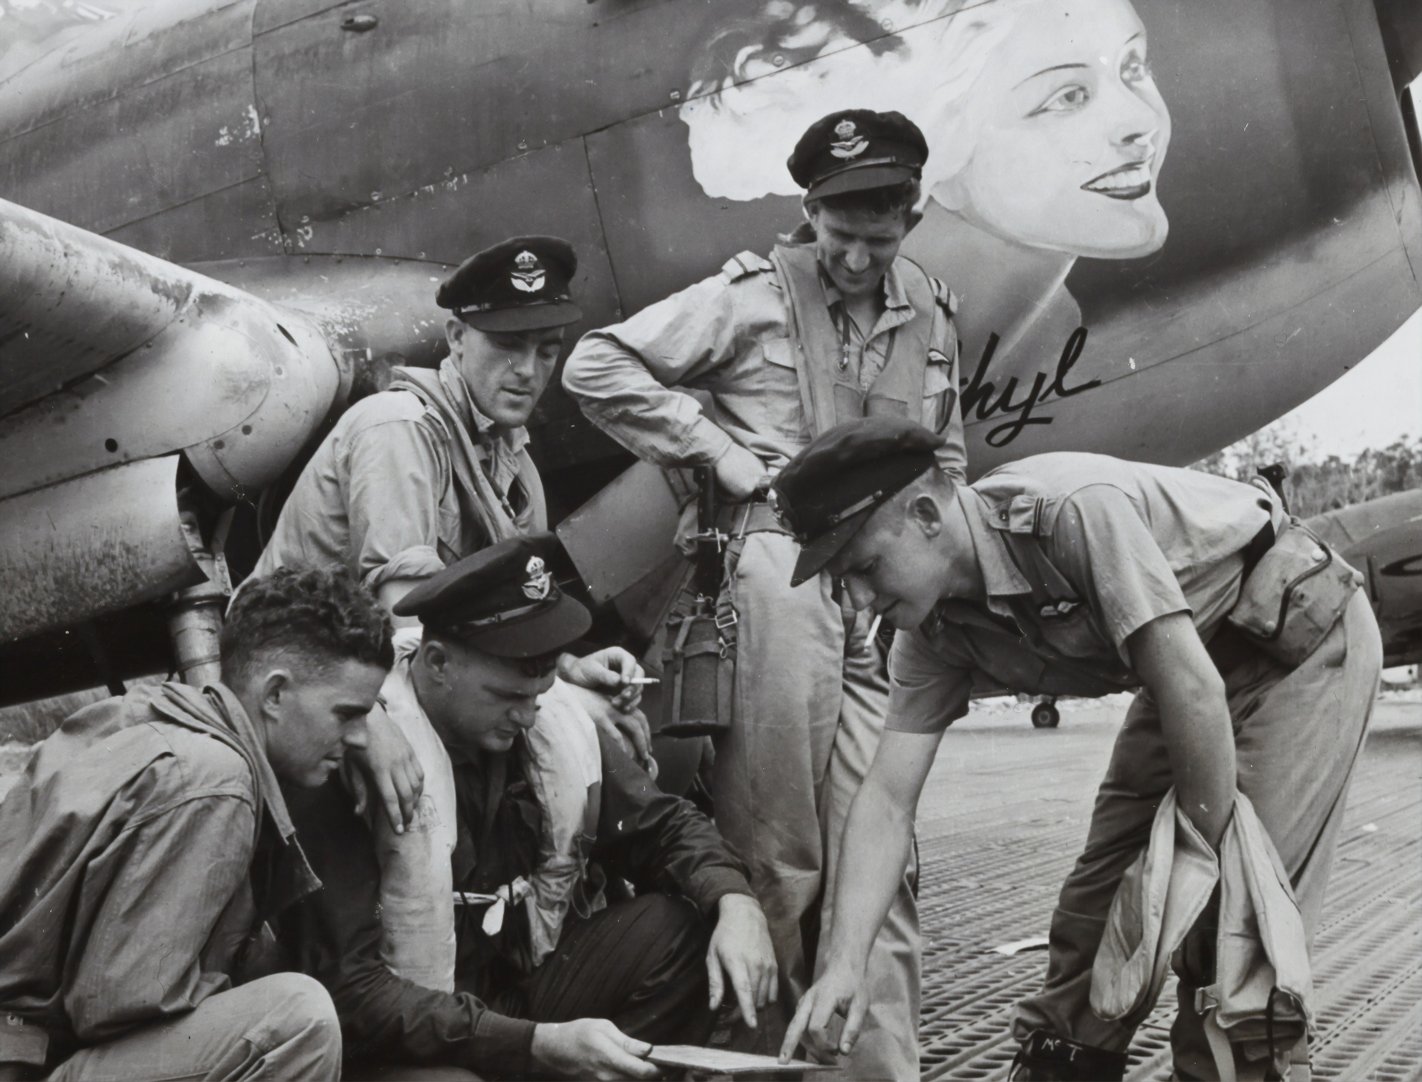
Victory in Europe
Victory in Europe Day/ VE Day took place on May 8th 1945. It was a public holiday and day of celebration to mark the defeat of Germany by the Allied forces in World War 2.
VE Day marked the formal conclusion of the war in Europe.

Slide 3
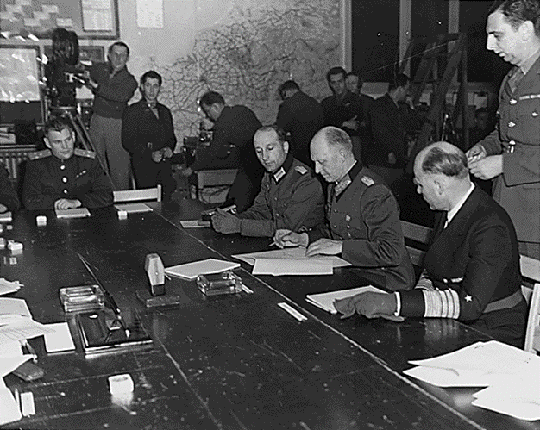
Surrender
After Hitler’s suicide in April, 1945, the Germans knew they could not win the war. General Jodl, travelled to see General Dwight D. Eisenhower - who was Supreme Commander of the Allied Forces in Europe – at the Headquarters in France.
On the 7th May, at 2.41am, in front of some of the leaders of the Western Allies, Jodl signed a surrender document on behalf of Germany. This meant that the war in Europe was over, although World War II continued in other countries.
Photo courtesy of Ras67 (@Wikipedia.com) - granted under creative commons licence – attribution

Slide 4
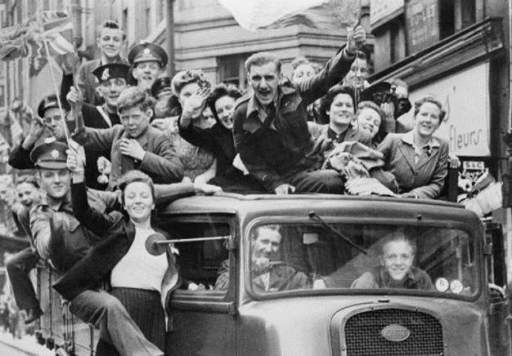
Celebrations
As news of the surrender spread, the war-weary British began to rejoice straight away. During the previous six years, half a million homes had been destroyed, thousands of civilians had been killed and many millions of lives disrupted, in Britain alone.
The news of a surrender was what everyone needed to hear.
People ran out on to the streets, hanging bunting and banners and dancing. People organised impromptu street parties, shared rationed food with the neighbours and listened to the wireless for updates.
Photo courtesy of Fæ (@Wikipedia.com) - granted under creative commons licence – attribution

Slide 5
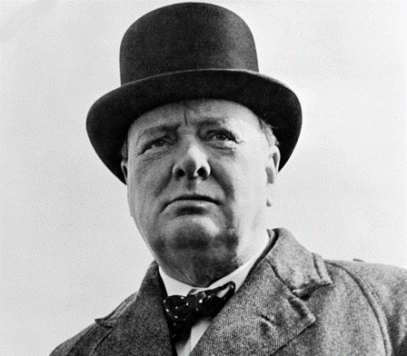
Announcement
Yet the British Prime Minister, Winston Churchill, had yet to make a formal announcement. He was being held back by Stalin, the leader of the Soviet Union. Stalin wanted his own document of surrender signing, so he was holding off announcing the fall of Germany.
Churchill was not going to give Stalin the satisfaction of making Britain wait, so at 19:40, Churchill made this announcement over the radio:
“In accordance with arrangements between the three great powers, tomorrow, Tuesday, will be treated as Victory in Europe Day and will be regarded as a holiday."

Slide 6
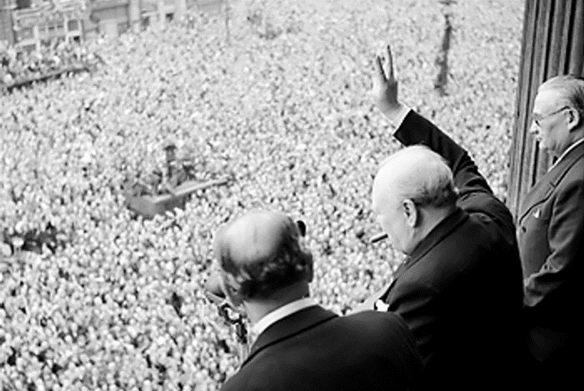
Victory in Europe
Photo courtesy of W.wolny (@Wikipedia.com) - granted under creative commons licence – attribution
This photograph shows Churchill waving to crowds in Whitehall, London, on the day he broadcast to the nation that the war with Germany had been won, 8th May 1945.

Slide 7
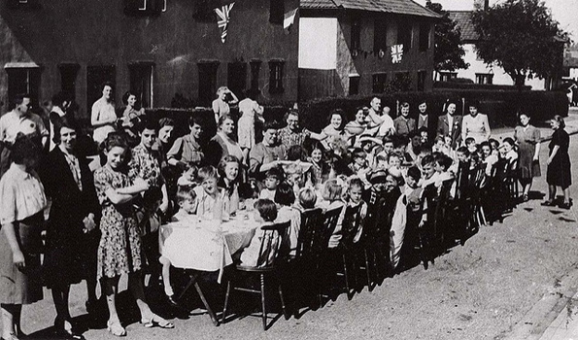
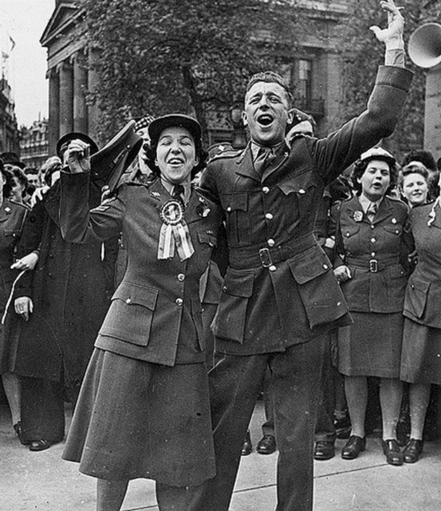
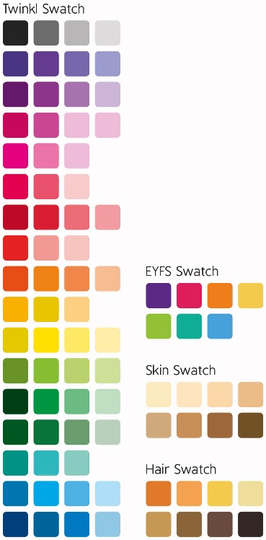
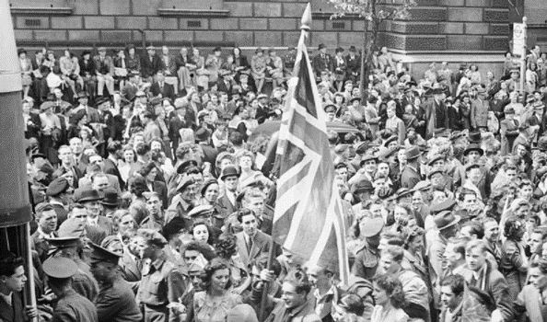
Time to Celebrate
Photo courtesy of Paul Townsend (@flickr.com) - granted under creative commons licence – attribution
Photo courtesy of Fæ (@Wikipedia.com) - granted under creative commons licence – attribution
Photo courtesy of Galt Museum & Archives (@flickr.com) - granted under creative commons licence – attribution

Slide 8
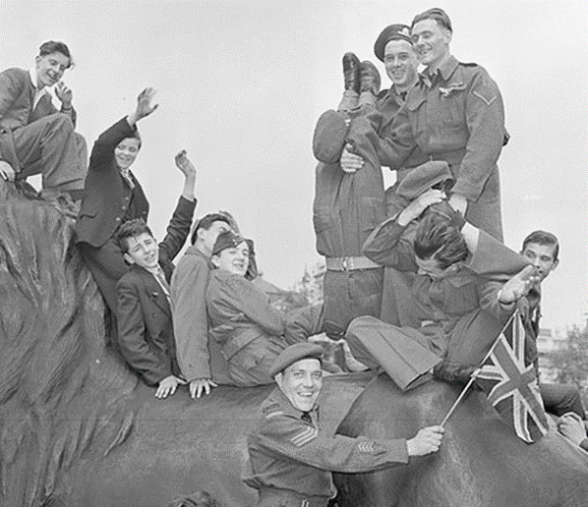
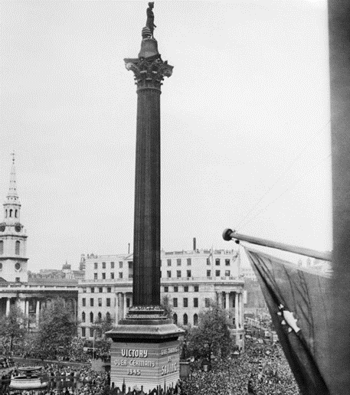
London VE Day
Photo courtesy of BiblioArchives (@flickr.com) - granted under creative commons licence – attribution
Photo courtesy of Fæ (@Wikipedia.com) - granted under creative commons licence – attribution
After suffering so many bombing raids, London was the place to be on VE Day and anyone who could reach the city did so. The centre of London was full of people wearing red, white and blue, waving flags, dancing and singing. Fireworks filled the sky with flashes of light.

Slide 9
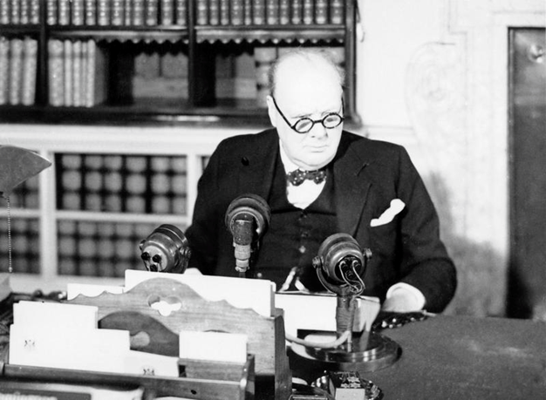
Britain’s Resolve and Strength
On VE Day, everyone, both in London and at home sitting by their wireless sets, wanted to hear just one man: Winston Churchill. At 3pm the Prime Minister broadcast to the nation. He praised the British spirit and reminded them that this was a victory of the great British nation as a whole. He also reminded them that the war continued against the Japanese, but ‘we can all take a night off today’.
Photo courtesy of Fæ (@Wikipedia.com) - granted under creative commons licence – attribution
Crowds gathered in Trafalgar Square and up The Mall, waiting for Winston Churchill and King George VI to make an appearance on the balcony of Buckingham Palace.

Slide 10
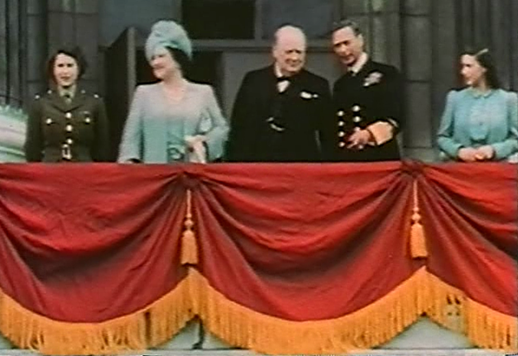
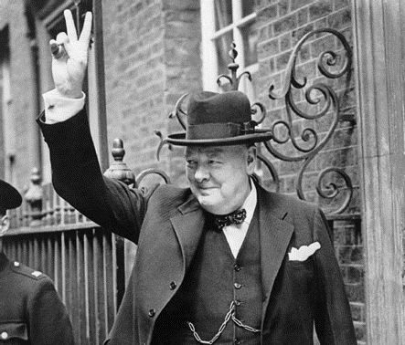
“This is your victory!”
Shortly after Churchill's speech, King George VI, Queen Elizabeth and the two princesses came out onto the balcony at Buckingham Palace. It was to be the first of eight appearances by the King and Queen on VE Day. When the doors onto the balcony were opened again at 17:30, the Royal Family stepped out accompanied by the man of the hour, Churchill. Churchill later told the crowds:
“This is your victory!”
Photo courtesy of Lewenstein (@Wikipedia.com) - granted under creative commons licence – attribution
Photo courtesy of Common Good (@Wikipedia.com) - granted under creative commons licence – attributiont

Slide 11
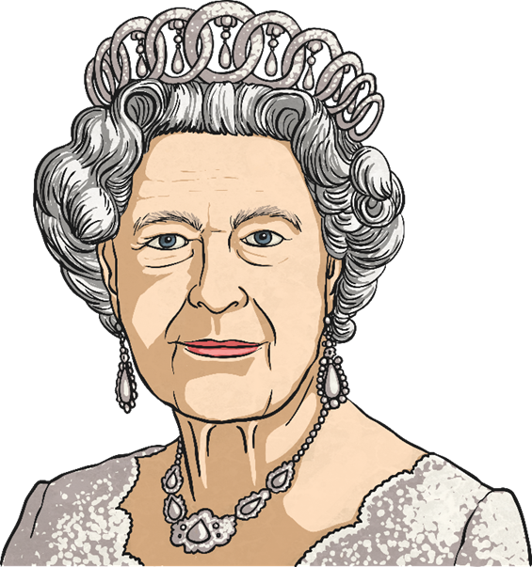
A Memorable Night
Later that evening, Princess Elizabeth and Princess Margaret slipped out of Buckingham Palace to experience the celebrations for themselves. They stood amongst the joyful crowds below the royal balcony.
HM Queen Elizabeth II recalled
the event:
"... my sister and I realised we couldn't see what the crowds were enjoying ... so we asked my parents if we could go out and see for ourselves ... After crossing Green Park we stood outside and shouted, 'We want the King', and were successful in seeing my parents on the balcony. I think it was one of the most memorable nights of my life.”

