Slide 1
Well Being Wednesday

Slide 2

Listen…

Slide 3
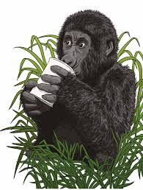
Listen again…

Slide 4
Story time…

Slide 5
Prayer
Dear Lord,
Thank you for helping me, guiding me, and for making me proud of all the good things that I do.
Amen

