Slide 1
Adding Fractions

Slide 2
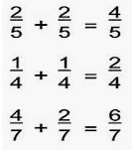
Adding fractions
Adding fractions with the same denominator is easy:

Slide 3
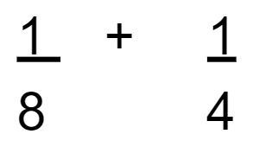
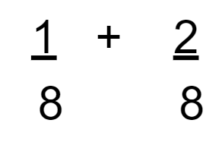
Adding fractions
If the denominators are different, you will need to make them the same:

Slide 4
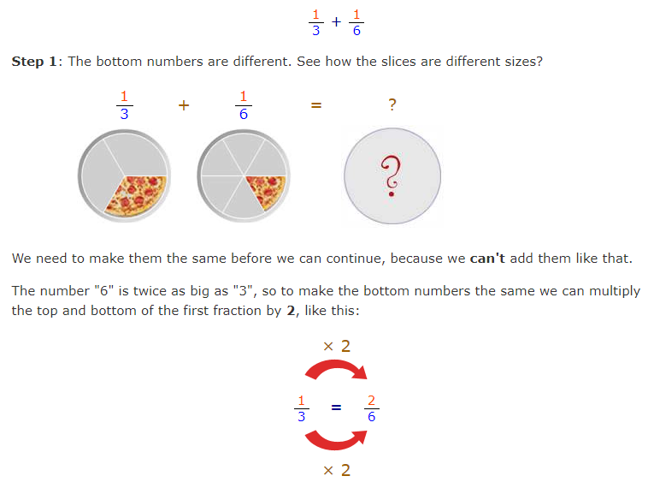

Slide 5
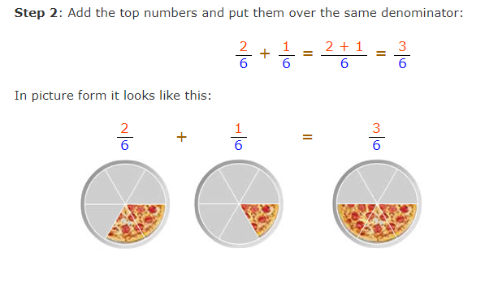

Slide 6
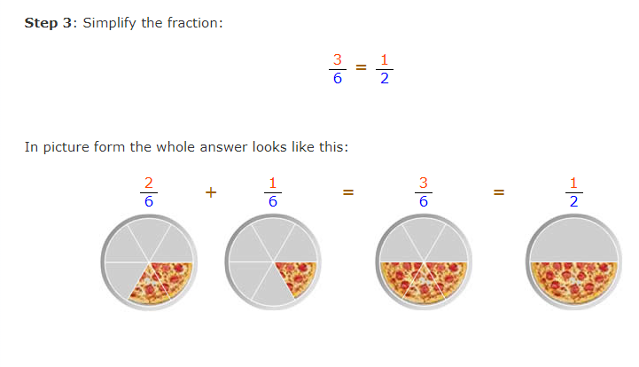

Slide 7



Adding Fractions – copy and solve these ten questions in your journals

Slide 8
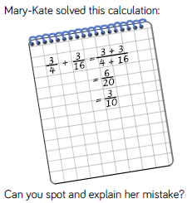
Additional Challenge

Slide 9
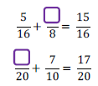
Fleur Challenge

