Slide 2
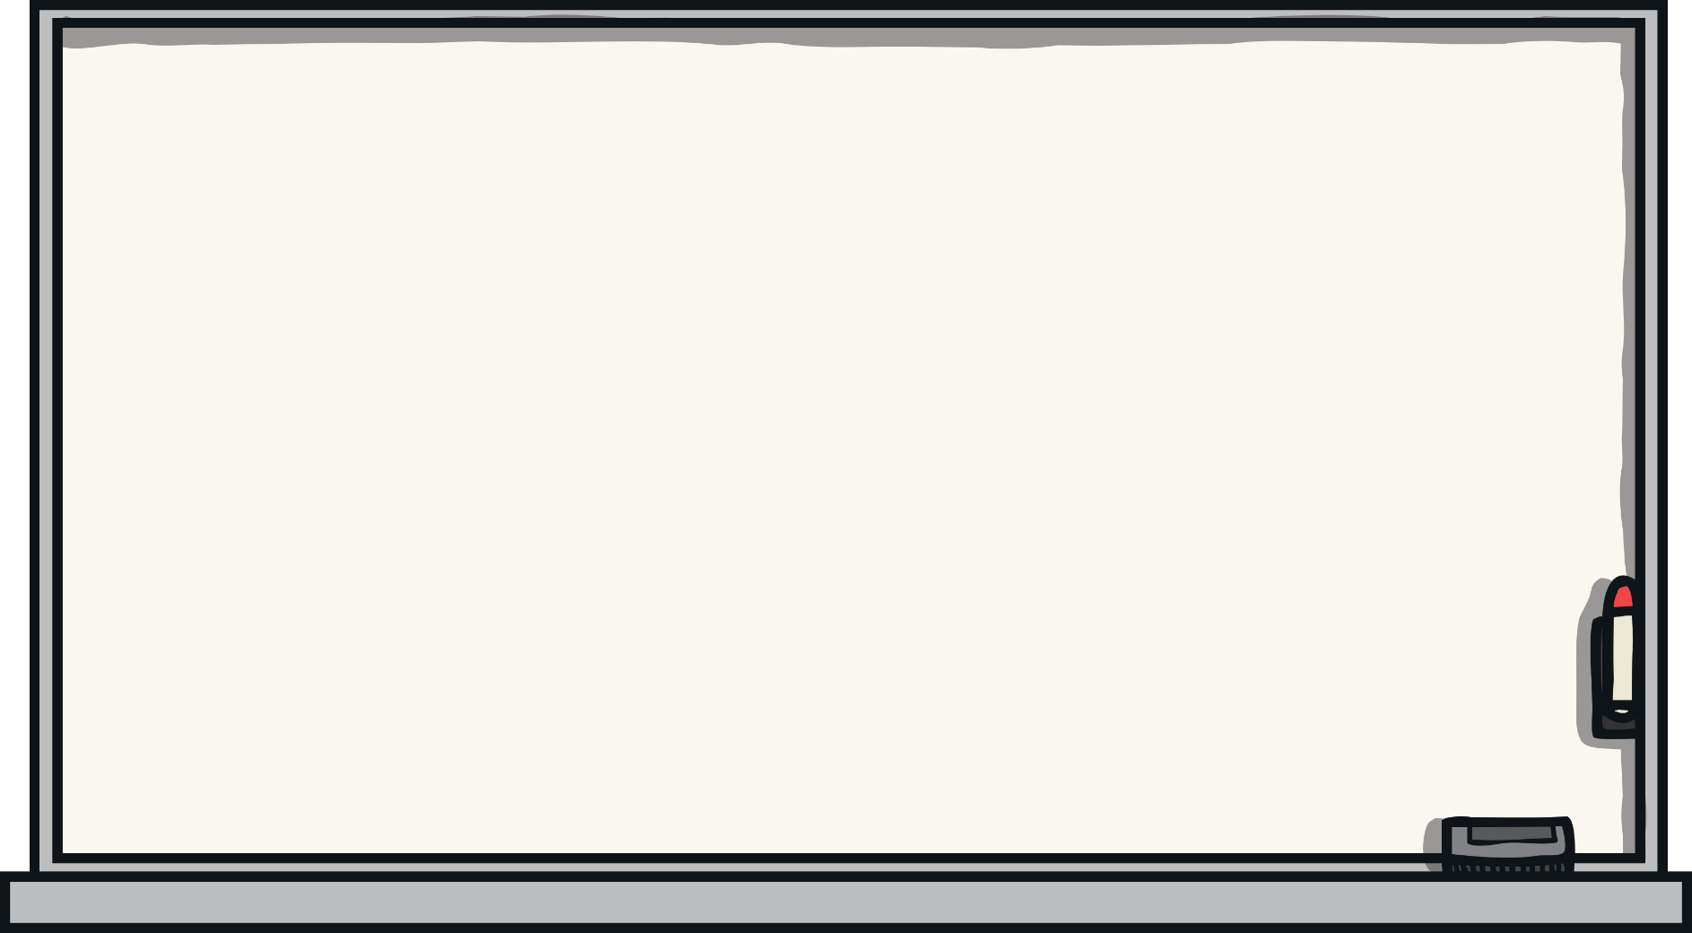
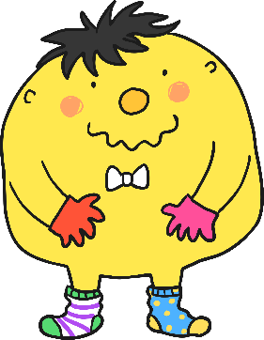
Help Mr Whoops
Can you help Mr Whoops to fix these sentences? Spot his mistakes and write the sentences correctly on your whiteboard.
Watch out for mistakes with his:
spelling;
grammar;
punctuation.
Next

Slide 3

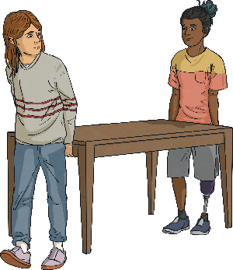

Fix the Sentence
1
Help Mr Whoops to fix this sentence:
Jim was caucious an obzervent as he carrying the incredably speshul and ainshent artefact throo the crowd by the churchs’ alter.
Can you correct all of his mistakes?
Answer

Slide 4
Fix the Sentence
1
The sentence should read:
Jim was cautious and observant as he carried
the incredibly special and ancient artefact
through the crowd by the church’s altar.
Did you manage to correct all of the mistakes?
Next

Slide 5
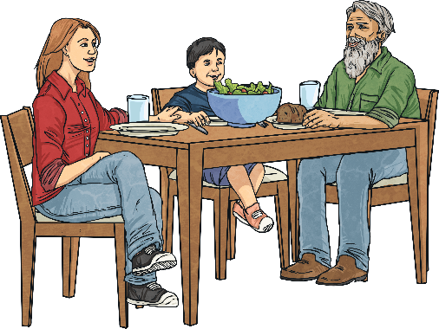
Fix the Sentence
2
Help Mr Whoops to fix this sentence:
dashing two reenter the restrant and unvoid the qeueu, fred was embarrassid as him distaked witch (table was him’s sisters)?
Can you correct all of his mistakes?
Answer

Slide 6
Fix the Sentence
2
The sentence should read:
Dashing to re-enter the restaurant and avoid the queue, Fred was embarrassed as he mistook which table was his sister’s.
Which mistake was the trickiest to spot?
Next

Slide 7
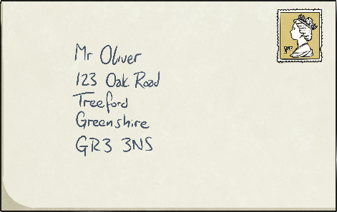
Fix the Sentence
3
Help Mr Whoops to fix this sentence:
“may i possably request that you overmain at home too recieve my post, asker Brenda, tho its understandable iv you do’nt got enuff time
this mourning?”
Can you correct all of his mistakes?
Answer

Slide 8
Fix the Sentence
3
The sentence should read:
“May I possibly request that you remain at home to receive my post?” asked Brenda, “Though it’s understandable if you don’t have enough time this morning.”
Which mistake was the hardest to correct?
Next

Slide 9

Fix the Sentence
4
Help Mr Whoops to fix this sentence:
teh ranger adviced us dat the disusual whether
might substantielly effect; our route the
inpact would bee noticable?
Can you correct all of his mistakes?
Answer

Slide 10
Fix the Sentence
4
The sentence should read:
The ranger advised us that the unusual weather
might substantially affect our route; the
impact would be noticeable.
Did any of the mistakes trip you up?
Next

Slide 11
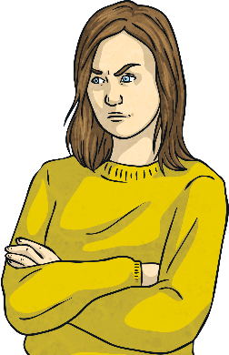
Fix the Sentence
5
Help Mr Whoops to fix this sentence:
sandra Usualy an reasonible and relierble (person) seemed vizably more agresive and shorttempered during the comitee meating
Can you correct all of his mistakes?
Answer

Slide 12
Fix the Sentence
5
The sentence should read:
Sandra (usually a reasonable and reliable person) seemed visibly more aggressive and short-tempered during the committee meeting.
Which mistake did you spot first?
Next

